Slide 1
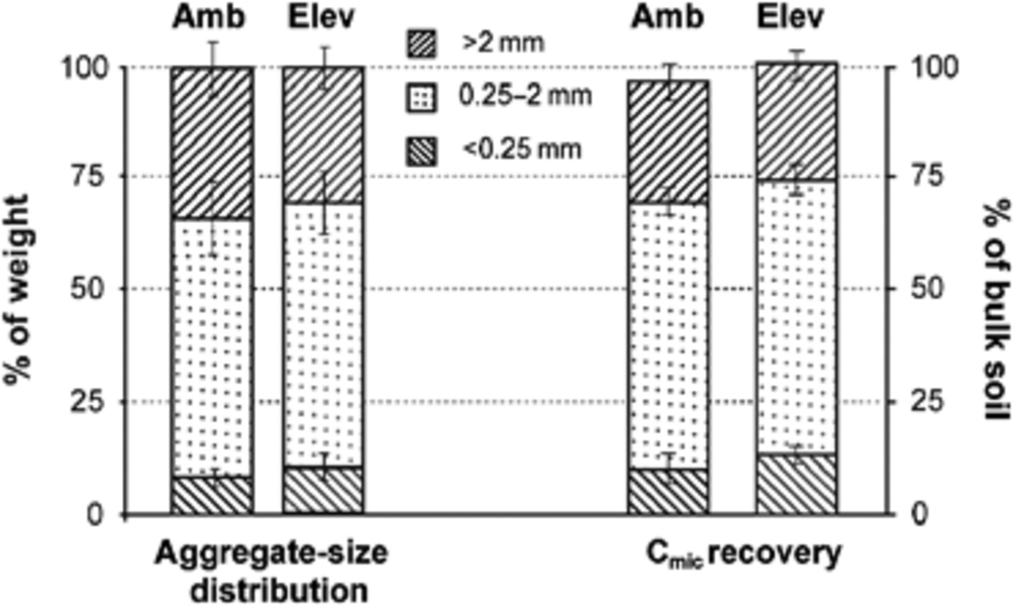
1 Aggregate-size distribution (left Y axis) and microbial biomass (C _{mic} ; right Y axis) in three ...
Notes:
1 Aggregate-size distribution (left Y axis) and microbial biomass (C mic ; right Y axis) in three aggregate size classes expressed as a percentage of total weight of bulk soil and the total C mic under ambient and elevated CO 2 .
Unless provided in the caption above, the following copyright applies to the content of this slide: © 2009 Federation of European Microbiological Societies. Published by Blackwell Publishing Ltd. All rights reserved

Slide 2
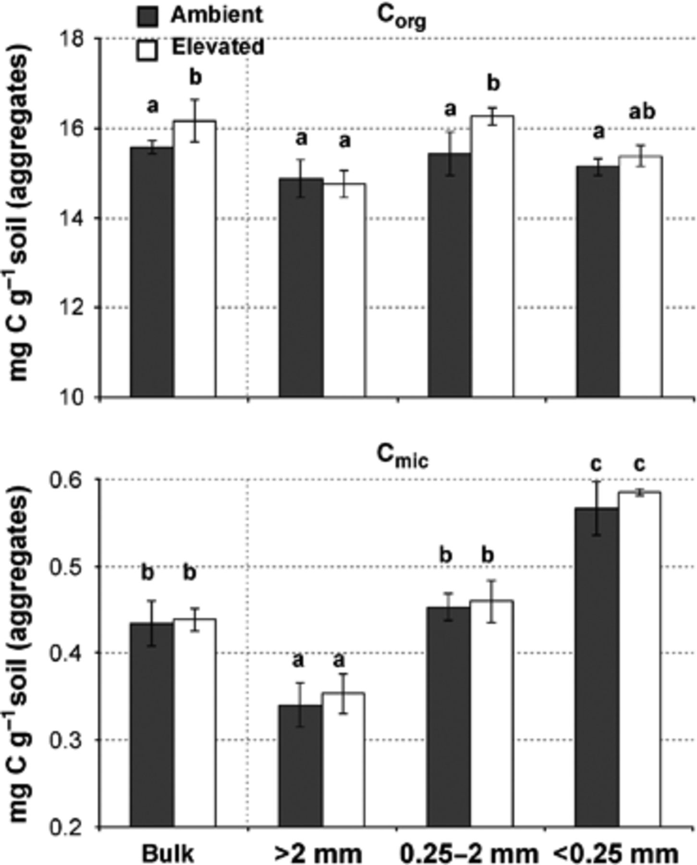
2 Organic carbon content (C _{org} ), and microbial biomass (C _{mic} ) in bulk soil and three ...
Notes:
2 Organic carbon content (C org ), and microbial biomass (C mic ) in bulk soil and three aggregate-size classes under ambient and elevated CO 2 . Values are averages (± SE) of four replicates. Treatments followed by the same letters are not significantly different between aggregate size classes at P ≤0.05. There were no significant differences between elevated and ambient CO 2 treatments.
Unless provided in the caption above, the following copyright applies to the content of this slide: © 2009 Federation of European Microbiological Societies. Published by Blackwell Publishing Ltd. All rights reserved

Slide 3
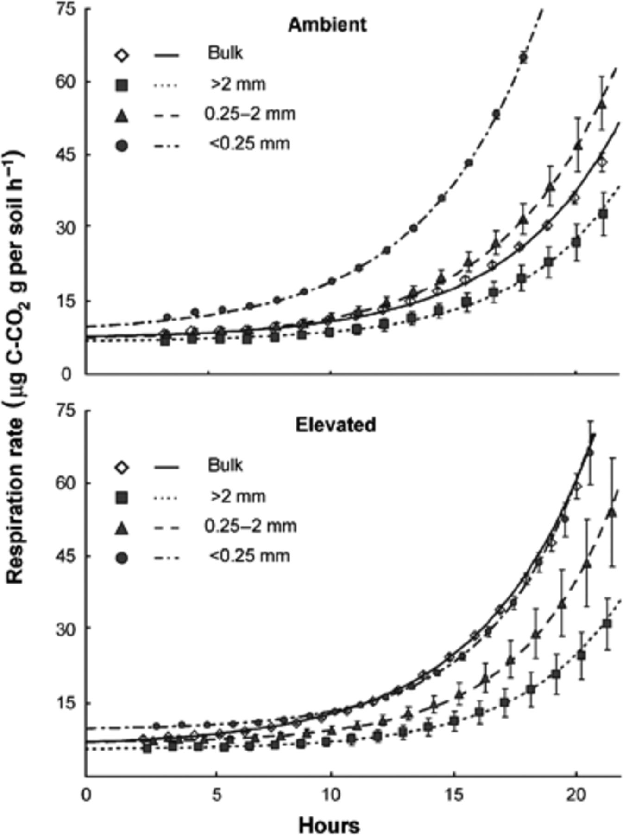
3 Measured respiration rates (symbols) and values fitted according to Eq.5 (lines) after glucose and nutrients ...
Notes:
3 Measured respiration rates (symbols) and values fitted according to Eq.5 (lines) after glucose and nutrients amendment of the bulk soil and three aggregate size classes under ambient (top) and elevated (bottom) CO 2 . Values are averages (± SE) of four replicates.
Unless provided in the caption above, the following copyright applies to the content of this slide: © 2009 Federation of European Microbiological Societies. Published by Blackwell Publishing Ltd. All rights reserved

Slide 4
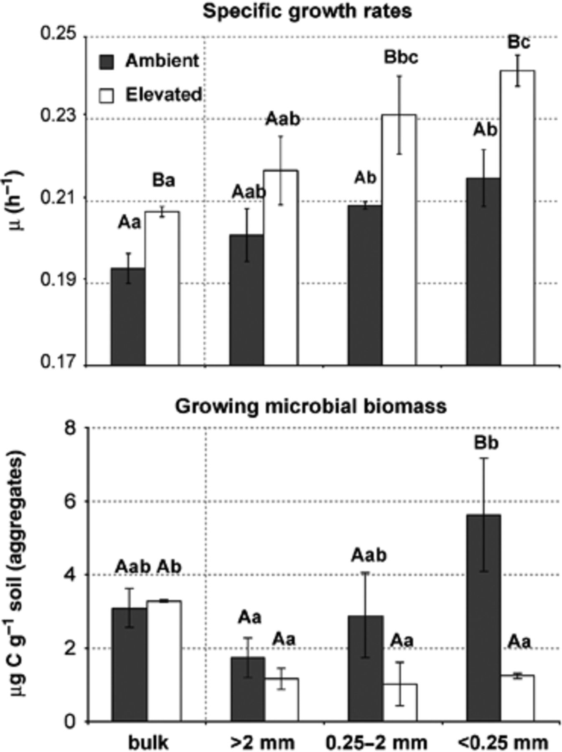
4 Specific growth rates (top) and amount of growing microbial biomass (bottom) in bulk soil and three ...
Notes:
4 Specific growth rates (top) and amount of growing microbial biomass (bottom) in bulk soil and three aggregate size classes under ambient and elevated CO 2 . Values are averages (± SE) of four replicates. Treatments followed by the same letters are not significantly different between elevated and ambient CO 2 (uppercase letters) and aggregate size classes (lowercase letters) at P ≤0.05.
Unless provided in the caption above, the following copyright applies to the content of this slide: © 2009 Federation of European Microbiological Societies. Published by Blackwell Publishing Ltd. All rights reserved

