Slide 1
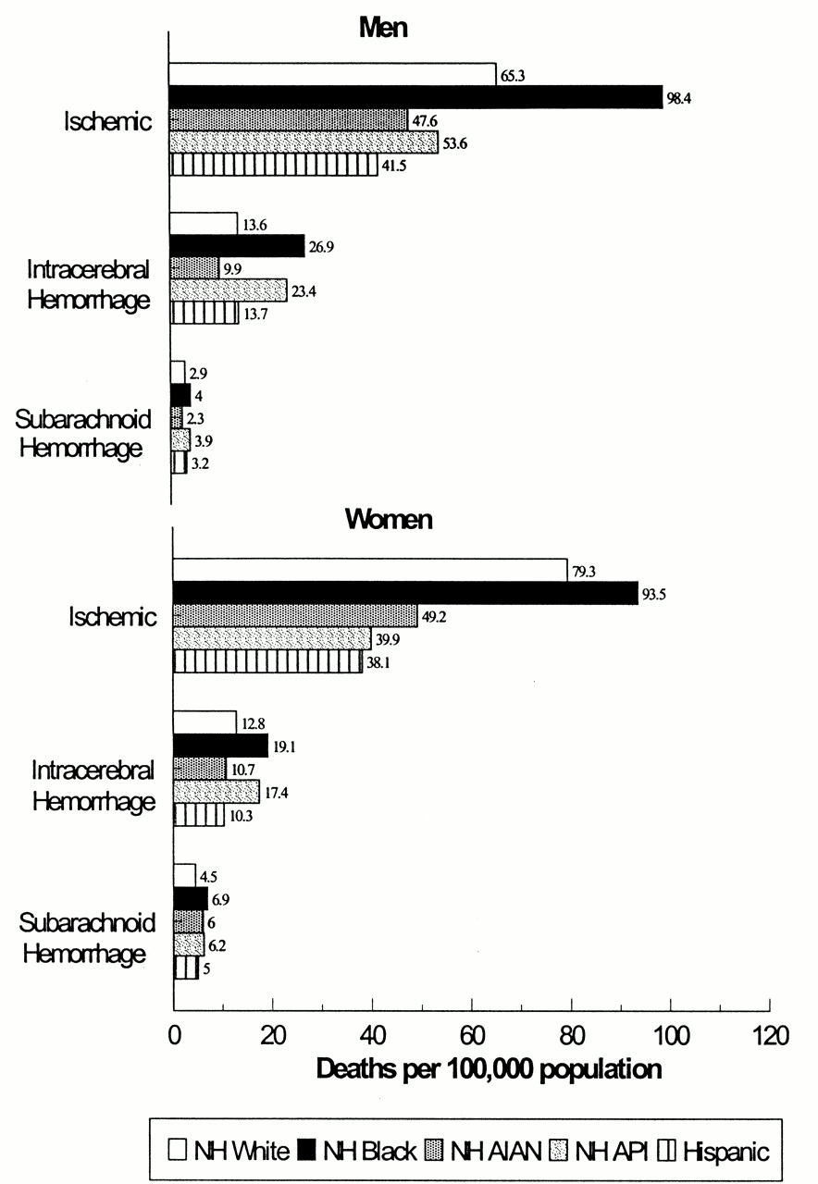
FIGURE 1. Age-standardized death rates (per 100,000 population) for stroke subtype among adults aged 25 years or older, ...
Notes:
FIGURE 1. Age-standardized death rates (per 100,000 population) for stroke subtype among adults aged 25 years or older, by race/ethnicity and sex, United States, 1995–1998. Death rates per 100,000, age adjusted to the 2000 total US standard population. International Classification of Diseases, Ninth Revision, codes for subarachnoid hemorrhage (code 430), intracerebral hemorrhage (codes 431–432), and ischemic hemorrhage (codes 433, 434, 436–438). Transient cerebral ischemia (code 435) was excluded. Categories for race and Hispanic origin (racial/ethnic populations) are mutually exclusive: NH, non-Hispanic; AIAN, American Indian/Alaska Native; API, Asian/Pacific Islander.
Unless provided in the caption above, the following copyright applies to the content of this slide:

Slide 2
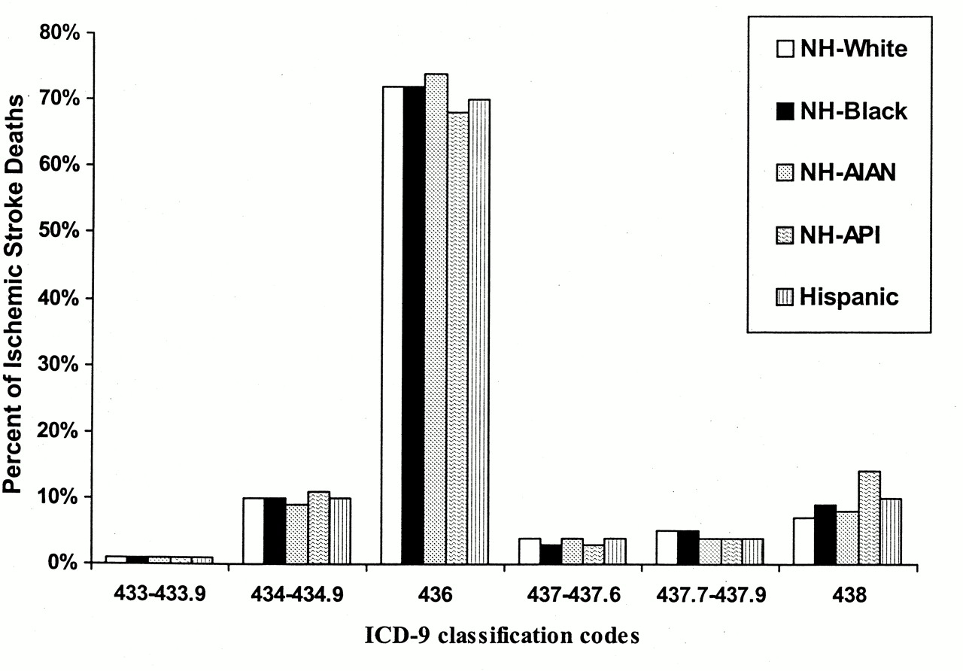
FIGURE 2. Percentage of ischemic stroke deaths in adults aged 25 years or older by International Classification of ...
Notes:
FIGURE 2. Percentage of ischemic stroke deaths in adults aged 25 years or older by International Classification of Diseases, Ninth Revision (ICD-9), codes for ischemic stroke (codes 433–434.9, 436–438) and race/ethnicity, United States, 1995–1998. Categories for race and Hispanic origin (racial/ethnic populations) are mutually exclusive: NH, non-Hispanic; AIAN, American Indian/Alaska Native; API, Asian/Pacific Islander.
Unless provided in the caption above, the following copyright applies to the content of this slide:

