Slide 1
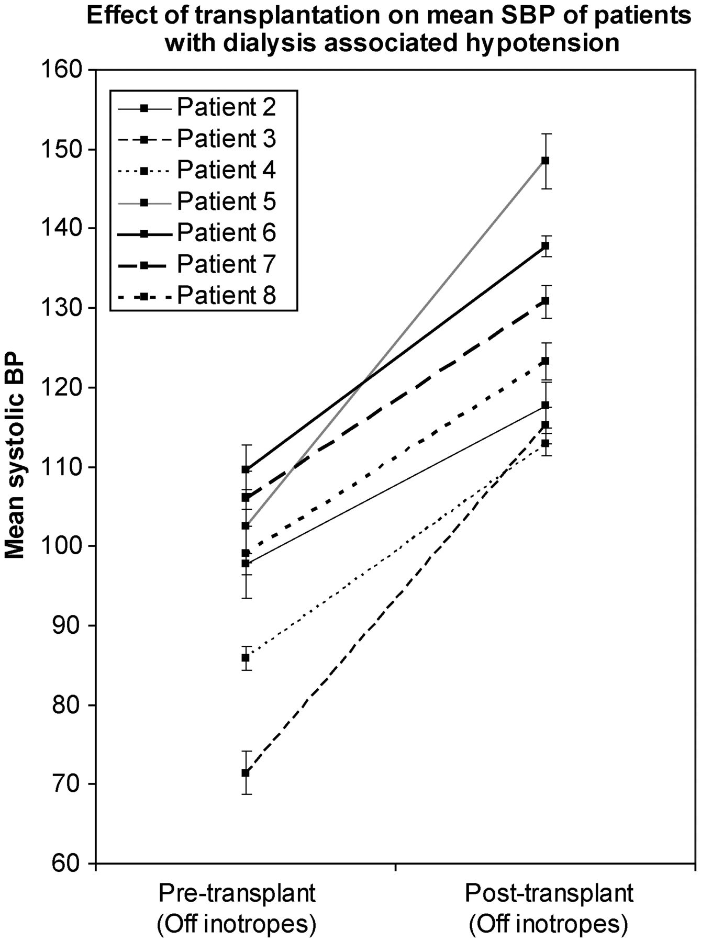
Fig. 1. Effect of transplantation on the SBP. Figure 1 shows the effect of transplantation on the mean blood pressure ...
Notes:
Fig. 1. Effect of transplantation on the SBP. Figure 1 shows the effect of transplantation on the mean blood pressure of the seven successfully transplanted patients. Patients 2–4 were severely hypotensive with an SBP <100 mmHg before and after dialysis, Patients 5–8 had an SBP usually 100 mmHg between sessions. The mean SBP measured in the immediate pre-treatment period is compared with mean SBP levels recorded in hospital after inotrope therapy was withdrawn, and in clinic in the first 2 weeks post-discharge from the hospital.
Unless provided in the caption above, the following copyright applies to the content of this slide: © The Author 2012. Published by Oxford University Press on behalf of ERA-EDTA. All rights reserved. For Permissions, please e-mail: journals.permissions@oup.com

