Slide 1
Figure 1. Lifespan of Sandhoff mice after intracranial infusions of rAAVα + rAAVβ is significantly extended. SD mice ...
Notes:
Figure 1. Lifespan of Sandhoff mice after intracranial infusions of rAAVα + rAAVβ is significantly extended. SD mice were injected bilaterally into the striatum and cerebellum at 4 (n = 22), 8 (n = 5), 10 (n = 5) and 12 (n = 12) weeks post-birth (WPB). Control groups: normal controls (n = 22) and SD (UT) mice (n = 37). Kaplan–Meier survival curve, data censored at 2 years (A). One-way ANOVA and Bonferroni multiple post hoc comparisons with mean ± SEM (B).
Unless provided in the caption above, the following copyright applies to the content of this slide: © The Author 2013. Published by Oxford University Press. All rights reserved. For Permissions, please email: journals.permissions@oup.com

Slide 2
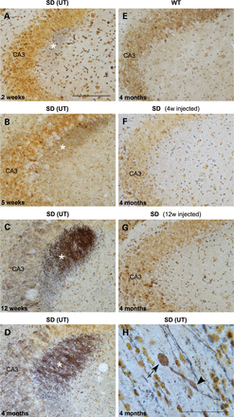
Figure 7. Neuronal degeneration increases with age and is prevented by intracranial gene transfer. SD (UT) (A–D and H) ...
Notes:
Figure 7. Neuronal degeneration increases with age and is prevented by intracranial gene transfer. SD (UT) (A–D and H) and wild-type mice (E), ages 2w–4 months, were studied by the chemical-development-silver method of Gallyas (21). Silver deposition in the stratum lucidum of the hippocampus (*) is seen at 2w and shows increasing intensity over time. The axons of SD (UT) at the terminal stage of the disease have numerous spheroids (arrowhead) and bulbous ends (arrow) (H). SD mice treated at 4w (F) and 12w (G) have significantly reduced staining. Field CA3 of hippocampus (CA3). Scale bars: 100 μm (A–G) and 25 μm (H).
Unless provided in the caption above, the following copyright applies to the content of this slide: © The Author 2013. Published by Oxford University Press. All rights reserved. For Permissions, please email: journals.permissions@oup.com

Slide 3
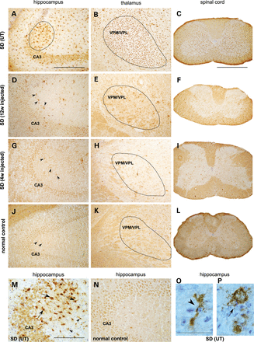
Figure 6. Gene transfer reduces the number of activated microglia. IHC staining against Cd68 of brain and spinal cord ...
Notes:
Figure 6. Gene transfer reduces the number of activated microglia. IHC staining against Cd68 of brain and spinal cord from treated SD at 4w (G–I) and 12w (D–F) mice was compared with SD (UT) (A–C and M) and normal controls (J–L and N). Treated animals and SD (UT) were killed at their humane end point and normal control at age 4 months. The number of activated microglia was significantly reduced throughout the neuraxis at all transduced ages. Small numbers remain in the VPM/VPL (ventroposterior medial and lateral) nuclei of the thalamus and grey, but not in white matter of spinal cord in 12w injected mice. Whereas most activated microglia in SD (UT) hippocampus had ramified morphology (magnified view in O), those in the stratum lucidum (encircled in A, and magnified in M and P) are amoeboid. Arrowheads and arrows point to ramified and amoeboid microglia, respectively. Field CA3 of hippocampus (CA3). Scale bars: 500 μm (C, F, I and L), 200 μm (A, B, D, E, G, H, J and K), 100 μm (M and N) and 50 μm (O and P).
Unless provided in the caption above, the following copyright applies to the content of this slide: © The Author 2013. Published by Oxford University Press. All rights reserved. For Permissions, please email: journals.permissions@oup.com

Slide 4
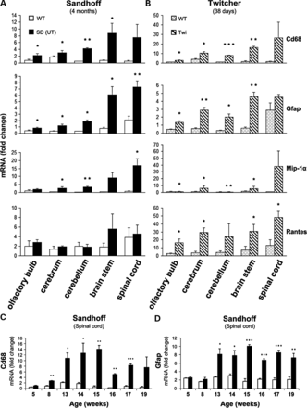
Figure 5. Spatial and temporal up-regulation of markers of inflammation in untreated Sandhoff and Krabbe (Twitcher) ...
Notes:
Figure 5. Spatial and temporal up-regulation of markers of inflammation in untreated Sandhoff and Krabbe (Twitcher) mouse models of disease by real-time PCR. Relative mRNA expression of Cd68 and Gfap, markers of activated microglia and astrocytes, respectively, and chemokines Mip-1α and Rantes relative to β-actin were examined in brain and spinal cord at the humane end point of 4 months in Sandhoff (A) and 38 days in twitcher mice (B). Greatest expression occurs in the hindbrain and spinal cord of both models of disease, areas particularly rich in myelin. Temporal expression of Cd68 (C) and Gfap (D) in spinal cord of Sandhoff mice shows largest up-regulation of these markers coincides with the start of the symptomatic phase at around age 13w. Student's t-test; *P < 0.05; **P < 0.01; ***P < 0.001.
Unless provided in the caption above, the following copyright applies to the content of this slide: © The Author 2013. Published by Oxford University Press. All rights reserved. For Permissions, please email: journals.permissions@oup.com

Slide 5
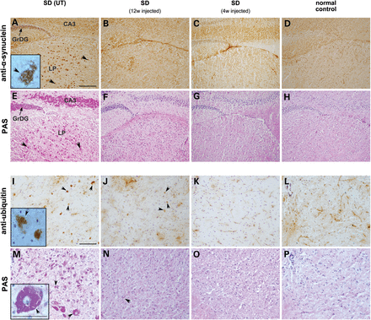
Figure 4. Gene transfer reduces α-synuclein and ubiquitin inclusions. We show representative staining by IHC of ...
Notes:
Figure 4. Gene transfer reduces α-synuclein and ubiquitin inclusions. We show representative staining by IHC of hippocampus and thalamus of 4w (C) and 12w (B) injected animals at their humane end points with a monoclonal antibody against α-synuclein. Controls were 12-week-old SD (UT) (A), and 4-month-old normal control (D). Insert in (A) is a magnified view of a cell with characteristic α-synuclein inclusions. Whereas SD (UT) granular layer of the dentate gyrus (GrDG) and lateral posterior thalamic nucleus (LP) show numerous cells with α-synuclein inclusions, treated animals had normalized staining (B and C). In SD (UT), the number of cells containing α-synuclein inclusions and glycoconjugate storage was similar, and localized to the same regions (E), but treated SD and normal controls had neither α-synuclein nor glycoconjugate inclusions (F–H). IHC against ubiquitin shows a small number of scattered cells intensely staining in the grey matter of spinal cord of a 4-month-old SD (UT) (I), and absence of inclusions in normal controls (L). While staining intensity in 12w injected mice was only reduced (J), it was fully normalized in the 4w injected group (K). PAS staining demonstrated that a larger number of cells are positive for glycoconjugate storage than for ubiquitin in SD (UT) (M). Treated SD animals had a PAS-staining pattern (N and O) similar to normal controls (P). Inserts in (I) and (M) are magnified views of inclusions-containing cells. Arrowheads point to stained cells. Field CA3 of hippocampus (CA3); granular layer of the dentate gyrus (GrDG); lateral posterior thalamic nucleus (LP). Scale bars: 200 μm (A–H); 100 μm (I–P and inserts).
Unless provided in the caption above, the following copyright applies to the content of this slide: © The Author 2013. Published by Oxford University Press. All rights reserved. For Permissions, please email: journals.permissions@oup.com

Slide 6
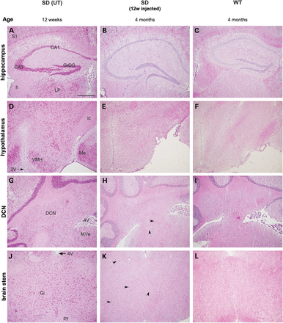
Figure 3. Glycoconjugate storage is reduced throughout the neuraxis. Sections from a representative 12w rAAVα + rAAVβ ...
Notes:
Figure 3. Glycoconjugate storage is reduced throughout the neuraxis. Sections from a representative 12w rAAVα + rAAVβ injected SD mouse killed at the humane end point of 4 months were stained with PAS (B, E, H and K). Controls were 12-week-old SD (UT) (A, D, G and J) and 4-month-old normal control (C, F, I and L). Anatomical regions shown are hippocampus (A–C), hypothalamus (D–F), deep cerebellar nuclei (G–I) and brain stem (J–L). Arrow heads point to PAS-positive neurones. Deep cerebellar nuclei (DCN); fields CA1(CA1) and CA3 (CA3) of hippocampus; fimbria (fi); fourth ventricle (4V); gigantocellular reticular nucleus (Gi); granular layer of the dentate gyrus (GrDG); internal capsule (ic); lateral posterior thalamic nucleus (LP); medial amygdaloidal nucleus (Me); medial vestibular nucleus (MVe); primary somatosensory cortex (S1); pyramidal tract (py); third ventricle (3V); ventromedial hypothalamic nucleus (VMH). Scale bar: 500 μm (A–L).
Unless provided in the caption above, the following copyright applies to the content of this slide: © The Author 2013. Published by Oxford University Press. All rights reserved. For Permissions, please email: journals.permissions@oup.com

Slide 7
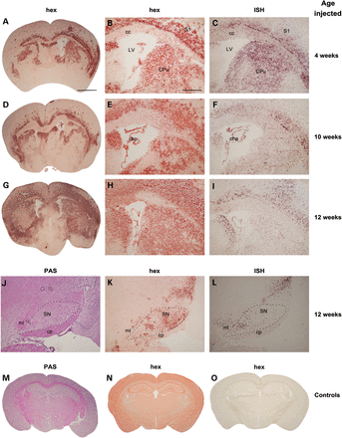
Figure 2. Abundant and wide bio-distribution of enzyme and viral RNA is achieved by intracranial vector delivery. In ...
Notes:
Figure 2. Abundant and wide bio-distribution of enzyme and viral RNA is achieved by intracranial vector delivery. In situ β-hexosaminidase activity staining (hex), red precipitate, of SD mice injected with rAAVα + rAAVβ at 4w (A and B), 10w (D and E) and 12w (G, H and K) age, and killed at their humane end point. Brain parenchyma and choroid plexus (chp) are strongly labelled. Controls were SD (UT) (N), and normal control (O) killed at 4 months of age. Viral mRNA ISH, black stain, of consecutive sections from 4w (C), 10w (F) and 12w (I and L) injected mice is shown. Grey but also white matter (corpus callosum, cc) in brain parenchyma, and choroid plexus were transduced. The substantia nigra (SN) from a 12w injected mouse stained with hex (K) and ISH (L). PAS staining of SN shows absence of glycoconjugate storage (J). Normal control stained with PAS (M). Caudate putamen (CPu), cerebral peduncle (cp), lateral ventricle (LV), medial lemniscus (ml) and primary somatosensory cortex (S1). Scale bars: 2 mm (A, D, G, M, N and O); 500 μm (B, C, E, F, H, I and J–L).
Unless provided in the caption above, the following copyright applies to the content of this slide: © The Author 2013. Published by Oxford University Press. All rights reserved. For Permissions, please email: journals.permissions@oup.com

Slide 8
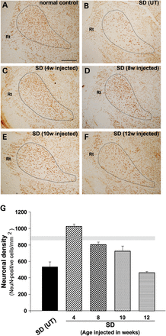
Figure 8. Neuronal cell death is prevented by treatment. NeuN-positive cells were counted in the VPM/VPL thalamic ...
Notes:
Figure 8. Neuronal cell death is prevented by treatment. NeuN-positive cells were counted in the VPM/VPL thalamic nuclei of SD mice treated at 4w (C), 8w (D), 10w (E) and 12w (F) and killed at their humane end points; SD (UT) (B) and normal controls (A) were killed at 4 months and 4 months–2 years, respectively. Mean ± SEM for each group is represented graphically (G). Horizontal light grey area is NeuN-positive cell numbers in normal controls. 4w injected SD mice (asymptomatic phase) had NeuN-positive cell numbers similar to normal controls. Neuronal density in SD mice injected at age 8–10w (2–3 months, early symptomatic phase) was ∼80–90% that of normal controls; a loss of 15–37% is expected to have already occurred by the time animals were injected (22). P 0.05).
Unless provided in the caption above, the following copyright applies to the content of this slide: © The Author 2013. Published by Oxford University Press. All rights reserved. For Permissions, please email: journals.permissions@oup.com

Slide 9
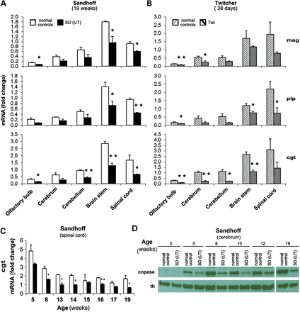
Figure 9. Spatial and temporal expression of myelin markers in untreated Sandhoff and Krabbe (Twitcher) mouse models of ...
Notes:
Figure 9. Spatial and temporal expression of myelin markers in untreated Sandhoff and Krabbe (Twitcher) mouse models of disease. Relative mRNA expression of mag, plp and cgt relative to β-actin was examined in brain and spinal cord at the humane end point of 19w in Sandhoff (A) and 38 days in twitcher mice (B). Myelin mRNA expression in SD (UT) is about half that of normal controls in all areas of the brain and spinal cord at the humane end point (A), and reduced expression appears to be an early feature of the disease process (C). Western blot of SD (UT) cerebrum extracts of different ages against the non-compacted myelin marker cnpase also suggests early myelin deficits compared with age-matched controls, while no obvious differences were seen with an antibody against the enzyme th that was probed on the same blot.
Unless provided in the caption above, the following copyright applies to the content of this slide: © The Author 2013. Published by Oxford University Press. All rights reserved. For Permissions, please email: journals.permissions@oup.com

Slide 10
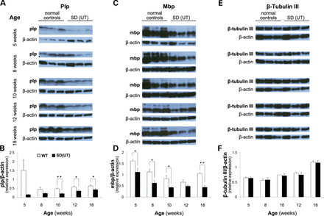
Figure 10. Compacted myelin proteins are reduced in SD (UT). Amounts of myelin markers Plp (A) and Mbp (C) and neuronal ...
Notes:
Figure 10. Compacted myelin proteins are reduced in SD (UT). Amounts of myelin markers Plp (A) and Mbp (C) and neuronal β-tubulin III (E) were analysed relative to β-actin by western blot on cerebrum extracts of SD (UT) and age-matched normal controls. Densitometry analysis of protein species on western blots indicates reduced myelin protein content (B, D), while β-tubulin III composition remains unaltered (F). Student's t-test; *P < 0.05; **P < 0.01.
Unless provided in the caption above, the following copyright applies to the content of this slide: © The Author 2013. Published by Oxford University Press. All rights reserved. For Permissions, please email: journals.permissions@oup.com

Slide 11
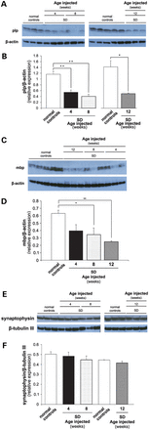
Figure 11. Deficits in myelin protein composition persist after therapeutic gene transfer. Amounts of myelin proteins ...
Notes:
Figure 11. Deficits in myelin protein composition persist after therapeutic gene transfer. Amounts of myelin proteins Plp (A) and Mbp (C) relative to β-actin and neuronal synaptophysin relative to β-tubulin III (E) were analysed by western blot on cerebrum extracts of SD mice treated at 4w, 8w and 12w age and normal controls. Mutant animals were killed at their humane end point and normal controls at a range of ages to cover for the different ages in the treatment groups. Densitometry analysis of protein species on western blots indicates reduced myelin protein content in treated SD (B, D), while synaptophysin relative to β-tubulin III remained largely unchanged (F). *P < 0.05; **P < 0.01 (Bonferroni post hoc test).
Unless provided in the caption above, the following copyright applies to the content of this slide: © The Author 2013. Published by Oxford University Press. All rights reserved. For Permissions, please email: journals.permissions@oup.com

