Slide 1
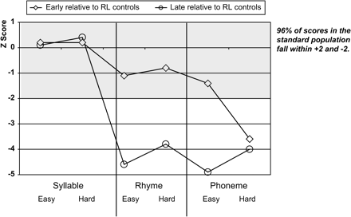
Figure 1 Line chart to show z-scores for PA tests (congruent and incongruent trials) relative to reading-matched ...
Notes:
Figure 1 Line chart to show z-scores for PA tests (congruent and incongruent trials) relative to reading-matched group.
Unless provided in the caption above, the following copyright applies to the content of this slide: © The Author 2007. Published by Oxford University Press. All rights reserved. For Permissions, please email: journals.permissions@oxfordjournals.org

Slide 2
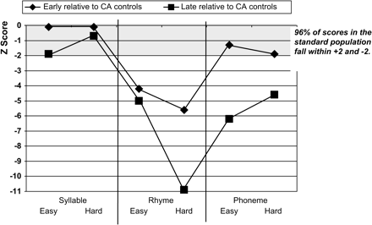
Figure 2 Line chart to show z-scores for PA tests (congruent and incongruent trials) relative to chronological ...
Notes:
Figure 2 Line chart to show z-scores for PA tests (congruent and incongruent trials) relative to chronological age-matched group.
Unless provided in the caption above, the following copyright applies to the content of this slide: © The Author 2007. Published by Oxford University Press. All rights reserved. For Permissions, please email: journals.permissions@oxfordjournals.org

Slide 3
Figure 3 Line charts to show growth in PA (incongruent trials) in early and late CI groups.
Notes:
Figure 3 Line charts to show growth in PA (incongruent trials) in early and late CI groups.
Unless provided in the caption above, the following copyright applies to the content of this slide: © The Author 2007. Published by Oxford University Press. All rights reserved. For Permissions, please email: journals.permissions@oxfordjournals.org

Slide 4
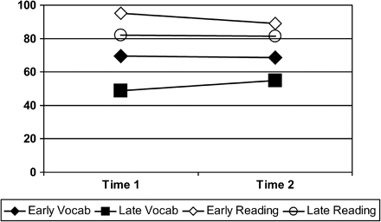
Figure 4 Line charts to show growth in standard scores on vocabulary and word reading in early and late CI groups.
Notes:
Figure 4 Line charts to show growth in standard scores on vocabulary and word reading in early and late CI groups.
Unless provided in the caption above, the following copyright applies to the content of this slide: © The Author 2007. Published by Oxford University Press. All rights reserved. For Permissions, please email: journals.permissions@oxfordjournals.org

Slide 5
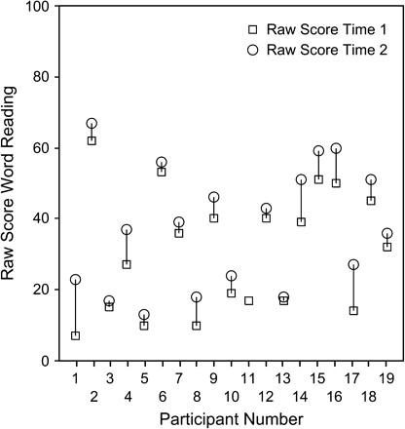
Figure 5 Individual growth rates between Time 1 and Time 2 on word reading in CI users.
Notes:
Figure 5 Individual growth rates between Time 1 and Time 2 on word reading in CI users.
Unless provided in the caption above, the following copyright applies to the content of this slide: © The Author 2007. Published by Oxford University Press. All rights reserved. For Permissions, please email: journals.permissions@oxfordjournals.org

Slide 6
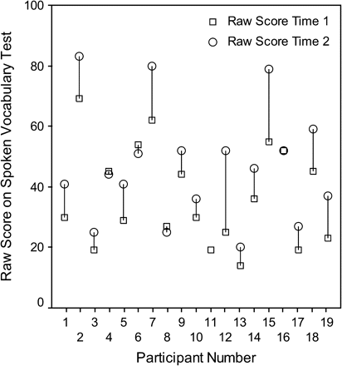
Figure 6 Individual growth in spoken receptive vocabulary between Time 1 and Time 2 in CI users.
Notes:
Figure 6 Individual growth in spoken receptive vocabulary between Time 1 and Time 2 in CI users.
Unless provided in the caption above, the following copyright applies to the content of this slide: © The Author 2007. Published by Oxford University Press. All rights reserved. For Permissions, please email: journals.permissions@oxfordjournals.org

