Slide 1
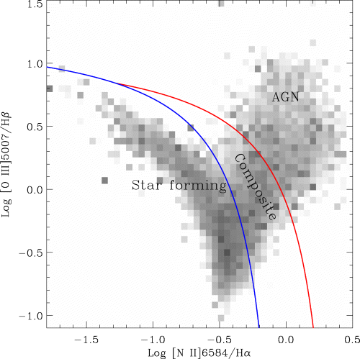
Figure 1 The distribution of the galaxies in our sample in the BPT line-ratio diagram. The two lines shows the ...
Notes:
Figure 1 The distribution of the galaxies in our sample in the BPT line-ratio diagram. The two lines shows the division of our sample into the three subsamples discussed in the text. An unweighted version of this diagram can be seen in Fig. 9. The galaxies plotted here have S/N > 3 in all four lines.
Unless provided in the caption above, the following copyright applies to the content of this slide: © 2004 RAS

Slide 2
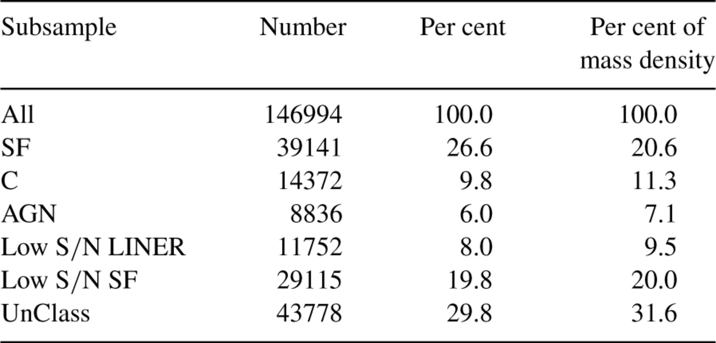
Table 1 Basic data about the subsamples discussed in the text.
Notes:
Table 1 Basic data about the subsamples discussed in the text.
Unless provided in the caption above, the following copyright applies to the content of this slide: © 2004 RAS

Slide 3
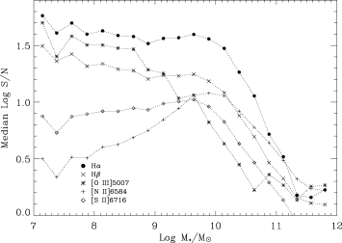
Figure 3 The median signal-to-noise ratio for five of our lines that can be observed over the entire redshift range ...
Notes:
Figure 3 The median signal-to-noise ratio for five of our lines that can be observed over the entire redshift range spanned by our sample. Notice in particular how [O iii]5007 goes from being very strong at low masses to being the weakest line at high masses.
Unless provided in the caption above, the following copyright applies to the content of this slide: © 2004 RAS

Slide 4
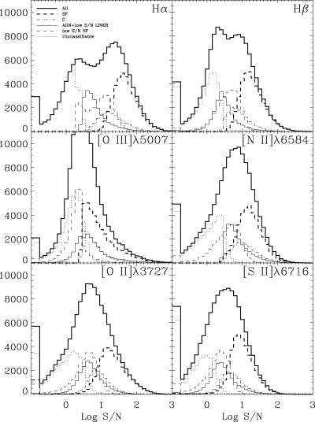
Figure 2 The distribution of signal-to-noise ratio for the six lines that we include in our fits. The thick solid line ...
Notes:
Figure 2 The distribution of signal-to-noise ratio for the six lines that we include in our fits. The thick solid line shows the overall distribution and the distributions for the different subcategories are shown with different line styles as indicated in the legend. The objects with S/N in the emission line outside the displayed range are included in the extreme three bins of the distributions.
Unless provided in the caption above, the following copyright applies to the content of this slide: © 2004 RAS

Slide 5
Table 2 The model grid calculated for the present work. This is calculated for a constant star formation history at ...
Notes:
Table 2 The model grid calculated for the present work. This is calculated for a constant star formation history at t= 108 yr– see text for details.
Unless provided in the caption above, the following copyright applies to the content of this slide: © 2004 RAS

Slide 6
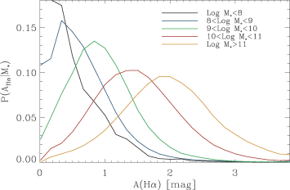
Figure 6 The likelihood distributions of the dust attenuation as a function of stellar mass. These are derived from ...
Notes:
Figure 6 The likelihood distributions of the dust attenuation as a function of stellar mass. These are derived from the model fits to the SF class.
Unless provided in the caption above, the following copyright applies to the content of this slide: © 2004 RAS

Slide 7
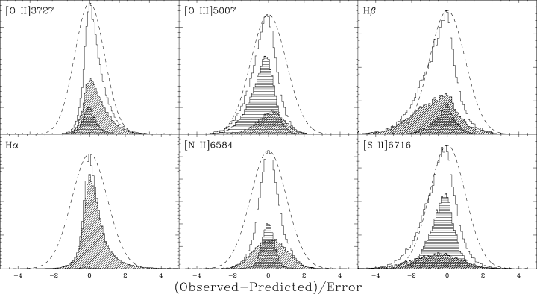
Figure 5 The distribution of the difference between the observed value of the line fluxes and that of the the best-fit ...
Notes:
Figure 5 The distribution of the difference between the observed value of the line fluxes and that of the the best-fit model, divided by the error for all galaxies in the SF class. The smooth dashed curve shows a unit Gaussian for reference. The horizontally shaded histogram shows the results for the galaxies that have S/N in the line between 3 and 10. The obliquely shaded histogram is for galaxies with S/N > 20 in the line.
Unless provided in the caption above, the following copyright applies to the content of this slide: © 2004 RAS

Slide 8
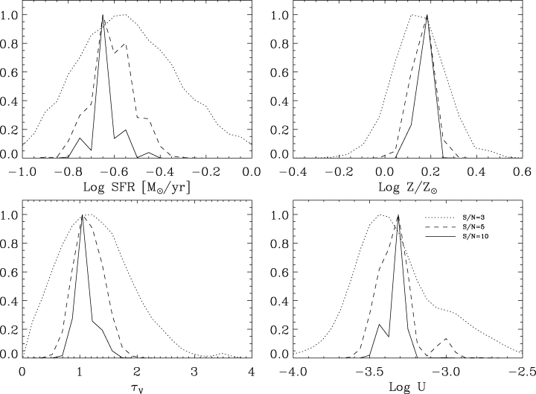
Figure 4 The likelihood distributions derived for model parameters and the SFR_{e} as a function of the S/N of ...
Notes:
Figure 4 The likelihood distributions derived for model parameters and the SFRe as a function of the S/N of the weakest line (here Hβ) for one high S/N galaxy. Each distribution is the average of 100 realizations with that S/N. The top left shows the likelihood distribution of log SFRe the top right the logarithm of the gas metallicity in units of solar. The bottom left-hand panel shows the dust attenuation in the emission lines at V and finally the bottom right shows the logarithm of the ionization parameter at the edge of the Strömgren sphere. The galaxy is SDSS J234342.75−001255.9 at z= 0.026.
Unless provided in the caption above, the following copyright applies to the content of this slide: © 2004 RAS

Slide 9
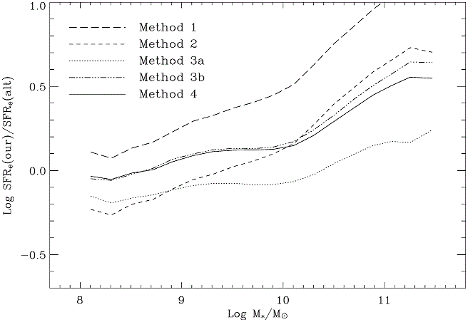
Figure 8 Our estimates compared with the simpler SFRe estimates discussed in the text as a function of stellar mass. ...
Notes:
Figure 8 Our estimates compared with the simpler SFRe estimates discussed in the text as a function of stellar mass. We have used all SF galaxies with S/N H± >10. The figure shows the logarithm of the ratio of our estimate of the SFRe to that obtained by the alternative method, so a value of zero corresponds to equality. See text for details.
Unless provided in the caption above, the following copyright applies to the content of this slide: © 2004 RAS

Slide 10
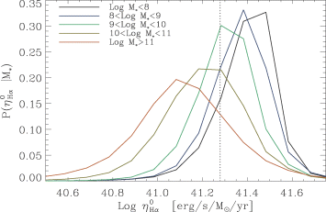
Figure 7 The likelihood distribution of the conversion factor between Hα luminosity and SFR_{e}, ...
Notes:
Figure 7 The likelihood distribution of the conversion factor between Hα luminosity and SFRe, η0Hα. These were again derived from the model fits to the SF class.
Unless provided in the caption above, the following copyright applies to the content of this slide: © 2004 RAS

Slide 11
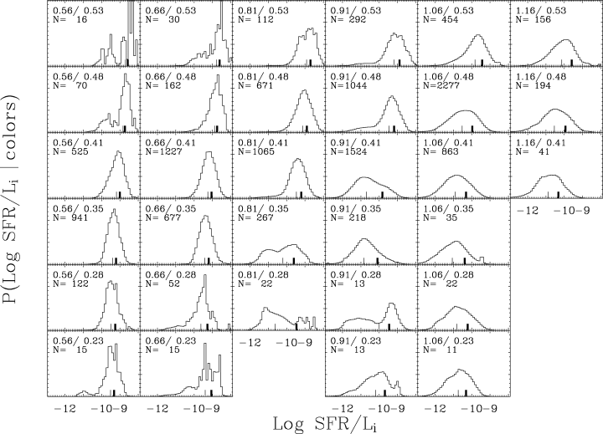
Figure 12 The likelihood distribution of log SFR/L_{i} in bins of ^{0.1}(g−r) and ^{0.1}(r−i). ...
Notes:
Figure 12 The likelihood distribution of log SFR/Li in bins of 0.1(g−r) and 0.1(r−i). The 0.1(g−r) colour increases to the right and is indicated as the first number in the top left-hand corner of each panel. The second number gives the 0.1(r−i) colour and this increases upwards in the figure. The thick black mark on the x-axis shows the average SFR/Li whereas the thin mark shows the median. Note that as one moves towards redder colours the distributions become highly non-symmetrical and there is a substantial difference between the average and the median. The number of objects contributing to the distribution shown in a given panel is indicated in each panel as N =X. Note also that this is a subset of the full 41 × 45 grid.
Unless provided in the caption above, the following copyright applies to the content of this slide: © 2004 RAS

Slide 12
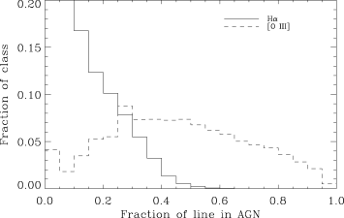
Figure 10 The fraction of [O _{iii}]5007 and Hα luminosity estimated to come from the AGN in the composite ...
Notes:
Figure 10 The fraction of [O iii]5007 and Hα luminosity estimated to come from the AGN in the composite galaxies (see text for details). The solid line refers to Hα and the dashed to [O iii]5007.
Unless provided in the caption above, the following copyright applies to the content of this slide: © 2004 RAS

Slide 13
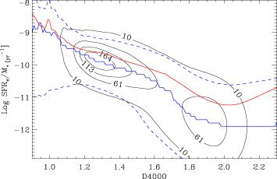
Figure 11 The observed relationship between D4000 and specific SFR_{e} (both inside the fibre). The contour ...
Notes:
Figure 11 The observed relationship between D4000 and specific SFRe (both inside the fibre). The contour lines are equally spaced from 10 galaxies per bin to the maximum. The bin size is 0.01 × 0.1 in the units given in the plot. The upper solid line shows the average at a given D4000 and the lower solid line shows the mode of the distribution. The dashed lines show the limits containing 95 per cent of the galaxies at a given D4000.
Unless provided in the caption above, the following copyright applies to the content of this slide: © 2004 RAS

Slide 14
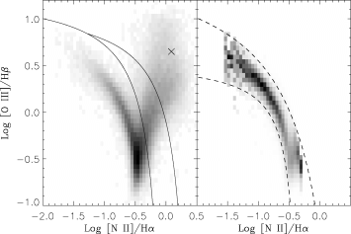
Figure 9 Left: the standard BPT excitation diagram for those galaxies in our sample with S/N > 3 in all lines used ...
Notes:
Figure 9 Left: the standard BPT excitation diagram for those galaxies in our sample with S/N > 3 in all lines used here (70189 in total). The grey-scale shows the square root of the number of galaxies in each bin of 0.05 in the x- and y-axes. The cross shows the location of the average AGN used to assess the AGN contribution to the Hα flux. The lines are the same as those in Fig. 1. Right: the same plot after removal of the composites and AGN (leaving 42 262 galaxies; cf. Table 1) and after normalizing the distribution in each bin along the x-axis to 1. The thick dashed lines show fits to intervals containing 95 per cent of the galaxies as described in the text.
Unless provided in the caption above, the following copyright applies to the content of this slide: © 2004 RAS

Slide 15
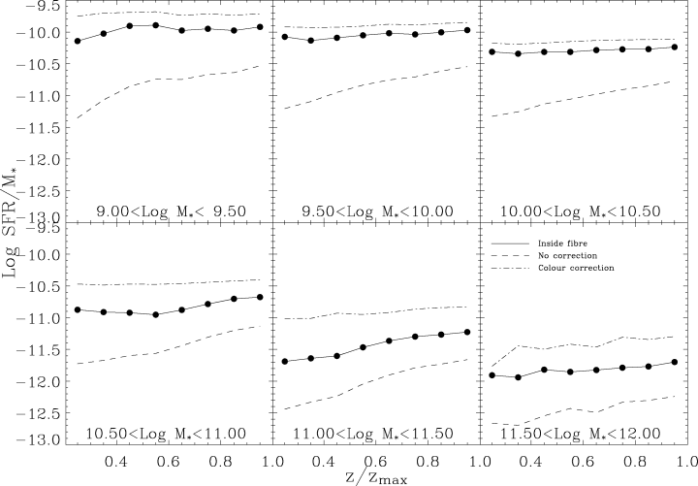
Figure 13 The value of the specific SFR, SFR/M* as a function of z/z_{max}. The solid line with dots ...
Notes:
Figure 13 The value of the specific SFR, SFR/M* as a function of z/zmax. The solid line with dots shows the trend within the fibre, i.e. both M* and SFR calculated within the fibre and a clear aperture effect is seen. The dashed line shows the result when assuming that all the SFR takes place inside the fibre, i.e. M* is for the galaxy as a whole and the SFR for the fibre only, and the dash–dotted line shows the result from our aperture corrections. Notice that we very nearly take out all aperture biases.
Unless provided in the caption above, the following copyright applies to the content of this slide: © 2004 RAS

Slide 16
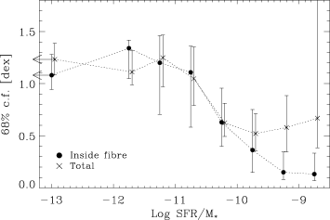
Figure 14 The distribution of the errors on the SFR estimates. The line with solid points show the uncertainties ...
Notes:
Figure 14 The distribution of the errors on the SFR estimates. The line with solid points show the uncertainties derived from the likelihood distributions inside the fibre. The line with crosses points shows the same for the likelihood distributions for the total SFR derived as described in the text. We have grouped together all galaxies with log SFR/M* < −12 into one point and placed this at log SFR/M*=−13. The x-axis shows log SFR/M*, measured inside the fibre for the solid points and total for the crosses. The points for the total SFR/M* are offset slightly for clarity.
Unless provided in the caption above, the following copyright applies to the content of this slide: © 2004 RAS

Slide 17
Table 3 The best estimate of the star formation density at z= 0.1 from our survey. We show the mode and the 68 per ...
Notes:
Table 3 The best estimate of the star formation density at z= 0.1 from our survey. We show the mode and the 68 per cent confidence intervals as well as the percentage contribution to the total for the different classes. The total for β= 0 (no evolution) is shown on the first row, the others use β= 3.
Unless provided in the caption above, the following copyright applies to the content of this slide: © 2004 RAS

Slide 18
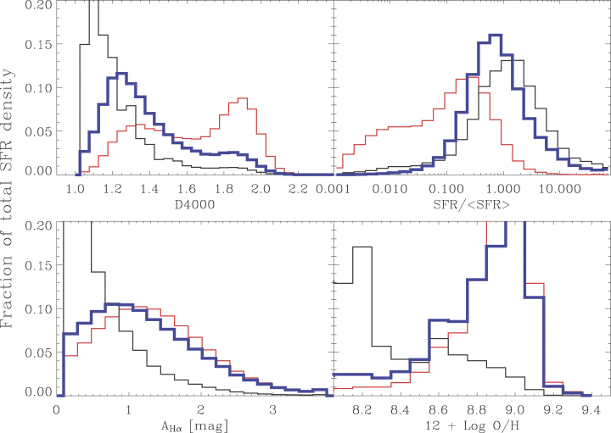
Figure 21 Like the previous figure, but this time showing the star formation density versus the 4000-Å break (upper ...
Notes:
Figure 21 Like the previous figure, but this time showing the star formation density versus the 4000-Å break (upper left-hand panel) the present to past-average SFR (upper right), the dust attenuation at Hα in mag (lower left) and the gas-phase oxygen abundance (lower right). The latter two use only the SF class.
Unless provided in the caption above, the following copyright applies to the content of this slide: © 2004 RAS

Slide 19
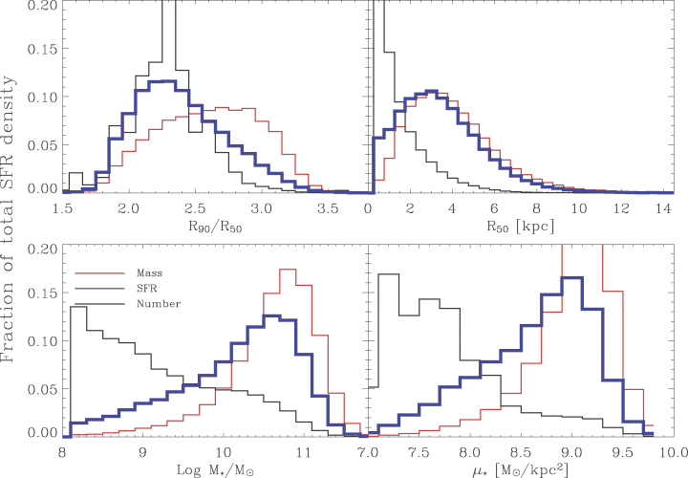
Figure 20 The contribution to the total number, mass and star formation density as a function of various galaxy ...
Notes:
Figure 20 The contribution to the total number, mass and star formation density as a function of various galaxy parameters. The SF density is shown in blue, the mass density in red and the number density in black. Top left: the contribution to the different densities as a function of the concentration of the galaxies. Top right: the same, but as a function of the half-light radii of the galaxies. Lower left: the density contributions as a function of log stellar mass. Lower right: the contributions as a function of log of the stellar surface density in M⊙ kpc−2.
Unless provided in the caption above, the following copyright applies to the content of this slide: © 2004 RAS

Slide 20
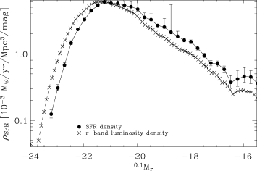
Figure 15 The star formation density as a function of r-band absolute magnitude compared with the r-band luminosity ...
Notes:
Figure 15 The star formation density as a function of r-band absolute magnitude compared with the r-band luminosity density scaled to have the same peak value. The error bars on the SFR density are derived from bootstrap resampling. The error bars on the luminosity density estimate are suppressed for clarity.
Unless provided in the caption above, the following copyright applies to the content of this slide: © 2004 RAS

Slide 21
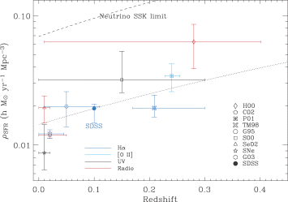
Figure 16 The star formation density in the present study. The filled circle is our preferred estimate with the ...
Notes:
Figure 16 The star formation density in the present study. The filled circle is our preferred estimate with the systematic and random errors included in the error bar. This is compared with several other recent determinations of the local SFR. The papers indicated in the legend are: H00: Haarsma et al. (2000), C02: Condon et al. (2002), P01: Pascual et al. (2001), TM98: Tresse & Maddox (1998), G95: Gallego et al. (1995), S00: Sullivan et al. (2000), Se02: Serjeant et al. (2002), SNe: SFR derived from SNe are as reported by Fukugita & Kawasaki (2003) who are also responsible for the upper limits from neutrino observations at SuperKamiokande, G03: Glazebrook et al. (2003) for whom we show the full range of the Hα-derived local SFR. The dotted line shows a (1 +z)3 evolution of ρSFR for comparison. All values have been corrected to the Kroupa (2001) universal IMF and h= 0.7.
Unless provided in the caption above, the following copyright applies to the content of this slide: © 2004 RAS

Slide 22
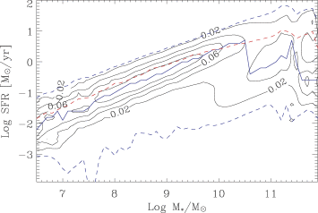
Figure 17 The relationship between the stellar mass and the SFR (both inside the fibre) for all galaxies with no AGN ...
Notes:
Figure 17 The relationship between the stellar mass and the SFR (both inside the fibre) for all galaxies with no AGN contribution. The figure has been volume weighted and normalized in bins of stellar mass. The contours are therefore showing the conditional likelihood of SFR given a stellar mass. The bin size is 0.1 × 0.1 in the units given in the plot. The red line shows the average at a given stellar mass, whereas the blue line shows the mode of the distribution. The dashed lines show the limits containing 95 per cent of the galaxies at a given stellar mass.
Unless provided in the caption above, the following copyright applies to the content of this slide: © 2004 RAS

Slide 23
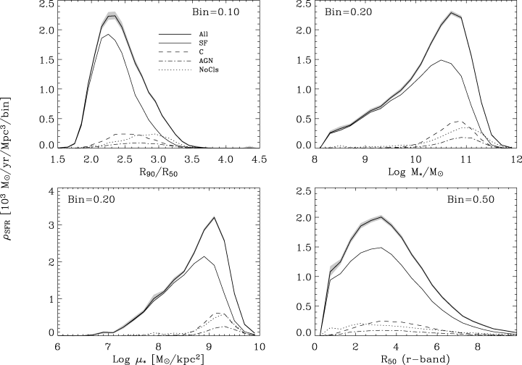
Figure 18 The total star formation density, ρ_{SFR}, as a function of Top left: the central concentration of ...
Notes:
Figure 18 The total star formation density, ρSFR, as a function of Top left: the central concentration of the galaxies. As discussed in section 7 this is a proxy for a proper morphological classification. Top right: the stellar mass and Bottom left: the stellar surface mass density. The final panel shows ρSFR as a function of the galaxy half-light radius. The shaded region in each panel shows the 68 per cent confidence region. The units are given on the left, and the bin size is given in each panel.
Unless provided in the caption above, the following copyright applies to the content of this slide: © 2004 RAS

Slide 24
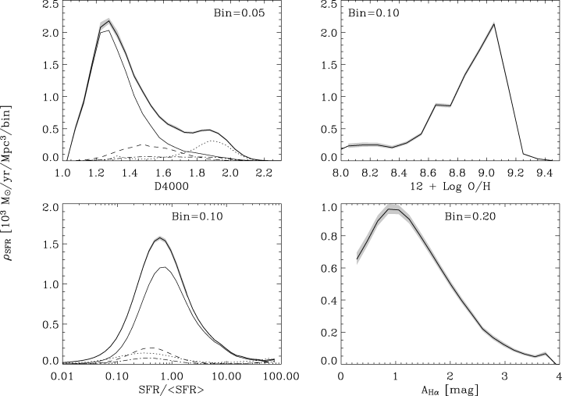
Figure 19 Like the previous figure, but this time we show parameters determined inside the fibre along the x-axis and ...
Notes:
Figure 19 Like the previous figure, but this time we show parameters determined inside the fibre along the x-axis and the distribution functions are therefore relative to the SFR density inside the fibre. The top left-hand panel shows the distribution with respect to the 4000-Å break, the gas-phase oxygen abundance is at the top right, the present-to-past average star formation rate is at the bottom left, and finally the dust attenuation at Hα is in the bottom right-hand panel.
Unless provided in the caption above, the following copyright applies to the content of this slide: © 2004 RAS

Slide 25
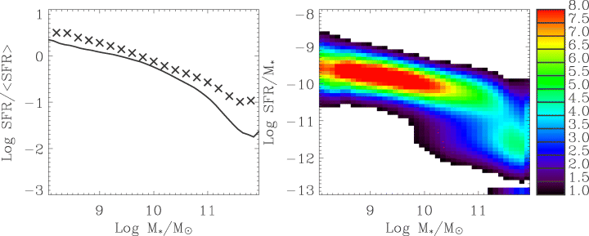
Figure 24 Similar to Fig. 23 but this time showing b as a function of the stellar mass.
Notes:
Figure 24 Similar to Fig. 23 but this time showing b as a function of the stellar mass.
Unless provided in the caption above, the following copyright applies to the content of this slide: © 2004 RAS

Slide 26
Table 4 The best estimate of the present-to-past average star formation rate, b^{V}. We have averaged the ...
Notes:
Table 4 The best estimate of the present-to-past average star formation rate, bV. We have averaged the values form β= 3 and β= 0 as appropriate for our systematic error estimates.
Unless provided in the caption above, the following copyright applies to the content of this slide: © 2004 RAS

Slide 27
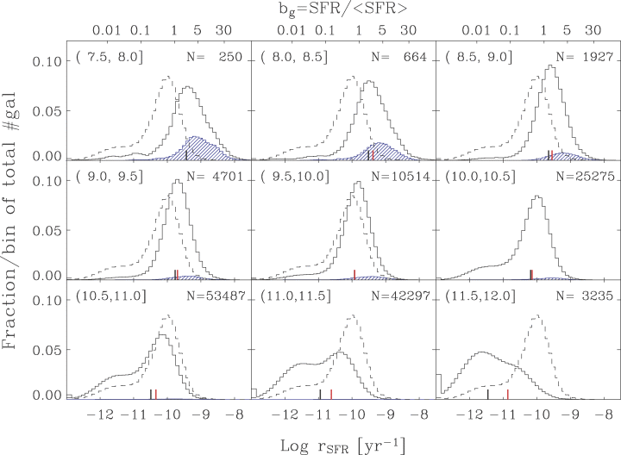
Figure 22 The observed specific star formation as a function of total stellar mass in the mass ranges indicated in the ...
Notes:
Figure 22 The observed specific star formation as a function of total stellar mass in the mass ranges indicated in the top left hand corner of each panel. Shaded areas show recent starbursts, see text for details. Each histogram is normalized to the total number of galaxies in the mass range, given as N in each panel. The dashed histogram is the distribution in the log M*∈ (10.0, 10.5] bin and is included for reference. The thick black bar shows the average b value, bg, in each mass range, and the thick red bar shows bV. The latter is not shown in the first panel because we might not be statistically complete there. All objects with log SFR/M*≤−12 have been placed as a Gaussian around log SFR/M*=−12 as discussed in the text.
Unless provided in the caption above, the following copyright applies to the content of this slide: © 2004 RAS

Slide 28
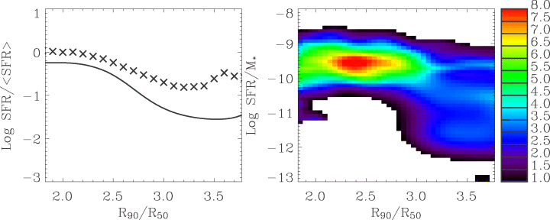
Figure 23 The specific SFR as a function of concentration. The left-hand panel contrasts b^{g} with ...
Notes:
Figure 23 The specific SFR as a function of concentration. The left-hand panel contrasts bg with bV. The continuous line in this plot shows the median of the unweighted bg (right-hand panel) and the crosses show bV calculated from the data in Fig. 20. The right-hand panel shows the (log of the) observed likelihood distribution of rSFR with respect to the concentration parameter, R90/R50, calculated as described in the text. The shading shows the conditional likelihood distribution (volume corrected) given a value for R90/R50. The contributions to the likelihood distributions below the plotted range have been put in the two lowest bins in rSFR.
Unless provided in the caption above, the following copyright applies to the content of this slide: © 2004 RAS

Slide 29
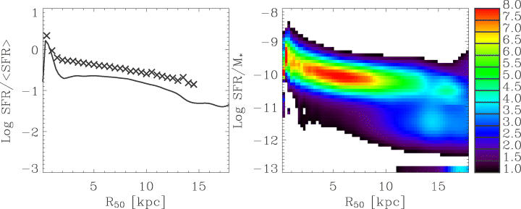
Figure 28 Similar to Fig. 23 but this time showing b as a function of the half-light radius of the galaxies.
Notes:
Figure 28 Similar to Fig. 23 but this time showing b as a function of the half-light radius of the galaxies.
Unless provided in the caption above, the following copyright applies to the content of this slide: © 2004 RAS

Slide 30
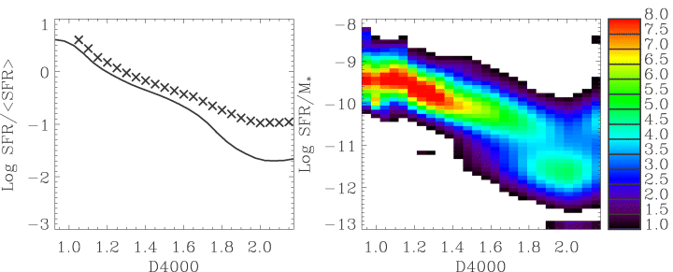
Figure 27 Similar to Fig. 23 but this time showing b as a function of D4000. Notice the clear correlation, despite a ...
Notes:
Figure 27 Similar to Fig. 23 but this time showing b as a function of D4000. Notice the clear correlation, despite a substantial scatter. In this figure the solid line shows bg determined in the fibre whereas the crosses are for the total.
Unless provided in the caption above, the following copyright applies to the content of this slide: © 2004 RAS

Slide 31
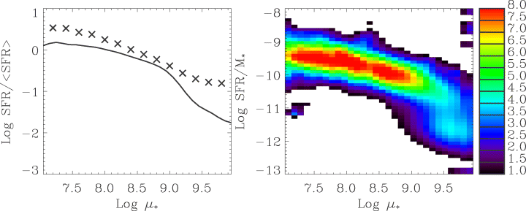
Figure 25 Similar to Fig. 23 but this time showing b as a function of stellar mass surface density.
Notes:
Figure 25 Similar to Fig. 23 but this time showing b as a function of stellar mass surface density.
Unless provided in the caption above, the following copyright applies to the content of this slide: © 2004 RAS

Slide 32
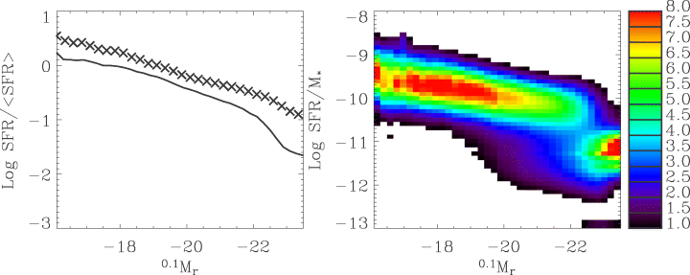
Figure 26 Similar to Fig. 23 but this time showing b as a function of ^{0.1}M_{r} mag.
Notes:
Figure 26 Similar to Fig. 23 but this time showing b as a function of 0.1Mr mag.
Unless provided in the caption above, the following copyright applies to the content of this slide: © 2004 RAS

Slide 33
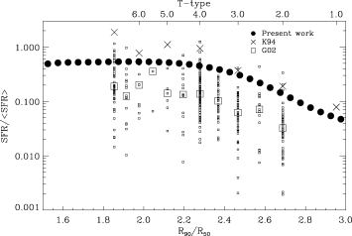
Figure 29 The present to past-average star formation rate for the sample plotted against central concentration in the ...
Notes:
Figure 29 The present to past-average star formation rate for the sample plotted against central concentration in the r-band. The top x-axis shows the mean T-type implied by the concentration according to the recipe described in the text. The crosses show the sample of Kennicutt et al. (1994) and the boxes that of Gavazzi et al. (2002).
Unless provided in the caption above, the following copyright applies to the content of this slide: © 2004 RAS

Slide 34
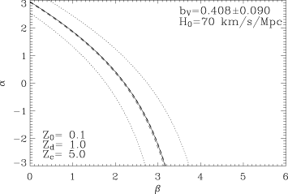
Figure 30 The constraint on α and β (see equation 13) from the b^{V} value calculated for our sample. The solid ...
Notes:
Figure 30 The constraint on α and β (see equation 13) from the bV value calculated for our sample. The solid line shows the locus of bV= 0.400, whereas the dashed line shows the 68 per cent confidence limits from the likelihood distributions and the dotted the locus of our conservative systematic error estimates.
Unless provided in the caption above, the following copyright applies to the content of this slide: © 2004 RAS

