Slide 1
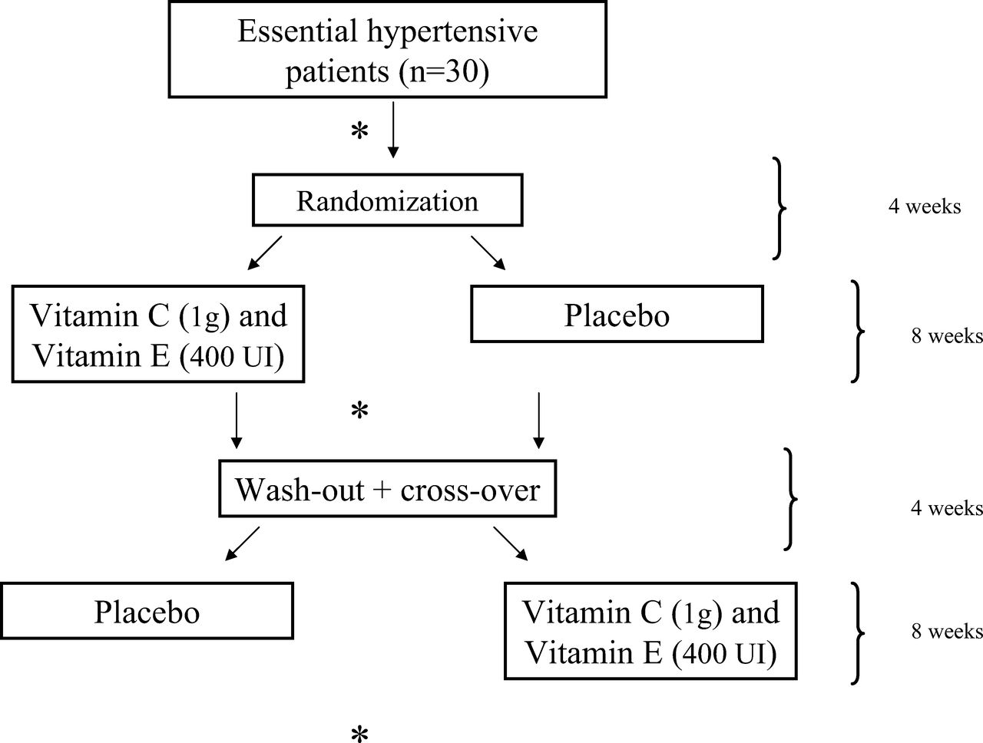
Figure 1. Outline of study design. *Vascular studies, ABPM monitoring, blood samples for plasma markers of oxidative ...
Notes:
Figure 1. Outline of study design. *Vascular studies, ABPM monitoring, blood samples for plasma markers of oxidative stress, and antioxidant status were performed.
Unless provided in the caption above, the following copyright applies to the content of this slide: © American Journal of Hypertension, Ltd. 2007

Slide 2
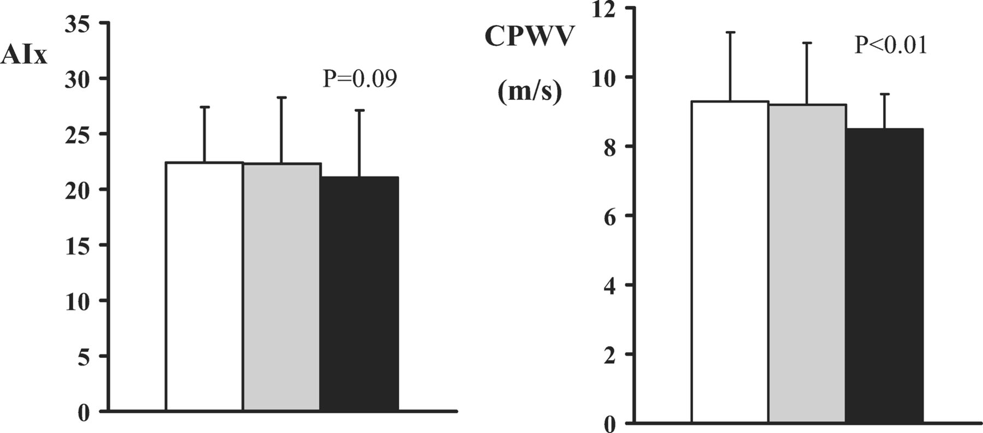
Figure 3. Graphs show differences in augmentation index (AIx) and central pulse wave velocity (CPVW) at baseline (white ...
Notes:
Figure 3. Graphs show differences in augmentation index (AIx) and central pulse wave velocity (CPVW) at baseline (white bars), after 8 weeks of vitamin antioxidant supplementation (black bars) as compared to placebo (gray bars). *Denotes a significant difference (P < .01).
Unless provided in the caption above, the following copyright applies to the content of this slide: © American Journal of Hypertension, Ltd. 2007

Slide 3
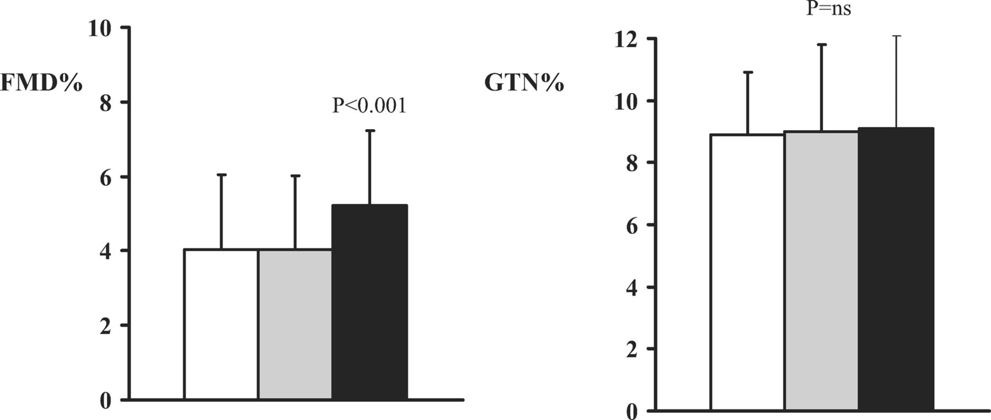
Figure 2. Graphs show differences in flow-mediated dilation (FMD) and response to sublingual glyceryl trinitrate (GTN) ...
Notes:
Figure 2. Graphs show differences in flow-mediated dilation (FMD) and response to sublingual glyceryl trinitrate (GTN) at baseline (white bars), after 8 weeks of vitamin antioxidant supplementation (black bars) as compared to placebo (gray bars). *Denotes a significant difference (P < .001).
Unless provided in the caption above, the following copyright applies to the content of this slide: © American Journal of Hypertension, Ltd. 2007

