Slide 1
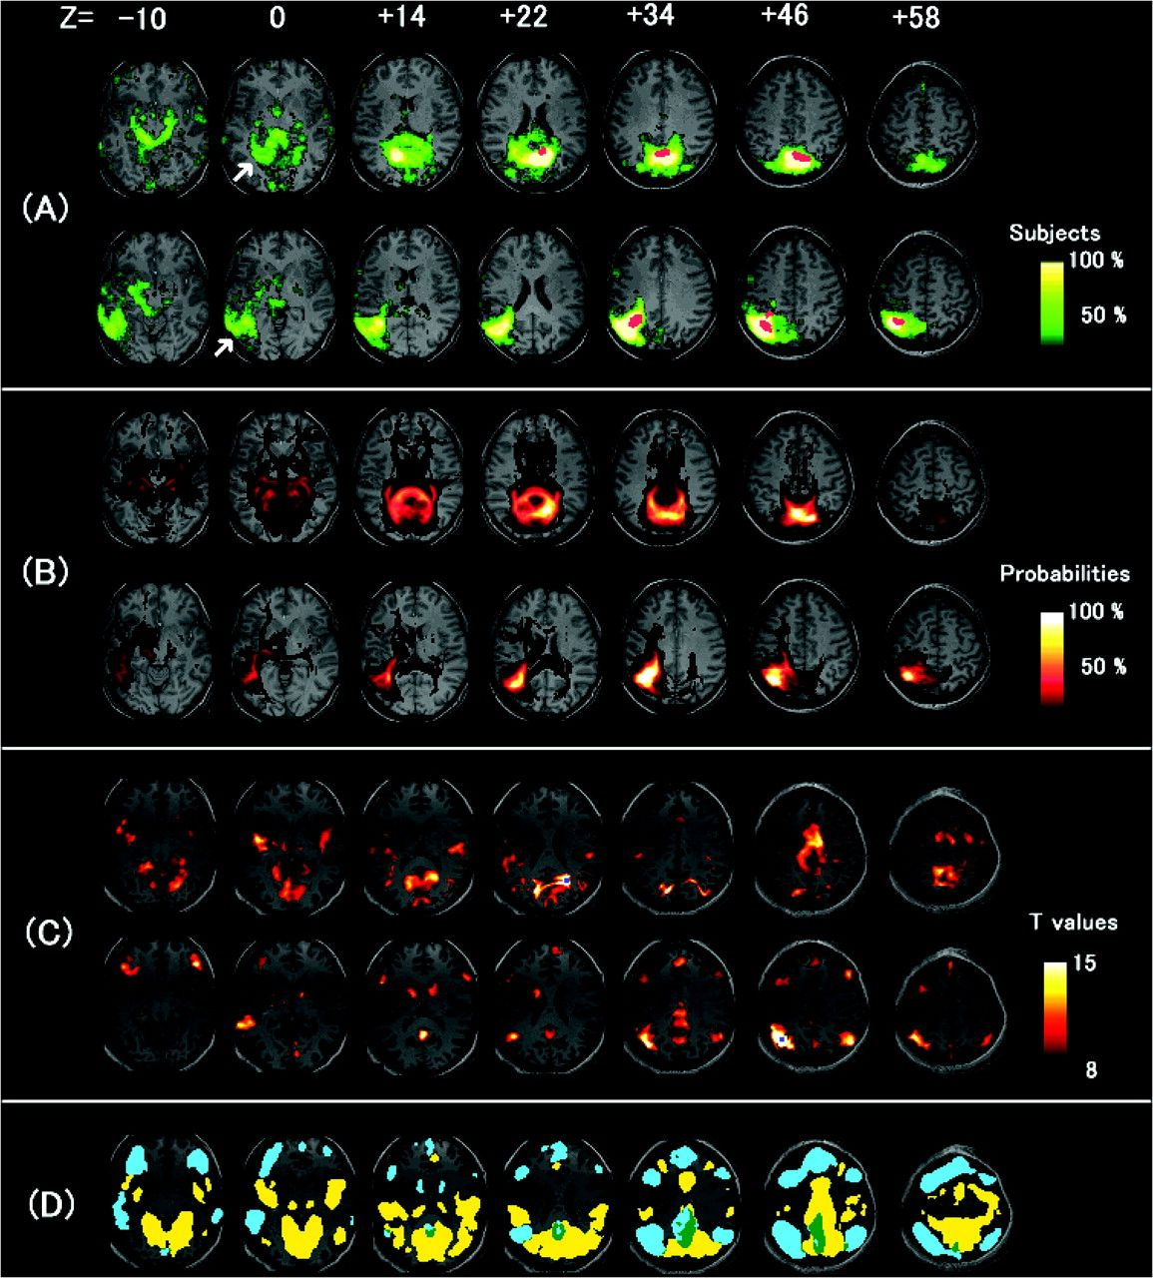
Figure 1. (A, B) Results of fiber-tracking analyses. (A) The average results of 20 subjects’ terminal points of DTI ...
Notes:
Figure 1. (A, B) Results of fiber-tracking analyses. (A) The average results of 20 subjects’ terminal points of DTI fiber tracking. The left hemisphere of the brain corresponds to the left side of the image. Fiber tracking was performed from the PCu (upper row) and left IPS (lower row) activation clusters revealed by “Hits versus Correct rejections” condition in all the 20 subjects. The activation clusters are shown in red. The terminals of the reconstructed fibers are displayed in yellow/green. The color scale represents the proportion of the subjects. White arrows show MTL (upper row) and the lateral temporal cortex (lower row). (B) Probabilistic maps of fiber tracking based on the boot-trac analysis from the same activated clusters in (A) (upper row: PCu, lower row: left IPS). The color scale represents probabilities of fibers. (C, D) Results of functional connectivity analyses. (C) The results of t-test on z transformed of correlation coefficients using activated regions in PCu (upper row) and left IPS (lower row) corrected for multiple comparisons for whole-brain at the voxel level (P 0.3) using activated regions in PCu and left IPS.
Unless provided in the caption above, the following copyright applies to the content of this slide: © The Author 2007. Published by Oxford University Press. All rights reserved. For permissions, please e-mail: journals.permissions@oxfordjournals.org

Slide 2
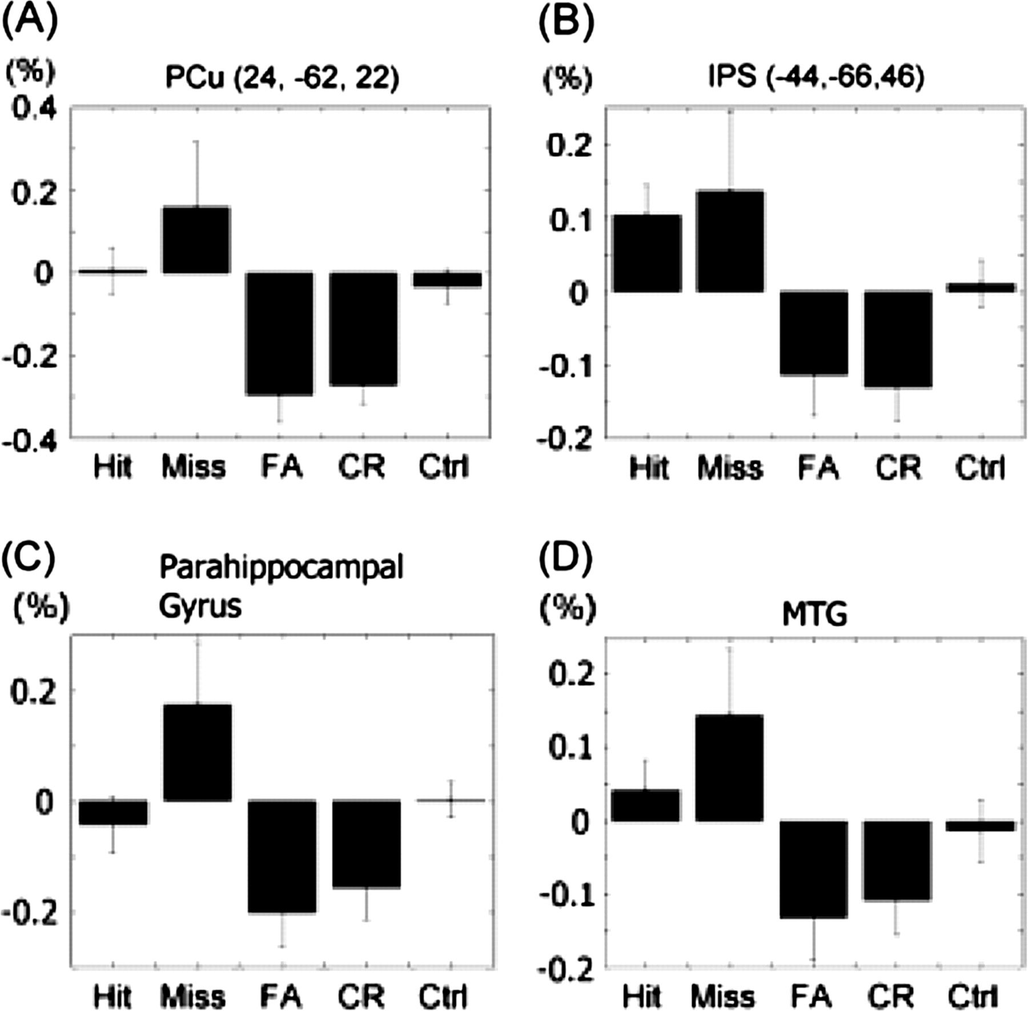
Figure 2. (A, B) Mean percent signal changes in the activated cluster in PCu and IPS. (A) Mean percent signal changes ...
Notes:
Figure 2. (A, B) Mean percent signal changes in the activated cluster in PCu and IPS. (A) Mean percent signal changes of the cluster in PCu (including the peak voxel, x, y, z = 24, −62, 22). (B) Mean percent signal changes of the cluster in IPS (including the peak voxel, x, y, z = −44, −66, 46). FA, false alarms; CR, correct rejections; Ctrl, control. (C, D) Pattern of activity in the clusters in the left MTG and parahippocampal gyrus. (C) Mean percent signal changes of the cluster in the parahippocampal gyrus. (D) Mean percent signal changes of the cluster in the left MTG.
Unless provided in the caption above, the following copyright applies to the content of this slide: © The Author 2007. Published by Oxford University Press. All rights reserved. For permissions, please e-mail: journals.permissions@oxfordjournals.org

