Slide 1
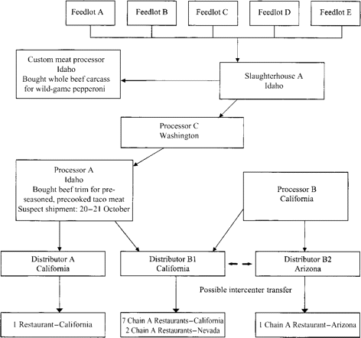
Figure 1 Flow diagram of production and distribution of beef products for chain A restaurants in Arizona, California, ...
Notes:
Figure 1 Flow diagram of production and distribution of beef products for chain A restaurants in Arizona, California, and Nevada and a custom meat processor in Idaho.
Unless provided in the caption above, the following copyright applies to the content of this slide: © 2004 by the Infectious Diseases Society of America

Slide 2
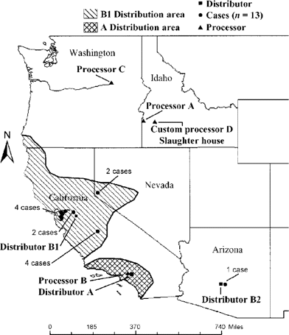
Figure 2 The distribution of ground beef to chain A restaurants, and the location of associated Escherichia coli ...
Notes:
Figure 2 The distribution of ground beef to chain A restaurants, and the location of associated Escherichia coli O157:H7 infections in the western United States, November 1999.
Unless provided in the caption above, the following copyright applies to the content of this slide: © 2004 by the Infectious Diseases Society of America

