Slide 1
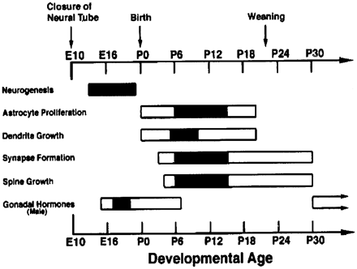
Figure 1 Timing and sequence of developmental processes of the CNS (adapted from Kolb, Gibb, Gorny, 2000b).
Notes:
Figure 1 Timing and sequence of developmental processes of the CNS (adapted from Kolb, Gibb, Gorny, 2000b).
Unless provided in the caption above, the following copyright applies to the content of this slide: © The Author (2011). Published by Oxford University Press on behalf of the Guarantors of Brain. All rights reserved. For Permissions, please email: journals.permissions@oup.com

Slide 2
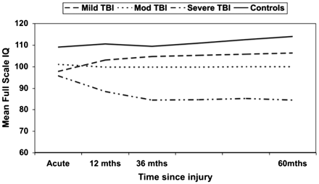
Figure 2 Recovery trajectories for intellectual ability over 5 years following childhood traumatic brain injury (TBI) ...
Notes:
Figure 2 Recovery trajectories for intellectual ability over 5 years following childhood traumatic brain injury (TBI) (adapted from Anderson et al., 2009a).
Unless provided in the caption above, the following copyright applies to the content of this slide: © The Author (2011). Published by Oxford University Press on behalf of the Guarantors of Brain. All rights reserved. For Permissions, please email: journals.permissions@oup.com

Slide 3
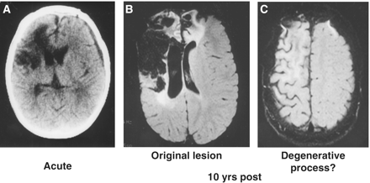
Figure 3 Brain pathology following brain insult in a 3-year old child (J.B.). (A) Acute CT scan, demonstrating extent ...
Notes:
Figure 3 Brain pathology following brain insult in a 3-year old child (J.B.). (A) Acute CT scan, demonstrating extent of initial injury, which includes extensive right frontal and subcortical damage. (B) MRI scans 8 years post-injury, illustrating the residual pathology, as well as generalized right hemisphere atrophy (C).
Unless provided in the caption above, the following copyright applies to the content of this slide: © The Author (2011). Published by Oxford University Press on behalf of the Guarantors of Brain. All rights reserved. For Permissions, please email: journals.permissions@oup.com

Slide 4
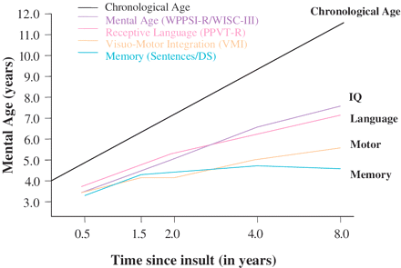
Figure 4 Neurobehavioural outcome to 8 years post-insult (J.B.).
Notes:
Figure 4 Neurobehavioural outcome to 8 years post-insult (J.B.).
Unless provided in the caption above, the following copyright applies to the content of this slide: © The Author (2011). Published by Oxford University Press on behalf of the Guarantors of Brain. All rights reserved. For Permissions, please email: journals.permissions@oup.com

Slide 5
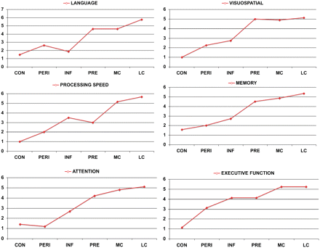
Figure 6 Early focal brain insult, age and neurobehavioural outcome. Adapted from Anderson et al., 2009b. ...
Notes:
Figure 6 Early focal brain insult, age and neurobehavioural outcome. Adapted from Anderson et al., 2009b. CON = congenital; INF = infancy; LC = late childhood; MC = middle childhood; PERI = perinatal; PRE = preschool.
Unless provided in the caption above, the following copyright applies to the content of this slide: © The Author (2011). Published by Oxford University Press on behalf of the Guarantors of Brain. All rights reserved. For Permissions, please email: journals.permissions@oup.com

Slide 6
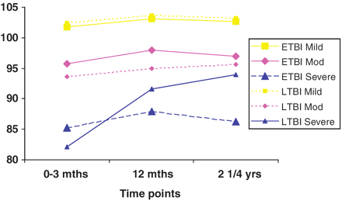
Figure 5 Impact of diffuse early brain injury (traumatic) and age at insult on intellectual function up to 2.25 years ...
Notes:
Figure 5 Impact of diffuse early brain injury (traumatic) and age at insult on intellectual function up to 2.25 years post-insult (ETBI = injury ≤7 years; LTBI = injury ≥ 8 years). Adapted from Anderson et al.(2005a).
Unless provided in the caption above, the following copyright applies to the content of this slide: © The Author (2011). Published by Oxford University Press on behalf of the Guarantors of Brain. All rights reserved. For Permissions, please email: journals.permissions@oup.com

Slide 7
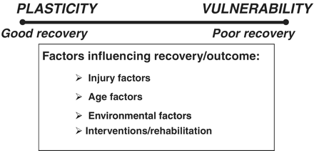
Figure 7 Recovery from early brain insult: a continuum?
Notes:
Figure 7 Recovery from early brain insult: a continuum?
Unless provided in the caption above, the following copyright applies to the content of this slide: © The Author (2011). Published by Oxford University Press on behalf of the Guarantors of Brain. All rights reserved. For Permissions, please email: journals.permissions@oup.com

