Slide 1
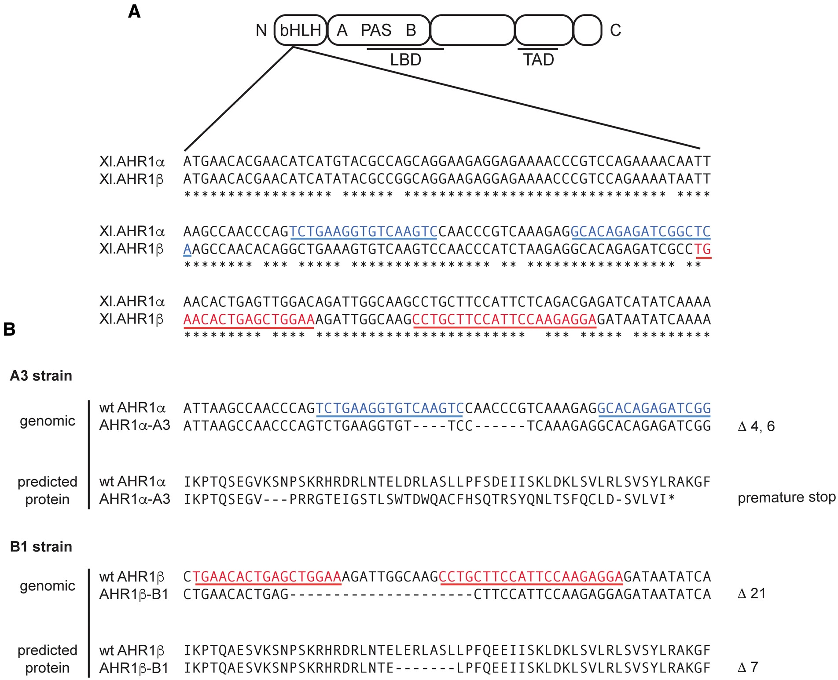
FIG. 1 TALEN-induced AHR mutations. A, XLK-WG cells were transfected with TALEN pairs targeting helix 1 of the bHLH ...
Notes:
FIG. 1 TALEN-induced AHR mutations. A, XLK-WG cells were transfected with TALEN pairs targeting helix 1 of the bHLH motif within exon 2 of AHR1α or AHR1β. Conserved functional or sequence domains are indicated by the following abbreviations: LBD, ligand-binding domain; TAD, transcriptional activation domain; PAS, Per-ARNT-Sim domain (Ma, 2012). TALEN binding signatures are underlined. *denotes sequence identities. B, Mutant AHRs were amplified with primers flanking the TALEN target site, and PCR products were cloned and sequenced. Genomic DNA sequences are depicted with TALEN-binding signatures highlighted. The predicted protein sequence of each mutant AHR was determined by translation of open reading frame. *indicates stop codon.
Unless provided in the caption above, the following copyright applies to the content of this slide: © The Author 2016. Published by Oxford University Press on behalf of the Society of Toxicology. All rights reserved. For Permissions, please e-mail: journals.permissions@oup.com

Slide 2
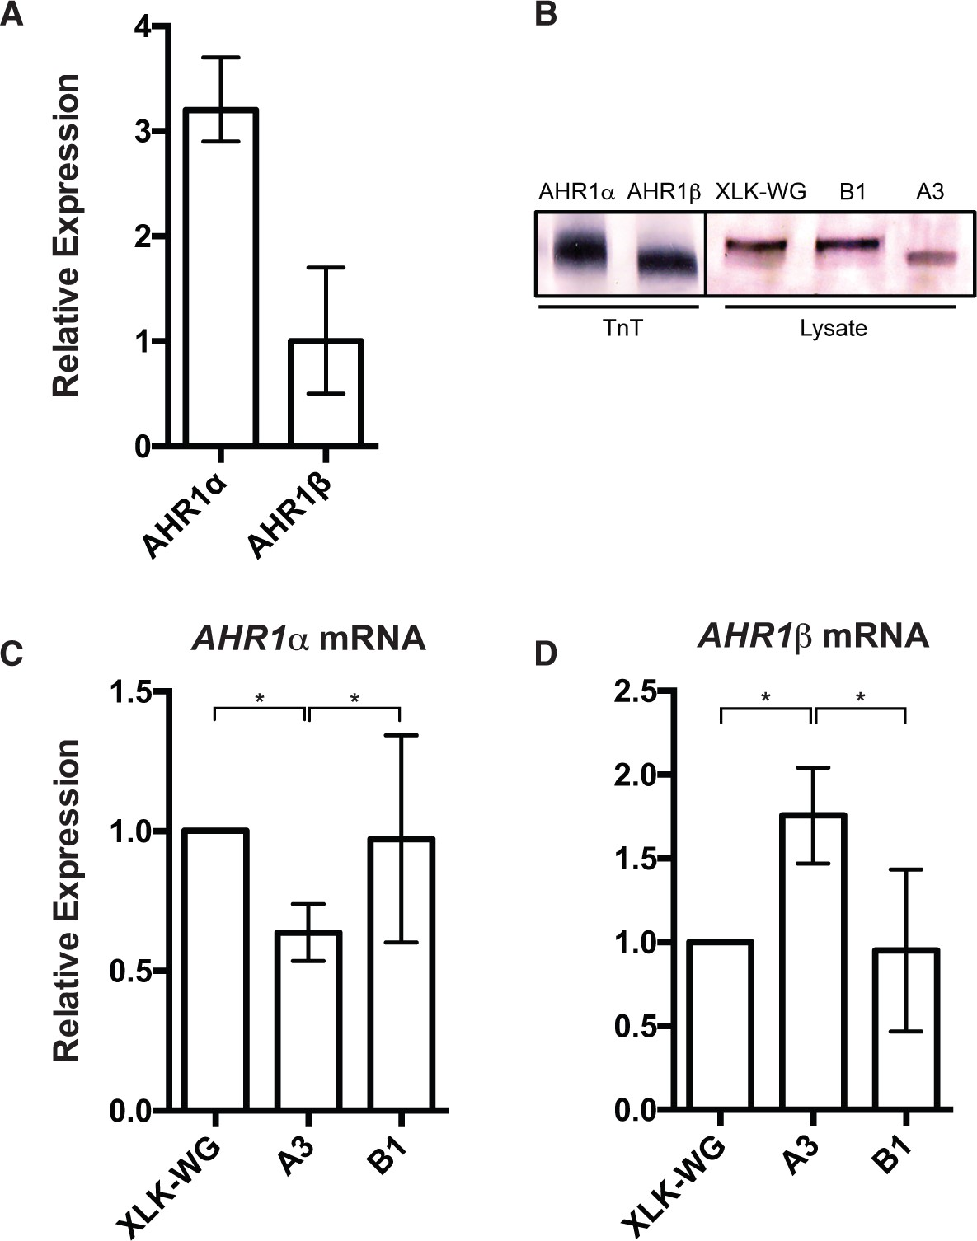
FIG. 2 AHR expression in mutant strains. A, qPCR. Total RNA was harvested from wild-type cells and reverse ...
Notes:
FIG. 2 AHR expression in mutant strains. A, qPCR. Total RNA was harvested from wild-type cells and reverse transcribed. mRNA abundance was measured in triplicate using qPCR with β-actin as endogenous control. n = 3. Representative experiment is depicted. B, Western blot. Cell lysate was subjected to SDS-PAGE, transferred to nitrocellulose, and probed with primary antibody SA-210 (1:1000; Enzo) directed against the N-terminal region of AHR1α (94.2 kDa) and AHR1β (93.6 kDa). AHR protein standards were generated by in vitro transcription using the TNT Quick-coupled Transcription/Translation kit (Promega). C and D, qPCR was accomplished as described. mRNA expression is reported relative to wild-type cells. C, AHR1α. One-way ANOVA with Tukey’s multiple comparisons test. p = .043. n = 5 biological replicates. D, AHR1β. One-way ANOVA with Tukey’s multiple comparisons test. P = .011. n = 4 biological replicates. Error bars = SEM. *P < .05.
Unless provided in the caption above, the following copyright applies to the content of this slide: © The Author 2016. Published by Oxford University Press on behalf of the Society of Toxicology. All rights reserved. For Permissions, please e-mail: journals.permissions@oup.com

Slide 3
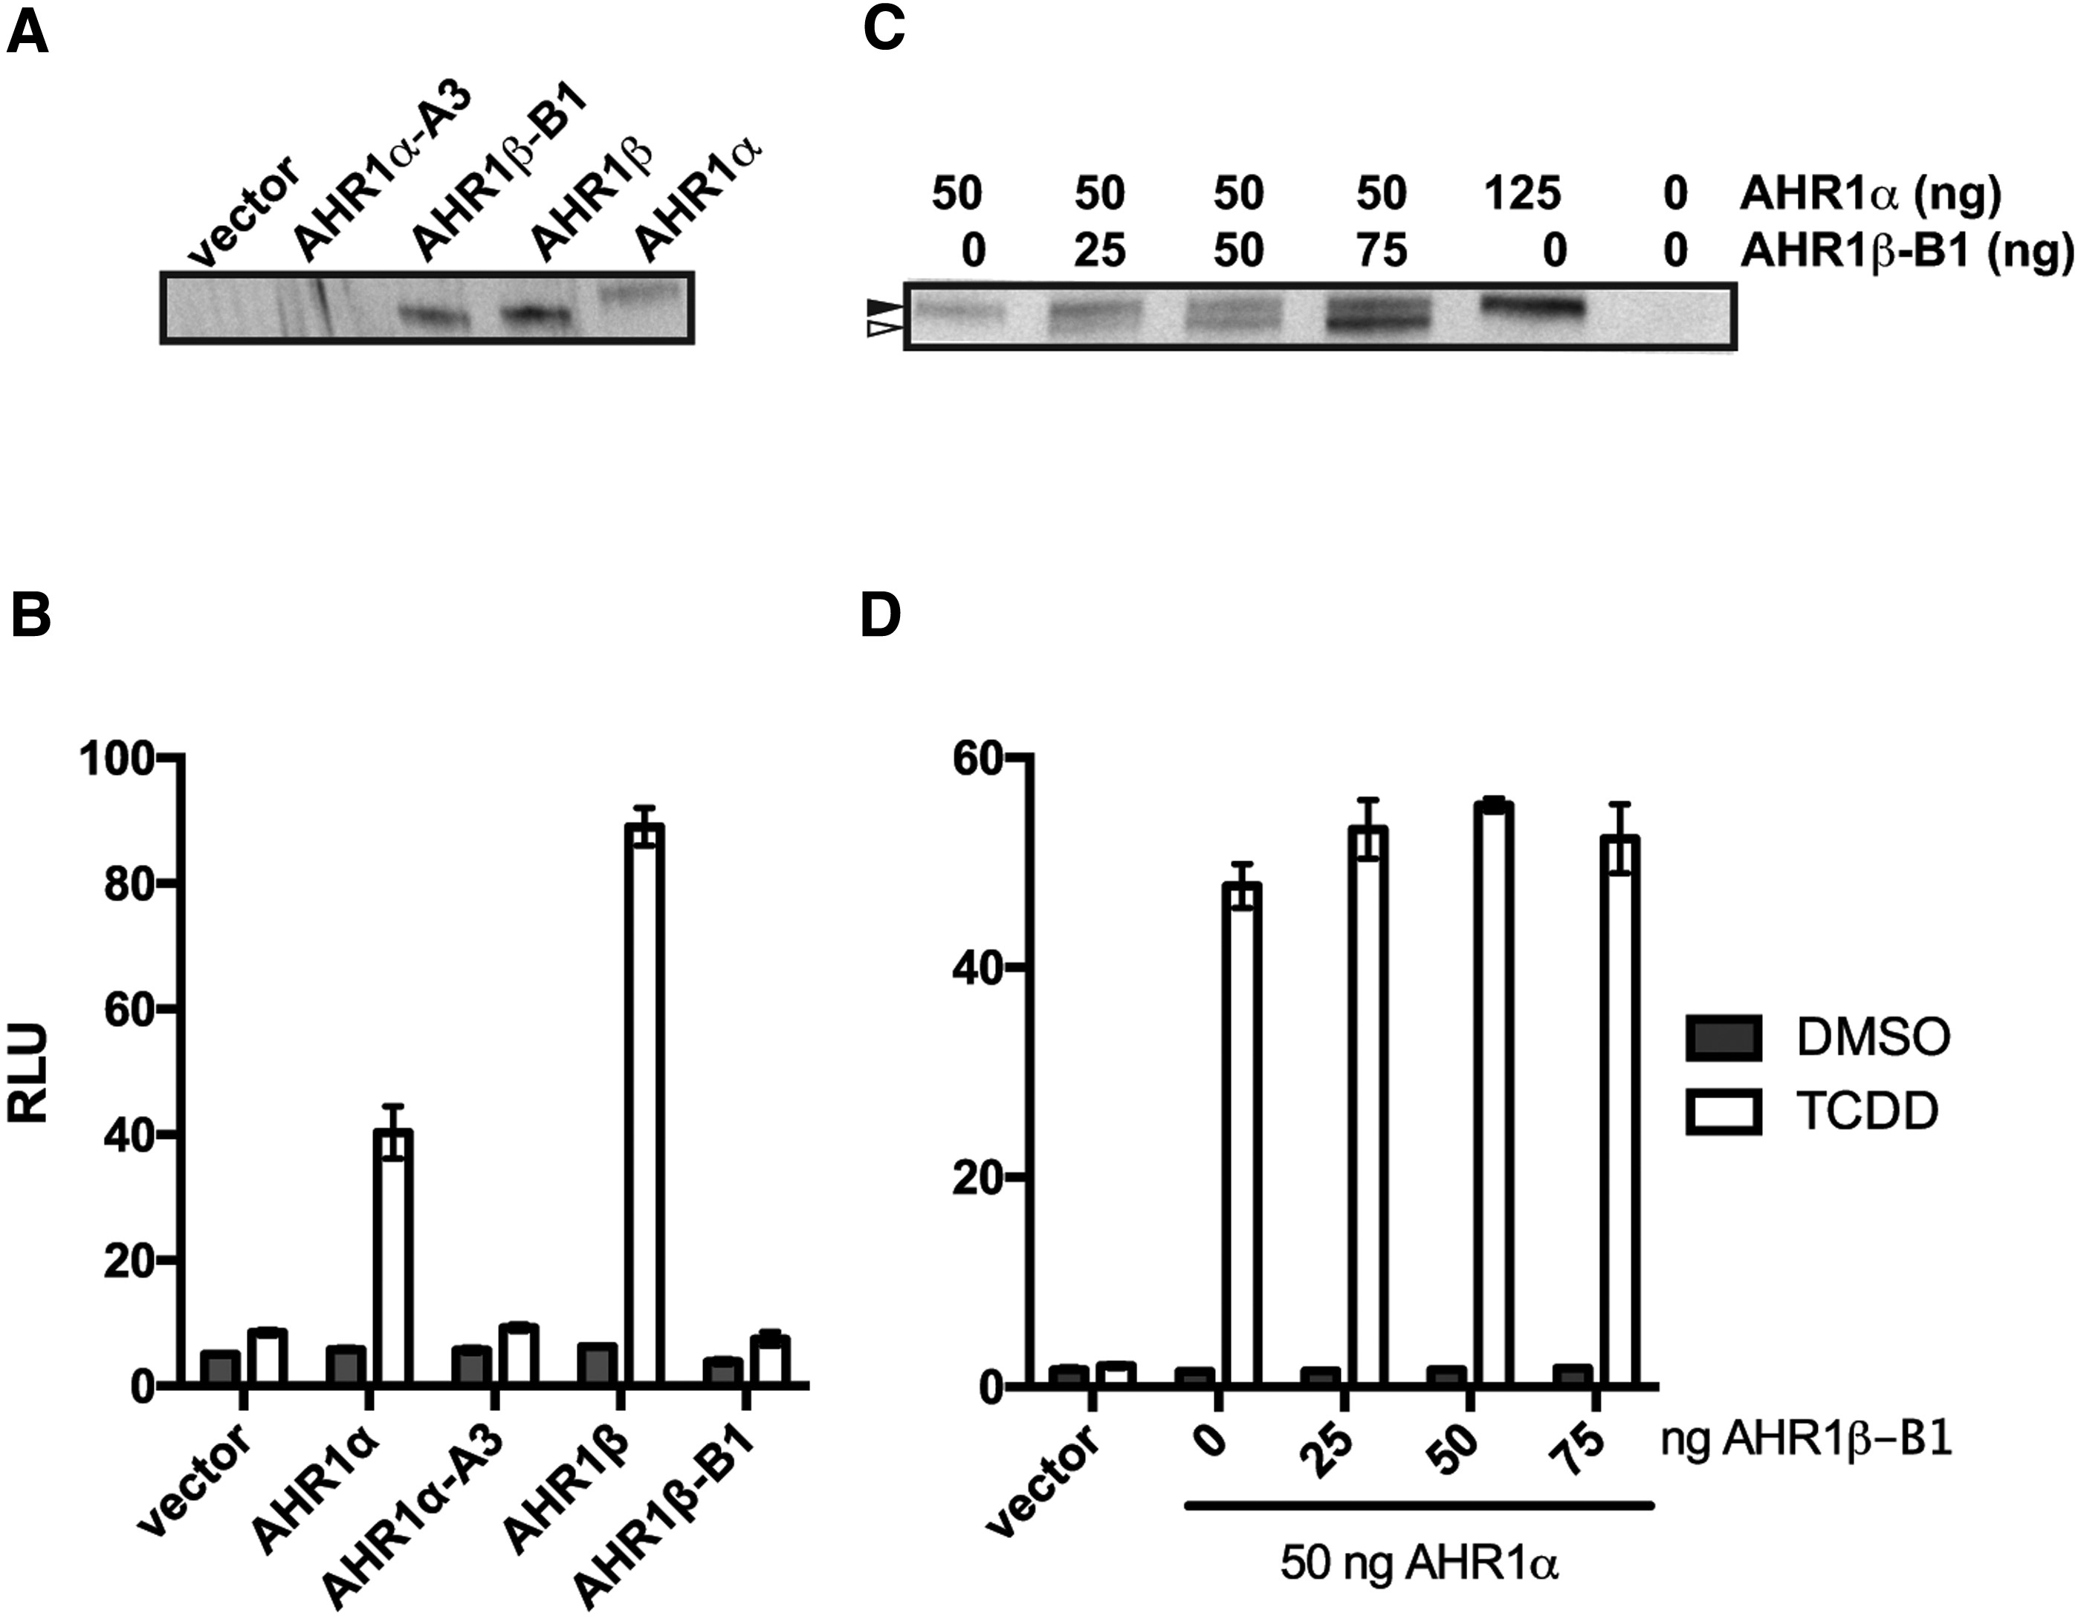
FIG. 3 Mutant AHRs are transcriptionally inactive in response to TCDD. COS-7 cells were treated with 100 nM TCDD or ...
Notes:
FIG. 3 Mutant AHRs are transcriptionally inactive in response to TCDD. COS-7 cells were treated with 100 nM TCDD or DMSO (0.6%) for 18 h beginning 5 h after transfection with AHR and ARNT constructs. Transcriptional activity was measured in triplicate using a luciferase reporter gene driven by a portion of the mouse CYP1A1 enhancer. Transactivation is given by the ratio of reporter-derived luciferase luminescence to that of constitutively expressed Renilla luciferase, reported as RLU. A, Detection of heterologously expressed AHRs by western blotting using antibody SA-210. B, Reporter gene activity. Cells were transfected with 50 ng ARNT and an equal amount of AHR or vector. n = 2 biological replicates. Representative experiment. Error bars = SEM. C, Co-expression of AHR1α (solid arrow) and AHR1β-B1 (open arrow) detected by western blotting. Labels above indicate quantities of each expression plasmid transfected per well. D, Reporter gene activity. Cells were transfected with 50 ng AHR1α expression plasmid and indicated amounts of AHR1β-B1 plasmid. n = 2 biological replicates. Representative experiment is presented. Error bars = SEM.
Unless provided in the caption above, the following copyright applies to the content of this slide: © The Author 2016. Published by Oxford University Press on behalf of the Society of Toxicology. All rights reserved. For Permissions, please e-mail: journals.permissions@oup.com

Slide 4
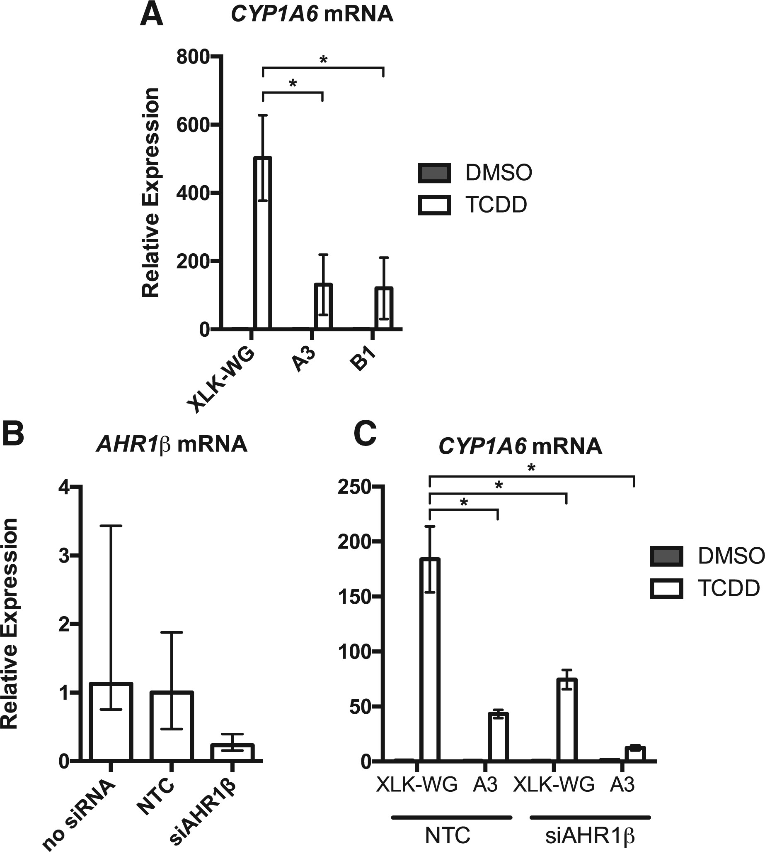
FIG. 4 AHR1α and AHR1β co-regulate CYP1A6 induction by TCDD. A, Cells were treated with 100 nM TCDD or DMSO (0.25%) ...
Notes:
FIG. 4 AHR1α and AHR1β co-regulate CYP1A6 induction by TCDD. A, Cells were treated with 100 nM TCDD or DMSO (0.25%) for 22 h. RNA was harvested, reverse transcribed, and amplified in triplicate using qPCR with β-actin as endogenous control. Relative expression is normalized to mRNA abundance in DMSO-treated XLK-WG cells. Two-way ANOVA with Tukey’s multiple comparisons test. P = .03. n = 3 biological replicates. B, XLK-WG cells were treated with NTC siRNA or siAHR1β. Relative AHR1β expression was measured as described 30 h post-transfection. C, Cells were transfected with NTC or siAHR1β (300 nM) and treated with 100 nM TCDD or DMSO (0.5%) 8 h after transfection. RNA was harvested 30 h following transfection, and CYP1A6 was amplified as described. Two-way ANOVA with Tukey’s multiple comparisons test. P < .0001, n = 3 biological replicates. Error bars = SEM. *P < .01.
Unless provided in the caption above, the following copyright applies to the content of this slide: © The Author 2016. Published by Oxford University Press on behalf of the Society of Toxicology. All rights reserved. For Permissions, please e-mail: journals.permissions@oup.com

Slide 5
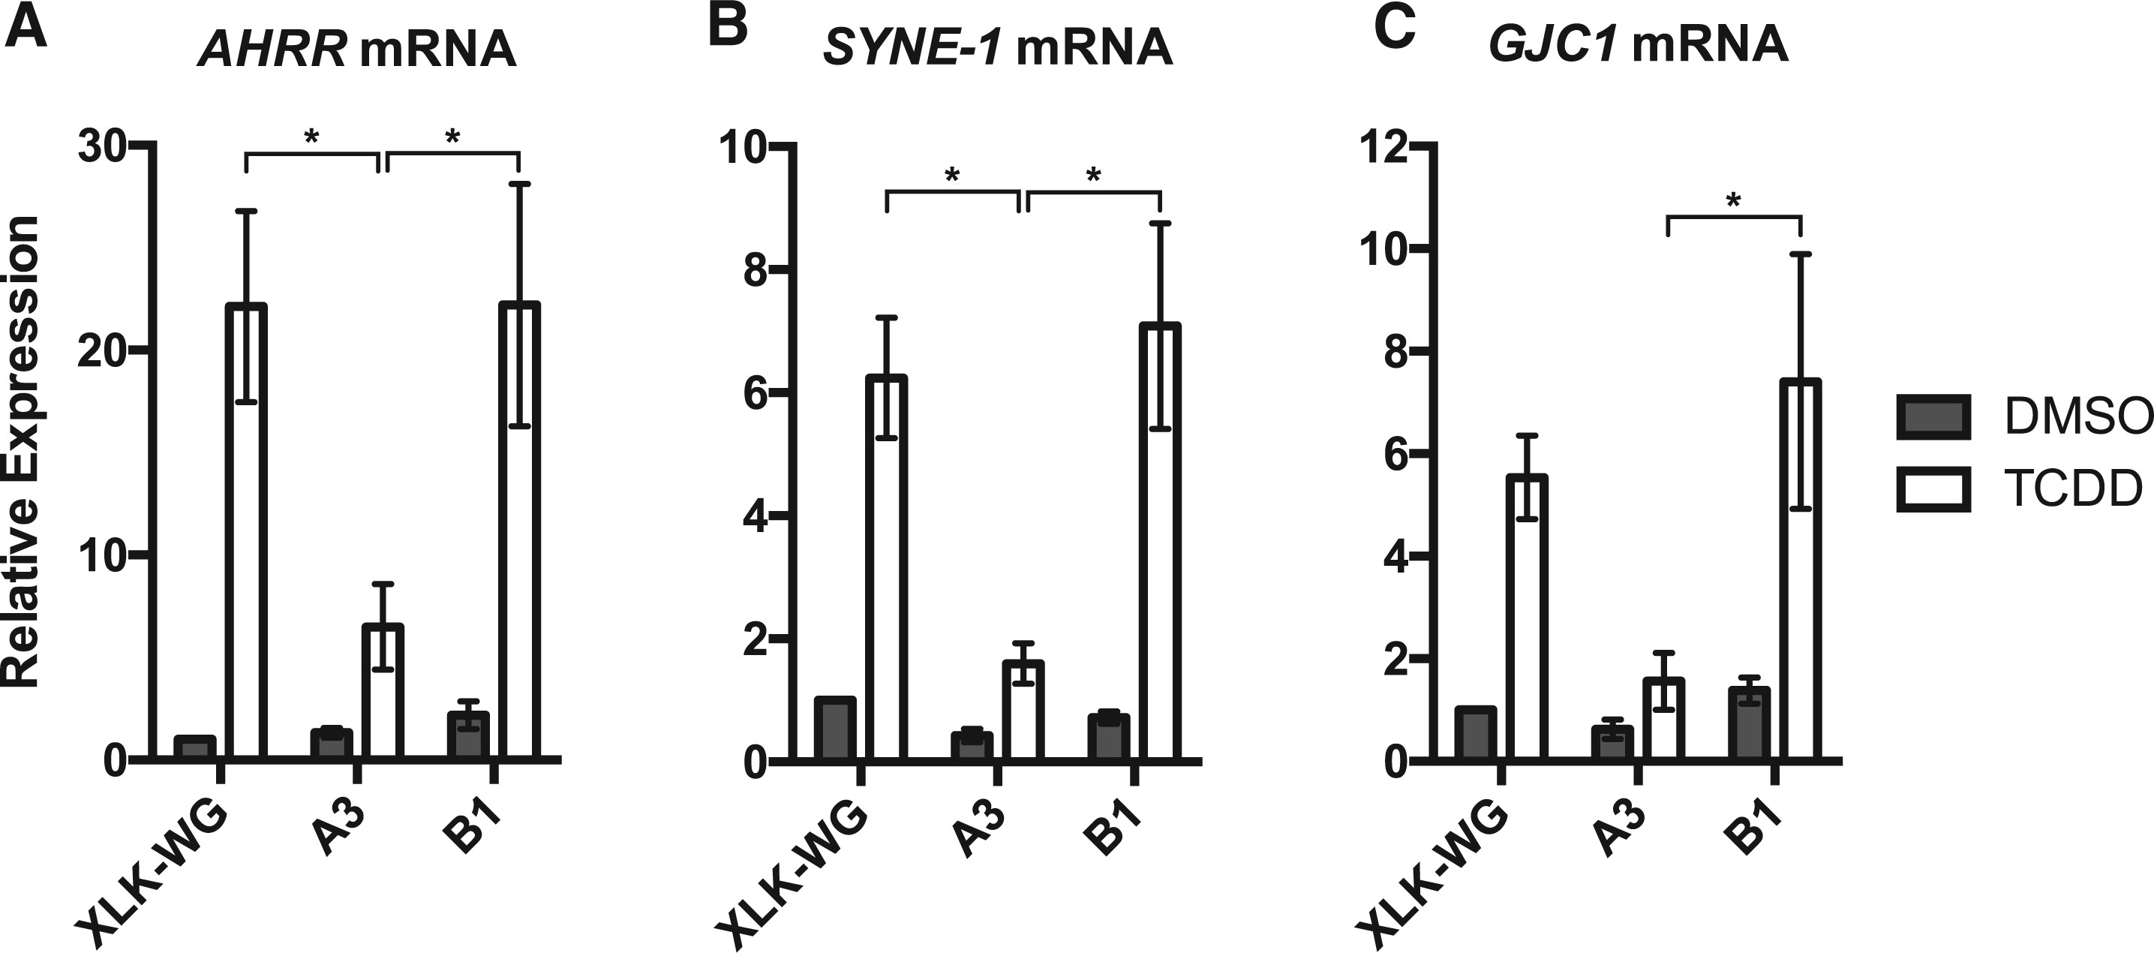
FIG. 5 AHR1α and AHR1β differentially regulate transcription in response to TCDD. Cells were treated with 100 nM ...
Notes:
FIG. 5 AHR1α and AHR1β differentially regulate transcription in response to TCDD. Cells were treated with 100 nM TCDD or DMSO (0.25%). Twenty-two hours after exposure, RNA was harvested, reverse transcribed, and amplified in triplicate using qPCR with β-actin as endogenous control. Relative expression is normalized to mRNA abundance in DMSO-treated XLK-WG cells. A, Two-way ANOVA with Tukey’s multiple comparisons test. P = .043. n = 3 biological replicates. B, Two-way ANOVA with Tukey’s multiple comparisons test. P = .007, n = 3 biological replicates. C, Two-way ANOVA with Tukey’s multiple comparisons test. P = .02. n = 4 biological replicates. Error bars = SEM. *P < .05.
Unless provided in the caption above, the following copyright applies to the content of this slide: © The Author 2016. Published by Oxford University Press on behalf of the Society of Toxicology. All rights reserved. For Permissions, please e-mail: journals.permissions@oup.com

Slide 6
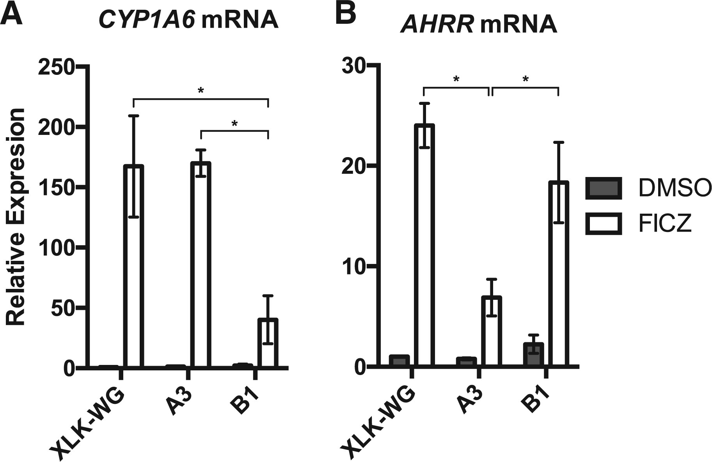
FIG. 6 AHR1α and AHR1β have distinct target gene preferences during FICZ responsiveness. Cells were treated with ...
Notes:
FIG. 6 AHR1α and AHR1β have distinct target gene preferences during FICZ responsiveness. Cells were treated with 100 nM FICZ or DMSO (0.25%). Twenty-two hours after exposure, RNA was harvested, reverse transcribed, and amplified in triplicate using qPCR with β-actin as endogenous control. Relative expression is normalized to mRNA abundance in DMSO-treated XLK-WG cells. A, Two-way ANOVA with Tukey’s multiple comparisons test. P = .009. n = 3 biological replicates. B, Two-way ANOVA with Tukey’s multiple comparisons test. P = .001, n = 4 biological replicates. Error bars = SEM. *P < .05.
Unless provided in the caption above, the following copyright applies to the content of this slide: © The Author 2016. Published by Oxford University Press on behalf of the Society of Toxicology. All rights reserved. For Permissions, please e-mail: journals.permissions@oup.com

Slide 7
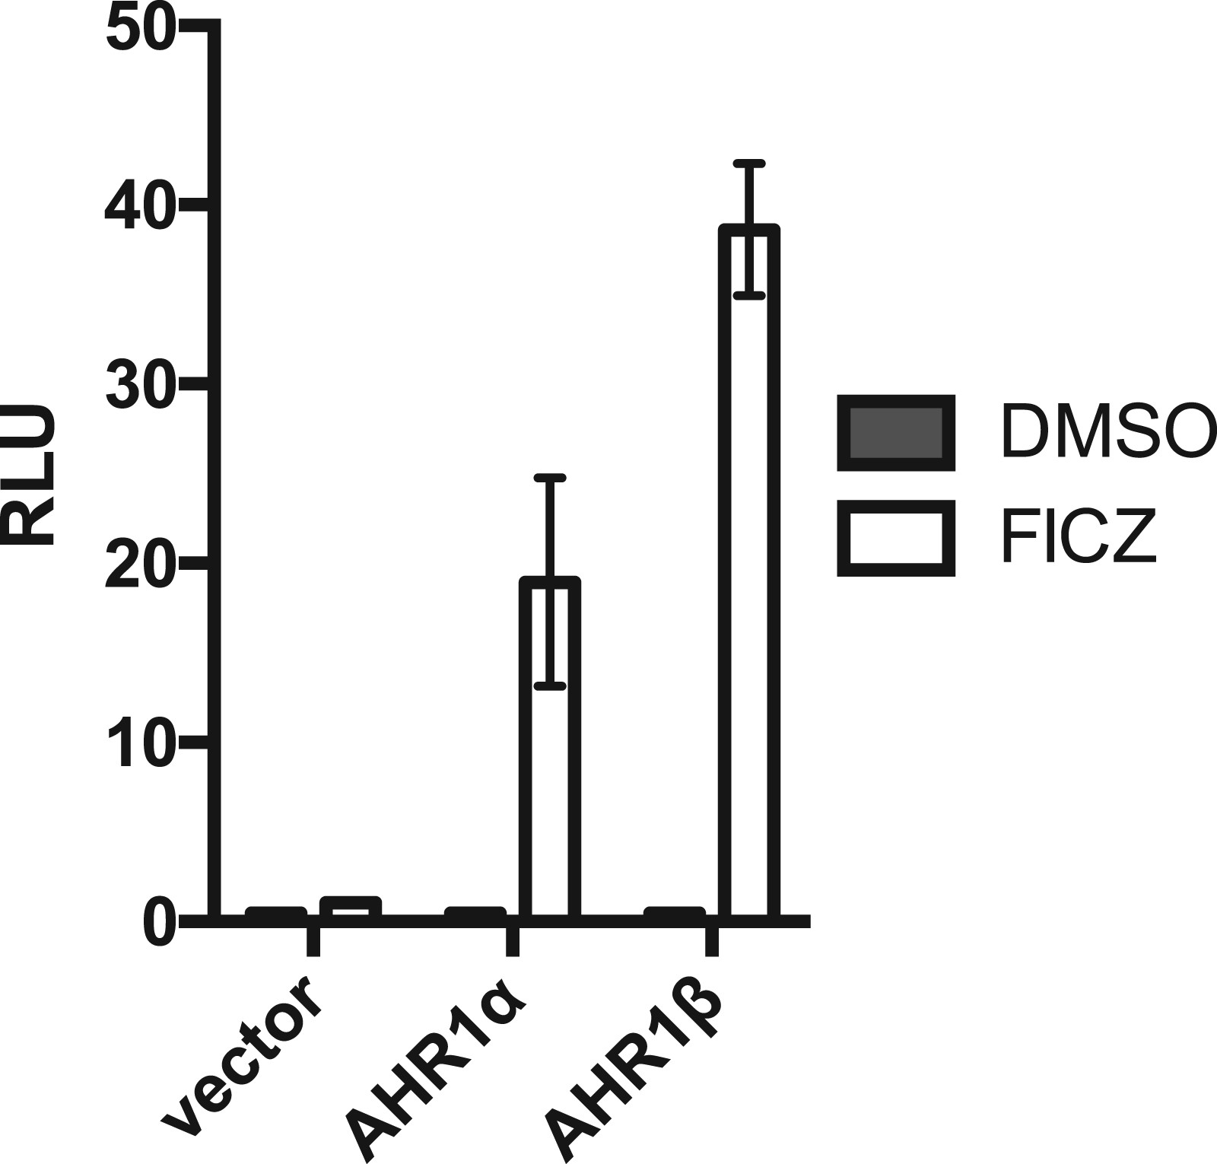
FIG. 7 FICZ induces AHR1α-mediated expression of a CYP1A1-driven reporter gene. COS-7 cells were transfected with ...
Notes:
FIG. 7 FICZ induces AHR1α-mediated expression of a CYP1A1-driven reporter gene. COS-7 cells were transfected with 50 ng ARNT and 50 ng AHR or vector. Five hours after transfection, cells were treated with 100 nM FICZ or DMSO (0.6%) for 18 h. Transcriptional activity was measured in triplicate using a luciferase reporter gene driven by a portion of the mouse CYP1A1 enhancer. Transactivation is given by the ratio of reporter-derived luciferase luminescence to constitutively expressed control Renilla luciferase luminescence, reported as RLUs. n = 2 biological replicates. Representative experiment is depicted. Error bars = SEM.
Unless provided in the caption above, the following copyright applies to the content of this slide: © The Author 2016. Published by Oxford University Press on behalf of the Society of Toxicology. All rights reserved. For Permissions, please e-mail: journals.permissions@oup.com

