Slide 1
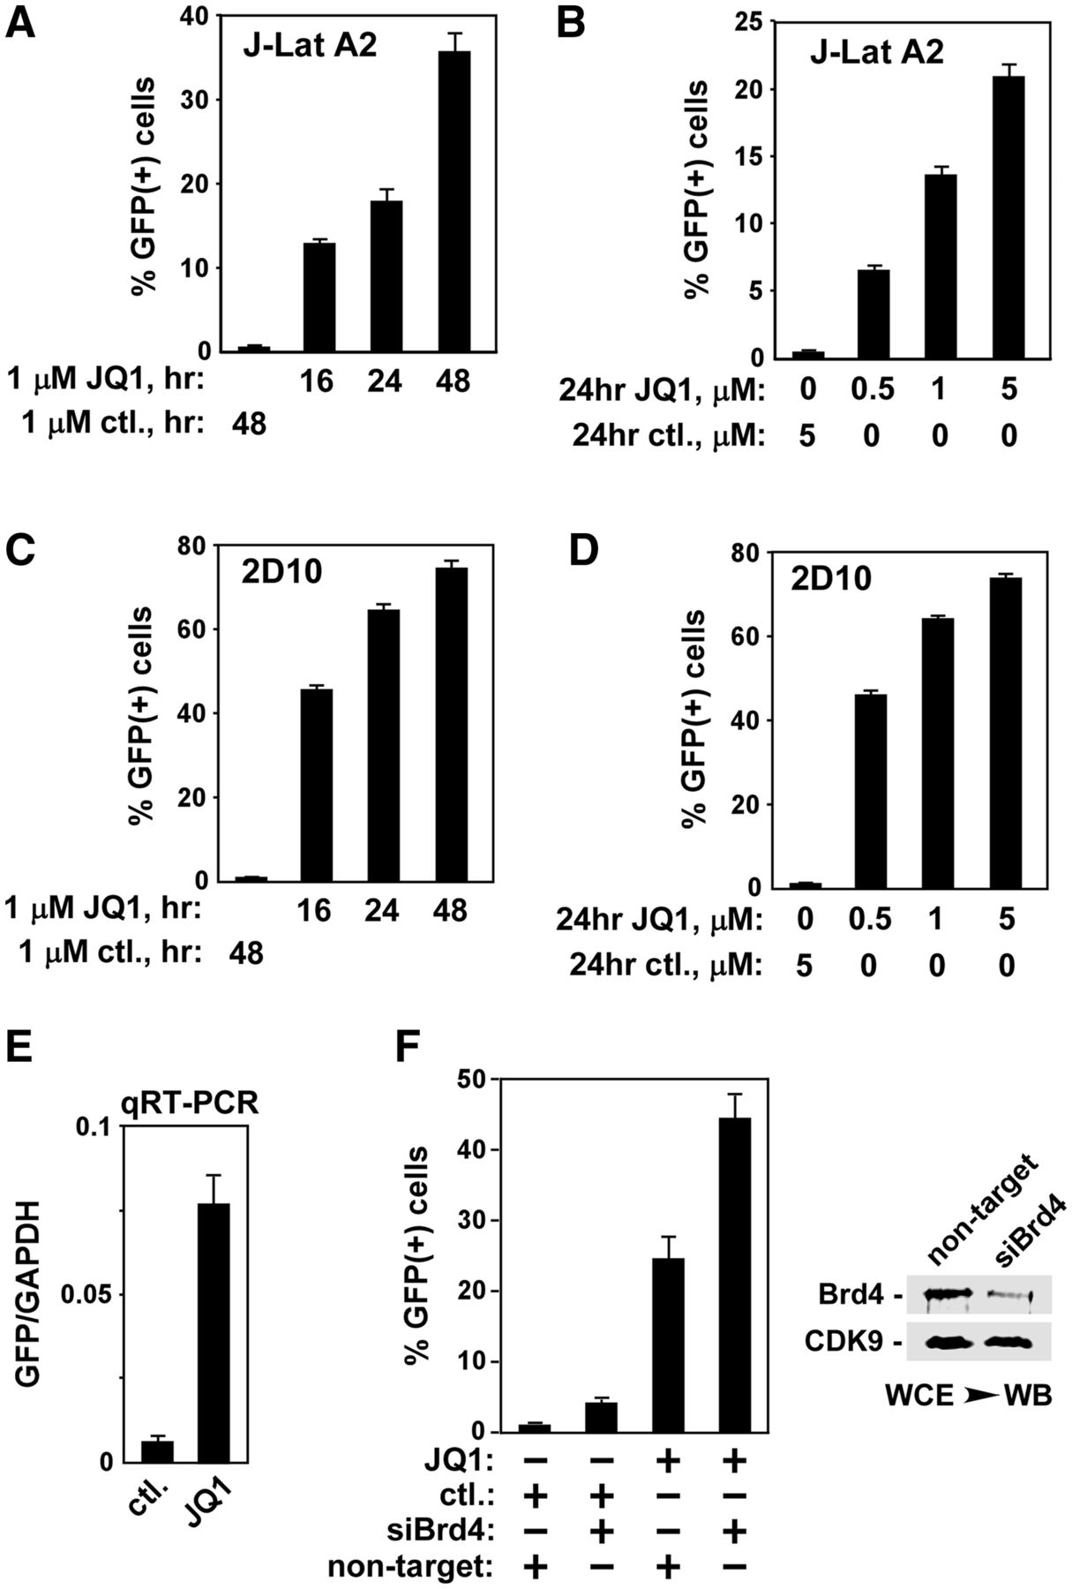
Figure 1. JQ1 activates HIV transcription in latently infected Jurkat T cells, and this effect is further enhanced by ...
Notes:
Figure 1. JQ1 activates HIV transcription in latently infected Jurkat T cells, and this effect is further enhanced by Brd4 KD. (A and B). J-Lat A2 cells were treated with 1 µM of JQ1 or the control enantiomer for the indicated periods of time (A) or for 24 h at the indicated concentrations (B). The induction of GFP expression was measured by flow cytometry (FACS) and expressed as percentages of GFP(+) cells of the entire population. (C and D). 2D10 cells were treated and analysed exactly as in A & B. (E) The ratios of the GFP/GAPDH mRNA levels in treated J-Lat A2 cells were determined by quantitative RT-PCR (qRT-PCR). (F) J-Lat A2 cells were nucleofected with either the Brd4-specific siRNA or a control non-target siRNA and then treated with JQ1 or the control enantiomer as indicated. The extent of Brd4 KD was determined by western blotting (WB) of whole cell extracts (WCE; right panel). The percentages of GFP(+) cells were measured by FACS (left panel). The error bars in all panels represent mean ± SD from three independent experiments.
Unless provided in the caption above, the following copyright applies to the content of this slide: © The Author(s) 2012. Published by Oxford University Press.This is an Open Access article distributed under the terms of the Creative Commons Attribution License (http://creativecommons.org/licenses/by-nc/3.0/), which permits non-commercial reuse, distribution, and reproduction in any medium, provided the original work is properly cited. For commercial re-use, please contact journals.permissions@oup.com.

Slide 2
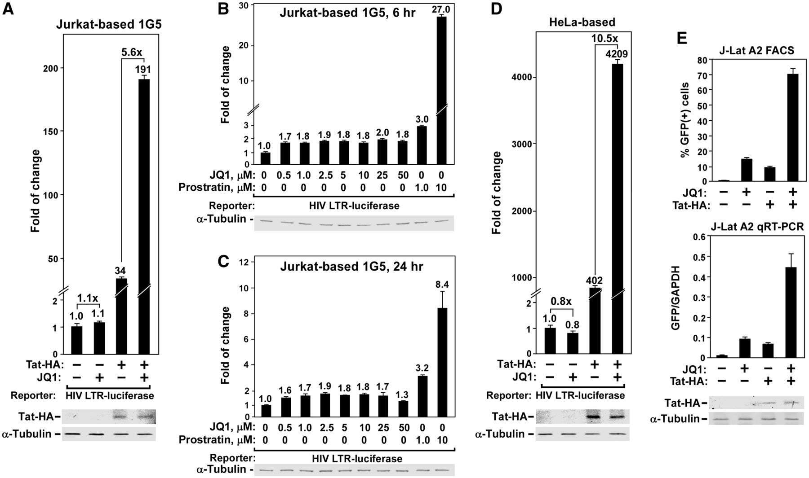
Figure 2. JQ1 stimulates predominantly Tat-dependent HIV transcription in both Jurkat and HeLa cells and ectopically ...
Notes:
Figure 2. JQ1 stimulates predominantly Tat-dependent HIV transcription in both Jurkat and HeLa cells and ectopically expressed Tat is largely insufficient to overcome Brd4 inhibition of Tat-transactivation. (A) The Jurkat-based 1G5 cells containing an integrated HIV LTR-luciferase construct were nucleofected with the vector expressing Tat-HA (+) or nothing (−) and then treated with JQ1 or DMSO (−) as indicated. Whole cell extracts (WCE) were examined for the contained luciferase activities (top panel) and indicated proteins by western blotting (WB, bottom panel). (B and C) 1G5 cells were treated for 6 h (B) or 24 h (C) with the indicated concentrations of JQ1 or prostratin. WCE were examined for luciferase activities (top panels) and α-tubulin levels (bottom panels) as in A. (D) The HeLa-based NH1 cells expressing no Tat (left two columns) and NH2 cells stably expressing Tat-HA (right two columns), with both containing an integrated HIV LTR-luciferase construct, were treated with JQ1 or DMSO (−) and analysed as in A. (E) J-Lat A2 cells were treated as in A and analysed by FACS to determine the percentages of GFP(+) cells (top panel), by qRT-PCR for the GFP/GAPDH mRNA ratios (middle), and by WB for the indicated proteins in WCE (bottom). The error bars in all panels represent mean ± SD from three independent experiments.
Unless provided in the caption above, the following copyright applies to the content of this slide: © The Author(s) 2012. Published by Oxford University Press.This is an Open Access article distributed under the terms of the Creative Commons Attribution License (http://creativecommons.org/licenses/by-nc/3.0/), which permits non-commercial reuse, distribution, and reproduction in any medium, provided the original work is properly cited. For commercial re-use, please contact journals.permissions@oup.com.

Slide 3
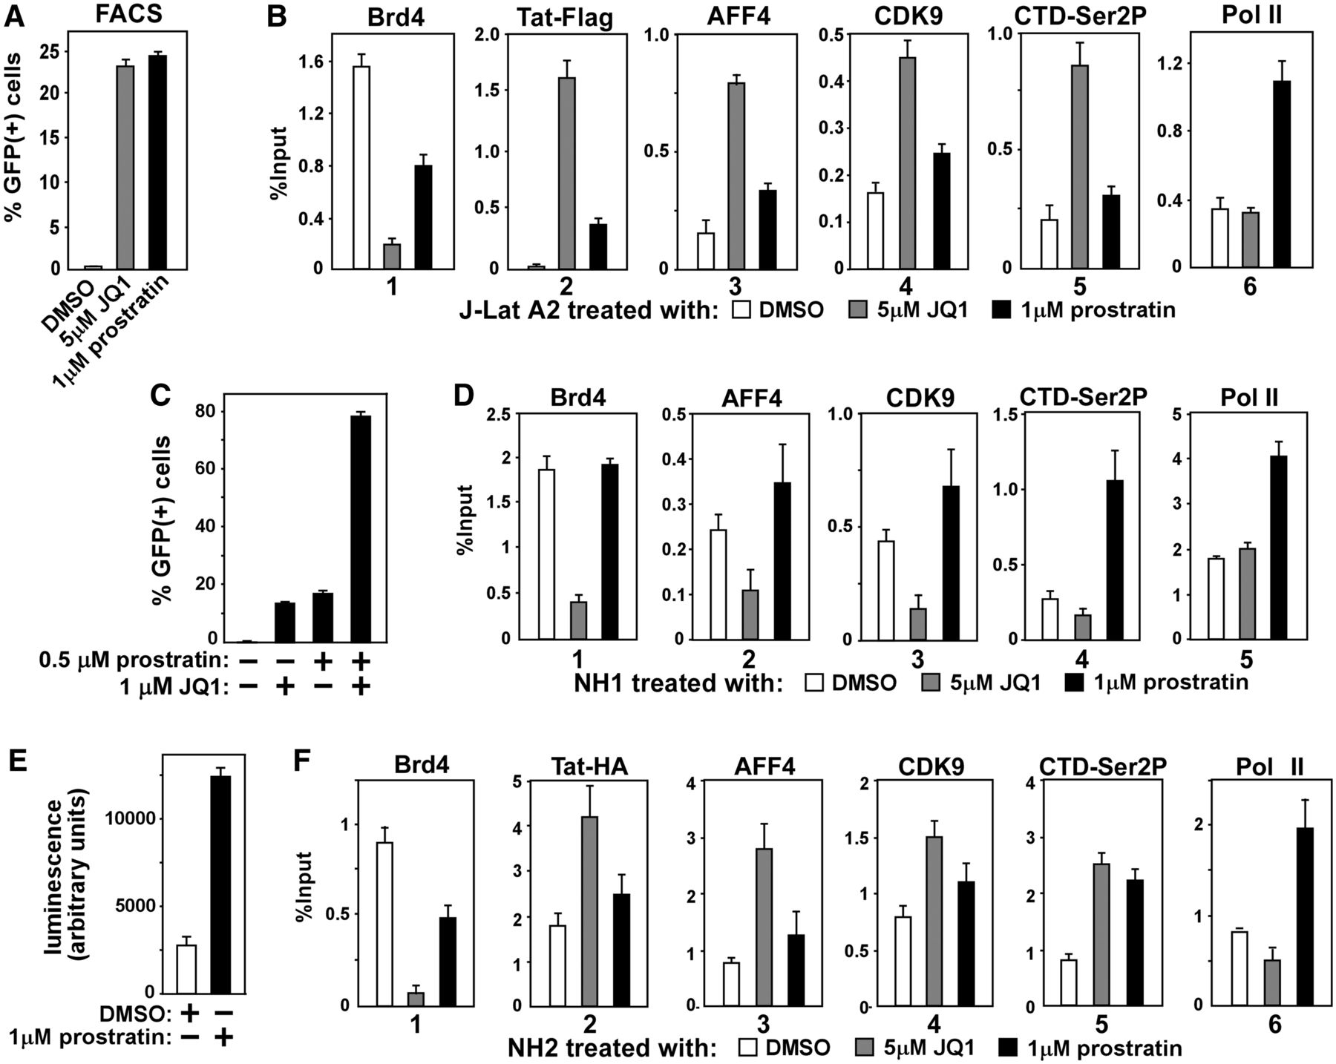
Figure 3. The JQ1-induced Brd4 dissociation enables Tat to recruit SEC to HIV promoter and induce Pol II CTD ...
Notes:
Figure 3. The JQ1-induced Brd4 dissociation enables Tat to recruit SEC to HIV promoter and induce Pol II CTD phosphorylation and viral transcription. (A) J-Lat A2 cells were treated with the indicated reagents and analysed by FACS for the percentages of GFP (+) cells in the population. (B) A2 cells were treated as in A and then subjected to ChIP analysis to determine the levels of the indicated factors bound to the HIV promoter. The signals were normalized to those of input. (C) A2 cells were treated with the indicated agents and analysed for GFP expression as in A. (D) The HeLa-based NH1 cells that contain an integrated HIV LTR-driven luciferase reporter gene, but express no Tat protein, were treated and analysed as in B. (E) Luciferase activities in lysates of NH1 cells treated with the indicated reagents were measured. (F) The HeLa-based NH2 cells stably expressing Tat-HA and containing the integrated HIV LTR-luciferase construct were treated and analysed by ChIP as in B. The error bars in all panels represent mean ± SD from three independent experiments.
Unless provided in the caption above, the following copyright applies to the content of this slide: © The Author(s) 2012. Published by Oxford University Press.This is an Open Access article distributed under the terms of the Creative Commons Attribution License (http://creativecommons.org/licenses/by-nc/3.0/), which permits non-commercial reuse, distribution, and reproduction in any medium, provided the original work is properly cited. For commercial re-use, please contact journals.permissions@oup.com.

Slide 4
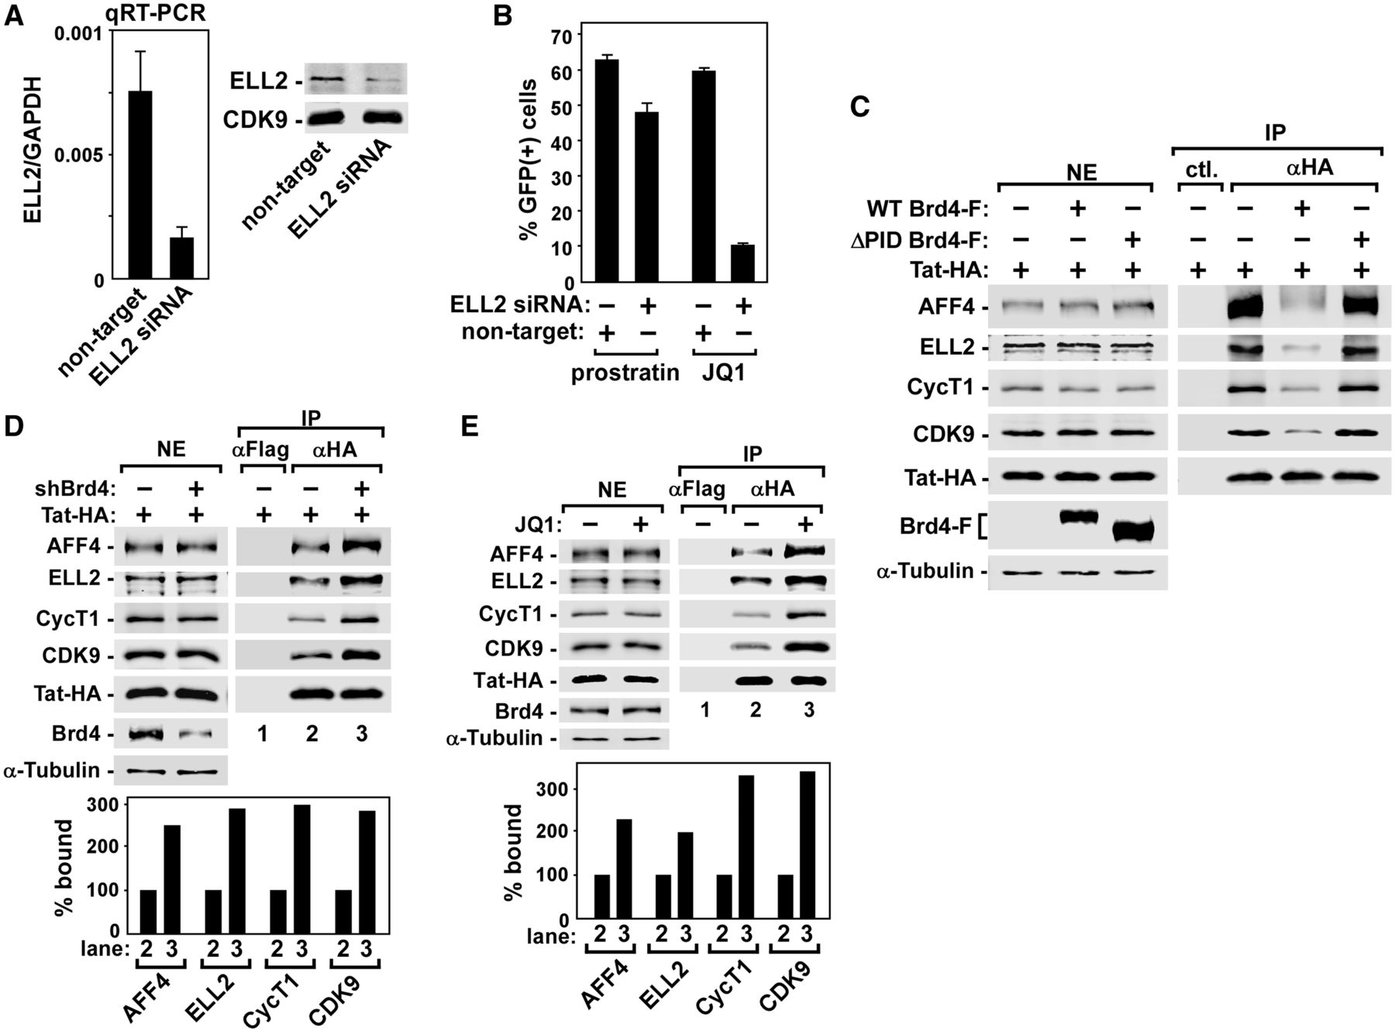
Figure 4. The SEC function is required for JQ1 activation of HIV transcription and Brd4 inhibits Tat-SEC interaction by ...
Notes:
Figure 4. The SEC function is required for JQ1 activation of HIV transcription and Brd4 inhibits Tat-SEC interaction by competing with Tat for binding to P-TEFb on HIV promoter. (A) The ELL2-specific siRNA and a non-target control siRNA were transfected separately into 2D10 cells, and the ELL2 mRNA and protein levels were examined by qRT-PCR (left) and western blotting (right). (B) The same cells in A were examined for the impact of ELL2 KD on induction of GFP production by prostratin and JQ1. The percentages of GFP (+) cells were measured by FACS, and the error bars represent mean ± SD from three independent experiments. (C and D) HeLa cells were transfected with plasmids expressing the indicated proteins or shRNA. Nuclear extracts (NE) and immunoprecipitates (IP) obtained with either the specific (anti-HA) or control antibodies (ctl. IgG or anti-Flag) were examined by western blotting (WB) for the indicated proteins. The indicated SEC components bound to the immunoprecipitated Tat-HA in lanes 2 and 3 of D were quantified, normalized to the signals of Tat-HA and displayed in the bottom panel of D, with the signals in lane 2 artificially set to 100%. (E) HeLa cells transfected with the Tat-HA-expressing construct were treated with (+) or without (−) JQ1, analysed and quantified as in D.
Unless provided in the caption above, the following copyright applies to the content of this slide: © The Author(s) 2012. Published by Oxford University Press.This is an Open Access article distributed under the terms of the Creative Commons Attribution License (http://creativecommons.org/licenses/by-nc/3.0/), which permits non-commercial reuse, distribution, and reproduction in any medium, provided the original work is properly cited. For commercial re-use, please contact journals.permissions@oup.com.

Slide 5
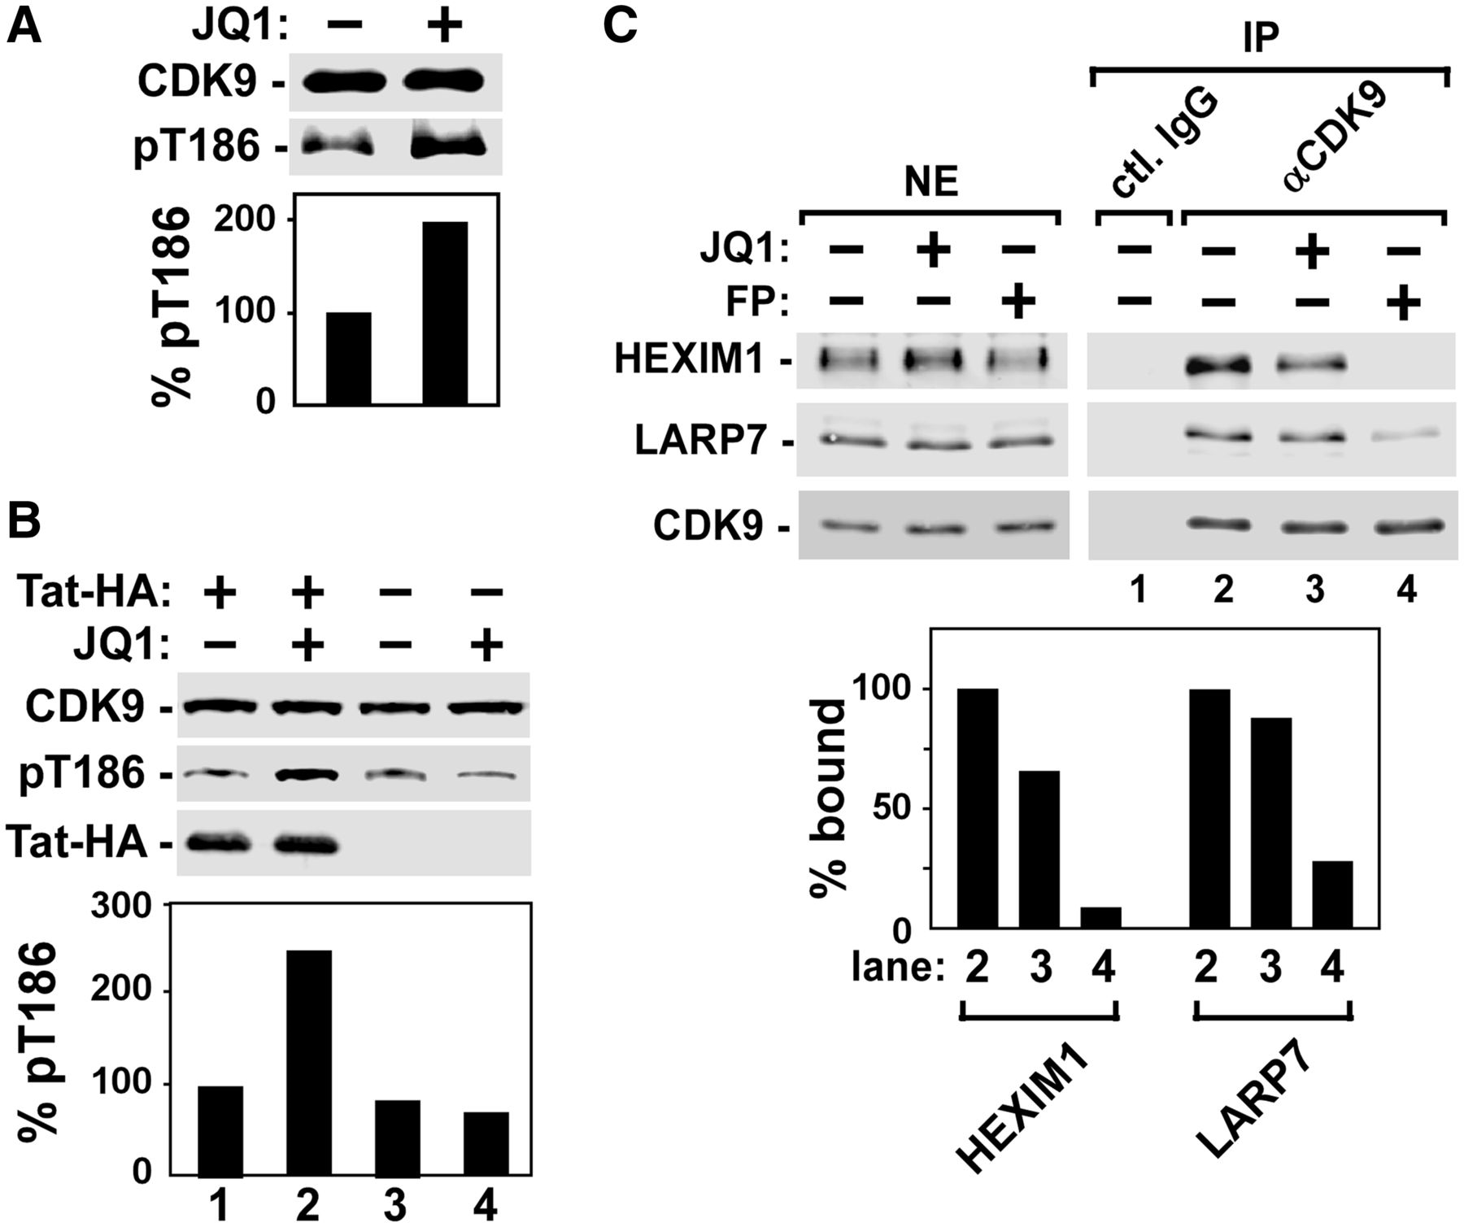
Figure 5. JQ1 enables Tat to increase CDK9 T-loop phosphorylation and partially dissociates P-TEFb from 7SK snRNP in ...
Notes:
Figure 5. JQ1 enables Tat to increase CDK9 T-loop phosphorylation and partially dissociates P-TEFb from 7SK snRNP in Jurkat T cells. (A) The total CDK9 levels and the extent of CDK9 phosphorylation on Thr186 (pT186) were examined by Western analysis of affinity-purified CDK9 derived from J-Lat A2 cells treated with (+) or without (−) JQ1. The pT186 levels were quantified, normalized to those of total CDK9 and shown at the bottom, with the level in untreated cells set to 100%. (B) CDK9 affinity-purified from HeLa cells expressing Tat-HA or not and treated with or without JQ1 were analysed and quantified as in A for the phosphorylation on T186. The levels of Tat-HA in cell lysates were detected by anti-HA western blotting (WB). (C) Nuclear extracts (NE) of Jurkat cells untreated (−) or treated with JQ1 or flavopiridol (FP) were analysed by WB for the indicated proteins (left panel). Immunoprecipitates (IP) derived from NE with the indicated antibodies were examined by WB for the indicated proteins (right panel). The amounts of HEXIM1 and LARP7 bound to immunoprecipitated CDK9 were quantified, normalized to CDK9 and shown at the bottom, with the levels in untreated cells (lane 2) set to 100%.
Unless provided in the caption above, the following copyright applies to the content of this slide: © The Author(s) 2012. Published by Oxford University Press.This is an Open Access article distributed under the terms of the Creative Commons Attribution License (http://creativecommons.org/licenses/by-nc/3.0/), which permits non-commercial reuse, distribution, and reproduction in any medium, provided the original work is properly cited. For commercial re-use, please contact journals.permissions@oup.com.

Slide 6
Figure 6. Diagram depicting Brd4 suppression of Tat-transactivation as a key inhibitory factor of HIV transcription and ...
Notes:
Figure 6. Diagram depicting Brd4 suppression of Tat-transactivation as a key inhibitory factor of HIV transcription and JQ1 as an effective antagonizer of this inhibition. Without JQ1, the HIV promoter-bound Brd4 (through interacting with acetylated histones, or Ac) competitively blocks the interaction of Tat with P-TEFb and prevents Tat from assembling a functional SEC. This leads to abortive transcriptional elongation. JQ1 dissociates Brd4 from the viral promoter to allow Tat to bind to P-TEFb and assemble a SEC on the TAR stem-loop structure for phosphorylation of the Pol II CTD and activation of productive elongation. Additionally, JQ1 also partially releases P-TEFb from the 7SK snRNP, providing another source of P-TEFb for SEC assembly at the promoter.
Unless provided in the caption above, the following copyright applies to the content of this slide: © The Author(s) 2012. Published by Oxford University Press.This is an Open Access article distributed under the terms of the Creative Commons Attribution License (http://creativecommons.org/licenses/by-nc/3.0/), which permits non-commercial reuse, distribution, and reproduction in any medium, provided the original work is properly cited. For commercial re-use, please contact journals.permissions@oup.com.

