Slide 1
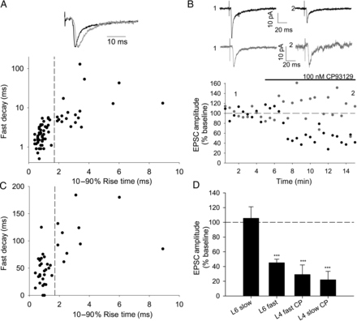
Figure 1. 5-HT_{1B} agonist CP93129 inhibits thalamic-evoked L6 excitatory postsynaptic currents (EPSCs) with ...
Notes:
Figure 1. 5-HT1B agonist CP93129 inhibits thalamic-evoked L6 excitatory postsynaptic currents (EPSCs) with fast but not slow kinetics. (A) L6 thalamic-evoked EPSCs showing fast (black) and slow (gray) kinetics scaled to peak amplitude. Graph shows 10–90% rise time and fast decay (fast τ from a double exponential fit) for L6 EPSCs on a subset of which CP93129 was tested. Fast population (τfast 2.3 ± 0.2 ms, 10–90% rise time 0.8 ± 0.04, n = 51) and slow population (τfast 15.2 ± 6.4 ms, 10–90% rise time 3.1 ± 0.4, n = 21). Dashed line indicates rise time of 1.7 ms used to separate fast and slow populations. (B) Example experiments showing the effect of 100 nM CP93129 on fast (black) and slow (gray) EPSCs in L6. Traces show the average of 30 traces before (1) and after (2) application of CP93129 at time points shown. Points on this amplitude versus time plot and plot in B show peak amplitude of an average of 3 consecutive traces. Stimulus artifacts in this and following figures have been truncated. (C) Graph showing rise time versus EPSC amplitude as % baseline in CP93129 of all L6 cells tested. Dashed line indicates rise time of 1.7 ms used to separate fast and slow populations. (D) Summary graph showing the effect of CP93129 in conditions stated. ***P < 0.005.
Unless provided in the caption above, the following copyright applies to the content of this slide: © The Author 2014. Published by Oxford University Press.This is an Open Access article distributed under the terms of the Creative Commons Attribution License (http://creativecommons.org/licenses/by/3.0/), which permits unrestricted reuse, distribution, and reproduction in any medium, provided the original work is properly cited.

Slide 2
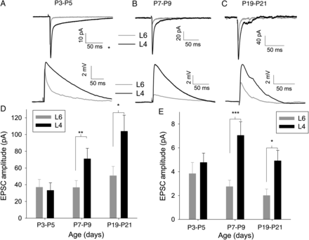
Figure 2. TC input to L4 increases relative to L6 during the first postnatal week. (A) Example traces showing an ...
Notes:
Figure 2. TC input to L4 increases relative to L6 during the first postnatal week. (A) Example traces showing an average of 15 TC EPSCs (upper) and excitatory postsynaptic potentials (EPSPs) (lower) in simultaneously recorded cells from mice aged P3–P5 in L4 (black) and L6 (gray). (B) As for A except mice aged P7–P9. (C) As for A except mice aged P19–P21. (D) Summary graph showing change in EPSC amplitude throughout the first week in L4 (black) and L6 (gray). (E) Summary graph showing change in EPSP amplitude throughout first week rise time throughout first week. *P < 0.5, **P < 0.01, ***P < 0.005.
Unless provided in the caption above, the following copyright applies to the content of this slide: © The Author 2014. Published by Oxford University Press.This is an Open Access article distributed under the terms of the Creative Commons Attribution License (http://creativecommons.org/licenses/by/3.0/), which permits unrestricted reuse, distribution, and reproduction in any medium, provided the original work is properly cited.

Slide 3
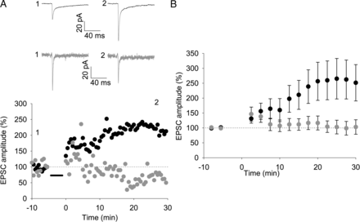
Figure 3. A pairing protocol induces LTP in L4 but not in L6 cells. (A) Upper panel: example traces from simultaneously ...
Notes:
Figure 3. A pairing protocol induces LTP in L4 but not in L6 cells. (A) Upper panel: example traces from simultaneously recorded L4 (black) and L6 (gray) cells before (1) and after (2) pairing 50 stimuli at 0.2 Hz with a postsynaptic holding potential of 0 mV. Traces show an average of 3 sweeps. Lower panel: amplitude versus time plot for EPSCs from cells shown in A. Points in graph show peak amplitude from an average of 3 traces. (B) Summary graph showing the average of all experiments as shown in (A). Points show the average of 5 values as shown in (A).
Unless provided in the caption above, the following copyright applies to the content of this slide: © The Author 2014. Published by Oxford University Press.This is an Open Access article distributed under the terms of the Creative Commons Attribution License (http://creativecommons.org/licenses/by/3.0/), which permits unrestricted reuse, distribution, and reproduction in any medium, provided the original work is properly cited.

Slide 4
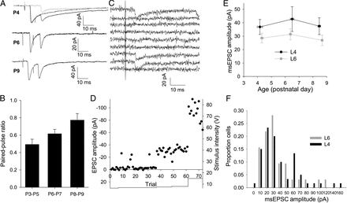
Figure 4. TC EPSCs evoked by minimal stimulation do not alter with age not true. (A) Example traces (average of 20 ...
Notes:
Figure 4. TC EPSCs evoked by minimal stimulation do not alter with age not true. (A) Example traces (average of 20 traces) showing paired stimuli at 100 Hz at different ages. Dotted line in top trace shows peak-scaled EPSC from interleaved trails. Gray line shows subtracted trace used to calculate peak of second EPSC. (B) Summary graph showing paired-pulse ratio at 100 Hz at P3–P5, P6–P7, and P8–P9. (C) Traces from 10 consecutive trials in an L4 cell with minimal TC stimulation intensity. In this case, 3 of the 10 trials evoked an EPSC. (D) Amplitude versus time plot for the experiment shown in (C). Points show peak amplitude for individual trials. Solid line shows stimulation intensity. (E) Summary graph showing EPSC amplitude from all minimal stimulation experiments in L4 (black) and L6 (gray) cells (L4 P3–P5 37 ± 6 pA, n = 18, P6–P7 43 ± 9 pA, n = 16, P8–P9 37 ± 6 pA, n = 26; L6 P3–P5 29 ± 4 pA, n = 35, P6–P7 31 ± 4 pA, n = 40, P8–P9 27 ± 4 pA, n = 36). (F) Amplitude distributions of msEPSC amplitude in all L4 (black) and L6 (gray) cells.
Unless provided in the caption above, the following copyright applies to the content of this slide: © The Author 2014. Published by Oxford University Press.This is an Open Access article distributed under the terms of the Creative Commons Attribution License (http://creativecommons.org/licenses/by/3.0/), which permits unrestricted reuse, distribution, and reproduction in any medium, provided the original work is properly cited.

Slide 5
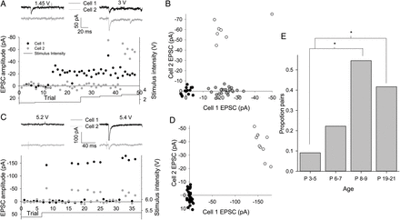
Figure 5. Increase in the proportion of L4 cells contacted by single TC axons with age. (A) Example experiment with 2 ...
Notes:
Figure 5. Increase in the proportion of L4 cells contacted by single TC axons with age. (A) Example experiment with 2 simultaneously recorded L4 cells during minimal TC stimulation. Traces show responses in cell 1 (black) and cell 2 (gray) to TC stimulation at intensity indicated. Lower panel shows amplitude and stimulus intensity versus trial no. plot for both cells. Note the failures in cell 2 on trials producing EPSCs in cell 1. (B) EPSC versus EPSC plot for all trials involving 2 cells shown in A (black circles no EPSC, gray circles EPSC in cell 1 only, and open circles EPSC in both cells). (C) As for A but 2 cells respond to same trial stimuli. (D) EPSC versus EPSC plot for all trials involving 2 cells shown in C (black circles no EPSC and open circles EPSC in both cells). (E) Bar graph showing the proportion of cell pairs responding to the same trials during minimal stimulation versus age. *P < 0.05.
Unless provided in the caption above, the following copyright applies to the content of this slide: © The Author 2014. Published by Oxford University Press.This is an Open Access article distributed under the terms of the Creative Commons Attribution License (http://creativecommons.org/licenses/by/3.0/), which permits unrestricted reuse, distribution, and reproduction in any medium, provided the original work is properly cited.

Slide 6
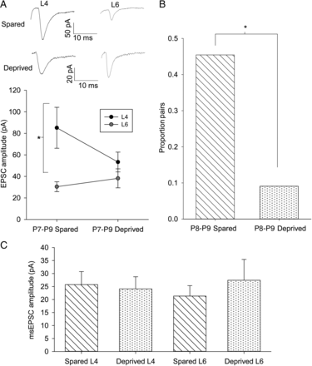
Figure 6. An increase in TC-L4 connectivity is experience-dependent. (A) Example traces and summary plot of ...
Notes:
Figure 6. An increase in TC-L4 connectivity is experience-dependent. (A) Example traces and summary plot of simultaneously recorded cells in L4 (black) and L6 (gray) in sensory-deprived and -spared hemispheres from P7 to P9 mice. (B) Summary graph showing the proportion of L4 cells pairs responding to same TC axon during minimal stimulation. * P < 0.05. (C) Summary graph showing minimal stimulation EPSC amplitudes in L4 and L6 in spared and deprived hemispheres.
Unless provided in the caption above, the following copyright applies to the content of this slide: © The Author 2014. Published by Oxford University Press.This is an Open Access article distributed under the terms of the Creative Commons Attribution License (http://creativecommons.org/licenses/by/3.0/), which permits unrestricted reuse, distribution, and reproduction in any medium, provided the original work is properly cited.

Slide 7
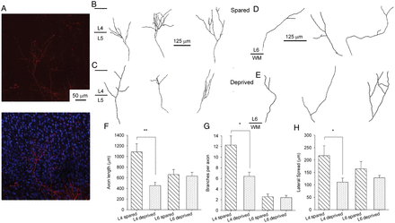
Figure 7. TC axon branching is reduced in deprived cortex. (A) Example images showing DiI labeling (red) of TC axons in ...
Notes:
Figure 7. TC axon branching is reduced in deprived cortex. (A) Example images showing DiI labeling (red) of TC axons in cortex with overlaid Topro labeling (right image, blue) to identify cortical layers. (B) Example traced axons in L4 from the spared hemisphere. Middle tracing taken from image shown in A. (C) Example axon traces from L4 in the deprived hemisphere. (D) Example axon traces from L6 in the spared hemisphere. (E) Example axon traces from L6 in the deprived hemisphere. (F) Bar graph showing mean total TC axon length in L4 and L6 in both deprived and spared hemispheres. (G) Bar graph showing the mean lateral spread of TC axons in both deprived and spared hemispheres. (H) Bar graph showing the mean number of TC axon branches in L4 in deprived and spared hemispheres. * P < 0.05, **P < 0.005.
Unless provided in the caption above, the following copyright applies to the content of this slide: © The Author 2014. Published by Oxford University Press.This is an Open Access article distributed under the terms of the Creative Commons Attribution License (http://creativecommons.org/licenses/by/3.0/), which permits unrestricted reuse, distribution, and reproduction in any medium, provided the original work is properly cited.

Slide 8
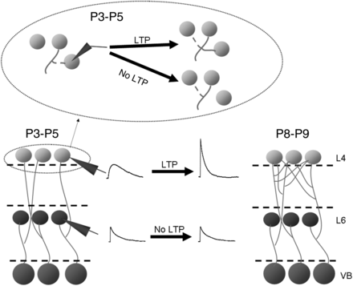
Figure 8. Development of TC Input to L4 and L6. Diagrammatic representation of findings showing the speeding of L4 TC ...
Notes:
Figure 8. Development of TC Input to L4 and L6. Diagrammatic representation of findings showing the speeding of L4 TC EPSP kinetics and increase in amplitude resulting from LTP and an increase in the number of L4 cells contacted by each TC axon and the lack of relative change in L6 TC EPSP properties. The inset above shows that temporary synaptic contacts are made repeatedly in L4 during the P3–P5 period and only retained if that synapse undergoes LTP.
Unless provided in the caption above, the following copyright applies to the content of this slide: © The Author 2014. Published by Oxford University Press.This is an Open Access article distributed under the terms of the Creative Commons Attribution License (http://creativecommons.org/licenses/by/3.0/), which permits unrestricted reuse, distribution, and reproduction in any medium, provided the original work is properly cited.

