Slide 1
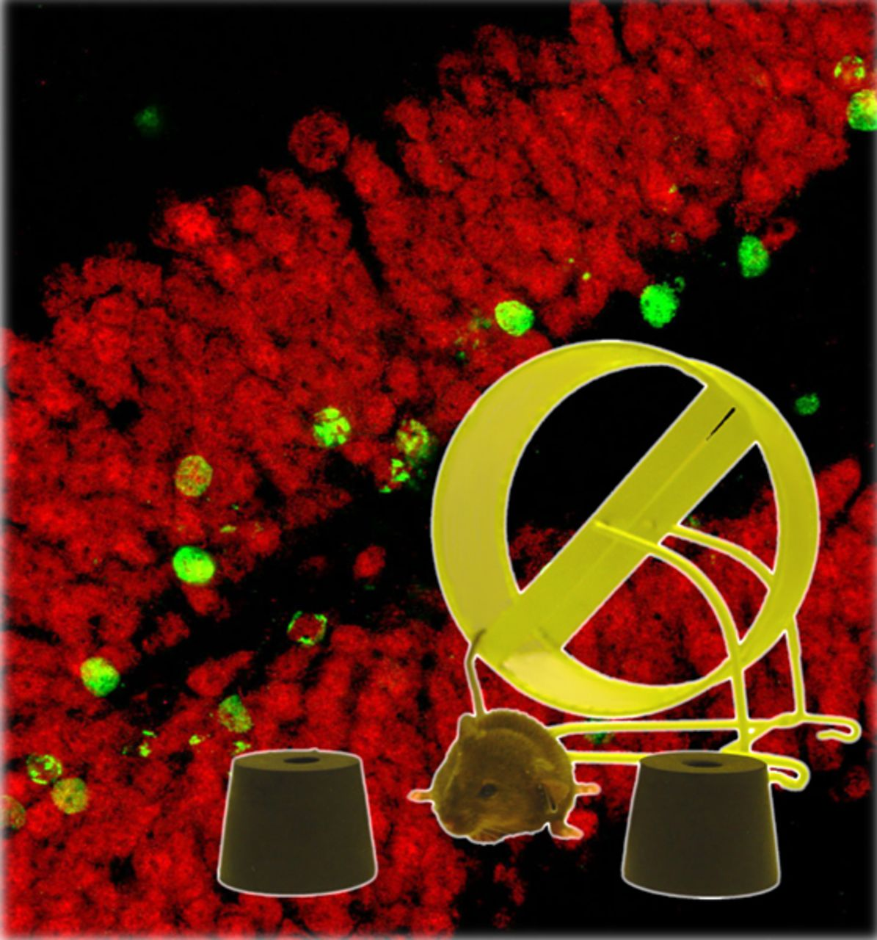
Physical activity can offer protection against cognitive decline and neurodegenerative diseases, but whether ...
Notes:
Physical activity can offer protection against cognitive decline and neurodegenerative diseases, but whether it slows the trajectory of normal ageing or boosts plasticity above and beyond preservation of function is unclear. Duzel et al. examine the evidence that exercise improves hippocampal plasticity in ageing and discuss avenues for future research.
Unless provided in the caption above, the following copyright applies to the content of this slide: © The Author (2016). Published by Oxford University Press on behalf of the Guarantors of Brain. This is an Open Access article distributed under the terms of the Creative Commons Attribution Non-Commercial License ( http://creativecommons.org/licenses/by-nc/4.0/ ), which permits non-commercial re-use, distribution, and reproduction in any medium, provided the original work is properly cited. For commercial re-use, please contact journals.permissions@oup.com

Slide 2
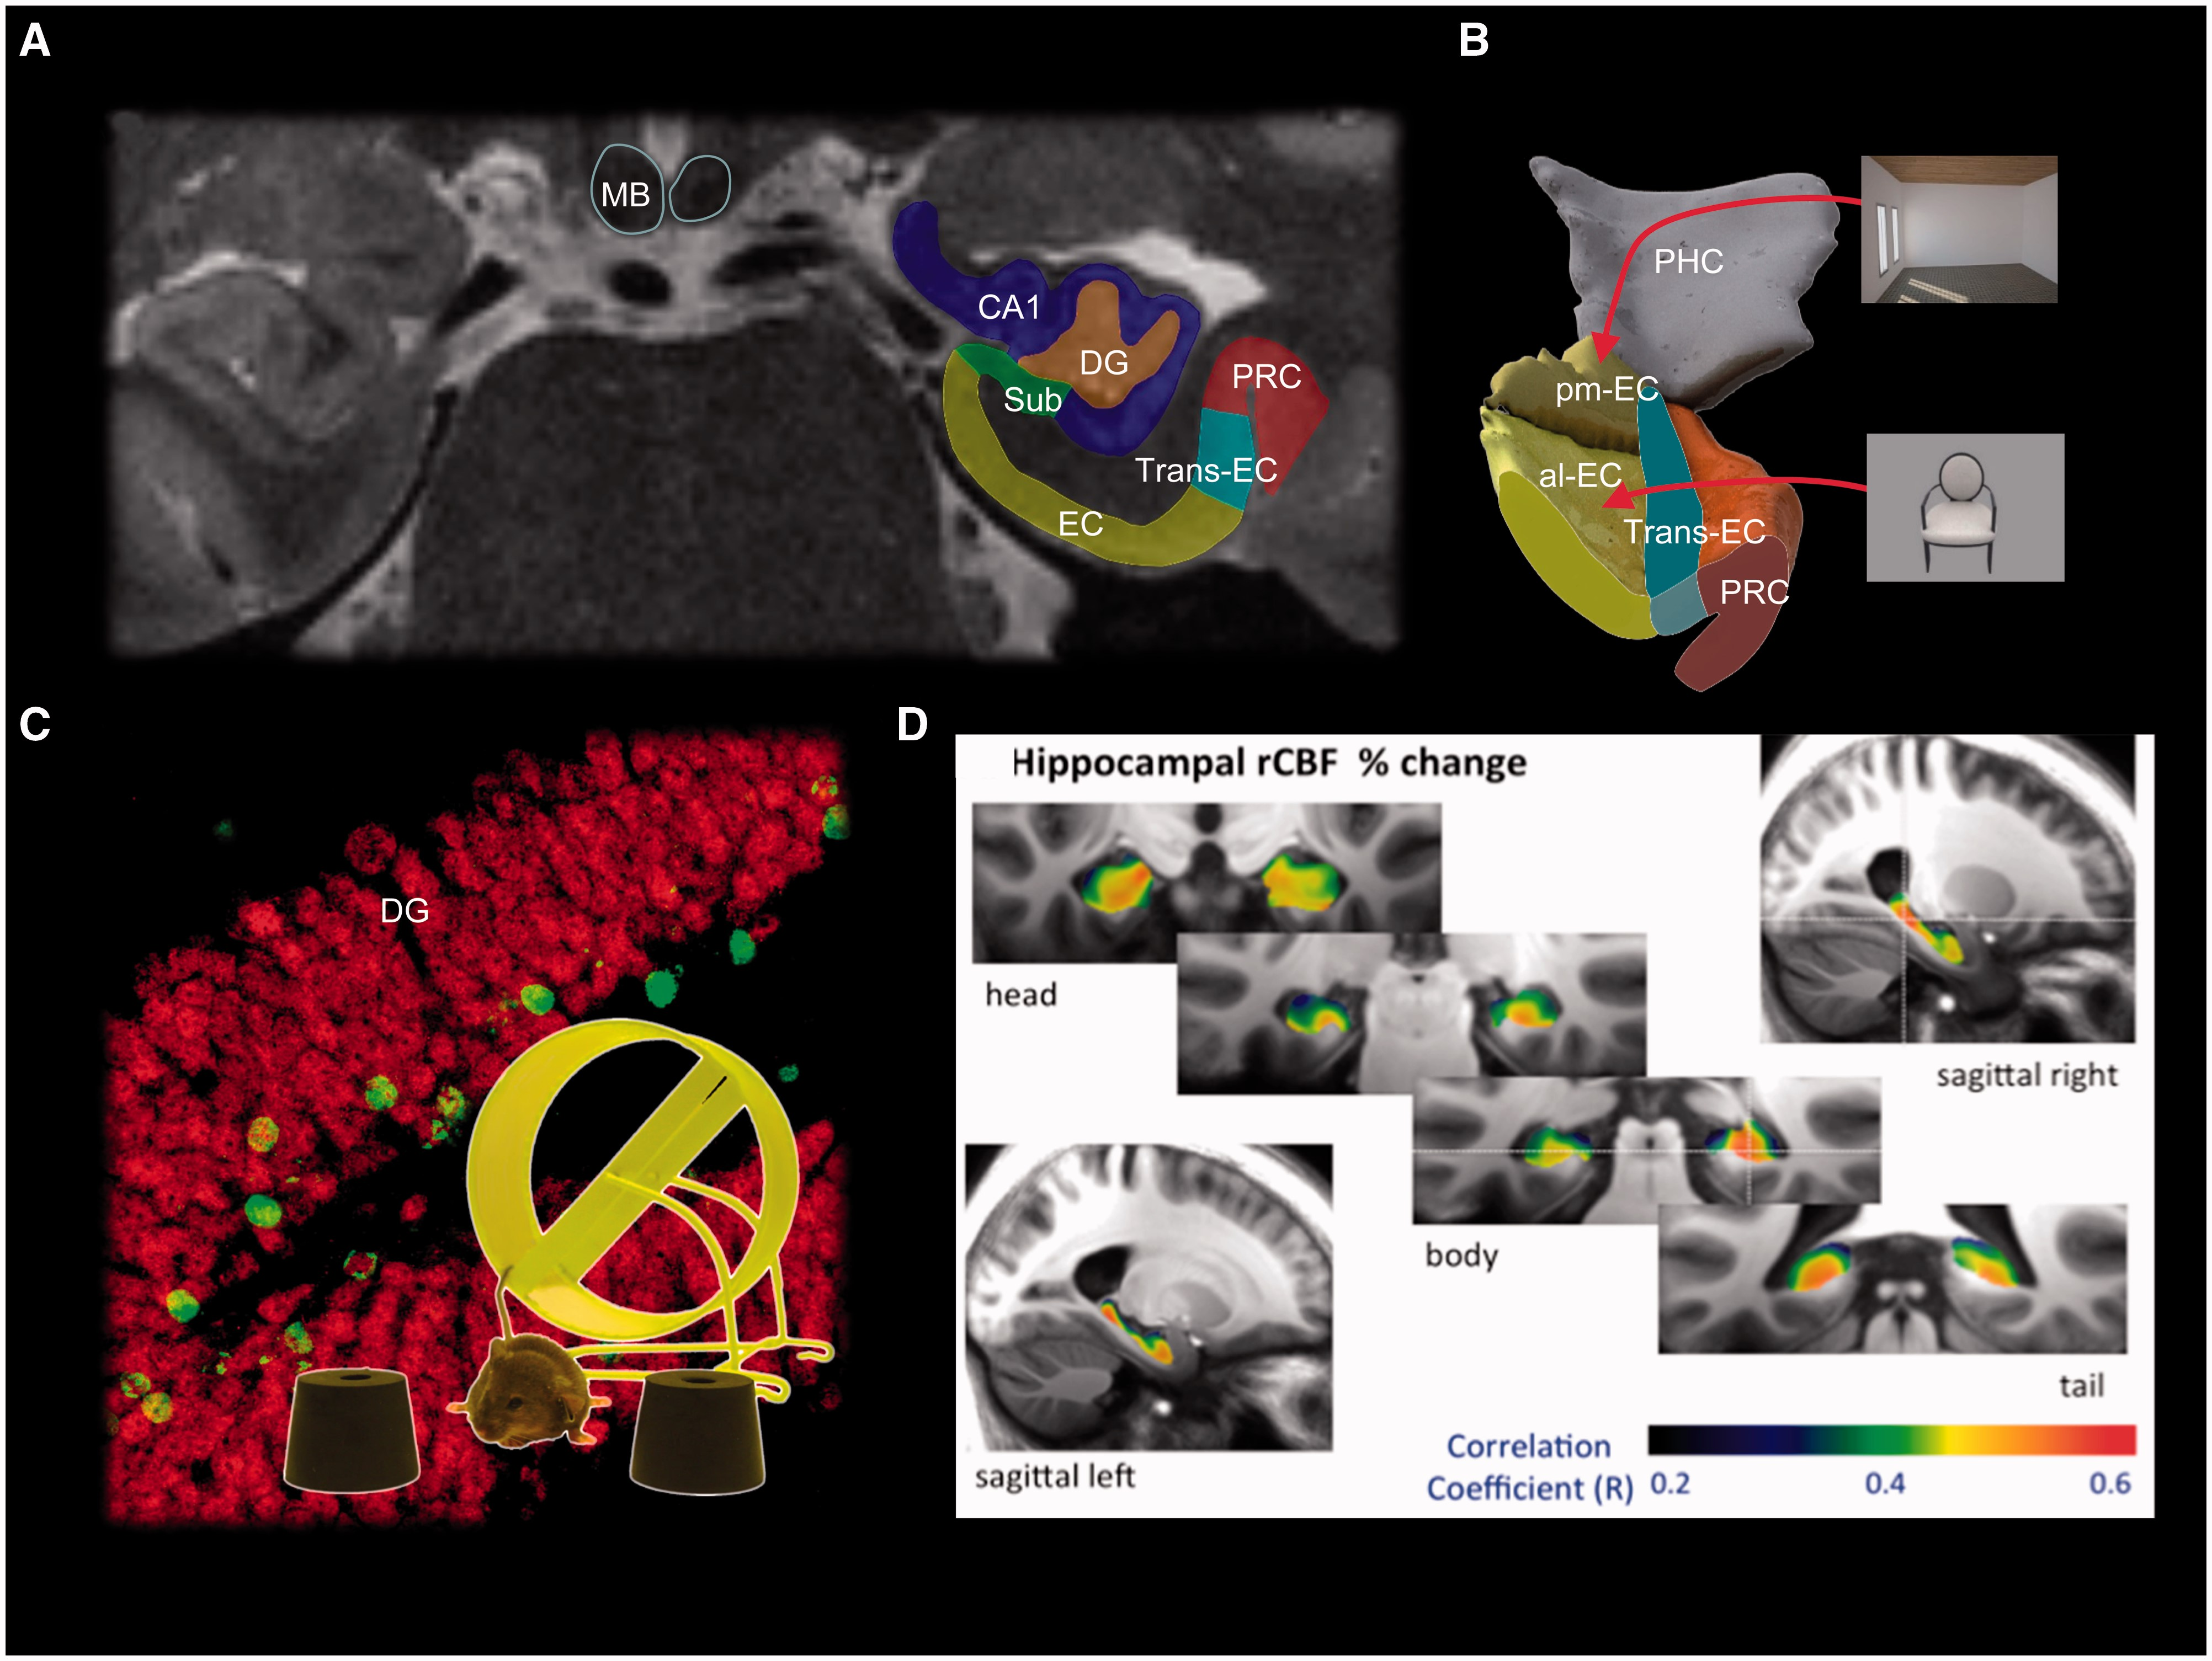
Figure 1 Brain regions and networks that are affected by exercise. ( A ) Subfields of the hippocampus (HC) and ...
Notes:
Figure 1 Brain regions and networks that are affected by exercise. ( A ) Subfields of the hippocampus (HC) and adjacent medial temporal lobe. The entorhinal cortex (EC) is a major gateway for hippocampus (for review see van Strien et al. , 2009 ). The dentate gyrus (DG) seems to be important for pattern separation of novel information ( Leutgeb et al. , 2007 ; Neunuebel and Knierim, 2014 ), whereas CA3 (not visible in this section) is implicated in pattern completion. Pattern separation dissociates different memories to non-overlapping neural codes so that they are not confused with each other even if similar. Pattern completion, on the other hand, associates different memories to overlapping and linked neural codes such that a full episodic experience can be remembered from a partial memory ( Neunuebel and Knierim, 2014 ). CA1 probably remaps memory representations back to their cortical topography ( Kumaran and McClelland, 2012 ). ( B ) The entorhinal cortex receives inputs about object representations from perirhinal (PRC) and space/scene representations from parahippocampal cortices (PHC) ( Witter et al. , 2014 ). In humans, the anterior-lateral (al) entorhinal cortex is functionally associated with the perirhinal cortex ( Maass et al. , 2015 a ) and object processing ( Navarro Schroder et al. , 2015 ) whereas the posterior-medial (pm) entorhinal cortex is functionally associated with the parahippocampal cortex ( Maass et al. , 2015 a ) and scene processing ( Navarro Schroder et al. , 2015 ). The mammillary bodies (MB) are a major subcortical hub for the hippocampus. Trans-EC = transentorhinal cortex, a transition zone between lateral entorhinal cortex and perirhinal cortex affected early in Alzheimer’s disease by tau pathology. MB = mammillary bodies. Atrophy of the mammillary bodies can be seen in ∼60% of patients with Alzheimer’s disease ( Hornberger et al. , 2012 ) and correlates with impaired recollection ( Tsivilis et al. , 2008 ; Vann et al. , 2009 ). In animals running can enhance the connectivity between the mammillary bodies and new neurons in the dentate gyrus ( Vivar et al. , 2015 ). ( C ) Running increases adult neurogenesis in the dentate gyrus and improves discrimination between similar stimuli (such as the two brown conical shapes on either side of the mouse). In the background is a photomicrograph of a coronal section through the mouse dentate gyrus double-labelled with the neuronal nuclei marker NeuN (red) and bromodeoxyuridine (BrdU, green), a thymidine analogue that labels dividing cells. Cells that show an overlap of red and green labels are considered to be newly born neurons in the adult mouse brain. ( D ) Voxel-based multiple regression analyses between changes in hippocampal regional cerebral blood flow (rCBF) changes after exercise in old age and changes in hippocampal grey matter density (with 7 T MRI, adapted from Maass et al. , 2015 b ). Sub = subiculum.
Unless provided in the caption above, the following copyright applies to the content of this slide: © The Author (2016). Published by Oxford University Press on behalf of the Guarantors of Brain. This is an Open Access article distributed under the terms of the Creative Commons Attribution Non-Commercial License ( http://creativecommons.org/licenses/by-nc/4.0/ ), which permits non-commercial re-use, distribution, and reproduction in any medium, provided the original work is properly cited. For commercial re-use, please contact journals.permissions@oup.com

Slide 3
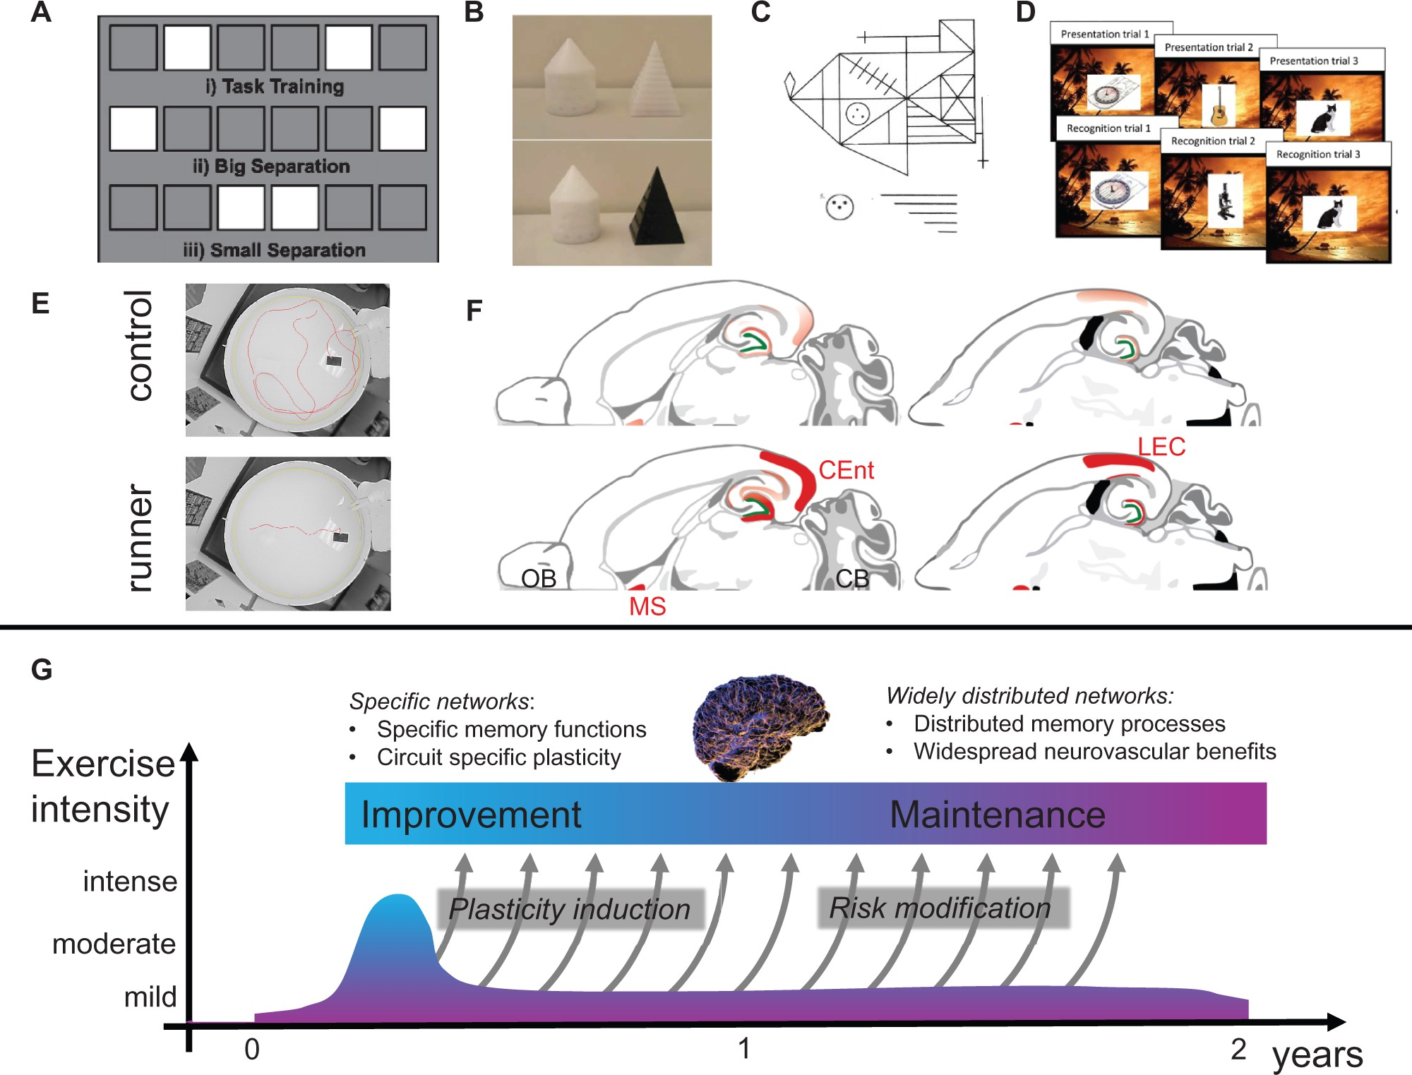
Figure 2 Effects of exercise on spatial memory, pattern separation and hippocampal circuitry. ( A–D ) Examples of ...
Notes:
Figure 2 Effects of exercise on spatial memory, pattern separation and hippocampal circuitry. ( A–D ) Examples of tasks that tap into pattern separation and are influenced by exercise in animals ( A , Creer et al. , 2010 and B , Bolz et al. , 2015 ) and old ( C , Maass et al., 2015c ) and young ( D , Dery et al., 2015 ) human adults. ( E ) Running reduces latency and path-length in the Morris water maze in aged male mice. ( F , Vivar et al., 2015 ) Horizontal sections modified from the mouse brain atlas ( Paxinos and Franklin, 2007 ) under sedentary ( top sections) and running ( bottom sections) conditions. Running increased innervation (red) from both caudomedial entorhinal cortex (CEnt) and lateral entorhinal cortex (LEC), proportionate to the increase in adult hippocampal neurogenesis ( Vivar et al., 2015 ). MS = medial septum; OB = olfactory bulb; CB = cerebellum. ( G ) A hypothetical relationship between exercise duration/intensity and improvement and preservation of cognitive function.
Unless provided in the caption above, the following copyright applies to the content of this slide: © The Author (2016). Published by Oxford University Press on behalf of the Guarantors of Brain. This is an Open Access article distributed under the terms of the Creative Commons Attribution Non-Commercial License ( http://creativecommons.org/licenses/by-nc/4.0/ ), which permits non-commercial re-use, distribution, and reproduction in any medium, provided the original work is properly cited. For commercial re-use, please contact journals.permissions@oup.com

