Slide 1
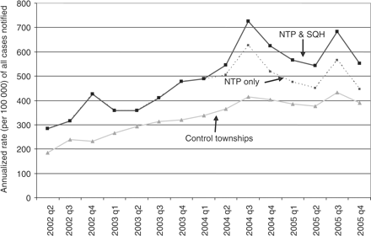
Figure 1 Trend of DOTS case notification rates of all cases in SQH townships and control townships
Notes:
Figure 1 Trend of DOTS case notification rates of all cases in SQH townships and control townships
Unless provided in the caption above, the following copyright applies to the content of this slide: Published by Oxford University Press in association with The London School of Hygiene and Tropical Medicine © The Author 2007; all rights reserved.

Slide 2
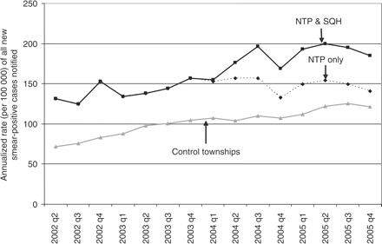
Figure 2 Trend of DOTS case notification rates of all new smear-positive cases in SQH townships and control townships
Notes:
Figure 2 Trend of DOTS case notification rates of all new smear-positive cases in SQH townships and control townships
Unless provided in the caption above, the following copyright applies to the content of this slide: Published by Oxford University Press in association with The London School of Hygiene and Tropical Medicine © The Author 2007; all rights reserved.

