Slide 1
1 Examples of cps-lacZ induction by antibiotics. E. coli FSSG02-1K was plated and tested for antibiotic ...
Notes:
1 Examples of cps-lacZ induction by antibiotics. E. coli FSSG02-1K was plated and tested for antibiotic sensitivity and expression of β-galactosidase by disk diffusion assay. Representative reactions are shown. β-galactosidase acting on the substrate X-gal in the medium produced blue rings at the periphery of zones of inhibition. Results for all antibiotics tested are summarized in Table 1. A: Cephaloridine. B: Colistin. C: Ampicillin. D: Chloramphenicol. E: Nalidixic acid.
Unless provided in the caption above, the following copyright applies to the content of this slide: © 2003 Federation of European Microbiological Societies

Slide 2
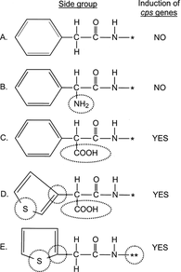
2 Side groups of selected antibiotics and effects on cps-lacZ induction. A single asterisk (*) indicates that ...
Notes:
2 Side groups of selected antibiotics and effects on cps-lacZ induction. A single asterisk (*) indicates that the side group is attached to a penicillin β-lactam core; a double asterisk (**) indicates that the side group is attached to a cephalosporin β-lactam core. Dashed circles denote differences from penicillin G. R-groups attached to the other side of the β-lactam core are not shown for cephaloridine, cephalothin or ticarcillin. A: Penicillin G. B: Ampicillin. C: Carbenicillin. D: Ticarcillin. E: Cephaloridine and cephalothin.
Unless provided in the caption above, the following copyright applies to the content of this slide: © 2003 Federation of European Microbiological Societies

