Slide 1
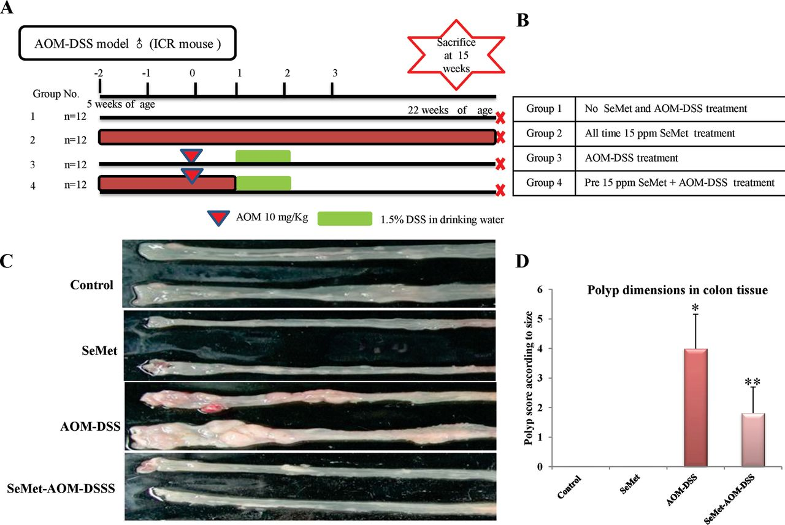
Fig. 1. ( A ) Experimental design for analyzing the chemopreventive effect of SeMet against AOM/DSS-induced colon ...
Notes:
Fig. 1. ( A ) Experimental design for analyzing the chemopreventive effect of SeMet against AOM/DSS-induced colon carcinogenesis. ( B ) Group 1: mice given normal food and no AOM–DSS or SeMet. Group 2: mice were treated with 15 p.p.m. of SeMet throughout the experimental period without AOM–DSS. Group 3: mice received only a single intraperitoneal injection of 10mg/kg body wt of AOM followed by a 1 week exposure to 1.5% (w/v) DSS in drinking water in the absence of SeMet supplementation. Group 4: mice were initially provided SeMet (15 p.p.m.) containing feed prior to AOM–DSS (same dose as Group 3). All mice were between 5 weeks of age at the beginning of the experiment. ( C ) Representative appearance of colon tumors in mice of different groups (control, SeMet, AOM–DSS, SeMet–AOM–DSS treated) at the time of killing (22 weeks). ( D ) Polyp analysis was performed by scoring based on diameter of each polyp (as explained in Materials and methods) showing dramatically lower size of polyps in SeMet–AOM–DSS-treated mice than that in AOM–DSS-treated mice. There was no apparent polyps present in the SeMet-treated mice. * P < 0.05 and ** P < 0.01.
Unless provided in the caption above, the following copyright applies to the content of this slide: © The Author 2013. Published by Oxford University Press. All rights reserved. For Permissions, please email: journals.permissions@oup.com

Slide 2
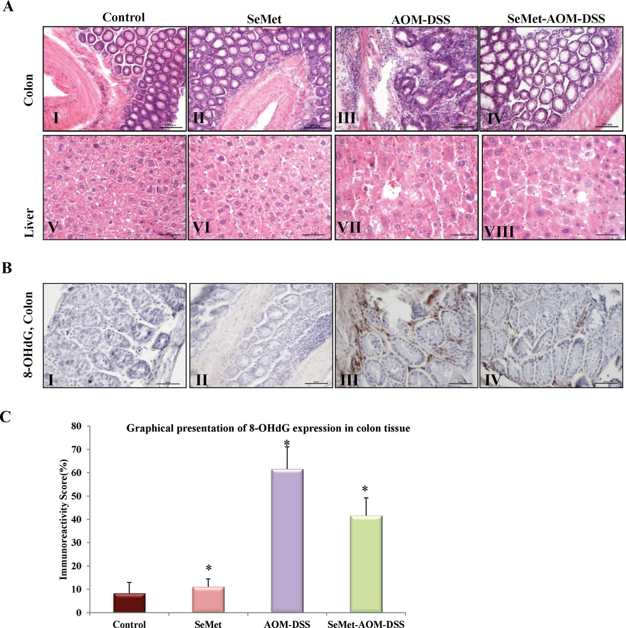
Fig. 2. ( A ) Cross sections of colon tissue from mice (representative images) showing a significantly less advanced ...
Notes:
Fig. 2. ( A ) Cross sections of colon tissue from mice (representative images) showing a significantly less advanced stage of carcinogenesis in mouse treated with SeMet before AOM–DSS treatment ( IV ) than in the AOM–DSS only group ( III ), which showed partial destruction of epithelial architecture, submucosal edema and predominant lymphocytic infiltration with H&E staining. No destruction was observed in control and SeMet-treated groups ( I and II , respectively). Histology of mouse liver tissue from animals treated with AOM–DSS only ( VII ) demonstrated diffuse microscopic glandula-like arrangement with increased vascularity indicating micro metastasis, in contrast, livers of SeMet-treated animals ( VI ) and control animals ( V ) showing almost normal appearance of the hepatic sinusoids except for some hyperplasia of hepatocytes in SeMet–AOM–DSS-treated mice ( VIII ). Images of colon tissue were taken at ×200 magnification and scale bar = 100 µm. Liver section pictures were taken at ×400 and scale bar = 50 µm. ( B ) Immunohistochemical staining for the 8-OHdG in colonic tissue showing positive staining in majority of cells in a homogeneous pattern from AOM–DSS group ( BIII ) but SeMet–AOM–DSS tissue ( BIV ) shows a mixture of positively and negatively stained cells. Control group ( BI ) and SeMet group ( BII ) do not show any significant change in 8-OHdG staining. ( C ) Graphical presentations were done for expression of 8-OHdG, where y -axis represents immunoreactivity score in percentage (%) as described in Materials and methods. * P < 0.05.
Unless provided in the caption above, the following copyright applies to the content of this slide: © The Author 2013. Published by Oxford University Press. All rights reserved. For Permissions, please email: journals.permissions@oup.com

Slide 3
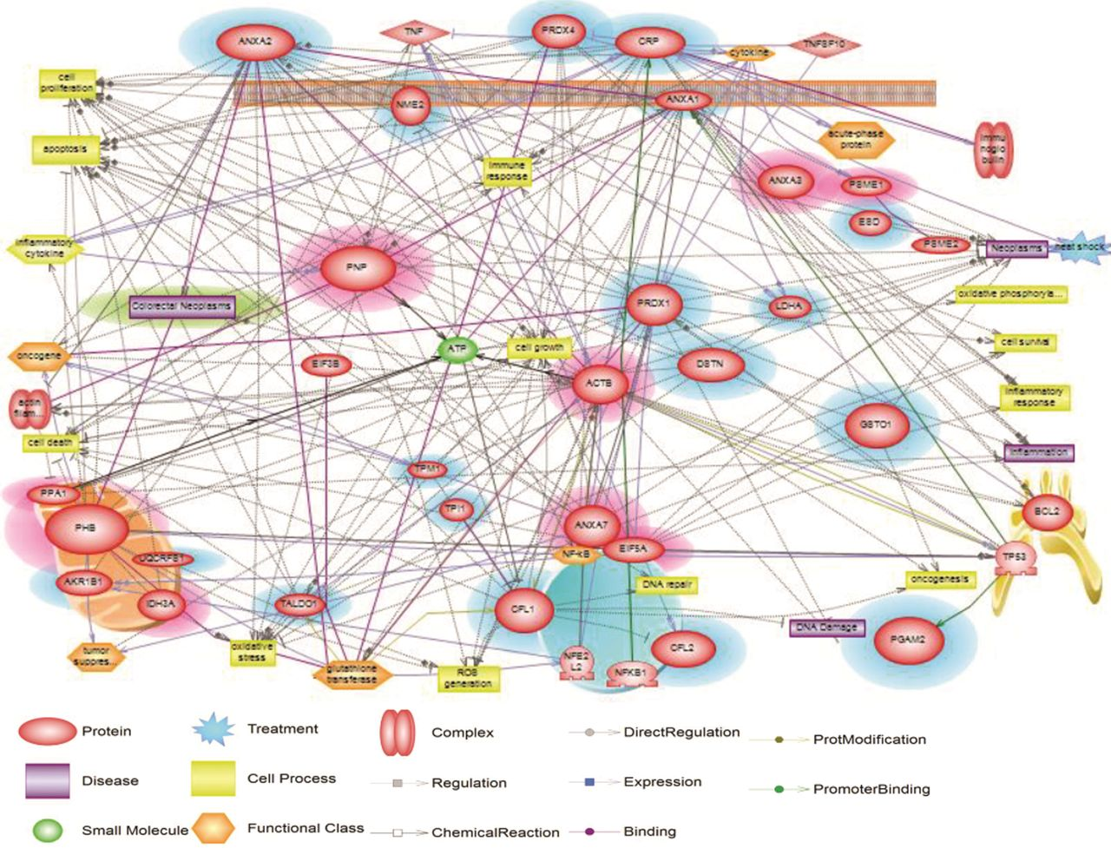
Fig. 3. Biological networks generated by pathway analyses in Pathway Studio software using proteins identified by 2D ...
Notes:
Fig. 3. Biological networks generated by pathway analyses in Pathway Studio software using proteins identified by 2D gel proteomics analysis show proteins (red), cell processes (yellow) and their localizations (blue circle = nucleus, orange-ellipsoid = mitochondria, orange parallel lines = cell membrane, yellow structure = endoplasmic reticulum) and their interrelationships. Proteins that were increased and decreased in SeMet–AOM–DSS compared with AOM–DSS only are indicated by purple and blue shadows, respectively.
Unless provided in the caption above, the following copyright applies to the content of this slide: © The Author 2013. Published by Oxford University Press. All rights reserved. For Permissions, please email: journals.permissions@oup.com

Slide 4
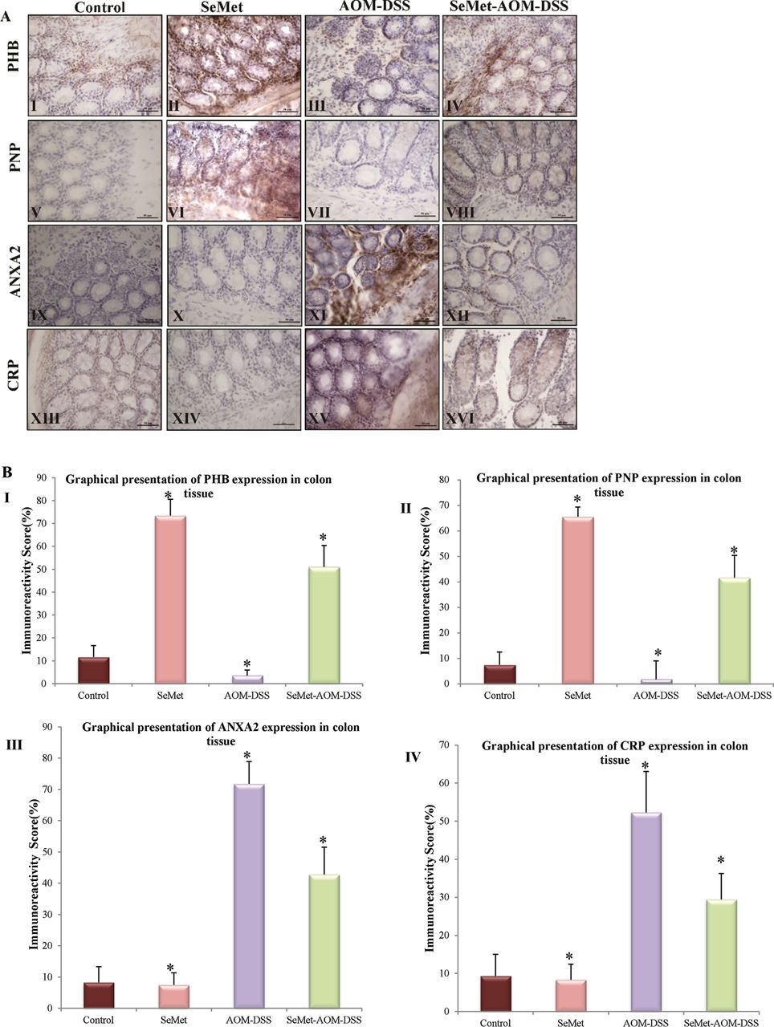
Fig. 4. ( A ) Validation of selected candidate proteins from 2D proteomics analysis using immunohistochemistry. PHB ...
Notes:
Fig. 4. ( A ) Validation of selected candidate proteins from 2D proteomics analysis using immunohistochemistry. PHB ( I–IV ) is highly increased in SeMet-treated mice colon tissue ( II ) and quite reduced in AOM–DSS tissue ( III ) as expected but some amount of positive staining can be seen in SeMet–AOM–DSS-treated tissue ( IV ). PNP also shows the same pattern of staining ( V–VIII ). ANXA2 staining ( IX–XII ) is increased in AOM–DSS tissue ( XI ) but reduced in SeMet–AOM–DSS tissue ( XII ) and no stain in control ( IX ) and SeMet ( X ) only–treated groups. CRP ( XIII–XVI ) staining pattern is similar to ANXA2. Allpictures were taken at ×400 magnification and scale bar = 50 µm. ( B ) Statistical presentations of protein expression against PHB ( I ), PNP ( II ), ANXA2 ( III ) and CRP ( IV ) antibody in colon tissue. The y -axis represents immunoreactivity score in percentage (%) as described in Materials and methods. * P < 0.05.
Unless provided in the caption above, the following copyright applies to the content of this slide: © The Author 2013. Published by Oxford University Press. All rights reserved. For Permissions, please email: journals.permissions@oup.com

Slide 5
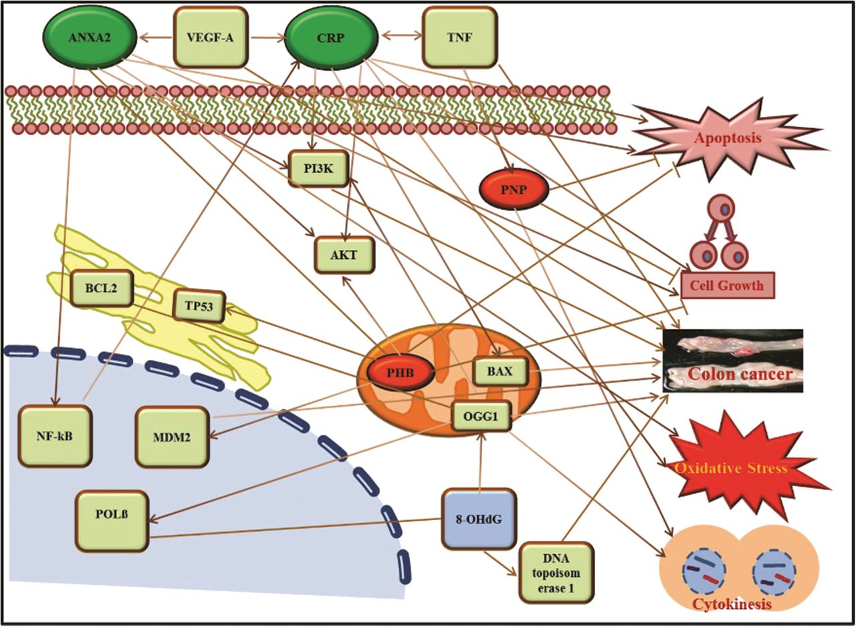
Fig. 5. Manually prepared illustration of biological networks found through pathway analyses with the help of Pathway ...
Notes:
Fig. 5. Manually prepared illustration of biological networks found through pathway analyses with the help of Pathway Studio software using 8-OHdG protein, CRC and validated major four proteins (PHB, PNP, ANXA2 and CRP) from 2D proteomics analysis. Proteins that were increased and decreased in SeMet–AOM–DSS group were compared with AOM–DSS only and are indicated by red and green color, respectively.
Unless provided in the caption above, the following copyright applies to the content of this slide: © The Author 2013. Published by Oxford University Press. All rights reserved. For Permissions, please email: journals.permissions@oup.com

