Slide 1
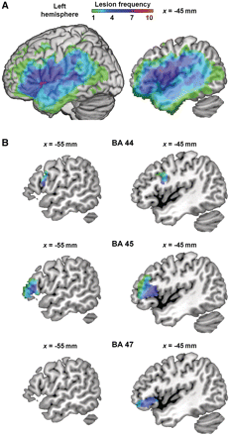
Figure 1 Lesion frequency map. (A) Whole-brain view. Across patients, damage covers left hemisphere regions including ...
Notes:
Figure 1 Lesion frequency map. (A) Whole-brain view. Across patients, damage covers left hemisphere regions including inferior and middle frontal gyri, superior and middle temporal gyri, superior and inferior parietal lobules, insula and basal ganglia. Colour indicates number of patients with damage at each voxel. Left = surface of left hemisphere. Right = sagittal section at MNI x = −45 mm. (B) Lesion frequency shown in separate subregions of left inferior frontal gyrus: BA 44, 45 and 47. Damage was comparable between subregions, with most voxels having a lesion frequency of 4–6. Regions were defined using the Brodmann atlas from MRIcron. Sagittal sections at MNI x = −45 mm (left column), slightly more medial sagittal sections at MNI x = −55 mm (right column).
Unless provided in the caption above, the following copyright applies to the content of this slide: © The Author(s) 2011. Published by Oxford University Press on behalf of Brain.This is an Open Access article distributed under the terms of the Creative Commons Attribution Non-Commercial License (http://creativecommons.org/licenses/by-nc/2.5), which permits unrestricted non-commercial use, distribution, and reproduction in any medium, provided the original work is properly cited.

Slide 2
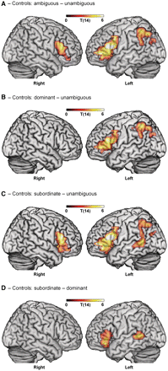
Figure 2 Effects of syntactic ambiguity in controls. (A) Controls show an overall effect of ambiguity in bilateral ...
Notes:
Figure 2 Effects of syntactic ambiguity in controls. (A) Controls show an overall effect of ambiguity in bilateral inferior frontal gyrus and left inferior parietal lobule, angular gyrus and supramarginal gyrus. (B) Sentences with the dominant continuation of the ambiguous phrase activate left inferior frontal gyrus and left inferior parietal lobule, angular gyrus and supramarginal gyrus only. (C) Sentences using the subordinate continuation activate bilateral inferior frontal gyrus, left inferior parietal lobule, angular gyrus, supramarginal gyrus and left posterior middle temporal gyrus. (D) Subordinate sentences elicit stronger activity than dominant in left inferior frontal gyrus and left posterior middle temporal gyrus. Voxel-level threshold P < 0.01; cluster-level threshold P < 0.05, corrected for multiple comparisons.
Unless provided in the caption above, the following copyright applies to the content of this slide: © The Author(s) 2011. Published by Oxford University Press on behalf of Brain.This is an Open Access article distributed under the terms of the Creative Commons Attribution Non-Commercial License (http://creativecommons.org/licenses/by-nc/2.5), which permits unrestricted non-commercial use, distribution, and reproduction in any medium, provided the original work is properly cited.

Slide 3
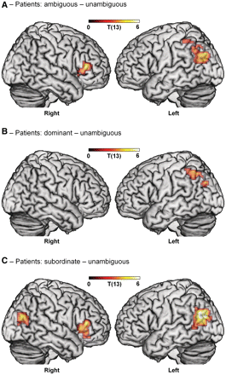
Figure 3 Effects of syntactic ambiguity in patients. (A) Patients show an overall effect of ambiguity in right ...
Notes:
Figure 3 Effects of syntactic ambiguity in patients. (A) Patients show an overall effect of ambiguity in right inferior frontal gyrus (BA 45 extending to BA 47) and left inferior parietal lobule, angular gyrus and supramarginal gyrus. (B) Sentences using the dominant continuation of the ambiguous phrase activate left inferior parietal lobule, angular gyrus and supramarginal gyrus. (C) Sentences using the subordinate continuation activate right inferior frontal gyrus (BA 45 extending to BA 47) and bilateral posterior middle temporal gyrus (extending to angular gyrus). (Note: there were no significant differences between subordinate and dominant sentences in patients). Voxel-level threshold P < 0.01; cluster-level threshold P < 0.05, corrected for multiple comparisons.
Unless provided in the caption above, the following copyright applies to the content of this slide: © The Author(s) 2011. Published by Oxford University Press on behalf of Brain.This is an Open Access article distributed under the terms of the Creative Commons Attribution Non-Commercial License (http://creativecommons.org/licenses/by-nc/2.5), which permits unrestricted non-commercial use, distribution, and reproduction in any medium, provided the original work is properly cited.

Slide 4
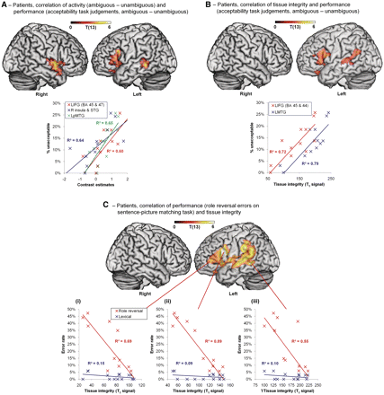
Figure 4 Correlations between performance, activity and tissue integrity in patients. (A) Activity in left inferior ...
Notes:
Figure 4 Correlations between performance, activity and tissue integrity in patients. (A) Activity in left inferior frontal gyrus (BA 45 extending to BA 47), right insula, superior temporal gyrus and left posterior middle temporal gyrus correlates with performance on the acceptability task (difference in unacceptable judgements between ambiguous and unambiguous sentences). Plot: performance over cluster mean activity for each region. (B) Tissue integrity in left inferior frontal gyrus (BA 45 and 47) and left posterior middle temporal gyrus correlates with performance on the acceptability task (as in A). Plot: performance over cluster mean tissue integrity for each region. (C) Tissue integrity in corresponding regions correlates with syntactic impairment on the sentence-picture matching task (partial correlation with role reversal errors controlling for lexical errors). Plots: performance over tissue integrity at voxels in left inferior frontal gyrus BA 45 (i; MNI −51, 39, 3), BA 44 (ii; MNI −54, 12, 20) and left posterior middle temporal gyrus (iii; MNI −59, −44, −2). All effects shown voxel-level P < 0.01, (A) and (B) cluster-level P < 0.05 uncorrected, (C) cluster-level P < 0.05 corrected. See ‘Results’ section for explanation of thresholds. LIFG = left inferior frontal gyrus; LpMTG = left posterior middle temporal gyrus; LMTG = left middle temporal gyrus; MNI = Montreal Neurological Institute coordinates; R = right; STG = superior temporal gyrus.
Unless provided in the caption above, the following copyright applies to the content of this slide: © The Author(s) 2011. Published by Oxford University Press on behalf of Brain.This is an Open Access article distributed under the terms of the Creative Commons Attribution Non-Commercial License (http://creativecommons.org/licenses/by-nc/2.5), which permits unrestricted non-commercial use, distribution, and reproduction in any medium, provided the original work is properly cited.

