Slide 1
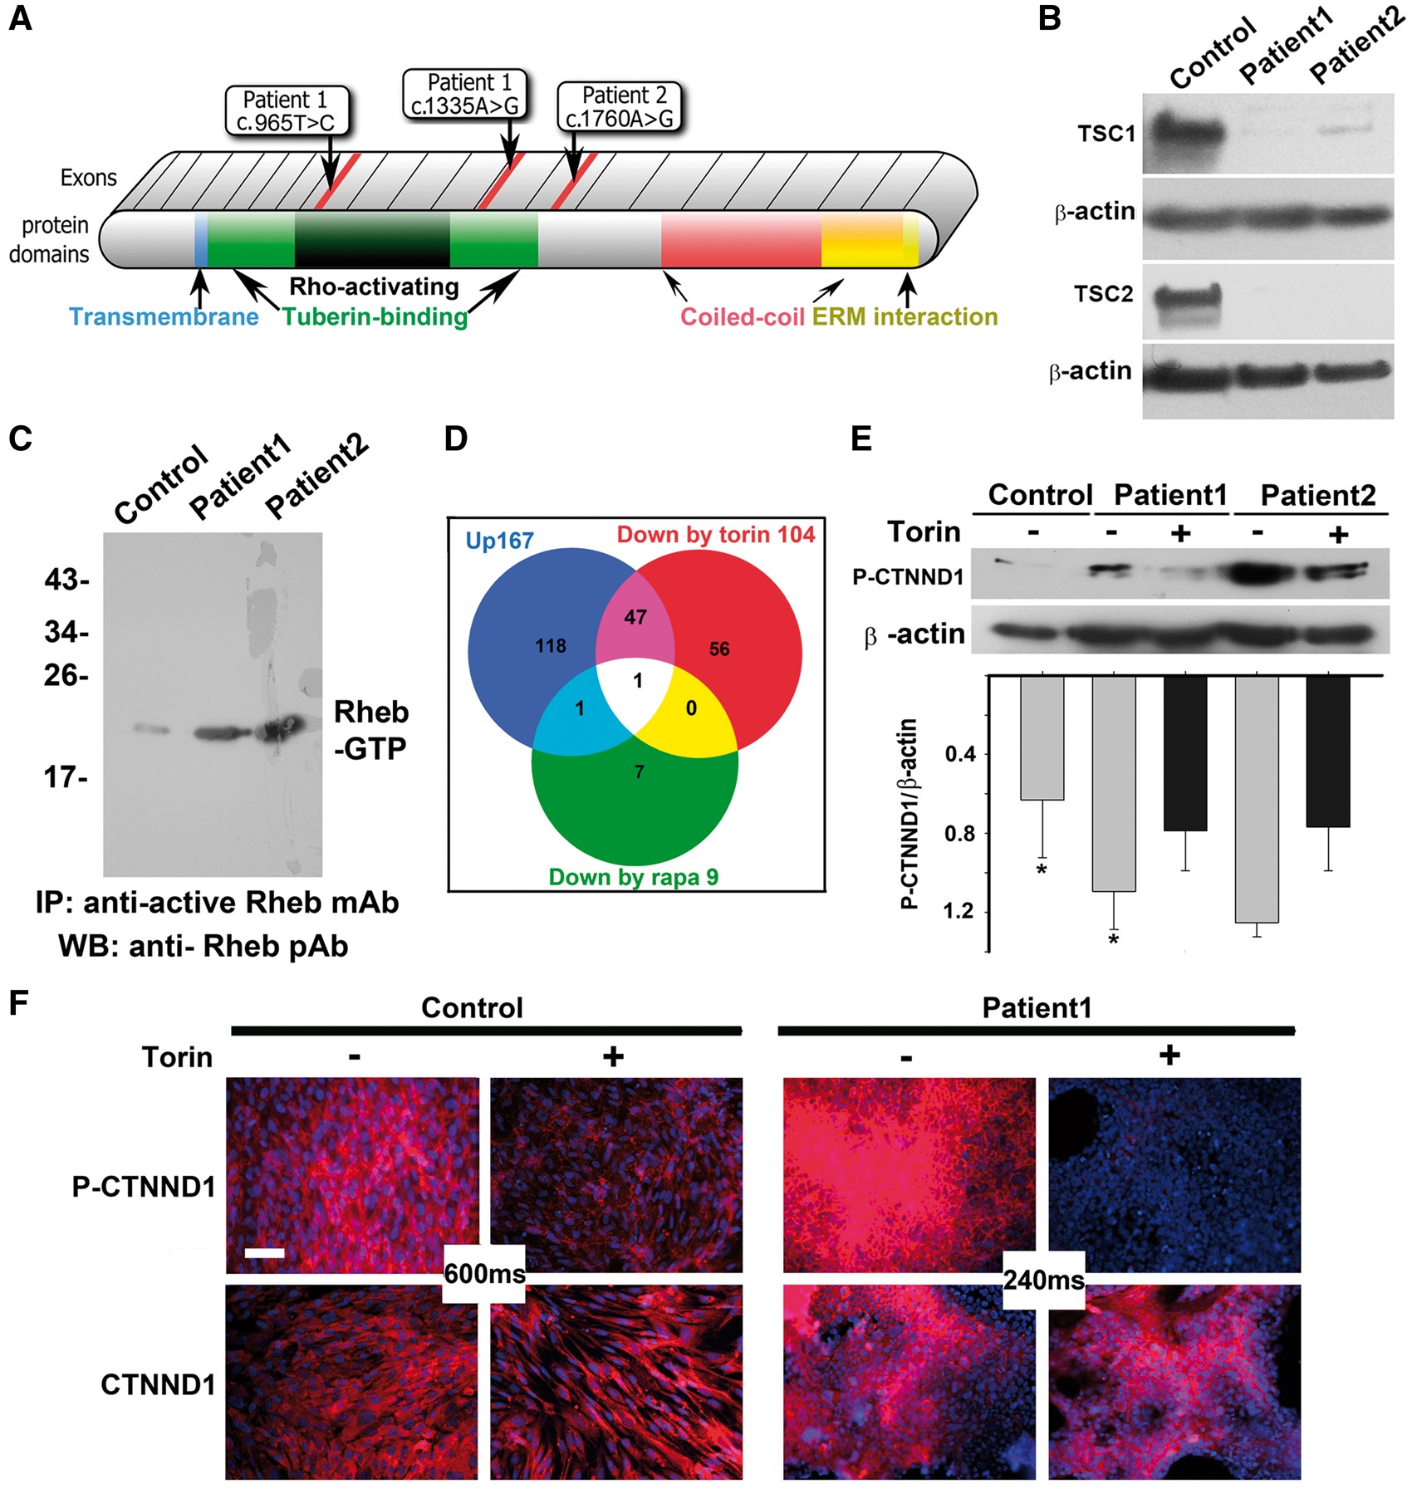
Figure 1. mTOR inhibitors block hyperphosphorylation of CTNND1 serine 268 in TSC patient astrocytes. (A) Diagram of ...
Notes:
Figure 1. mTOR inhibitors block hyperphosphorylation of CTNND1 serine 268 in TSC patient astrocytes. (A) Diagram of TSC1 protein, showing known motifs and the location of patient mutations. Patient 1 had compound, heterozygous base substitutions in both TSC1 alleles: c.965T > C in the Rho-activating domain of one allele, and C.1335A > G in the tuberin-binding domain of the other allele. Patient 2 exhibited a single c.1760A > G mutation in one of their TSC1 alleles. No deletions were found in microarray analyses. (B) Immunoblot analysis of astrocytic cell lines showed loss of TSC1 or TSC2 protein. Control human astrocytes were from a commercial source (ScienCell Research Laboratories #1800, Carlsbad, CA). (C) Active GTP-bound Rheb is upregulated in TSC patient astrocytes. Lysates from control human astrocytes and patient astrocytes, cultured to 80 to 90% confluence, were immunoprecipitated with an antibody that specifically recognizes GTP-bound Rheb. Immunoprecipitated protein was compared via immunoblot. (D)Stable Isotope Labelling by Amino acids in Cell culture (SILAC) in the absence and presence of Torin1 or rapamycin identified hyperphosphorylation of catenin delta-1 (CTNND1) alone as driving TSC1 mTOR-opathy. Venn diagram depicts proteins hyperphosphorylated in TSC patient astrocyte cultures grown in the presence of vehicle (blue circle; 167 phospo-peptides), rapamycin (green circle; 9 phospo-peptides) or Torin1 (red circle; 104 phospo-peptides). In lysates from TSC astrocytes, both mTOR inhibitors prevented hyperphosphorylation of the mTOR pathway component, CTNND1, on serine 268. (E,F) CTNND1 serine 268 is hyperphosphorylated via the overactive mTOR pathway in TSC patient astrocytes. Confluent cultures of control and patient astrocytes were incubated for 1 h in the absence or presence of the mTOR inhibitor, Torin1. E,Immunoblots of lysates derived from two patient cell lines (normalized to beta actin expression) show hyperphosphorylation of CTNND1 S268 was blocked by Torin1. Band intensity was measured via densitometry and normalized to β-actin levels. The relative value of normal was 0.52 ±0.24, whereas patient values were 1.17 ± 0.3131 (n = 3 immunoblots; *P = 0.048). F, Immunostaining for CTNND1 P-S268 shows hyperphosphorylation (but not expression) of CTNND1 in TSC patient astrocytes is downregulated by Torin1. Image acquisition times were dramatically reduced for mutant cultures (240 ms vs. 600 ms). Scale bar, 100 µm.
Unless provided in the caption above, the following copyright applies to the content of this slide: © The Author 2016. Published by Oxford University Press. All rights reserved. For Permissions, please email: journals.permissions@oup.com

Slide 2
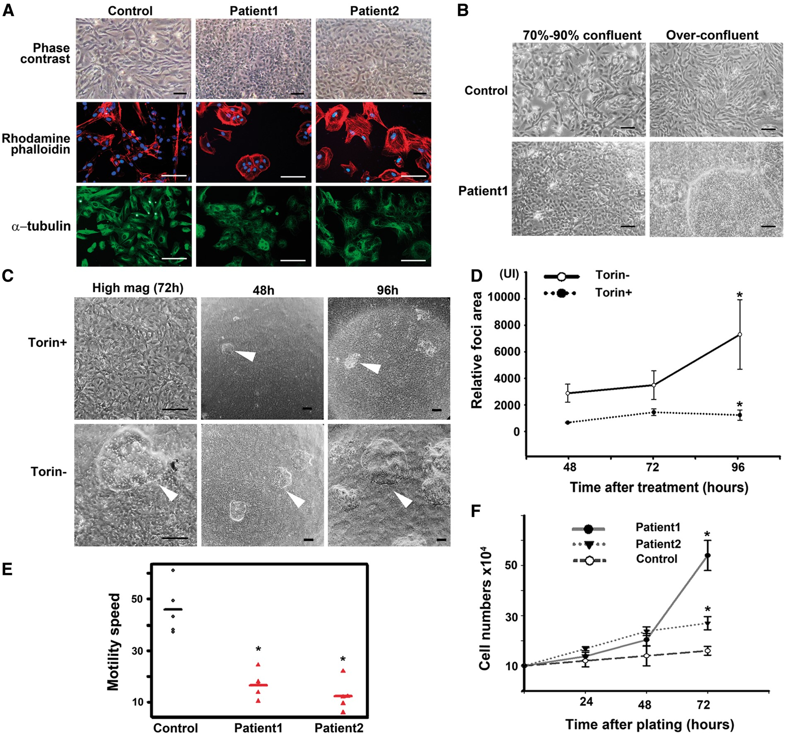
Figure 2. Cultured TSC astrocytes assume an adherent, mitotic phenotype that is mTOR-dependent. (A) TSC patient ...
Notes:
Figure 2. Cultured TSC astrocytes assume an adherent, mitotic phenotype that is mTOR-dependent. (A) TSC patient astrocytes were cultured and cell morphology visualized via phase contrast, rhodamine-phalloidin (β-actin marker, red), or α-tubulin immunolabelling (green). Images were merged with DAPI (blue) to show nuclei. Scale bars, 100 µm. (B) Control and TSC astrocytes were cultured to confluency or over-confluency and imaged with phase contrast. Scale bar, 100 µm. (C,D) Epithelial morphology and tuberous foci of TSC1 astrocytes are inhibited by the mTOR inhibitor, Torin1. Cells were seeded in 35-mm wells (∼100 x 104 cells/well), cultured to confluence, and grown in the presence or absence of 250 nM Torin1 for 48, 72 and 96 h. (C) Cells exposed to Torin1 assume a mesenchymal morphology. Scale bar, 100 µm. (D) At terminal time points, the area occupied by foci was quantified (3 areas/well, 3 wells). After 96 h, the mean sizes of foci were 873.33 ± 429 pixels in the presence of Torin1, and 6993.25 ± 2993 in the absence of Torin1 (n = 9 areas). *P = 0.026. Scale bar, 100 µm. (E) TSC astrocytes are less motile in an in vitro scratch-wound assay. A confluent monolayer of TSC astrocytes was ‘scratched’ to introduce an area devoid of cells. Cultures were imaged to measure cell migration into the void. Five cells of each sample were tracked to estimate the mean speed for each. The mean difference between patients and normal was 15.7 h (SE = 2). P <0.0001. (F) Proliferation of TSC astrocytes is resistant to contact inhibition. Cells were counted at 24, 48 and 72 h after plating. The mean difference in cell number between patients and control is 13.1 × 104 (SE = 2.6) at 72 h. The P-value is 0.002.
Unless provided in the caption above, the following copyright applies to the content of this slide: © The Author 2016. Published by Oxford University Press. All rights reserved. For Permissions, please email: journals.permissions@oup.com

Slide 3
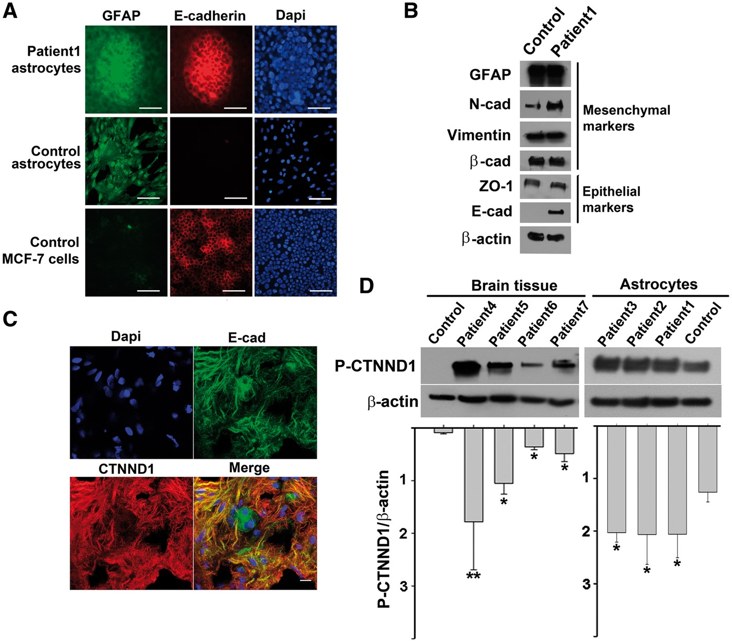
Figure 3. TSC astrocytes express CTNND1 P-S268, E-cadherin, and markers of both epithelial and mesenchymal cells A, B, ...
Notes:
Figure 3. TSC astrocytes express CTNND1 P-S268, E-cadherin, and markers of both epithelial and mesenchymal cells A, B, TSC astrocyte foci and epithelial MCF-7 breast cancer cells (but not control astrocytes) express the epithelial marker, E-cadherin, whereas TSC and control astrocytes (but not MCF-7 cells) express the mesenchymal marker GFAP. (A) Patient TSC astrocytes and control cells (normal astrocytes and epithelial MCF-7 breast cancer cells) were cultured beyond confluency, and triple labelled: GFAP immunolabelling (green), E-cadherin immunolabelling (red) and DAPI staining (blue). Scale bar, 100 µm. (B) Two days after reaching confluency, control and patient cells were harvested and lysates were immunoblotted for mesenchymal and epithelial markers. β-actin was used as a loading control. (C) CTNND1 P-S268 and E-cadherin are localized to the membrane of astrocyte processes in a TSC surgical specimen. Merged image shows staining for CTNND1 P-S268 (red), E-cadherin (green), and DAPI (blue) overlayed on the same image. Scale bar, 10 µm. (D) CTNND1 is hyperphosphorylated in surgical specimens from four additional TSC brains and a third TSC cell line. Patient-3, TSC2 c.488T > C. p.F163S; Patient-4, TSC1 c.901C > T, p.Q301X; Patient-5, TSC1, c.1525C > T, p.R509Ter; Patient-6, c.1821_1834del14bp.; and Patient-7, TSC2, c.2251C > T, p.Arg751Ter. TSC astrocyte line with higher cellular homogeneity also showed higher levels of CTNND1 P-S268 than surgical specimens. (* = P < 0.05; ** = P < 0.005).
Unless provided in the caption above, the following copyright applies to the content of this slide: © The Author 2016. Published by Oxford University Press. All rights reserved. For Permissions, please email: journals.permissions@oup.com

Slide 4
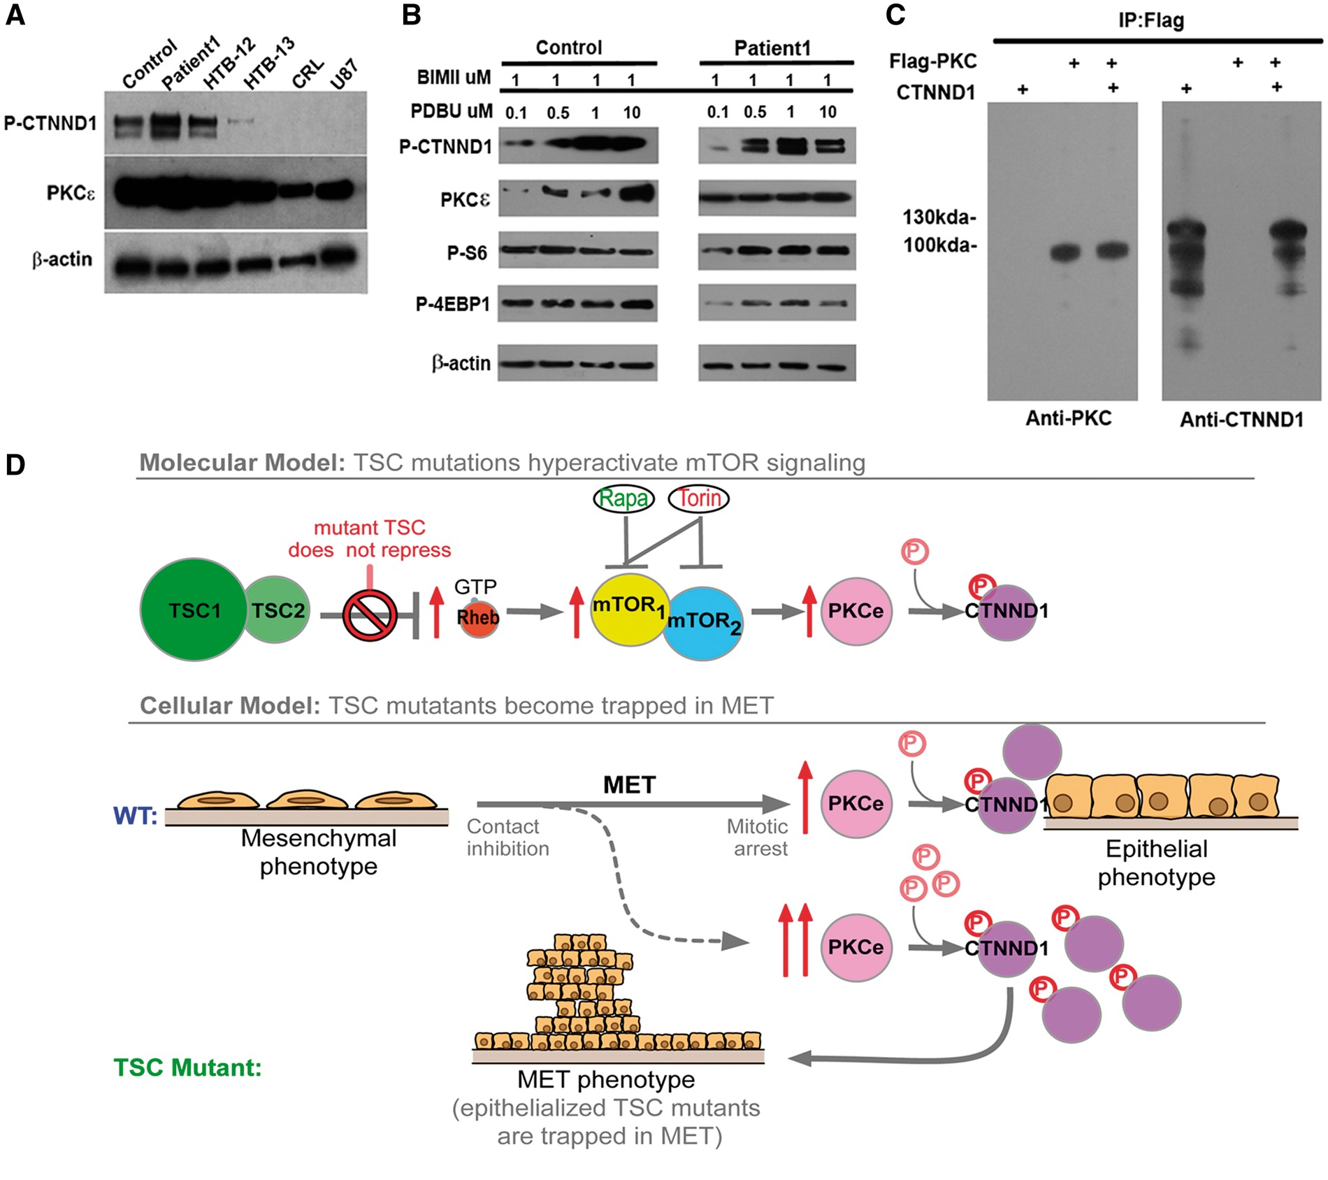
Figure 4. PKCe drives hyperphosphorylation of CTNND1 P-S268 and traps TSC astrocytes in the MET. (A) CTNND1 P-S268 and ...
Notes:
Figure 4. PKCe drives hyperphosphorylation of CTNND1 P-S268 and traps TSC astrocytes in the MET. (A) CTNND1 P-S268 and PKCe levels were higher in TSC patient samples than in malignant astrocytomas. HTB-12, -13, CRL-1718 and U87 are established malignant astrocytoma lines carrying mutations in tumour suppressor genes: PTEN, homozygous deletion (c.165_1212del1048) in HTB-12; c.209 + 1G > T in HTB-13; c.335T > G in CRL-1718; c.209 + 1G > T in U87. Cyclin-dependent kinase inhibitor 2A (CDKN2A) mutations: homozygote c.1_471del471 in HTB-12. TP53 homozygote c.817C > T in HTB-12; RB1 mutations: homozygote c.817C > T in HTB-12; compound heterozygote c.817C >T and c818G > A in HTB-13. (B) CTNND1 S268 is fully phosphorylated in patient but not control astrocytes. Control and TSC1-patient astrocyte lines were plated in 35-mm wells (100 x 104 cells/well) and grown to confluency (i.e. for 2 days); then the PKC inhibitor BIMII was added to eliminate basal activity of all PKC isoforms. PKCe was then specifically activated in a does-dependent manner, with the PKCe agonist, PDBU.(C) Co-immunoprecipitation of PKCe and CTNND1. HEK293 cells were transfected with FLAG-tagged PKCe and CTNND1. 24 hr after transfection, whole-cell extracts were immunoprecipitated with FLAG antibodies, and immunoblotted for PKCe and CTNND1. IgG antibody was used as a negative control for immunoprecipitation and 25–50μg of whole-cell protein lysate was used as input. (D) Inactivating mutations of the TSC complex epithelialize astrocytes, and make them prone to becoming trapped in the late mesenchymal-epithelial transition. In TSC astrocytes, constitutive mTOR signaling drives PKCe to fully phosphorylate CTNND1 and causes an epithelial phenotype. Such cells can get trapped in the late MET and continue to proliferate, despite their otherwise epithelialized phenotype.
Unless provided in the caption above, the following copyright applies to the content of this slide: © The Author 2016. Published by Oxford University Press. All rights reserved. For Permissions, please email: journals.permissions@oup.com

