Slide 1
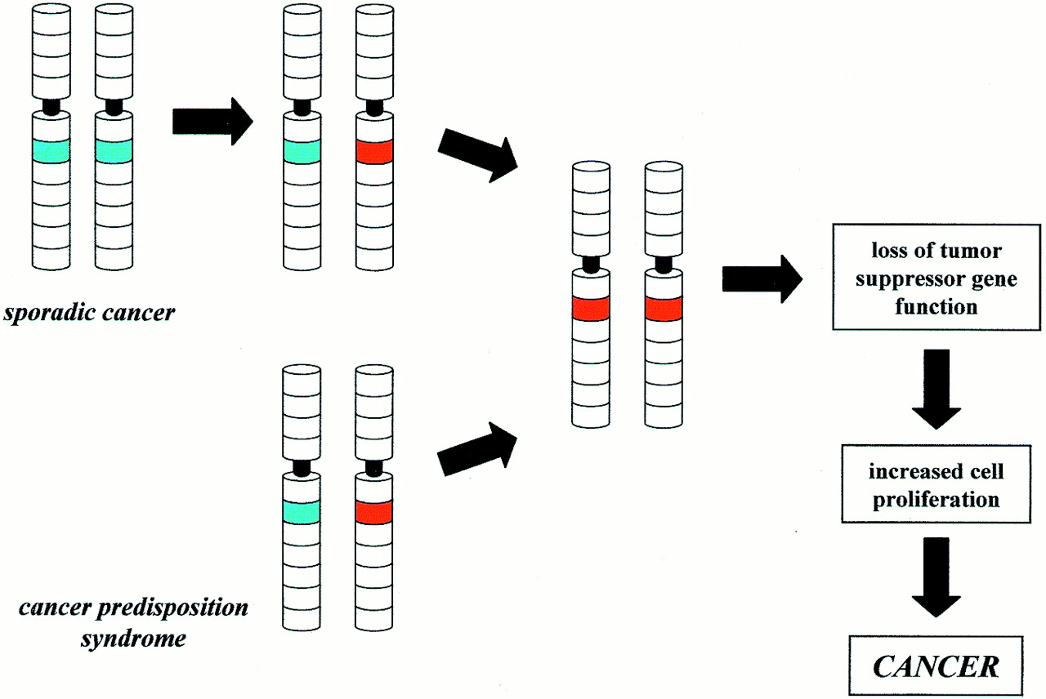
Figure 1. ‘Two-hit’ hypothesis for tumor formation. In sporadic cancer, functional inactivation of a specific ...
Notes:
Figure 1. ‘Two-hit’ hypothesis for tumor formation. In sporadic cancer, functional inactivation of a specific tumor suppressor requires two separate genetic events. In contrast, only one additional genetic event is required in individuals with a cancer predisposition syndrome. The wild-type (functional) allele is indicated in green and the inactivated (non-functional) allele is in red.
Unless provided in the caption above, the following copyright applies to the content of this slide:

