Slide 1
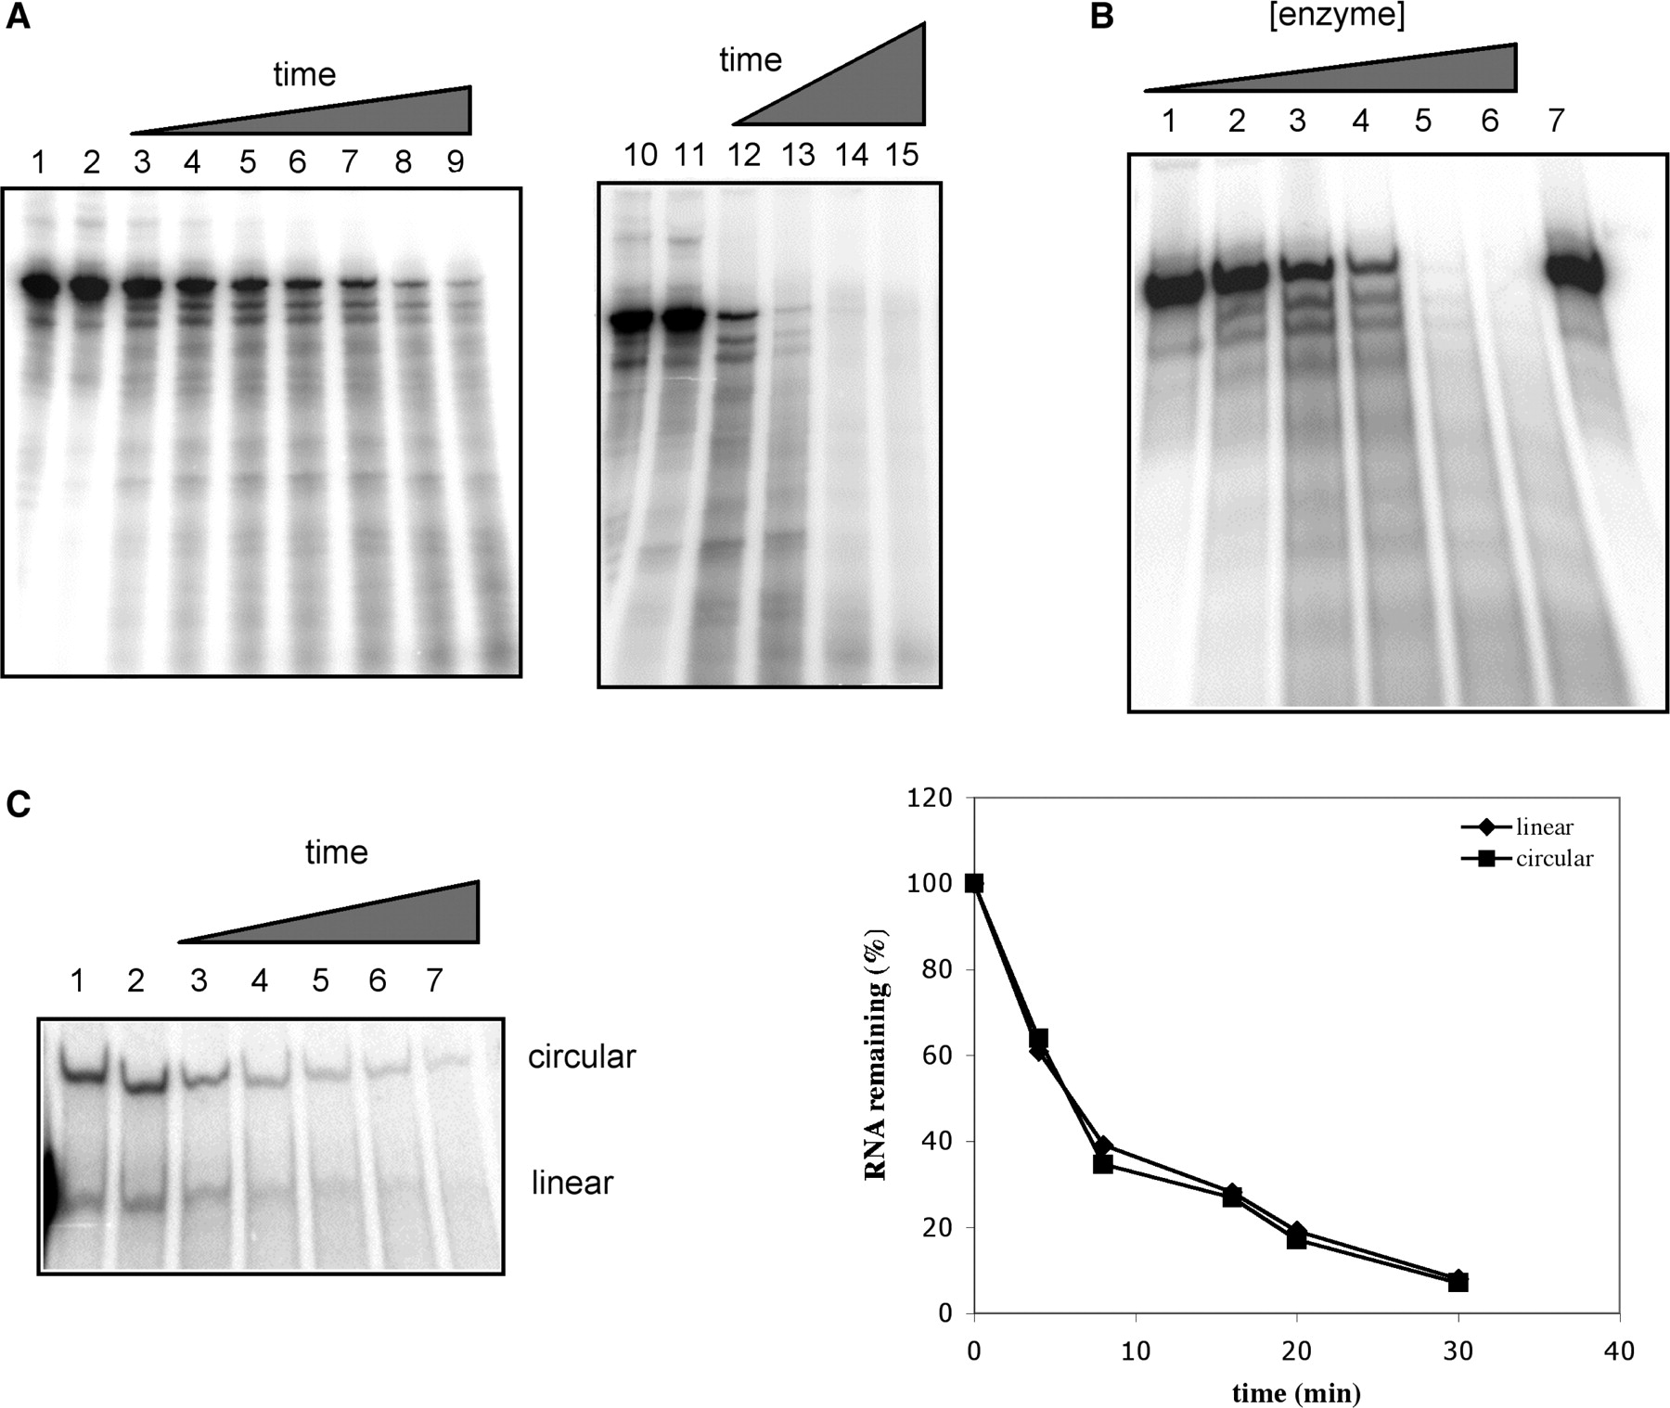
Figure 1. Nuclease activity of AtCPSF30. (A) Time course of the activity. Uniformly labeled RNA (200 nM) was incubated ...
Notes:
Figure 1. Nuclease activity of AtCPSF30. (A) Time course of the activity. Uniformly labeled RNA (200 nM) was incubated with MBP fusion protein of At CPSF30 (600 nM), samples were taken out at regular time intervals and added to phenol–chloroform to stop the reaction. The RNAs were recovered from the aqueous phase and subjected to urea-PAGE as described in Methods section. Lanes 2 and 11 are reactions that were halted before AtCPSF30 was added. Time points are: lanes 3–9—1, 2, 5, 7.5, 10, 15 and 20 min, respectively; lanes 12–15—15, 30, 60 and 120 min, respectively. Lanes 1 and 10 show the results of reactions performed with purified MBP instead of AtCPSF30 for 20 (lane 1) or 120 min (lane 10). (B) Concentration dependence of the nuclease activity. Uniformly labeled RNA (200 nM) was incubated with serial dilutions of purified protein (final AtCPSF30 concentrations of 1.2, 12, 120, 300, 600 and 960 nM, in lanes 1, 2, 3, 4, 5 and 6, respectively) for 30 min. The sample in lane 7 shows the results of incubating the RNA in the absence of protein. (C) AtCPSF30 acts on circular RNAs. Circular RNA was prepared from uniformly labeled RNA as described in the Methods section. The resultant mixture of circular and linear RNAs (so indicated in the figure) was incubated with MBP-At CPSF30 for 0, 4, 8, 16, 20 and 30 min(lanes 2, 3, 4, 5, 6 and 7, respectively) and the products were recovered and separated on a sequencing gel. Lane 1 shows the RNA mixture incubated for 30 min in the presence of purified MBP. The results are plotted on the right; in this panel, the percentage of the RNA substrate (circular or linear) remaining was plotted as a function of time, with the quantity in lane 2 being set as 100%.
Unless provided in the caption above, the following copyright applies to the content of this slide: © 2007 The Author(s)This is an Open Access article distributed under the terms of the Creative Commons Attribution Non-Commercial License (http://creativecommons.org/licenses/by-nc/2.0/uk/) which permits unrestricted non-commercial use, distribution, and reproduction in any medium, provided the original work is properly cited.

Slide 2
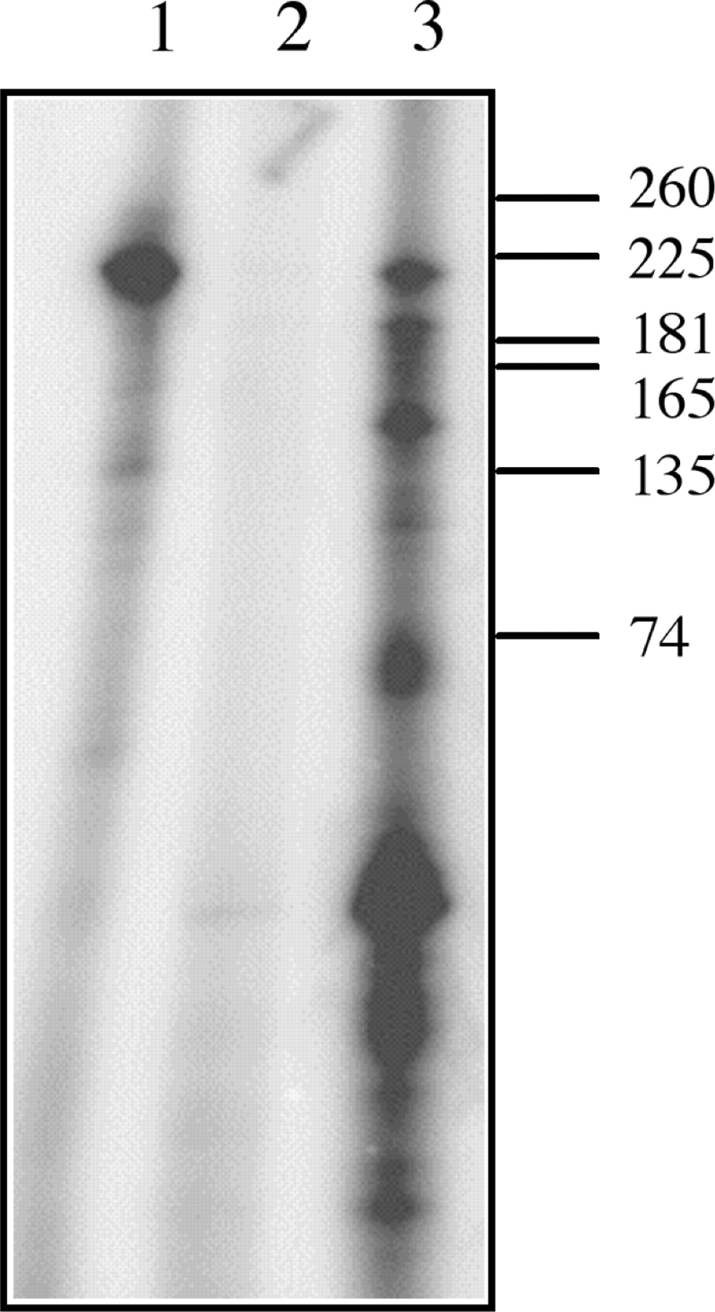
Figure 2. Cleavage by AtCPSF30 generates 3′OH groups. Unlabeled RNA (200 nM) was ligated with [³²P]-pCp ...
Notes:
Figure 2. Cleavage by AtCPSF30 generates 3′OH groups. Unlabeled RNA (200 nM) was ligated with [32P]-pCp before pre-treatment with PAP + 3′-dATP (lane 1), after treatment with PAP + 3′-dATP (lane 2) and after treatment with PAP + 3′-dATP and subsequent incubation with AtCPSF30 (300 nM) for 10 min at 30°C (Lane 3). The positions of RNA size standards are indicated to the right.
Unless provided in the caption above, the following copyright applies to the content of this slide: © 2007 The Author(s)This is an Open Access article distributed under the terms of the Creative Commons Attribution Non-Commercial License (http://creativecommons.org/licenses/by-nc/2.0/uk/) which permits unrestricted non-commercial use, distribution, and reproduction in any medium, provided the original work is properly cited.

Slide 3
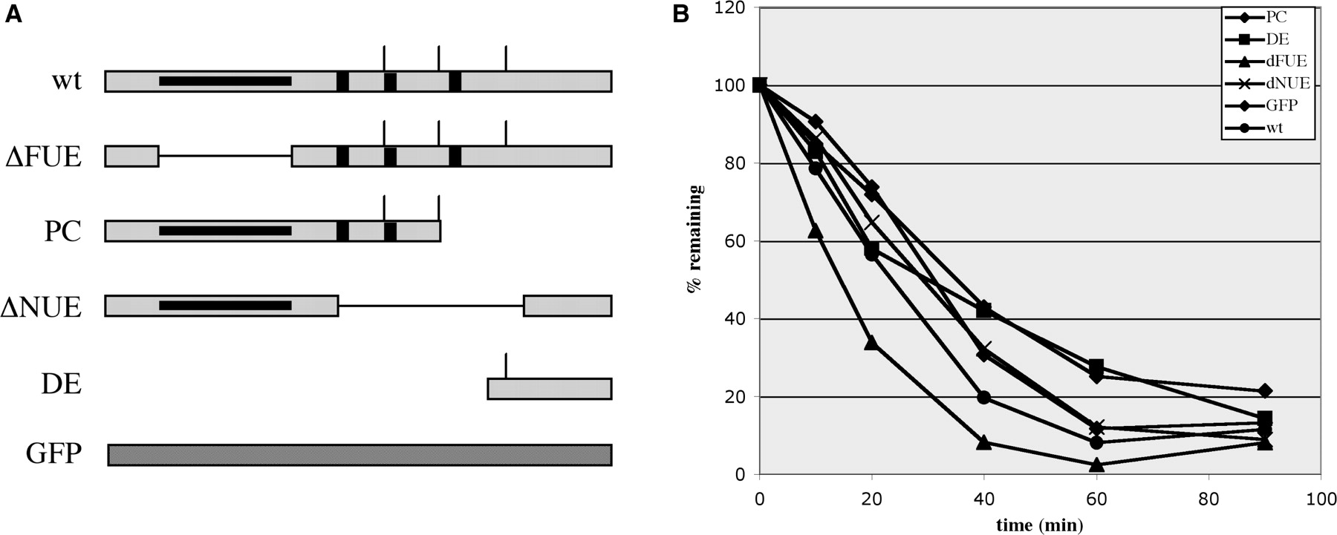
Figure 3. Activities with different RNAs. (A) Structure of the rbcS-E9-related RNAs. The designations of substrate E9 ...
Notes:
Figure 3. Activities with different RNAs. (A) Structure of the rbcS-E9-related RNAs. The designations of substrate E9 RNAs lacking one or more of the polyadenylation signal sequence elements (32), and their respective structures, are shown. ΔFUE (dFUE in the inset of the graph shown in panel B)—RNA lacking the FUE in this RNA; PC—‘pre-cleavedRNA, one that ends at the principal poly(A) site of this gene; ΔNUE (dNUE in the inset of the graph in panel B)—RNA lacking the three NUEs present in this region; DE–RNA containing sequences spanning from the third poly(A) site to a point 80-nt downstream from the second site; GFP—a control RNA containing no known polyadenylation-related cis elements. The polyadenylation signal (gray box) includes the FUE (black line within the poly(A) signal region), NUEs (black vertical bars) and cleavage sites (vertical line above the signal). (B) The RNAs depicted in panel A were incubated with MBP-AtCPSF30 for the indicated times; in all cases, the initial RNA concentration was 200 nM, and AtCPSF30 concentration was 300 nM. The percent of full-length RNAs (with the 0 time point set as 100%) remaining after at each time point was plotted as a function of time.
Unless provided in the caption above, the following copyright applies to the content of this slide: © 2007 The Author(s)This is an Open Access article distributed under the terms of the Creative Commons Attribution Non-Commercial License (http://creativecommons.org/licenses/by-nc/2.0/uk/) which permits unrestricted non-commercial use, distribution, and reproduction in any medium, provided the original work is properly cited.

Slide 4
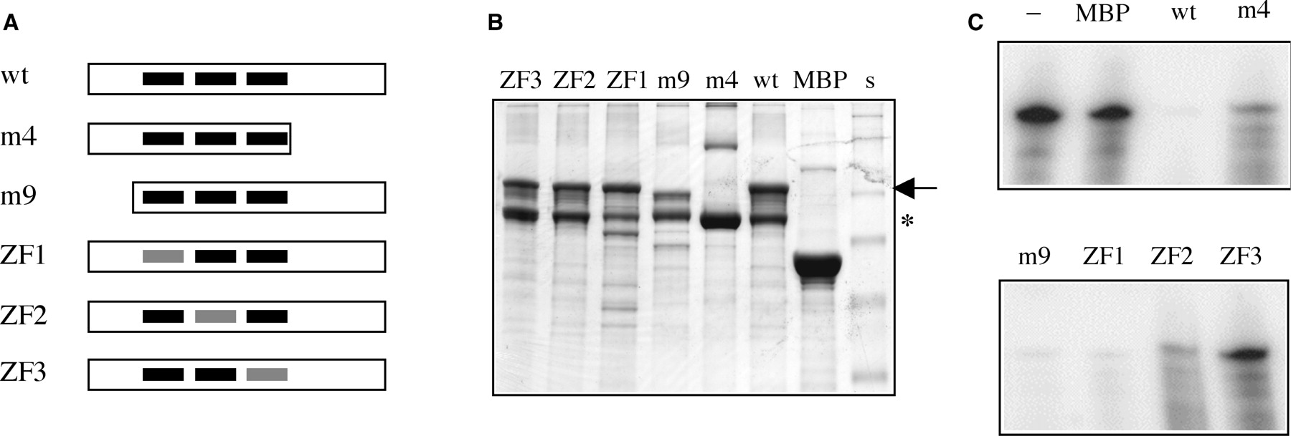
Figure 4. Mutational analysis of the nuclease activity. (A) Illustration of AtCPSF30 and the various mutants. For the ...
Notes:
Figure 4. Mutational analysis of the nuclease activity. (A) Illustration of AtCPSF30 and the various mutants. For the wild-type protein (‘wt’), the three zinc fingers are represented as black bars. The parts of the protein present in the m4 and m9 deletion mutants (30) are shown. Mutated zinc fingers for each of the three zinc finger mutants are depicted as gray bars. (B) Stained gel showing the various purified protein preparations.Three microliter of each purified protein preparation was separated on a 10% gel, which was subsequently stained with Coomassie Brilliant Blue. The identity of each preparation is indicated above the scan of the gel; the full-sized MBP-AtCPSF30 is denoted with an arrow besides the gel, and the previously described breakdown product (30) noted with an *. The high molecular weight bands seen in the MBP and m4 lanes are not consistently seen in all preparations. s—SeeBlue2 (Invitrogen) pre-stained protein size standards. (C) Nuclease activity of the AtCPSF30 variants. Uniformly labeled RNA (2 pmol = 200 nM) was incubated with purified MBP-AtCPSF30 mutant proteins or with MBP for 30 min at 30°C and the remaining RNA recovered and analyzed on a sequencing gel. The identity of the AtCPSF30 variant is indicated above the gel image (‘-’: no added protein); the quantities of the enzyme preparations were: MBP—12 pmol; ‘wt’ (wild-type AtCPSF30)—6 pmol; m4—12 pmol; m9—10 pmol; ZF1—10 pmol; ZF2—10 pmol; ZF3—10 pmol.
Unless provided in the caption above, the following copyright applies to the content of this slide: © 2007 The Author(s)This is an Open Access article distributed under the terms of the Creative Commons Attribution Non-Commercial License (http://creativecommons.org/licenses/by-nc/2.0/uk/) which permits unrestricted non-commercial use, distribution, and reproduction in any medium, provided the original work is properly cited.

Slide 5
Figure 5. RNA binding by the zinc finger mutants. Uniformly labeled RNA (final concentration of 300 nM) was incubated ...
Notes:
Figure 5. RNA binding by the zinc finger mutants. Uniformly labeled RNA (final concentration of 300 nM) was incubated with 2-fold serial dilutions of the wild-type AtCPSF30 and with the three zinc finger mutants shown in Figure 4A and RNA binding assessed using the electrophoretic mobility shift assay (see the Methods section). RNA with 3 µM MBP is shown in lane 1. Other lanes and their corresponding protein concentrations: Lane 2—3.5 µM wt protein; lane 3—1.8 µM wt protein; lane 4—0.88 µM wt protein; lane 5—0.44 µM wt protein; lane 6—4.5 µM ZF1 mutant; lane 7—2.3 µM ZF1 mutant; lane 8—1.1 µM ZF1 mutant; lane 9—0.56 µM ZF1 mutant; lane 10—3.2 µM ZF2 protein; lane 11—1.6 µM ZF2 protein; lane 12—0.8 µM ZF2 proteins; lane 13—0.4 µM ZF2 protein; lane 14—3.6 µM ZF3 protein; lane 15—1.8 µM ZF3 protein; lane 16—0.9 M ZF3 protein; lane 17—0.45 µM ZF3 protein. The autoradiographs are shown on the left, and the results plotted on the right. In the graph, the fraction of RNA present in the complexes was plotted as a function of protein concentration.
Unless provided in the caption above, the following copyright applies to the content of this slide: © 2007 The Author(s)This is an Open Access article distributed under the terms of the Creative Commons Attribution Non-Commercial License (http://creativecommons.org/licenses/by-nc/2.0/uk/) which permits unrestricted non-commercial use, distribution, and reproduction in any medium, provided the original work is properly cited.

Slide 6
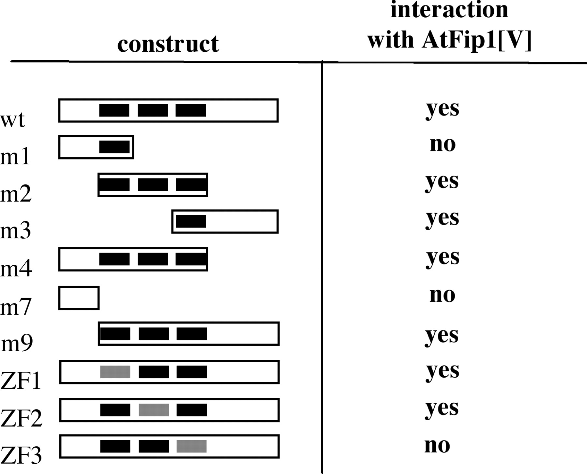
Figure 6. Two-hybrid analysis of the interaction between AtCPSF30 and AtFip1(V). The battery of mutants tested in the ...
Notes:
Figure 6. Two-hybrid analysis of the interaction between AtCPSF30 and AtFip1(V). The battery of mutants tested in the assay is shown on the left; as in Figure 4A, the three zinc fingers are represented as black bars, and mutated zinc fingers depicted as gray bars. The extents of each protein present in the two-hybrid construct are shown for each variant; the representation is not drawn to scale. The results of the tests are summarized on the right; ‘yes’ indicates that different independently isolated dual transformants were able to grow on the selective media (and therefore denotes an interaction in yeast cells), whereas ‘no’ indicates an inability to grow on such media.
Unless provided in the caption above, the following copyright applies to the content of this slide: © 2007 The Author(s)This is an Open Access article distributed under the terms of the Creative Commons Attribution Non-Commercial License (http://creativecommons.org/licenses/by-nc/2.0/uk/) which permits unrestricted non-commercial use, distribution, and reproduction in any medium, provided the original work is properly cited.

Slide 7
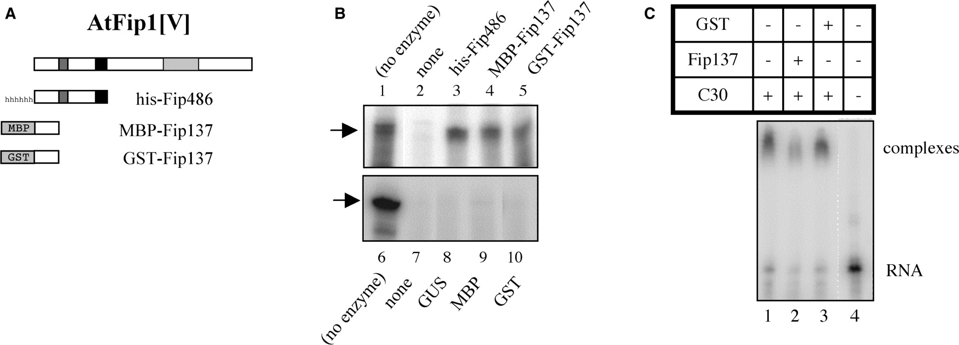
Figure 7. Inhibition of AtCPSF30 by the N-terminal domain of AtFip1(V) (A) Illustration of the parts of AtFip1(V) that ...
Notes:
Figure 7. Inhibition of AtCPSF30 by the N-terminal domain of AtFip1(V) (A) Illustration of the parts of AtFip1(V) that were tagged and used for these assays. At the top is a depiction of the full-sized AtFip1(V) protein, showing an N-terminal acidic domain (gray bar), Fip motif (black bar) and C-terminal RNA-binding domain [light gray bar (24)]. Beneath this are shown the parts of the protein present in the ‘Fip137’ and ‘Fip486’ constructs. The Fip137 segment was fused to MBP and GST, and the Fip486 segment to a histidine tag; the tags are not drawn to scale in the illustration. (B) Nuclease activities of AtCPSF30 in the presence of the Fip1 preparations. AtCPSF30 (300 nM) was assayed in the absence (lanes 2 and 7) of additional protein or in the presence of histidine-tagged Fip486 (lane 3), MBP-Fip137 (lane 4), GST-Fip137 (lane 5), histidine-tagged GUS (lane 8), purified MBP (lane 9) or purified GST (lane 10). For the reactions in lanes 3–5 and 8–10, the concentrations of the respective additional protein was 600 nM. RNA incubated without enzyme is shown in lanes 1 and 6. In addition to lane numbers, the proteins used to supplement AtCPSF30 nuclease reactions are shown above or beneath their respective lanes; (no enzyme) denotes samples in which RNA was incubated with buffer and no protein. In all reactions, the RNA concentration was 200 nM. (C) Effects of GST-Fip137 on RNA binding by AtCPSF30. RNA (300 nM) and AtCPSF30 (3.5 µM) were incubated and analyzed as described in the Methods section. AtCPSF30 was assayed by itself (lane 1) or with 4 µM GST-Fip137 (lane 2) or 4 µM GST (lane 3). The sample in lane 4 had no protein. GST-Fip137 and GST have no RNA-binding activity [(24); data not shown]. These component combinations are summarized in the table above the autoradiogram.
Unless provided in the caption above, the following copyright applies to the content of this slide: © 2007 The Author(s)This is an Open Access article distributed under the terms of the Creative Commons Attribution Non-Commercial License (http://creativecommons.org/licenses/by-nc/2.0/uk/) which permits unrestricted non-commercial use, distribution, and reproduction in any medium, provided the original work is properly cited.

Slide 8
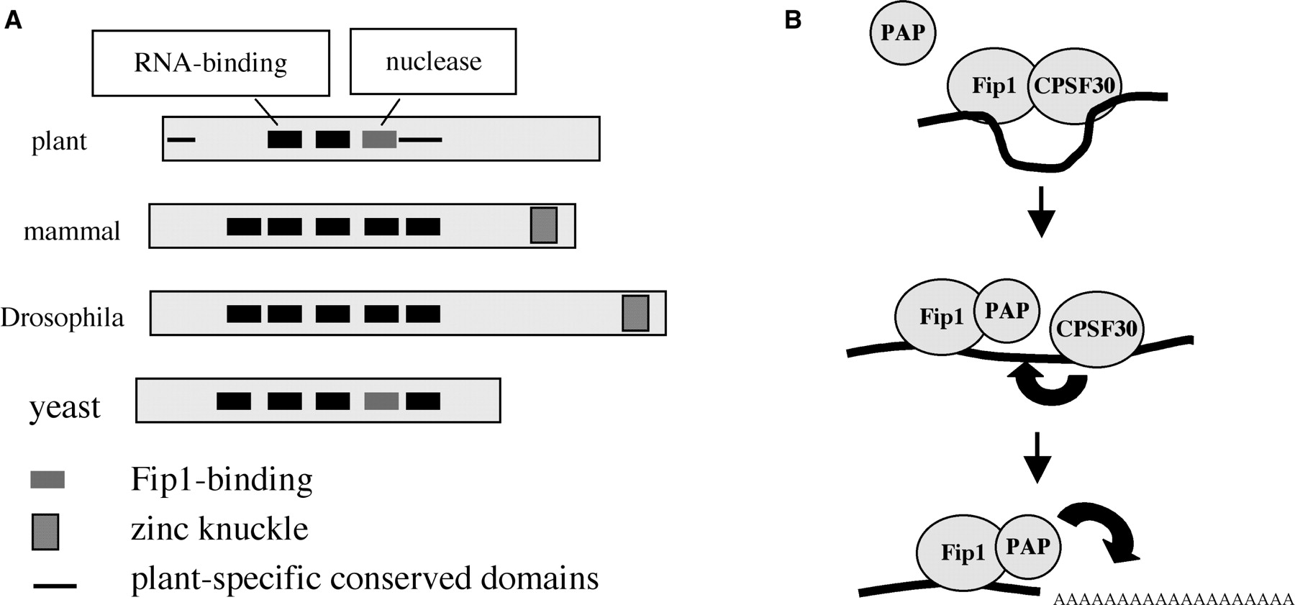
Figure 8. Models for the structure and function of AtCPSF30. (A) Illustration of the domain organization of AtCPSF30 ...
Notes:
Figure 8. Models for the structure and function of AtCPSF30. (A) Illustration of the domain organization of AtCPSF30 (30), showing the correspondence with orthologs from mammals, Drosophila and yeast (4,14,26,27). Domains of the plant protein that are associated with particular activities are indicated above the depiction of the plant protein. Symbols are as indicated beneath the representations of the proteins. (B) Model for the action of CPSF30 in the course of pre-mRNA 3′ end processing in plants. Initially, AtCPSF30 is associated with AtFip1(V); in this complex nuclease activity is repressed, the complex may bind RNA via the AtFip1(V) and AtCPSF30 RNA-binding sites. PAP may displace AtCPSF30 from AtFip1(V) as shown in the middle panel; this would activate the endonucleolytic activity of AtCPSF30 (thick black arrow). Subsequent to this processing, PAP would polyadenylate the processed RNA as shown in the bottom panel.
Unless provided in the caption above, the following copyright applies to the content of this slide: © 2007 The Author(s)This is an Open Access article distributed under the terms of the Creative Commons Attribution Non-Commercial License (http://creativecommons.org/licenses/by-nc/2.0/uk/) which permits unrestricted non-commercial use, distribution, and reproduction in any medium, provided the original work is properly cited.

