Slide 1
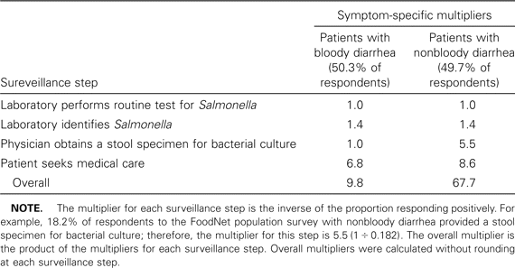
Table 1 FoodNet symptom-specific multipliers used to determine the burden of salmonellosis in the United States, ...
Notes:
Table 1 FoodNet symptom-specific multipliers used to determine the burden of salmonellosis in the United States, 1996–1999.
Unless provided in the caption above, the following copyright applies to the content of this slide: © 2004 by the Infectious Diseases Society of America

Slide 2
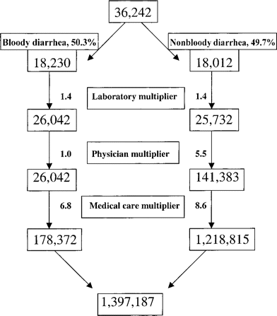
Figure 1 Diagram showing the estimates of cases of salmonellosis at each of the 4 surveillance steps (represented by ...
Notes:
Figure 1 Diagram showing the estimates of cases of salmonellosis at each of the 4 surveillance steps (represented by discrete levels in the diagram) and total annual number of cases of salmonellosis in the United States. The uppermost box represents the total estimated number of culture-confirmed cases using the age-specific incidence of salmonellosis in the FoodNet sites and extrapolating to the US population. Case series data from the FoodNet serogroup B and D case-control study were used to estimate the percentages of case patients who had either bloody or nonbloody diarrhea. Symptom-specific “multipliers” were used at each surveillance step to estimate the total number of cases shown in the lowermost box (for definitions of the multipliers, see “Burden of illness” in Methods and see table 1).
Unless provided in the caption above, the following copyright applies to the content of this slide: © 2004 by the Infectious Diseases Society of America

