Slide 1
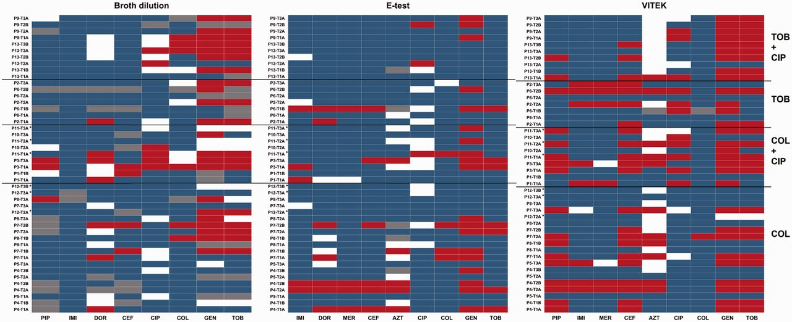
Figure 1. Resistance profiles of clinical isolates compared with EUCAST resistance breakpoints based on (a) broth ...
Notes:
Figure 1. Resistance profiles of clinical isolates compared with EUCAST resistance breakpoints based on (a) broth dilution; (b) E-test and (c) VITEK. Heat maps represent categories resistant (red), intermediately resistant (white), sensitive (blue) or not measured (grey). Asterisks indicate COL-TOB cycling. Abbreviations on the left describe previous treatment of patients. See Table 1 for abbreviations of antibiotics
Unless provided in the caption above, the following copyright applies to the content of this slide: © The Author(s) 2016. Published by Oxford University Press on behalf of the Foundation for Evolution, Medicine, and Public Health.This is an Open Access article distributed under the terms of the Creative Commons Attribution License (http://creativecommons.org/licenses/by/4.0/), which permits unrestricted reuse, distribution, and reproduction in any medium, provided the original work is properly cited.

Slide 2
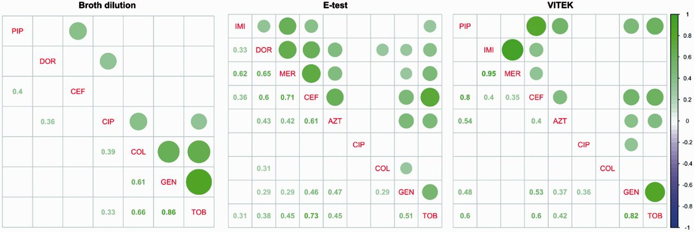
Figure 2. Pairwise correlations of resistances among antibiotics based on EUCAST resistance data using Pearson’s ...
Notes:
Figure 2. Pairwise correlations of resistances among antibiotics based on EUCAST resistance data using Pearson’s correlation coefficient ρ. Only statistically significant correlations (P < 0.05) and corresponding values of ρ are shown. Purple circles, sensitivity; green circles, resistance. Circle sizes graphically depict strengths of correlations
Unless provided in the caption above, the following copyright applies to the content of this slide: © The Author(s) 2016. Published by Oxford University Press on behalf of the Foundation for Evolution, Medicine, and Public Health.This is an Open Access article distributed under the terms of the Creative Commons Attribution License (http://creativecommons.org/licenses/by/4.0/), which permits unrestricted reuse, distribution, and reproduction in any medium, provided the original work is properly cited.

Slide 3
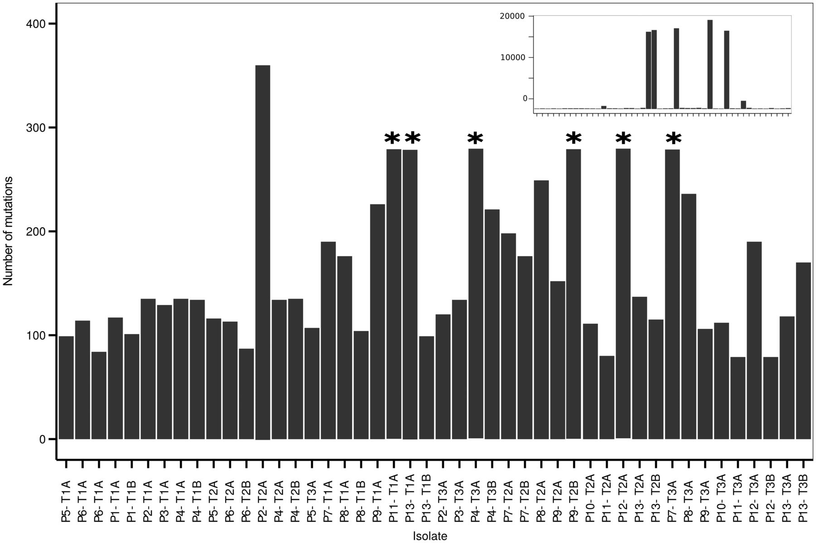
Figure 3. Number of SNPs and indels for clinical isolates compared with PA14. Stars indicate truncated bars. Strains ...
Notes:
Figure 3. Number of SNPs and indels for clinical isolates compared with PA14. Stars indicate truncated bars. Strains with high numbers of differences to PA14 are shown in the inlay (note increased range of Y axis)
Unless provided in the caption above, the following copyright applies to the content of this slide: © The Author(s) 2016. Published by Oxford University Press on behalf of the Foundation for Evolution, Medicine, and Public Health.This is an Open Access article distributed under the terms of the Creative Commons Attribution License (http://creativecommons.org/licenses/by/4.0/), which permits unrestricted reuse, distribution, and reproduction in any medium, provided the original work is properly cited.

Slide 4
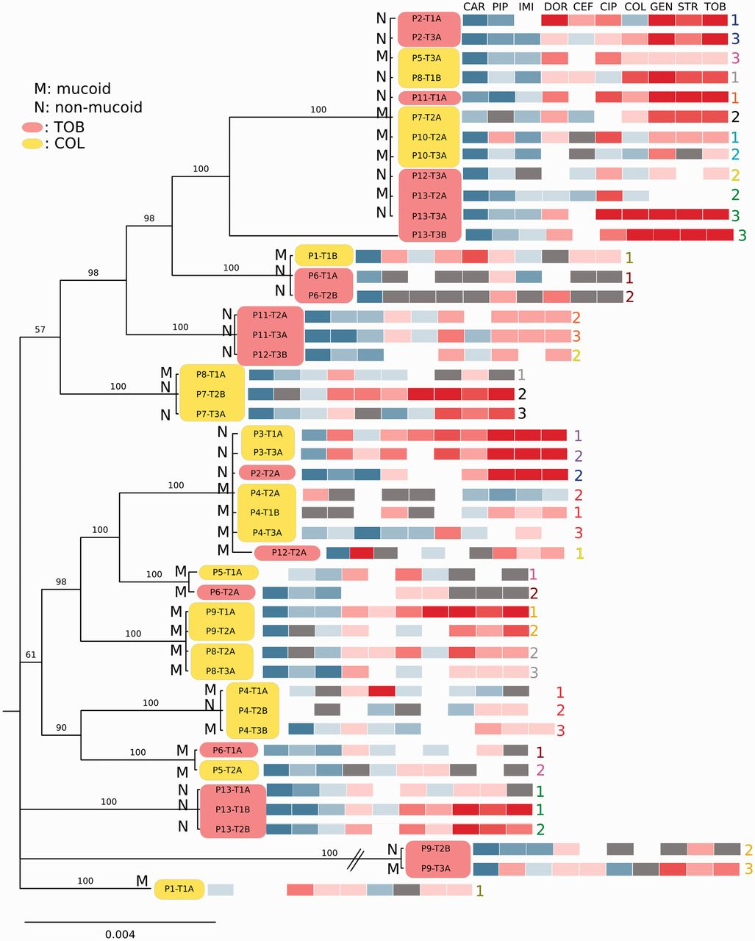
Figure 4. Phylogenetic interrelationships among clinical isolates based on 13 MLST genes. Bayesian phylogram based on a ...
Notes:
Figure 4. Phylogenetic interrelationships among clinical isolates based on 13 MLST genes. Bayesian phylogram based on a GTR + Γ + I model of molecular evolution, 6 million generations of MCMCMC with 25% burn-in. Nodes are labeled with posterior probabilities. The phylogeny is annotated with the EUCAST E-test resistance profiles as in Fig. 1b. Yellow and magenta boxes indicate isolates from patients treated with colistin and tobramycin, respectively. M, mucoid; N, non-mucoid. Numbers in corresponding colours express order in which isolates were taken from the same patient at consecutive time points
Unless provided in the caption above, the following copyright applies to the content of this slide: © The Author(s) 2016. Published by Oxford University Press on behalf of the Foundation for Evolution, Medicine, and Public Health.This is an Open Access article distributed under the terms of the Creative Commons Attribution License (http://creativecommons.org/licenses/by/4.0/), which permits unrestricted reuse, distribution, and reproduction in any medium, provided the original work is properly cited.

