Slide 1
Fig. 1: Concepts and examples of the theoretical basis of nurses' health promotion activities.
Notes:
Fig. 1: Concepts and examples of the theoretical basis of nurses' health promotion activities.
Unless provided in the caption above, the following copyright applies to the content of this slide: © The Author (2012). Published by Oxford University Press. All rights reserved. For Permissions, please email: journals.permissions@oup.com

Slide 2
Fig. 2: Concepts and examples of the types of nurses' expertise as health promoters.
Notes:
Fig. 2: Concepts and examples of the types of nurses' expertise as health promoters.
Unless provided in the caption above, the following copyright applies to the content of this slide: © The Author (2012). Published by Oxford University Press. All rights reserved. For Permissions, please email: journals.permissions@oup.com

Slide 3
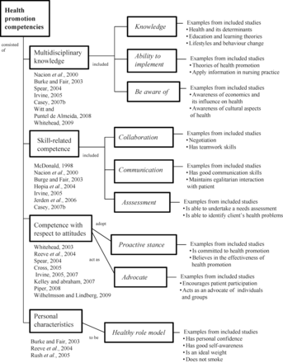
Fig. 3: Concepts and examples of nurses' health promotion competencies.
Notes:
Fig. 3: Concepts and examples of nurses' health promotion competencies.
Unless provided in the caption above, the following copyright applies to the content of this slide: © The Author (2012). Published by Oxford University Press. All rights reserved. For Permissions, please email: journals.permissions@oup.com

Slide 4
Fig. 4: Concepts and examples of organizational culture associated with health promotion activities.
Notes:
Fig. 4: Concepts and examples of organizational culture associated with health promotion activities.
Unless provided in the caption above, the following copyright applies to the content of this slide: © The Author (2012). Published by Oxford University Press. All rights reserved. For Permissions, please email: journals.permissions@oup.com

