Slide 1
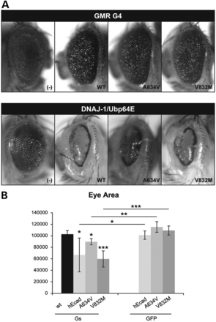
Figure 1. DnaJ-1/Ubp64E interact with WT and mutant human E-cadherin in vivo. (A and B) A Drosophila genetic screen ...
Notes:
Figure 1. DnaJ-1/Ubp64E interact with WT and mutant human E-cadherin in vivo. (A and B) A Drosophila genetic screen identifies the pair DnaJ-1/Ubp64E as E-cadherin interactors. (A) Representative images of the phenotypes obtained from overexpression of different hEcad forms (WT and HDCG-associated mutants A634V and V832M) in the fly eye, in comparison with a normal eye (top). Overexpression phenotypes of the putative E-cadherin interactors DnaJ-1/Ubp64E crossed with hEcad strains, in comparison with the phenotype of overexpressing DnaJ-1/Ubp64E alone (bottom). (B) Graphic representation of the areas of the flies eyes as in (A) and upon crossing hEcad with a GFP strain, as control. (*) P < 0.05; (**) P < 0.01; (***) P < 0.005.
Unless provided in the caption above, the following copyright applies to the content of this slide: © The Author 2013. Published by Oxford University Press. All rights reserved. For Permissions, please email: journals.permissions@oup.com

Slide 2
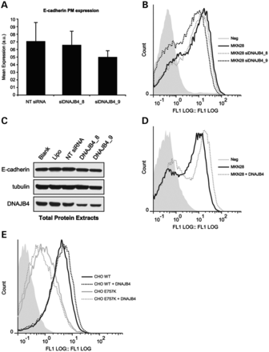
Figure 2. DNAJB4 regulates E-cadherin expression at the transcriptional and post-transcriptional level, determining its ...
Notes:
Figure 2. DNAJB4 regulates E-cadherin expression at the transcriptional and post-transcriptional level, determining its expression at the PM. (A–C) MKN28 cells were transfected with two different siRNA against DNAJB4 and Ecad expression at the PM was analyzed by Flow Cytometry (A and B) or by WB (C). (A) The results are the average of three independent experiments. (B) Representative histograms corresponding to Ecad PM expression in control conditions (MKN28) or upon DNAJB4 silencing. (C) 40 µg of total cell extract were analyzed by WB and probed for Ecad and DNAJB4, demonstrating the silencing of DNAJB4. α-tubulin was used as a loading control. (D) Representative histograms corresponding to Ecad PM expression in control conditions (MKN28) or upon DNAJB4 overexpression; (E) CHO cells stably expressing WT or E757K Ecad were transiently transfected with DNAJB4, the amount of PM Ecad was analyzed by Flow Cytometry, and representative histograms are shown.
Unless provided in the caption above, the following copyright applies to the content of this slide: © The Author 2013. Published by Oxford University Press. All rights reserved. For Permissions, please email: journals.permissions@oup.com

Slide 3
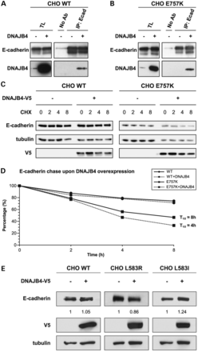
Figure 3. DNAJB4 acts as a molecular chaperone of E-cadherin. CHO cell lines stably expressing WT and E757K Ecad were ...
Notes:
Figure 3. DNAJB4 acts as a molecular chaperone of E-cadherin. CHO cell lines stably expressing WT and E757K Ecad were transfected with DNAJB4. (A and B) Ecad was immunoprecipitated, and the interaction with DNAJB4 was analyzed by WB. Membranes were probed with anti-DNAJB4 and anti-Ecad antibodies. (C and D) 48 h after transient transfection of DNAJB4-V5, cells where incubated with the protein synthesis inhibitor Cicloheximide (CHX) for 0, 2, 4 or 8 h. Ecad expression was analyzed by WB, transfection was confirmed with anti-V5, and α-tubulin served as a loading control for quantification purposes. (D) In each time point, Ecad expression was normalized to the control (0 h, CHX). The results are the average of three independent experiments. Circles represent WT cells and squares represent E757K mutant cells. Dashed lines represent cells upon overexpression of DNAJB4. (E) Ecad was either transfected alone or co-transfected with DNAJB4-V5 into the CHO parental cell line, and 48 h later the expression of Ecad, DNAJB4 and α-tubulin was analyzed by WB. Ecad expression was quantified by densitometry and is presented as the ratio to control conditions (condition without DNAJB4).
Unless provided in the caption above, the following copyright applies to the content of this slide: © The Author 2013. Published by Oxford University Press. All rights reserved. For Permissions, please email: journals.permissions@oup.com

Slide 4
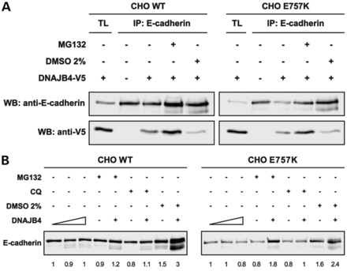
Figure 4. DNAJB4 mediates the recognition of unfolded E-cadherin for degradation in the proteasome. CHO cell lines ...
Notes:
Figure 4. DNAJB4 mediates the recognition of unfolded E-cadherin for degradation in the proteasome. CHO cell lines stably expressing WT and E757K Ecad were transfected with DNAJB4-V5 and 24 h after transfection cells were treated with MG132 (8 h), 2% DMSO (24 h) or Chloroquine (CQ, 6 h) as indicated. (A) Immunoprecipitation was performed with anti-Ecad antibody, and WB against Ecad and V5 tag; (B) Total cell extracts were analyzed by WB, probed for Ecad, and the bands intensities were quantified. The result is representative of three biological replicas.
Unless provided in the caption above, the following copyright applies to the content of this slide: © The Author 2013. Published by Oxford University Press. All rights reserved. For Permissions, please email: journals.permissions@oup.com

Slide 5
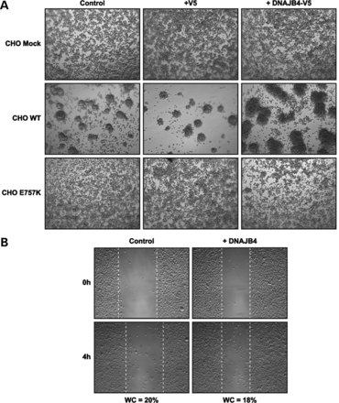
Figure 5. Post-translational regulation of E-cadherin by DNAJB4 is sufficient to induce cell adhesion but does not ...
Notes:
Figure 5. Post-translational regulation of E-cadherin by DNAJB4 is sufficient to induce cell adhesion but does not reduce cell migration in vitro. CHO cell lines stably expressing WT or mutant (E757K) Ecad, or an empty vector were transiently transfected with DNAJB4-V5 or the V5-tag, as indicated. (A) Slow aggregation assay was performed and cells were photographed 48 h after seeding. Representative images are shown. (B) Wound healing assay was performed in CHO WT and cells were photographed every 2 h, during the 8 h period. The experiment was repeated three times and representative images are shown for time points 0 and 4 h; WC, wound closure.
Unless provided in the caption above, the following copyright applies to the content of this slide: © The Author 2013. Published by Oxford University Press. All rights reserved. For Permissions, please email: journals.permissions@oup.com

Slide 6
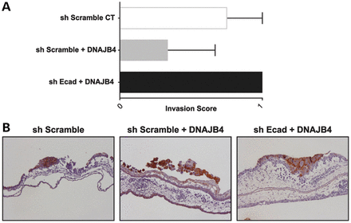
Figure 6. DNAJB4 potentiates the anti-invasive function of WT E-cadherin in human gastric cancer cells, as revealed by ...
Notes:
Figure 6. DNAJB4 potentiates the anti-invasive function of WT E-cadherin in human gastric cancer cells, as revealed by a chick embryo chorioallantoic membrane (CAM) assay. MKN28 cells where infected with a shRNA to silence Ecad (sh Ecad) or a scramble control (sh Scramble) and selected by antibiotic resistance. Cells were subsequently transfected with DNAJB4-V5 when indicated. A human-specific cytokeratin staining allowed the distinction of inoculated cells and the evaluation of cell invasion over the CAM; cells were scored as invasive (1) or non-invasive (0). At least three independent experiments were used for the graphic representation. (B) Representative images of the invasion of the same cells over the CAM. Amplification 20×.
Unless provided in the caption above, the following copyright applies to the content of this slide: © The Author 2013. Published by Oxford University Press. All rights reserved. For Permissions, please email: journals.permissions@oup.com

Slide 7
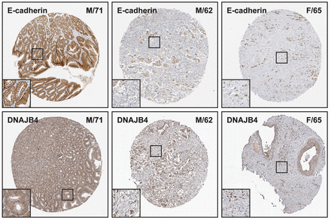
Figure 7. Concomitant decrease of E-cadherin and DNAJB4 expression in human gastric carcinomas. Representative ...
Notes:
Figure 7. Concomitant decrease of E-cadherin and DNAJB4 expression in human gastric carcinomas. Representative histological samples of one normal gastric tissue and two gastric carcinomas, stained with anti-Ecad and anti-DNAJB4 antibodies. Top and bottom stainings correspond to the same patient, and the age and gender are indicated in the top-right corner. The insight represents a higher magnification of each staining. F, female; M, male.
Unless provided in the caption above, the following copyright applies to the content of this slide: © The Author 2013. Published by Oxford University Press. All rights reserved. For Permissions, please email: journals.permissions@oup.com

Slide 8
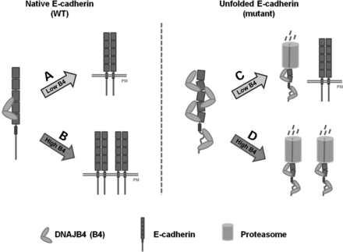
Figure 8. Proposed model establishing the role of DNAJB4 in the regulation of WT and mutant E-cadherin. DNAJB4 acts as ...
Notes:
Figure 8. Proposed model establishing the role of DNAJB4 in the regulation of WT and mutant E-cadherin. DNAJB4 acts as a molecular chaperone of Ecad, binding directly after synthesis, with increased affinity for unfolded mutant Ecad. High levels of DNAJB4 increase the expression of WT Ecad in the PM (B), in comparison to low DNAJB4 levels (A). In case of an unfolded Ecad, DNAJB4 recognizes the structural defects, and increased levels of DNAJB4 stimulate Ecad proteasome-dependent degradation, leading to decreased Ecad half-life and decreased PM expression (D), when compared with conditions with low DNAJB4 levels (C).
Unless provided in the caption above, the following copyright applies to the content of this slide: © The Author 2013. Published by Oxford University Press. All rights reserved. For Permissions, please email: journals.permissions@oup.com

