Slide 1
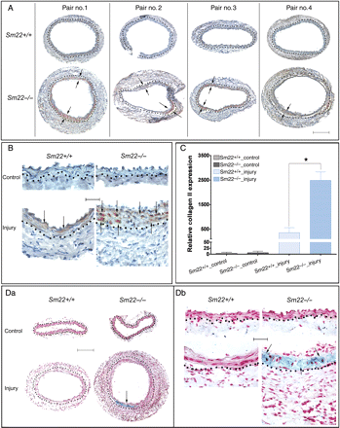
Figure 1 Enhanced type II collagen in Sm22^{−/−} mice 2 weeks after carotid denudation. Expression of type II ...
Notes:
Figure 1 Enhanced type II collagen in Sm22−/− mice 2 weeks after carotid denudation. Expression of type II collagen was evaluated by IHC. (A) Injured carotids from four Sm22−/− mice and their wild-type littermates at 100× magnification are shown. (B) Both injured carotids and non-injured controls at 400× magnification. Representative brown signals were indicated by the arrows. (C) Quantification of positive signals from images at 100× magnification in the media of carotids from five Sm22−/− and their littermates Sm22+/+ mice. (D) Alcian blue staining of carotids at 100× (Da) and at 400× magnification (Db). Blue signals, Alcian blue; red signals, nuclear fast red. Bar in (A and Da), 100 µm; bar in (B and Db), 20 µm. Dashed lines demarcated the border between media and adventitia. Values are means ± SE. The asterisk indicates P < 0.05 vs. Sm22+/+ mice.
Unless provided in the caption above, the following copyright applies to the content of this slide: Published on behalf of the European Society of Cardiology. All rights reserved. © The Author 2010. For permissions please email: journals.permissions@oup.com.

Slide 2
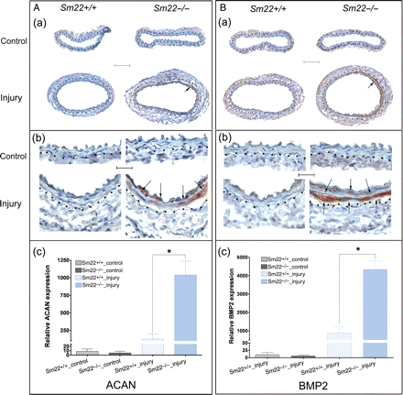
Figure 2 Augmented expression of aggrecan and BMP2 in Sm22^{−/−} mice 2 weeks after carotid denudation. (A) ...
Notes:
Figure 2 Augmented expression of aggrecan and BMP2 in Sm22−/− mice 2 weeks after carotid denudation. (A) IHC analyses of ACAN (a) at 100× magnification, (b) at 400× magnification and (c) quantification of positive signals from images at 100× magnification in the media of carotids from five Sm22−/− and their littermates Sm22+/+ mice. (B) IHC analyses of BMP2 (a) at 100× magnification, (b) at 400× magnification and (c) quantification of positive signals from images at 100× magnification in the media of carotids from five Sm22−/− and their littermates Sm22+/+ mice. Representative brown signals are indicated by the arrows. Bars in (Aa) and (Ba), 100 µm; bars in (Ab) and (Bb), 20 µm. Dashed lines demarcated the border between media and adventitia. Values in (Ac) and (Bc) are means ± SE. The asterisks indicate P < 0.05 vs. Sm22+/+ mice.
Unless provided in the caption above, the following copyright applies to the content of this slide: Published on behalf of the European Society of Cardiology. All rights reserved. © The Author 2010. For permissions please email: journals.permissions@oup.com.

Slide 3
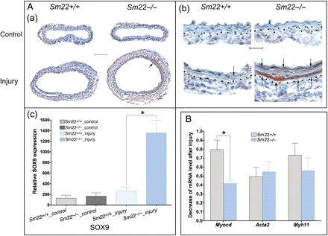
Figure 3 Up-regulation of Sox9 expression and down-regulation of Myocd expression in Sm22^{−/−} mice 2 weeks ...
Notes:
Figure 3 Up-regulation of Sox9 expression and down-regulation of Myocd expression in Sm22−/− mice 2 weeks after carotid denudation. (A) IHC analyses of SOX9 (a) at 100× magnification, (b) at 400× magnification and (c) quantification of positive signals from images at 100× magnification in the media of carotids from five Sm22−/− and their littermates Sm22+/+ mice. Representative brown signals were indicated by the arrows. Bar in (Aa), 100 µm; bar in (Ab), 20 µm. (B) Relative mRNA level of Myocd, Acta2 and Myh11 in injured carotids was evaluated using rtRT–PCR. Dashed lines demarcated the border between media and adventitia. Values in (Ac) and (B) are means ± SE. The asterisks indicate P < 0.05 vs. Sm22+/+ mice.
Unless provided in the caption above, the following copyright applies to the content of this slide: Published on behalf of the European Society of Cardiology. All rights reserved. © The Author 2010. For permissions please email: journals.permissions@oup.com.

Slide 4
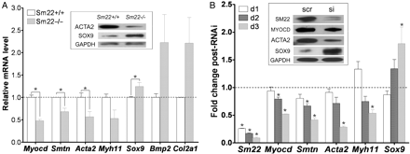
Figure 4 Chondrogenic switch of VSMCs in primary Sm22^{−/−} VSMCs and in PAC1 cells after Sm22 knockdown. (A) ...
Notes:
Figure 4 Chondrogenic switch of VSMCs in primary Sm22−/− VSMCs and in PAC1 cells after Sm22 knockdown. (A) In primary Sm22−/− and Sm22+/+ VSMCs, relative mRNA expression of Myocd, Smtn, Acta2, Myh11, Sox9, Bmp2 and Col2a1 was examined using rtRT–PCR and WB (insert panel). Values are means ± SE from primary VSMCs of four pairs of mice. The asterisks indicate P < 0.05 vs. Sm22+/+ VSMCs. (B) In PAC1 cells, Sm22 knockdown efficiency and the expression of Myocd, Smtn, Acta2, Myh11 and Sox9 were determined by rtRT–PCR 1 day, 2 days and 3 days after transfection, and by WB (insert panel) 3 days after transfection. Values are means ± SE from three independent experiments. The asterisks indicate P < 0.05 vs. the scr group. Abbreviations: scr, scrambled siRNA; si, Sm22 siRNA; d1/2/3, 1/2/3 days after transfection into PAC1 cells.
Unless provided in the caption above, the following copyright applies to the content of this slide: Published on behalf of the European Society of Cardiology. All rights reserved. © The Author 2010. For permissions please email: journals.permissions@oup.com.

Slide 5
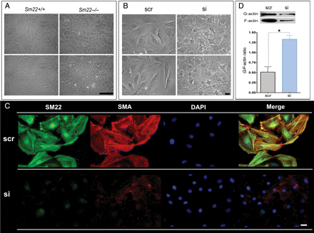
Figure 5 Compromised phenotype in primary Sm22^{−/−} VSMCs and in PAC1 cells after Sm22 knockdown. (A) Two ...
Notes:
Figure 5 Compromised phenotype in primary Sm22−/− VSMCs and in PAC1 cells after Sm22 knockdown. (A) Two views of phase-contrast images from primary Sm22−/− and Sm22+/+ VSMCs at passage 4. Bar, 50 µm. (B) The phase-contrast images from PAC1 cells in the absence or presence of Sm22 siRNA. Bar, 20 µm. (C) Expression of SM22 and SMA was investigated using IF. Bars, 20 µm. (D) Actin dynamics was determined by G/F-actin ratio in PAC1 cells without or with Sm22 siRNA. Values are means ± SE from three independent experiments. The asterisks indicate P < 0.05 vs. the scr group.
Unless provided in the caption above, the following copyright applies to the content of this slide: Published on behalf of the European Society of Cardiology. All rights reserved. © The Author 2010. For permissions please email: journals.permissions@oup.com.

Slide 6
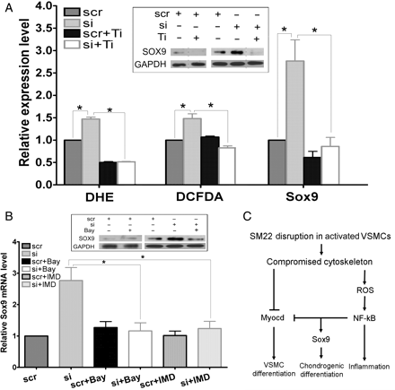
Figure 6 Elevated ROS production and NF-κB activation contributed to up-regulation of Sox9 after Sm22 knockdown in ...
Notes:
Figure 6 Elevated ROS production and NF-κB activation contributed to up-regulation of Sox9 after Sm22 knockdown in PAC1 cells. (A) ROS levels in PAC1 in the absence or presence of Sm22 siRNA cells were evaluated using DHE- and DCFDA-based fluorescence microscopy, and an ROS scavenger, Tiron, was applied. Thirty images were taken, respectively, each group. Sox9 expression was investigated using rtRT–PCR (Sox9 bars) and WB (insert panel) in PAC1 cells treated with Sm22 siRNA in the presence or absence of Tiron as indicated. (B) Suppression of Sox9 induction after Sm22 knockdown using two NF-κB pathway inhibitors, Bay-11–7082 (Bay) or IMD-0354 (IMD) was evaluated using rtRT–PCR and WB (insert panel). Values in (A) and (B) are means ± SE from three independent experiments. The asterisks indicate P < 0.05 between two compared groups. (C) Schematic representation of the transcriptional shift from myogenesis to chondrogenesis upon SM22 disruption in VSMCs.
Unless provided in the caption above, the following copyright applies to the content of this slide: Published on behalf of the European Society of Cardiology. All rights reserved. © The Author 2010. For permissions please email: journals.permissions@oup.com.

