Slide 1
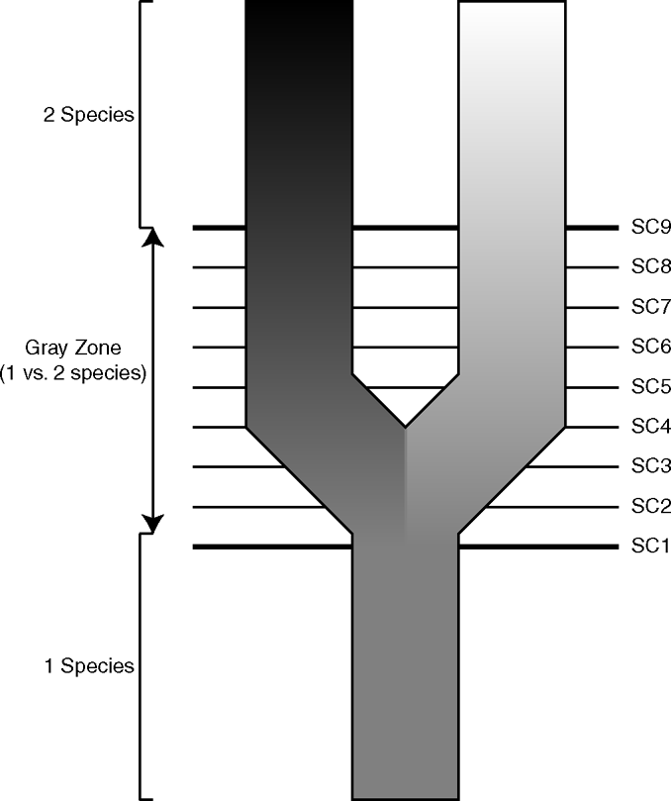
Figure 1 Lineage separation and divergence (speciation) and species concepts (after de Queiroz, 1998, 1999, 2005a). ...
Notes:
Figure 1 Lineage separation and divergence (speciation) and species concepts (after de Queiroz, 1998, 1999, 2005a). This highly simplified diagram represents a single lineage (species) splitting to form two lineages (species). The gradations in shades of gray represent the daughter lineages diverging through time, and the horizontal lines labeled SC (species criterion) 1 to 9 represent the times at which they acquire different properties (i.e., when they become phenetically distinguishable, diagnosable, reciprocally monophyletic, reproductively incompatible, ecologically distinct, etc.). The entire set of properties forms a gray zone within which alternative species concepts come into conflict. On either side of the gray zone, there will be unanimous agreement about the number of species. Before the acquisition of the first property, everyone will agree that there is a single species, and after the acquisition of the last property, everyone will agree that there are two. In between, however, there will be disagreement. The reason is that different contemporary species concepts adopt different properties (represented by the horizontal lines) as their species criteria—that is, as their cutoffs for considering a separately evolving lineage to have become a species.
Unless provided in the caption above, the following copyright applies to the content of this slide: © 2007 Society of Systematic Biologists

