Slide 1
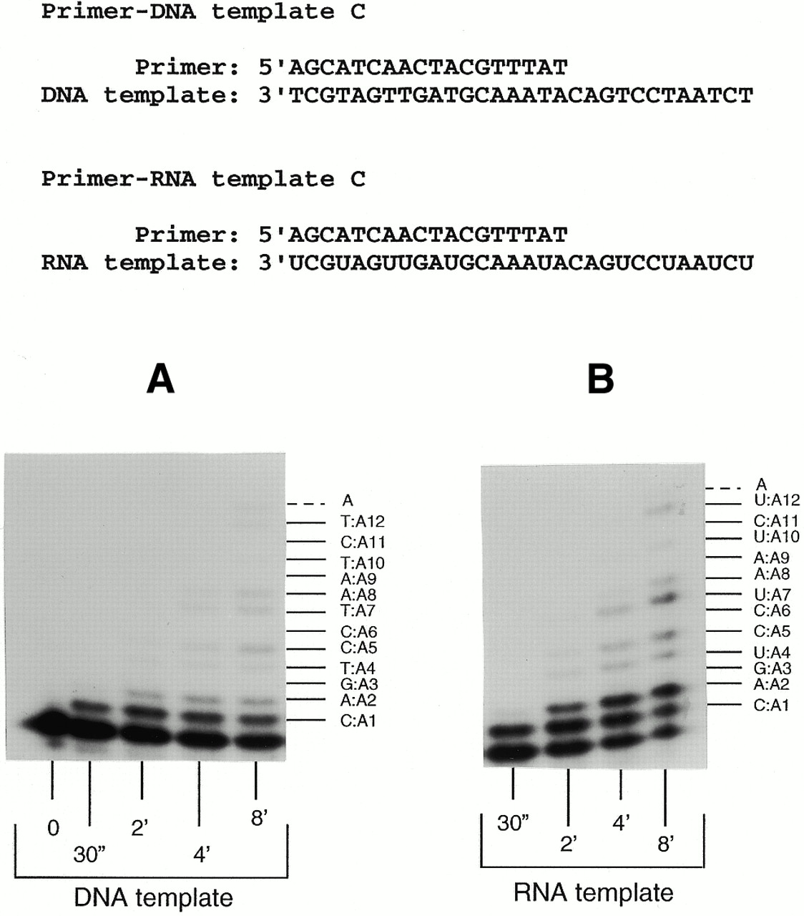
Figure 1. Gel autoradiograms showing Ty1 RT misincorporation and mispair extension ability on RNA or DNA ...
Notes:
Figure 1. Gel autoradiograms showing Ty1 RT misincorporation and mispair extension ability on RNA or DNA templates C. The 5′-32P-end-labeled primer was annealed to DNA or RNA template C, preincubated with Ty1 RT and mixed with dATP (1.5 mM) in a reaction buffer containing 17 mM Tris–HCl pH 7.5, 17 mM NaCl, 20 mM MgCl2 to start the reaction. The reactions were quenched at the indicated times and analyzed by polyacrylamide gel electrophoresis.
Unless provided in the caption above, the following copyright applies to the content of this slide:

Slide 2
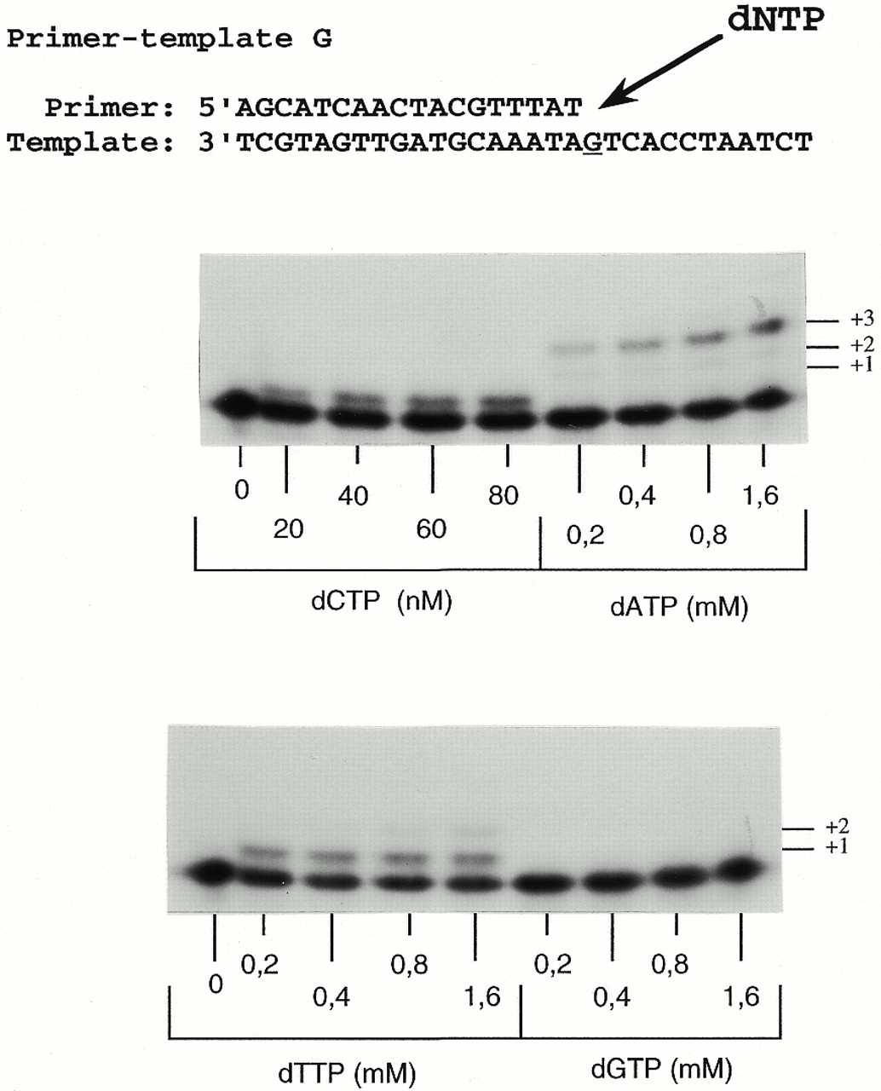
Figure 2. Fidelity of Ty1 RT opposite a template G residue. Ty1 RT (0.8 nM of active enzyme) was incubated ...
Notes:
Figure 2. Fidelity of Ty1 RT opposite a template G residue. Ty1 RT (0.8 nM of active enzyme) was incubated with 5′-32P-end-labeled primer-template substrate (13 nM) and varying concentrations of wrong (0.5–1.5 mM) or right (20–60 nM) dNTP in a reaction mixture containing 17 mM Tris–HCl pH 7.5, 17 mM NaCl, 20 mM MgCl2. Reactions were carried out at 22°C for 5 min for the wrong dNTPs and for 1 min for the right dNTPs. The quenched reactions were analyzed by polyacrylamide gel electrophoresis.
Unless provided in the caption above, the following copyright applies to the content of this slide:

Slide 3
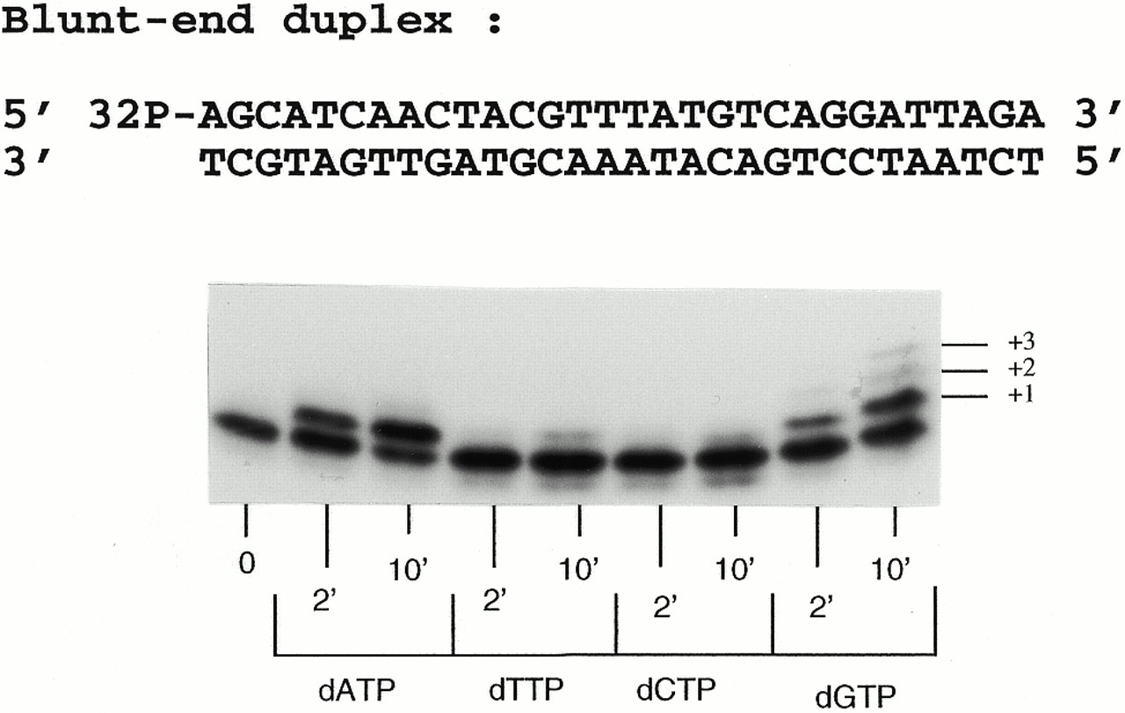
Figure 3. Blunt-end addition products synthesized by Ty1 RT. Lane 0 shows the unextended labeled 30mer ...
Notes:
Figure 3. Blunt-end addition products synthesized by Ty1 RT. Lane 0 shows the unextended labeled 30mer oligodeoxyribonucleotide. The products synthesized in the presence of individual dNTPs for 2 and 10 min are shown in lanes dATP, dTTP, dCTP and dGTP.
Unless provided in the caption above, the following copyright applies to the content of this slide:

