Slide 1
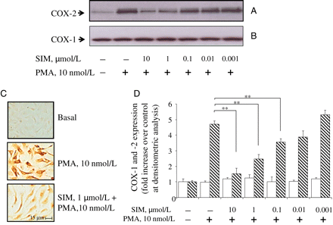
Figure 1 Simvastatin reduces PMA-stimulated COX-2 expression in a concentration-dependent fashion. Simvastatin (SIM) ...
Notes:
Figure 1 Simvastatin reduces PMA-stimulated COX-2 expression in a concentration-dependent fashion. Simvastatin (SIM) was incubated with confluent HUVECs for 12 h, after which PMA was added for an additional 12 h. Parallel monolayers were used to perform Western analysis for COX-2 (A) and COX-1 (B) and immunostaining for COX-2 (C). (D) Values of COX-2 and COX-1 expressions at Western analysis were obtained by band scanning and are shown as fold induction over control. Three independent experiments were performed. *P < 0.05 and **P < 0.01 between groups joined by the horizontal lines (ANOVA with post hoc testing).
Unless provided in the caption above, the following copyright applies to the content of this slide: Published on behalf of the European Society of Cardiology. All rights reserved. © The Author 2009. For permissions please email: journals.permissions@oxfordjournals.org.

Slide 2
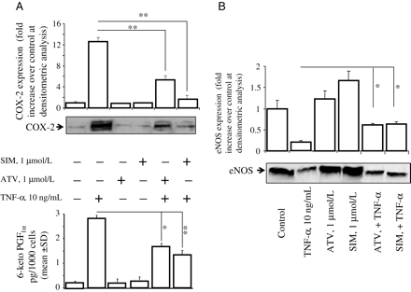
Figure 2 Statins reduce COX-2 protein expression and activity induced by TNF-α. (A) Simvastatin (SIM) and atorvastatin ...
Notes:
Figure 2 Statins reduce COX-2 protein expression and activity induced by TNF-α. (A) Simvastatin (SIM) and atorvastatin (ATV) were incubated with confluent HUVECs for 12 h, after which TNF-α was added for an additional 12 h. Monolayers were used to perform Western analysis, and supernatants were collected to assess the production of 6-keto-PGF1α in the medium. A significant reduction in COX-2 protein expression (upper panel) and enzyme activity (lower panel) is evident upon simvastatin treatment. Three independent experiments were performed. *P < 0.05 and **P < 0.01 between groups joined by the horizontal lines (ANOVA with post hoc testing). (B) In some experiments, blots, as in (A), were stripped and re-probed with an anti-eNOS antibody. Three independent experiments were performed. *P < 0.05 between groups joined by the horizontal lines (ANOVA with post hoc testing).
Unless provided in the caption above, the following copyright applies to the content of this slide: Published on behalf of the European Society of Cardiology. All rights reserved. © The Author 2009. For permissions please email: journals.permissions@oxfordjournals.org.

Slide 3
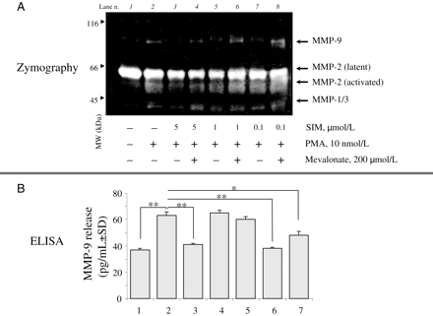
Figure 6 Simvastatin reduces the PMA-stimulated release of MMP-9 at gelatin zymography and EIA. Confluent HUVECs were ...
Notes:
Figure 6 Simvastatin reduces the PMA-stimulated release of MMP-9 at gelatin zymography and EIA. Confluent HUVECs were treated with simvastatin (SIM) in the presence or absence of mevalonate, GGpp, or Fpp (12 h before PMA stimulation) or only with NS-398 (30 min before PMA stimulation). After PMA stimulation, media were collected and analysed by gelatin zymography (A) or by enzyme-linked immunoassay (B). The image in (A) is representative of three separate experiments yielding similar results. In (B), the original readings were derived from three independent experiments each consisting of four replicates for each condition. *P < 0.05 and **P < 0.01 between groups joined by the horizontal lines (ANOVA with post hoc testing). Legend for (B): 1, basal; 2, PMA 10 nmol/L; 3, SIM 1 µmol/L + PMA 10 nmol/L; 4, SIM 1 µmol/L + PMA 10 nmol/L + mevalonate 200 µmol/L; 5, SIM 1 µmol/L + PMA 10 nmol/L + GGpp 5 µmol/L; 6, SIM 1 µmol/L + PMA 10 nmol/L + Fpp 5 µmol/L; 7, PMA 10 nmol/L + NS-398 1 mg/mL.
Unless provided in the caption above, the following copyright applies to the content of this slide: Published on behalf of the European Society of Cardiology. All rights reserved. © The Author 2009. For permissions please email: journals.permissions@oxfordjournals.org.

Slide 4
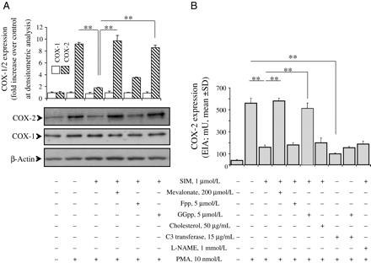
Figure 3 Effect of isoprenoid intermediates of the mevalonate pathway on COX-2 expression. (A) Confluent HUVECs were ...
Notes:
Figure 3 Effect of isoprenoid intermediates of the mevalonate pathway on COX-2 expression. (A) Confluent HUVECs were treated with simvastatin (SIM) in the presence or absence of mevalonate, GGpp, and Fpp for 12 h. Monolayers were then stimulated with PMA for a further 12 h, after which cell lysates were processed by Western analysis, with immunoblots probed first for COX-2 and then, after stripping, for COX-1 and/or β-actin. Images reported are representative of three separate experiments. Three independent experiments were performed. *P < 0.05 and **P < 0.01 between groups joined by the horizontal lines (ANOVA with post hoc testing). (B) Confluent HUVECs were treated as in (A), but also in the presence or absence of cholesterol, l-NAME, and C3 transferase. COX-2 expression was assessed by EIA. Original readings were derived from three independent experiments, each consisting of six replicates for each condition. **P < 0.05 between groups joined by the horizontal lines (ANOVA with post hoc testing).
Unless provided in the caption above, the following copyright applies to the content of this slide: Published on behalf of the European Society of Cardiology. All rights reserved. © The Author 2009. For permissions please email: journals.permissions@oxfordjournals.org.

Slide 5
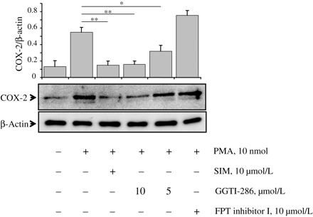
Figure 4 Effect of prenyltransferase inhibitors FTI-277 or GGTI-286 on PMA-dependent induction of COX-2. HUVECs were ...
Notes:
Figure 4 Effect of prenyltransferase inhibitors FTI-277 or GGTI-286 on PMA-dependent induction of COX-2. HUVECs were treated with simvastatin (SIM) or only with inhibitors of prenyltransferases and then stimulated with PMA for further 12 h. The levels of COX-2 were then assessed by Western analysis. Three independent experiments were performed. *P < 0.05 and **P < 0.01 between groups joined by the horizontal lines (ANOVA with post hoc testing).
Unless provided in the caption above, the following copyright applies to the content of this slide: Published on behalf of the European Society of Cardiology. All rights reserved. © The Author 2009. For permissions please email: journals.permissions@oxfordjournals.org.

Slide 6
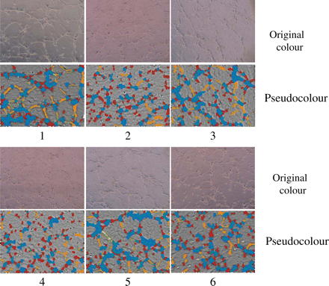
Figure 5 Effect of simvastatin and NS-398 on angiogenic activity of endothelial cells. HUVECs were treated with ...
Notes:
Figure 5 Effect of simvastatin and NS-398 on angiogenic activity of endothelial cells. HUVECs were treated with simvastatin in the presence or absence of mevalonate, GGpp, and Fpp for 12 h or with NS-398 for 30 min and, after enzymatic detachment, plated on Matrigel-coated 24-well plates and stimulated with PMA. After incubation at 37°C for 24 h, the images were taken, transformed, and analysed as indicated in section 2. Legend: 1, PMA 10 nmol/L; 2, SIM 1 µmol/L + PMA 10 nmol/L; 3, SIM 1 µmol/L + mevalonate 200 µmol/L + PMA 10 nmol/L; 4, SIM 1 µmol/L + Fpp 5 µmol/L + PMA 10 nmol/L; 5, SIM 1 µmol/L + GGpp 5 µmol/L + PMA 10 nmol/L; 6, NS-398 5 ng/mL + PMA 10 nmol/L.
Unless provided in the caption above, the following copyright applies to the content of this slide: Published on behalf of the European Society of Cardiology. All rights reserved. © The Author 2009. For permissions please email: journals.permissions@oxfordjournals.org.

