Slide 1
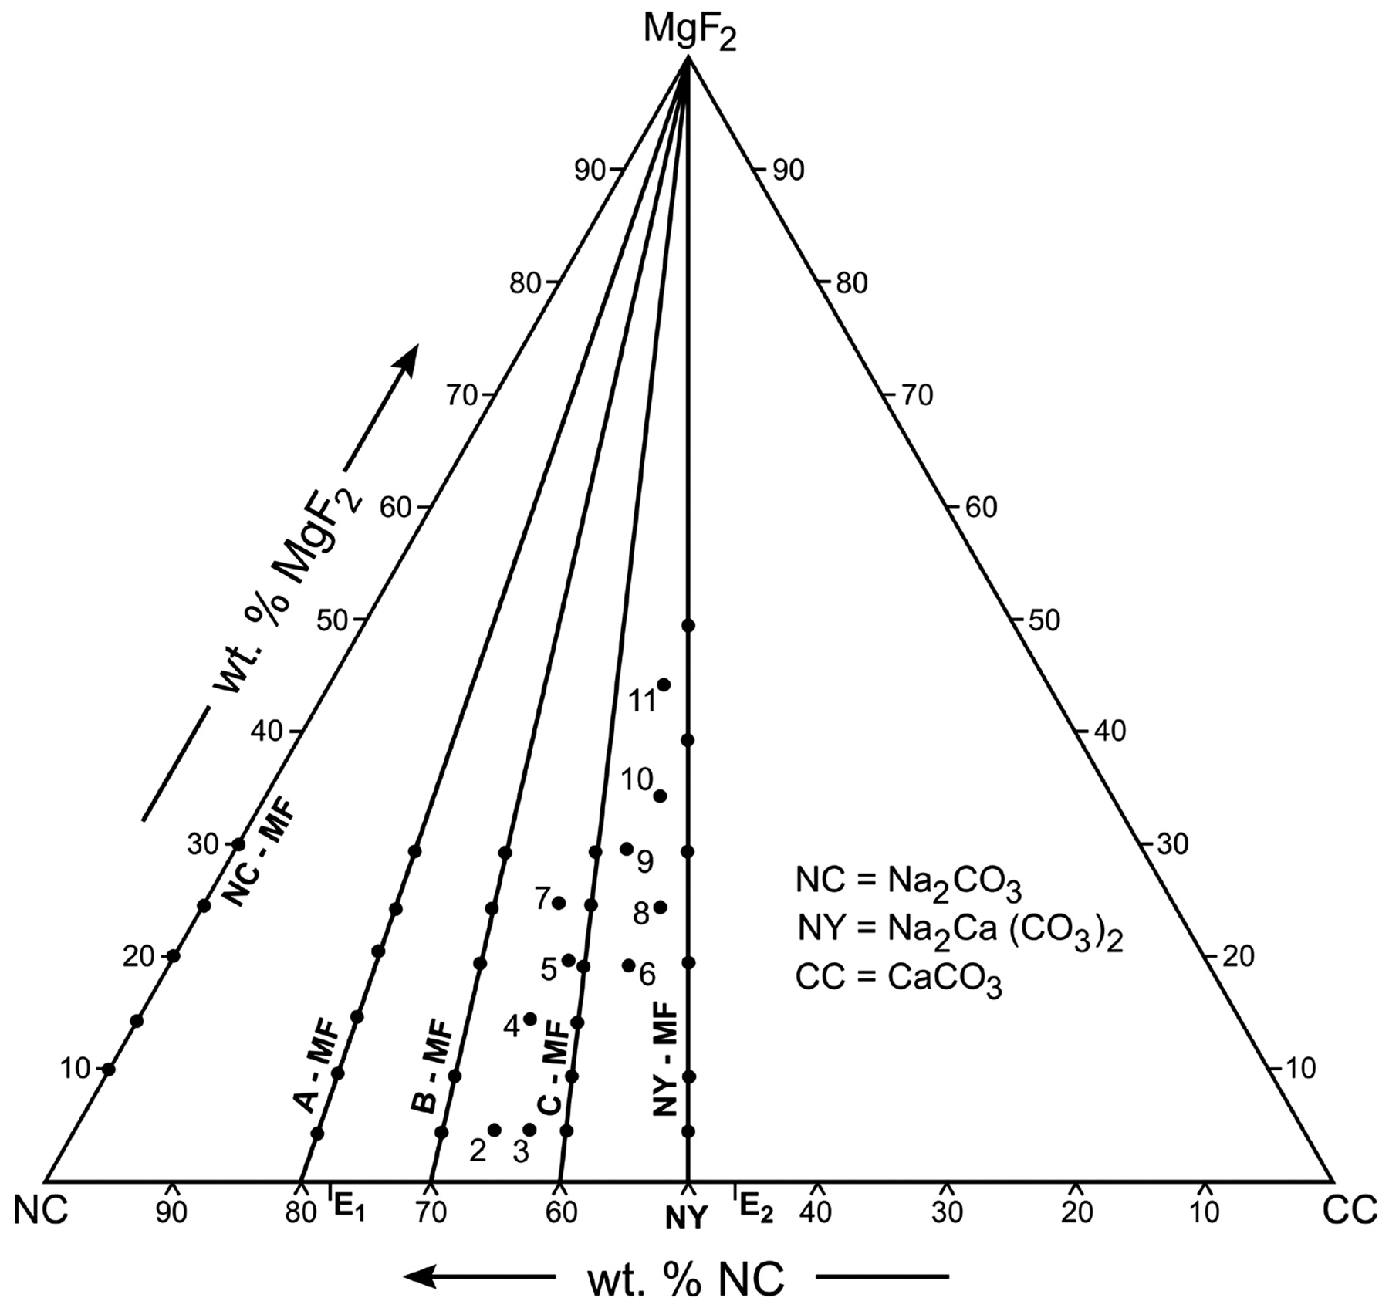
Fig. 1. Locations of the pseudobinary joins and bulk compositions studied in the ternary system ...
Notes:
Fig. 1. Locations of the pseudobinary joins and bulk compositions studied in the ternary system Na2CO3 (NC)–CaCO3 (CC)–MgF2. Numbers refer to sample numbers in Table 6.
Unless provided in the caption above, the following copyright applies to the content of this slide: © The Author 2010. Published by Oxford University Press. All rights reserved. For Permissions, please e-mail: journals.permissions@oup.com

Slide 2
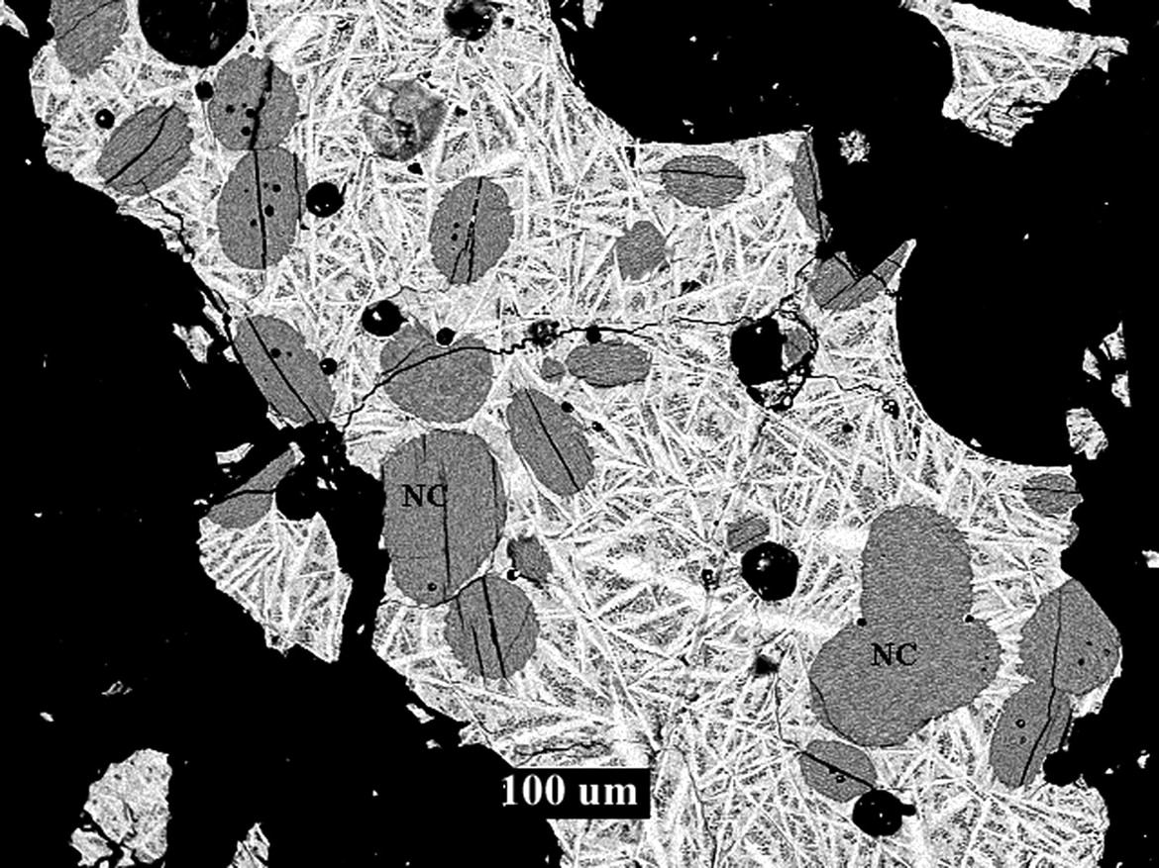
Fig. 2. Rounded primary liquidus crystals of Na₂CO₃ (NC) set in matrix of ...
Notes:
Fig. 2. Rounded primary liquidus crystals of Na2CO3 (NC) set in matrix of Na2Ca(CO3)2 laths and very fine-grained Na2CO3, NaMgF3 and Na2Mg(CO3)2. Composition (A)95(MF)5 at 650°C. BSE image.
Unless provided in the caption above, the following copyright applies to the content of this slide: © The Author 2010. Published by Oxford University Press. All rights reserved. For Permissions, please e-mail: journals.permissions@oup.com

Slide 3
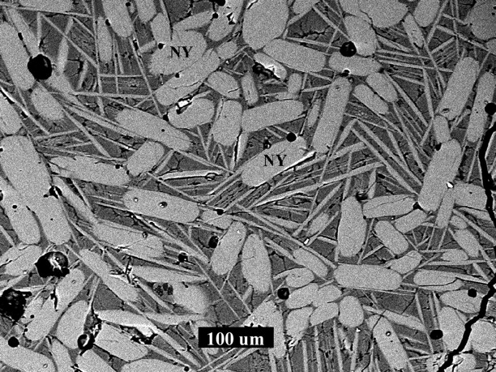
Fig. 3. Laths of primary liquidus crystals of Na₂Ca(CO₃)₂ (NY) set in a matrix of ...
Notes:
Fig. 3. Laths of primary liquidus crystals of Na2Ca(CO3)2 (NY) set in a matrix of skeletal quench NY (pale grey) and very fine-grained Na2CO3, NaMgF3 and Na2Mg(CO3)2. Composition (C)90(MF)10 at 600°C. BSE image.
Unless provided in the caption above, the following copyright applies to the content of this slide: © The Author 2010. Published by Oxford University Press. All rights reserved. For Permissions, please e-mail: journals.permissions@oup.com

Slide 4
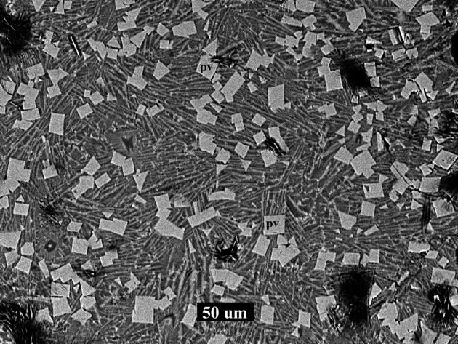
Fig. 4. Euhedral primary liquidus crystals of NaMgF₃ (PV) set in a matrix of quench crystals of ...
Notes:
Fig. 4. Euhedral primary liquidus crystals of NaMgF3 (PV) set in a matrix of quench crystals of Na2CO3 (pale grey) and Na2Mg(CO3)2 (dark grey). Composition (A)70(MF)30 at 700°C. BSE image.
Unless provided in the caption above, the following copyright applies to the content of this slide: © The Author 2010. Published by Oxford University Press. All rights reserved. For Permissions, please e-mail: journals.permissions@oup.com

Slide 5
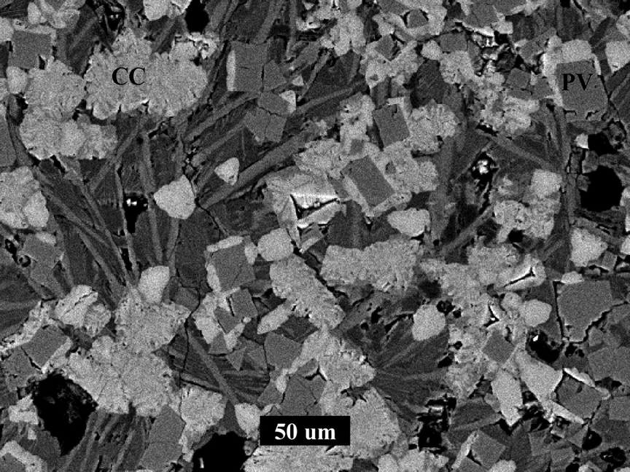
Fig. 5. Euhedral primary liquidus crystals of NaMgF₃ (PV) set in a matrix of quench crystals of calcite ...
Notes:
Fig. 5. Euhedral primary liquidus crystals of NaMgF3 (PV) set in a matrix of quench crystals of calcite (CC), Na2Ca(CO3)2 (light grey) and Na2Mg(CO3)2 (dark grey). Composition MF10 (Table 6) at 700°C. BSE image.
Unless provided in the caption above, the following copyright applies to the content of this slide: © The Author 2010. Published by Oxford University Press. All rights reserved. For Permissions, please e-mail: journals.permissions@oup.com

Slide 6
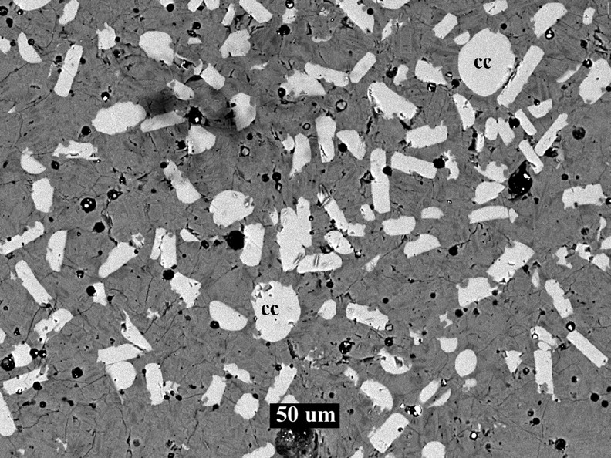
Fig. 6. Euhedral laths and rounded primary liquidus crystals of CaCO₃ (CC) set in a matrix of very ...
Notes:
Fig. 6. Euhedral laths and rounded primary liquidus crystals of CaCO3 (CC) set in a matrix of very fine-grained NY, Na2Mg(CO3)2 and NaMgF3. Composition (NY)80(MF)20 at 600°C. BSE image.
Unless provided in the caption above, the following copyright applies to the content of this slide: © The Author 2010. Published by Oxford University Press. All rights reserved. For Permissions, please e-mail: journals.permissions@oup.com

Slide 7
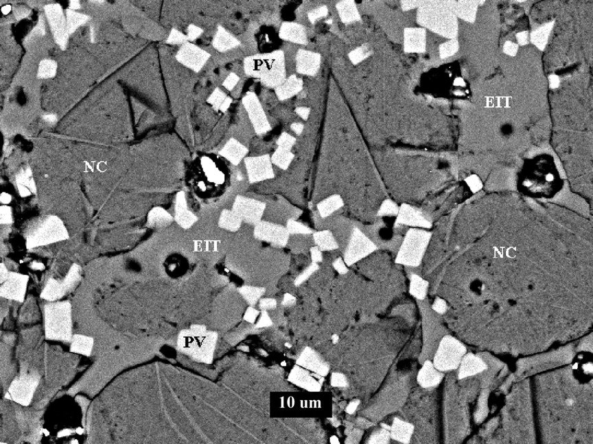
Fig. 7. Subsolidus assemblage of Na₂CO₃ (NC), NaMgF₃ (PV) and ...
Notes:
Fig. 7. Subsolidus assemblage of Na2CO3 (NC), NaMgF3 (PV) and Na2Mg(CO3)2 (EIT). Composition (NC)75(MF)25 at 550°C. BSE image.
Unless provided in the caption above, the following copyright applies to the content of this slide: © The Author 2010. Published by Oxford University Press. All rights reserved. For Permissions, please e-mail: journals.permissions@oup.com

Slide 8
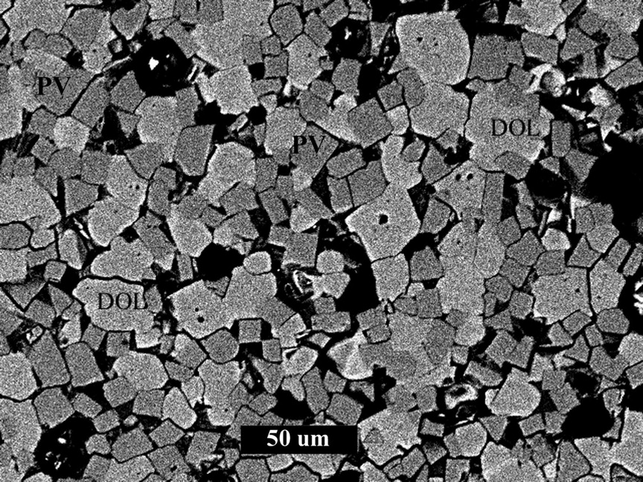
Fig. 8. Near solidus assemblage of NaMgF₃ (PV) and CaMg(CO₃)₂ (DOL). Dark areas are ...
Notes:
Fig. 8. Near solidus assemblage of NaMgF3 (PV) and CaMg(CO3)2 (DOL). Dark areas are fine grained mixtures of quench Na2Ca(CO3)2 and Na2Mg(CO3)2. Composition MF11 (Table 6) at 650°C. Back-scattered electron image.
Unless provided in the caption above, the following copyright applies to the content of this slide: © The Author 2010. Published by Oxford University Press. All rights reserved. For Permissions, please e-mail: journals.permissions@oup.com

Slide 9
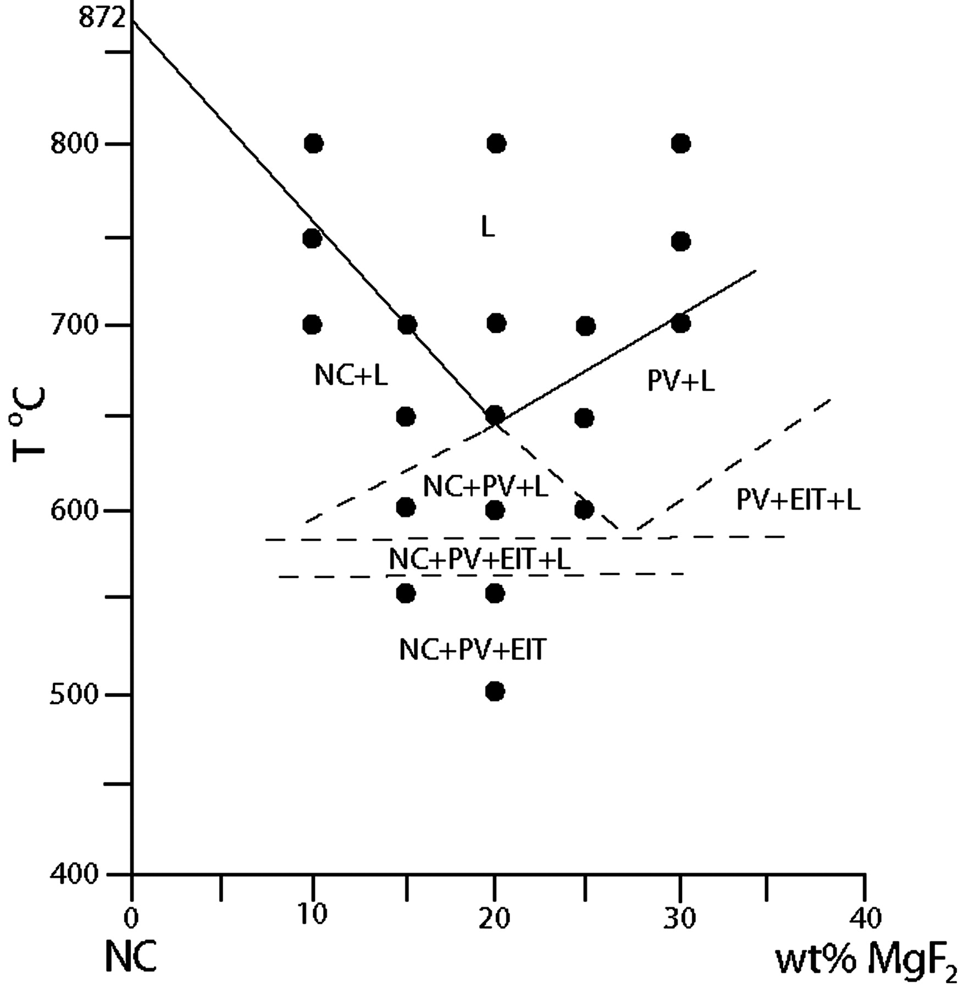
Fig. 9. Phase relationships along the pseudobinary join Na₂CO₃–MgF₂ (NC–MF) at ...
Notes:
Fig. 9. Phase relationships along the pseudobinary join Na2CO3–MgF2 (NC–MF) at 0·1 GPa pressure. NC, Na2CO3; PV, NaMgF3; EIT, Na2Mg(CO3)2; L, liquid.
Unless provided in the caption above, the following copyright applies to the content of this slide: © The Author 2010. Published by Oxford University Press. All rights reserved. For Permissions, please e-mail: journals.permissions@oup.com

Slide 10
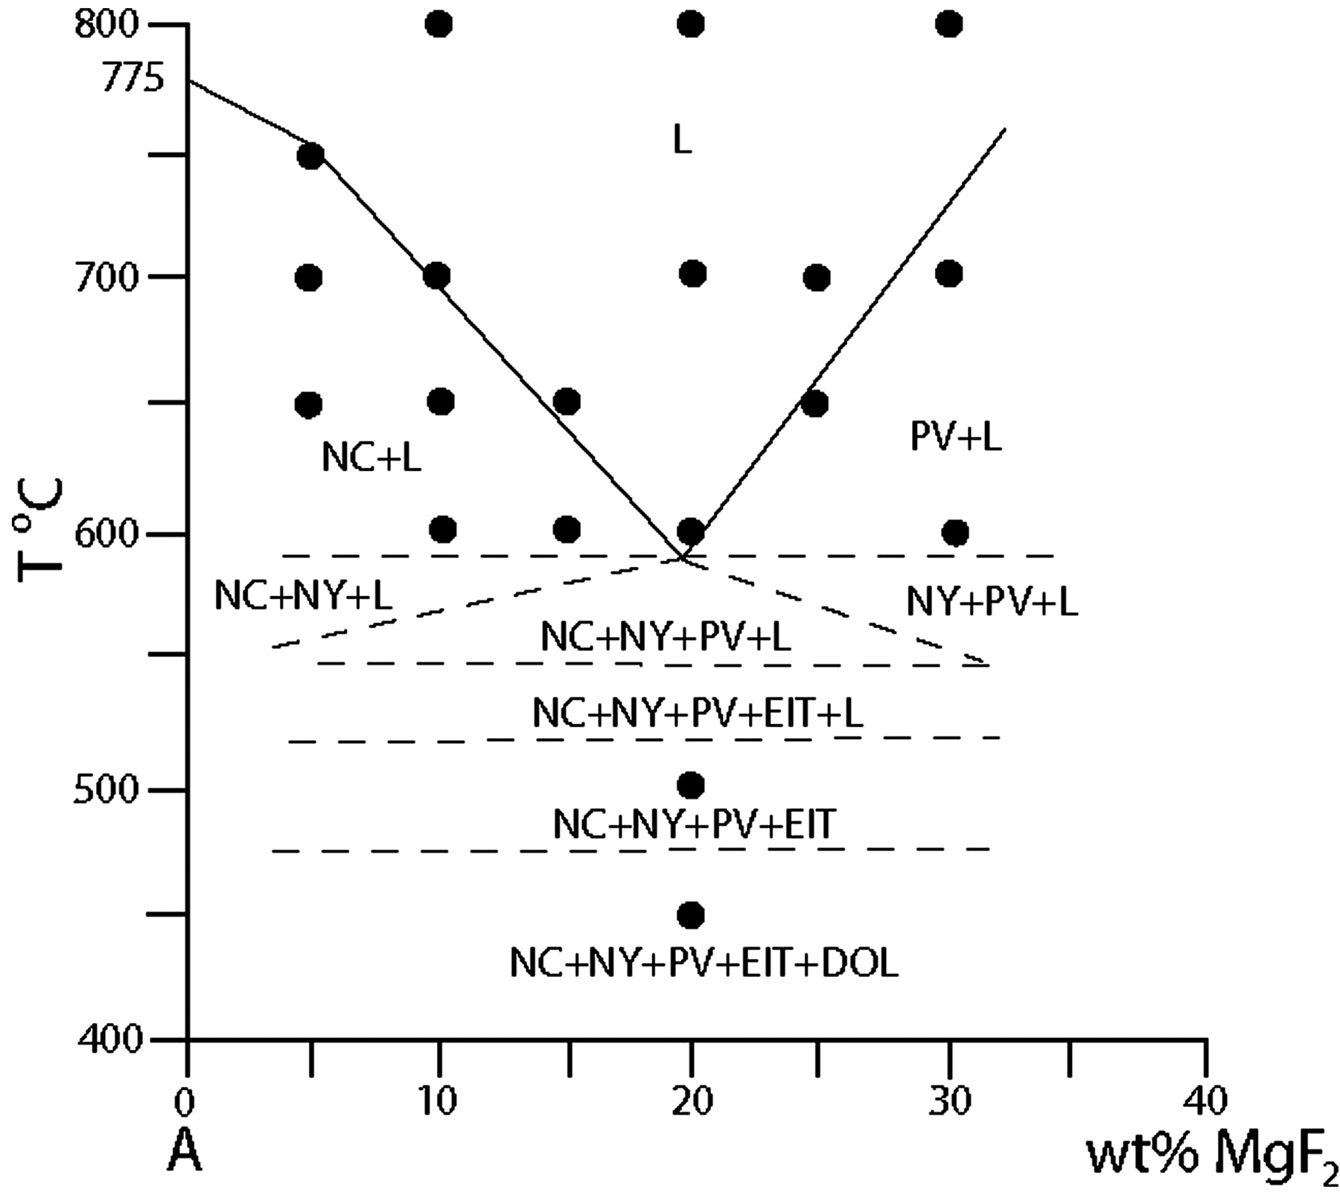
Fig. 10. Phase relationships along the pseudobinary join (A–MF) at 0·1 GPa pressure. NC, Na₂CO₃; ...
Notes:
Fig. 10. Phase relationships along the pseudobinary join (A–MF) at 0·1 GPa pressure. NC, Na2CO3; PV, NaMgF3; EIT, Na2Mg(CO3)2; NY, Na2Ca(CO3)2; DOL, CaMg(CO3)2; L, liquid.
Unless provided in the caption above, the following copyright applies to the content of this slide: © The Author 2010. Published by Oxford University Press. All rights reserved. For Permissions, please e-mail: journals.permissions@oup.com

Slide 11
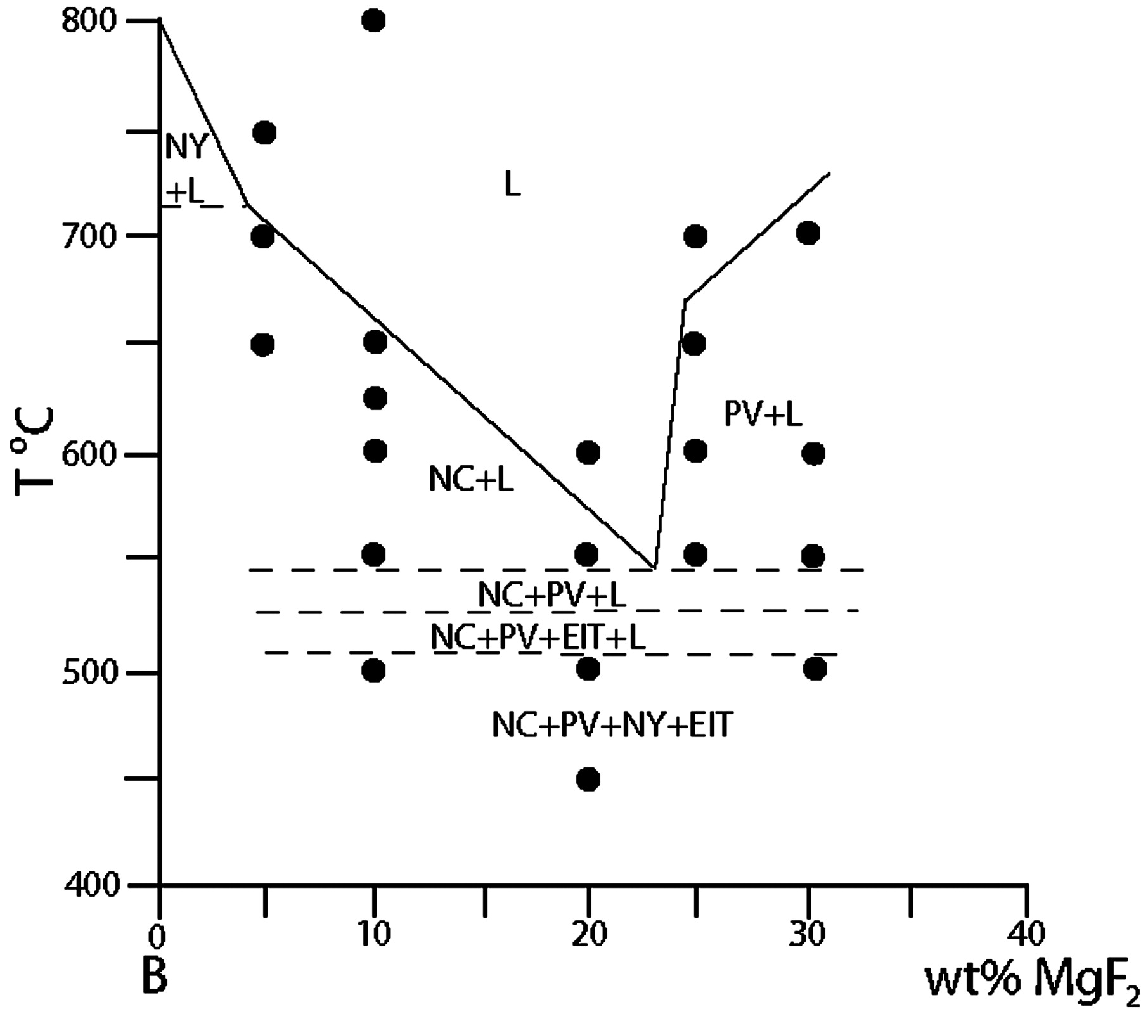
Fig. 11. Phase relationships along the pseudobinary join (B–MF) at 0·1 GPa pressure. NC, Na₂CO₃; ...
Notes:
Fig. 11. Phase relationships along the pseudobinary join (B–MF) at 0·1 GPa pressure. NC, Na2CO3; PV, NaMgF3; EIT, Na2Mg(CO3)2; NY, Na2Ca(CO3)2; L, liquid.
Unless provided in the caption above, the following copyright applies to the content of this slide: © The Author 2010. Published by Oxford University Press. All rights reserved. For Permissions, please e-mail: journals.permissions@oup.com

Slide 12
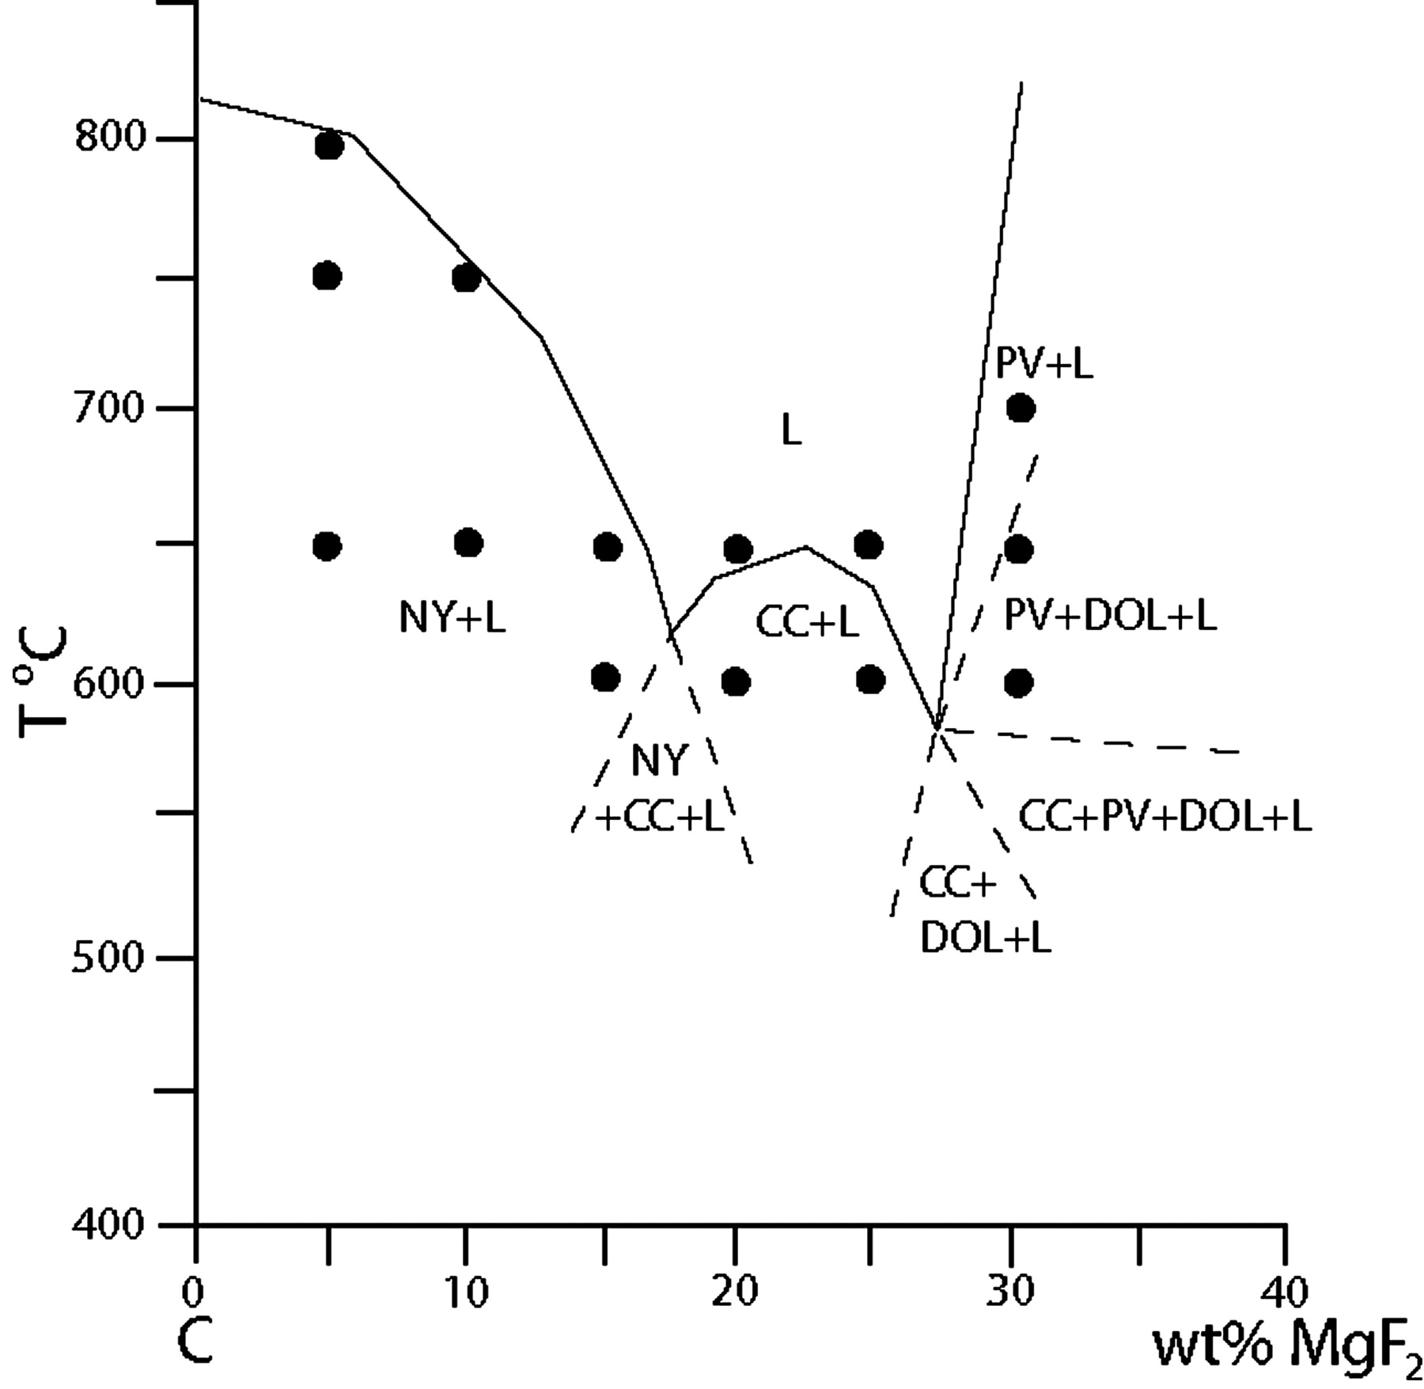
Fig. 12. Phase relationships along the pseudobinary join (C–MF) at 0·1 GPa pressure. NY, ...
Notes:
Fig. 12. Phase relationships along the pseudobinary join (C–MF) at 0·1 GPa pressure. NY, Na2Ca(CO3)2; PV, NaMgF3; CC, CaCO3; DOL, CaMg(CO3)2; L, liquid.
Unless provided in the caption above, the following copyright applies to the content of this slide: © The Author 2010. Published by Oxford University Press. All rights reserved. For Permissions, please e-mail: journals.permissions@oup.com

Slide 13
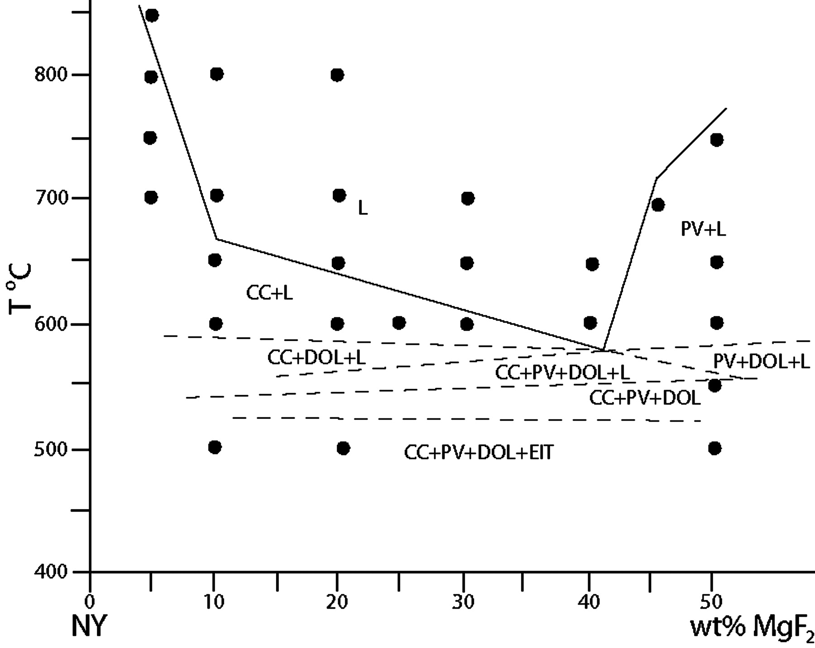
Fig. 13. Phase relationships along the pseudobinary join (NY–MF) at 0·1 GPa pressure. NY, ...
Notes:
Fig. 13. Phase relationships along the pseudobinary join (NY–MF) at 0·1 GPa pressure. NY, Na2Ca(CO3)2; PV, NaMgF3; EIT, Na2Mg(CO3)2; CC, CaCO3; DOL, CaMg(CO3)2; L, liquid.
Unless provided in the caption above, the following copyright applies to the content of this slide: © The Author 2010. Published by Oxford University Press. All rights reserved. For Permissions, please e-mail: journals.permissions@oup.com

Slide 14
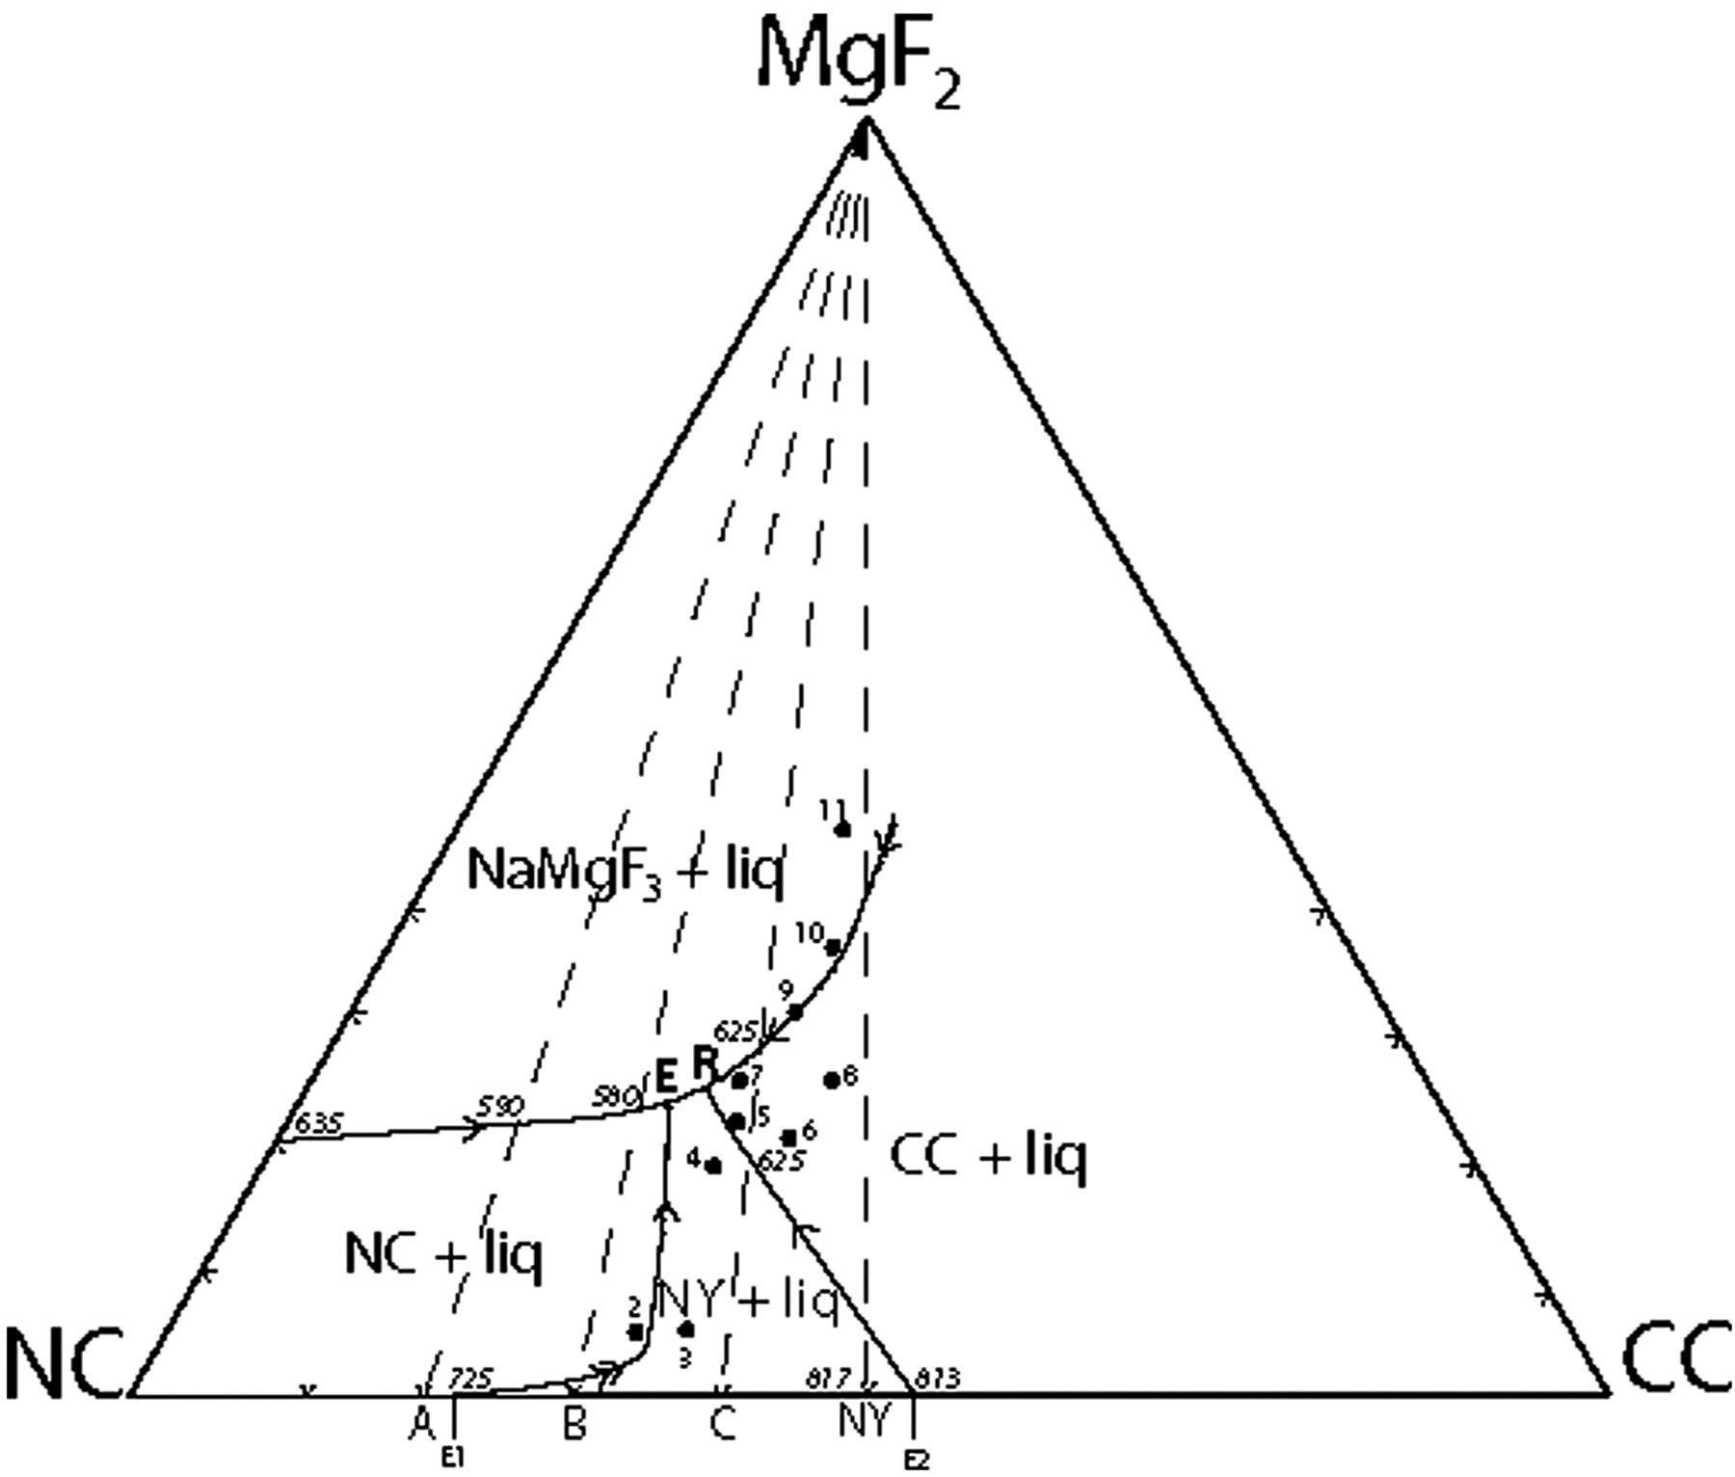
Fig. 14. Liquidus phase relationships in the pseudoternary system ...
Notes:
Fig. 14. Liquidus phase relationships in the pseudoternary system Na2CO3–CaCO3–MgF2 at 0·1 GPa pressure. Experimental run compositions labelled 2–11 (Table 6) were used to define the phase fields. E is a pseudoternary eutectic. R is a reaction point. NC, Na2CO3; NY, Na2Ca(CO3)2; CC, CaCO3; Liq, liquid.
Unless provided in the caption above, the following copyright applies to the content of this slide: © The Author 2010. Published by Oxford University Press. All rights reserved. For Permissions, please e-mail: journals.permissions@oup.com

Slide 15
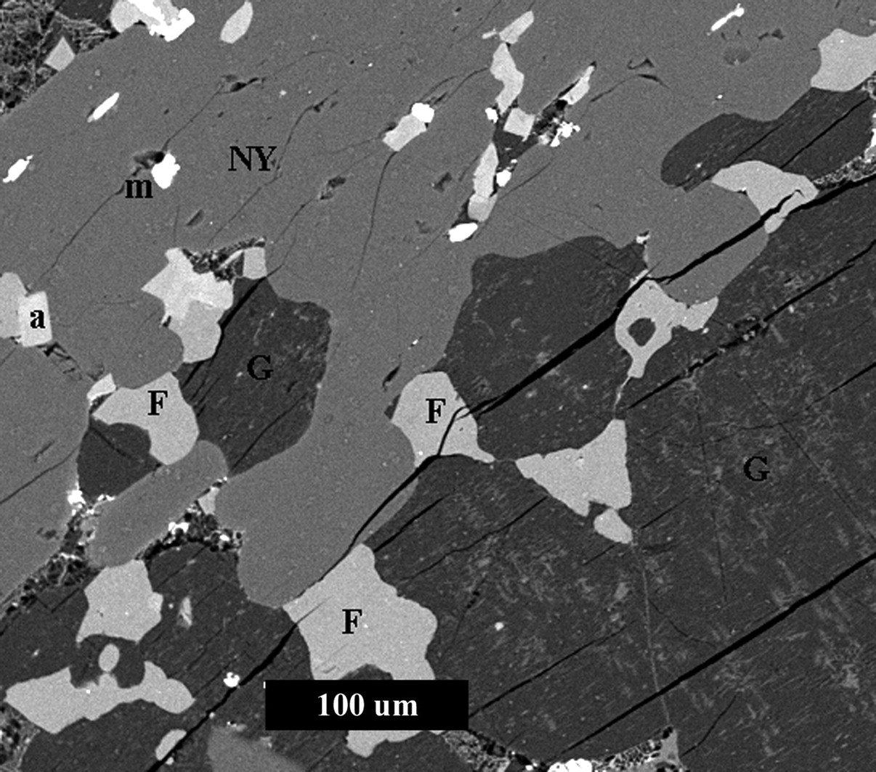
Fig. 15. Allotriomorphic granular textured microxenolith consisting of gregoryite (G), nyerereite (NY), and fluorite ...
Notes:
Fig. 15. Allotriomorphic granular textured microxenolith consisting of gregoryite (G), nyerereite (NY), and fluorite (F) with minor apatite (a) and magnetite (m). Natrocarbonatite flow 24 July 2000, hornito T49B, Oldoinyo Lengai, Tanzania.
Unless provided in the caption above, the following copyright applies to the content of this slide: © The Author 2010. Published by Oxford University Press. All rights reserved. For Permissions, please e-mail: journals.permissions@oup.com

Slide 16
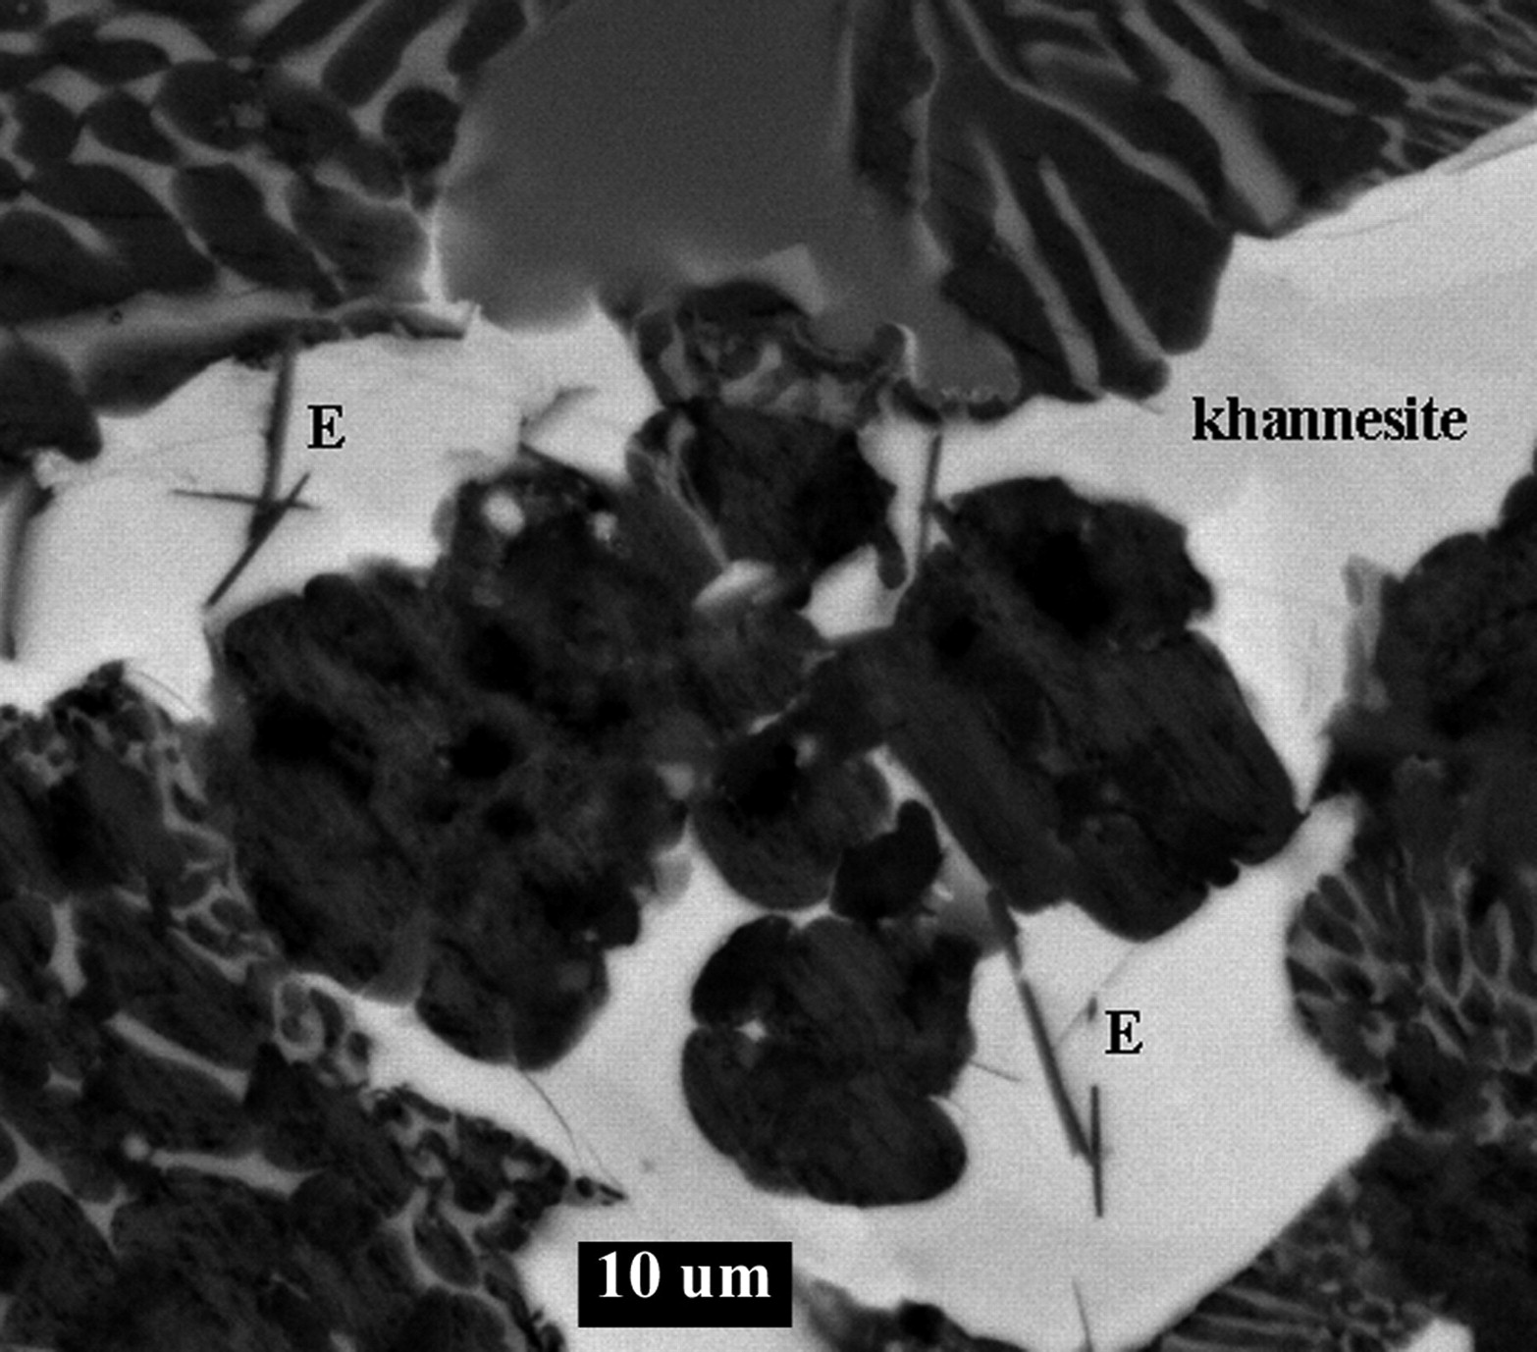
Fig. 16. Laths of a Mg-rich carbonate (?eitelite) set in a matrix of khannesite in the groundmass of a ...
Notes:
Fig. 16. Laths of a Mg-rich carbonate (?eitelite) set in a matrix of khannesite in the groundmass of a natrocarbonatite flow from hornito T37B, 26 July 200, Oldoinyo Lengai, Tanzania. E, eitelite.
Unless provided in the caption above, the following copyright applies to the content of this slide: © The Author 2010. Published by Oxford University Press. All rights reserved. For Permissions, please e-mail: journals.permissions@oup.com

