Slide 1
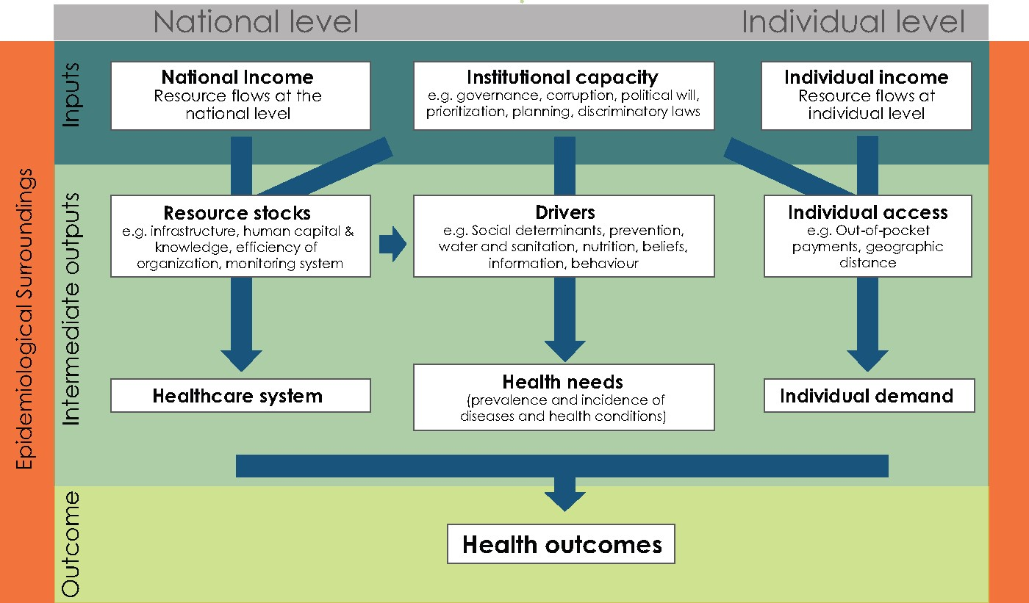
Figure 1. The health value chain within the epidemiological surroundings
Notes:
Figure 1. The health value chain within the epidemiological surroundings
Unless provided in the caption above, the following copyright applies to the content of this slide: The Author(s) 2017. Published by Oxford University Press in association with The London School of Hygiene and Tropical Medicine.This is an Open Access article distributed under the terms of the Creative Commons Attribution License (http://creativecommons.org/licenses/by/4.0/), which permits unrestricted reuse, distribution, and reproduction in any medium, provided the original work is properly cited.

Slide 2
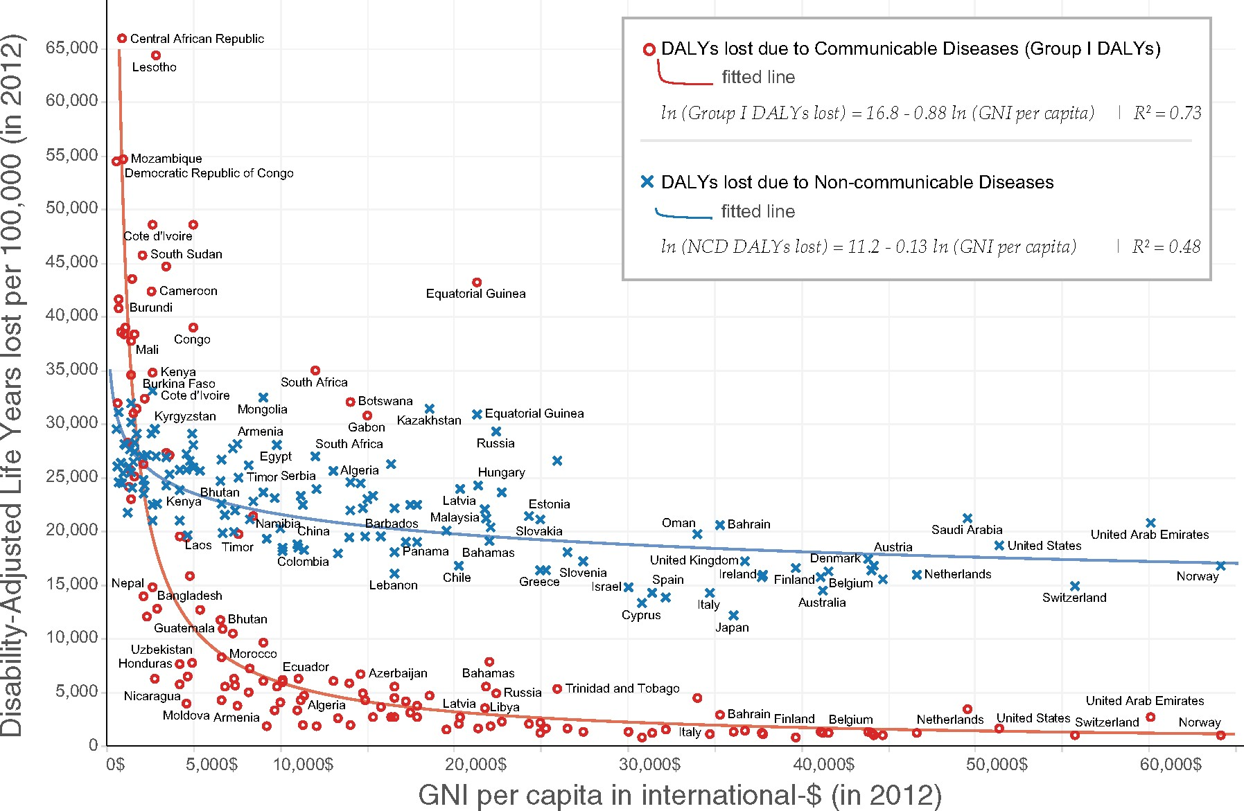
Figure 2. Scatter plots between DALYs lost per 100 000 and GNI per capita for 140 countries, distinguishing between ...
Notes:
Figure 2. Scatter plots between DALYs lost per 100 000 and GNI per capita for 140 countries, distinguishing between Group I DALYs and NCD DALYs
Unless provided in the caption above, the following copyright applies to the content of this slide: The Author(s) 2017. Published by Oxford University Press in association with The London School of Hygiene and Tropical Medicine.This is an Open Access article distributed under the terms of the Creative Commons Attribution License (http://creativecommons.org/licenses/by/4.0/), which permits unrestricted reuse, distribution, and reproduction in any medium, provided the original work is properly cited.

Slide 3
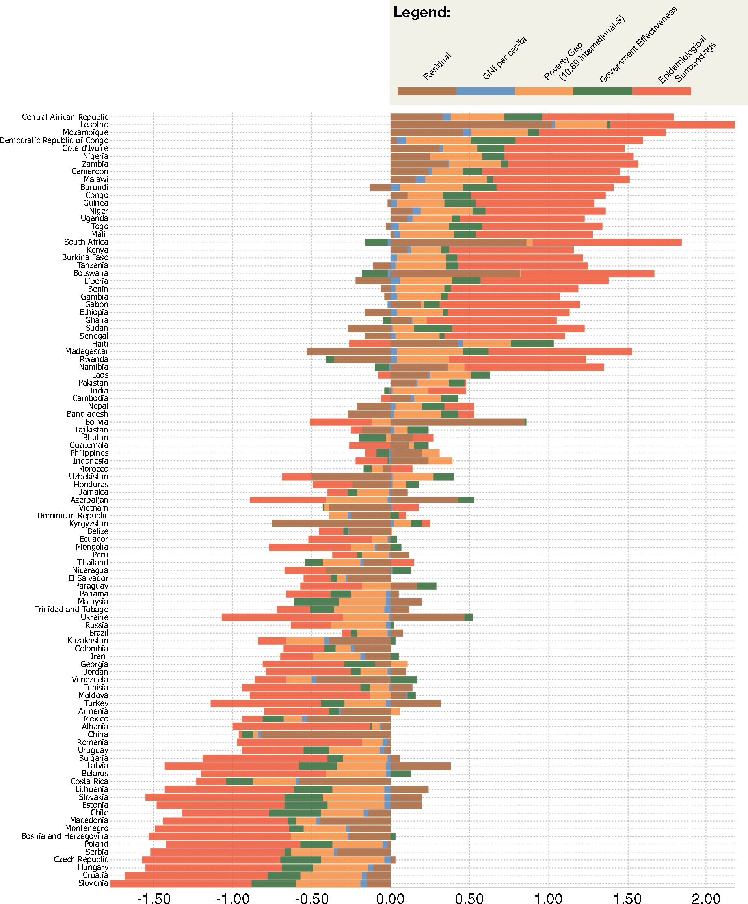
Figure 3. Decomposition of the contributions of our independent variables on Group I DALYs per country
Notes:
Figure 3. Decomposition of the contributions of our independent variables on Group I DALYs per country
Unless provided in the caption above, the following copyright applies to the content of this slide: The Author(s) 2017. Published by Oxford University Press in association with The London School of Hygiene and Tropical Medicine.This is an Open Access article distributed under the terms of the Creative Commons Attribution License (http://creativecommons.org/licenses/by/4.0/), which permits unrestricted reuse, distribution, and reproduction in any medium, provided the original work is properly cited.

