Slide 1
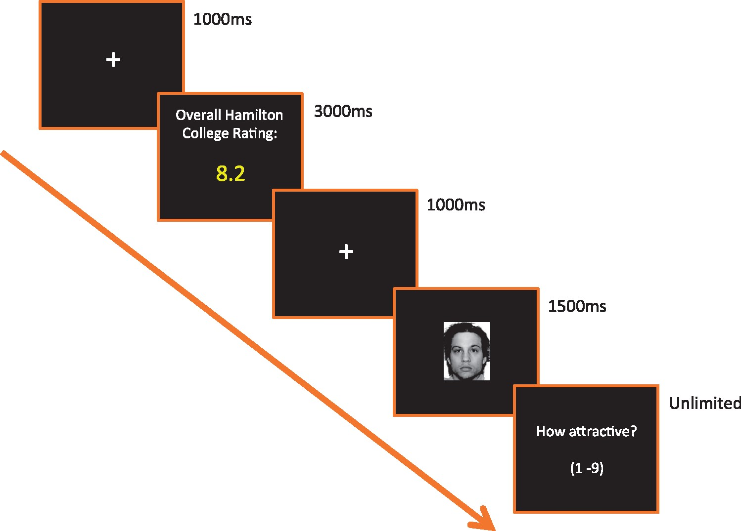
Fig. 1. Trial structure for the experimental task.
Notes:
Fig. 1. Trial structure for the experimental task.
Unless provided in the caption above, the following copyright applies to the content of this slide: © The Author(s) (2017). Published by Oxford University Press.This is an Open Access article distributed under the terms of the Creative Commons Attribution Non-Commercial License (http://creativecommons.org/licenses/by-nc/4.0/), which permits non-commercial re-use, distribution, and reproduction in any medium, provided the original work is properly cited. For commercial re-use, please contact journals.permissions@oup.com

Slide 2
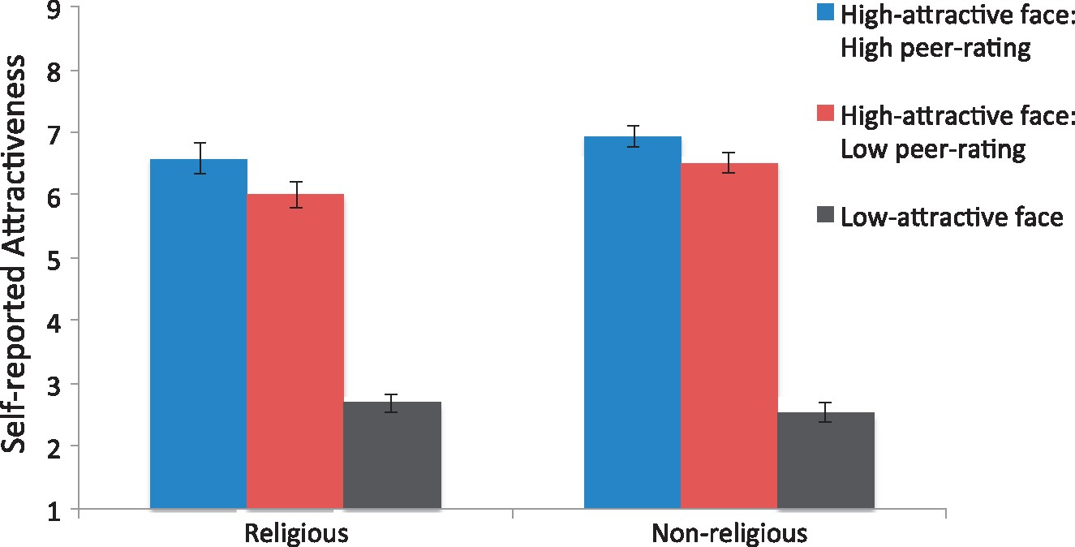
Fig. 2. Self-reported attractiveness scores by trial type in the religious and non-religious group. Error bars ...
Notes:
Fig. 2. Self-reported attractiveness scores by trial type in the religious and non-religious group. Error bars reflect standard error of the mean.
Unless provided in the caption above, the following copyright applies to the content of this slide: © The Author(s) (2017). Published by Oxford University Press.This is an Open Access article distributed under the terms of the Creative Commons Attribution Non-Commercial License (http://creativecommons.org/licenses/by-nc/4.0/), which permits non-commercial re-use, distribution, and reproduction in any medium, provided the original work is properly cited. For commercial re-use, please contact journals.permissions@oup.com

Slide 3
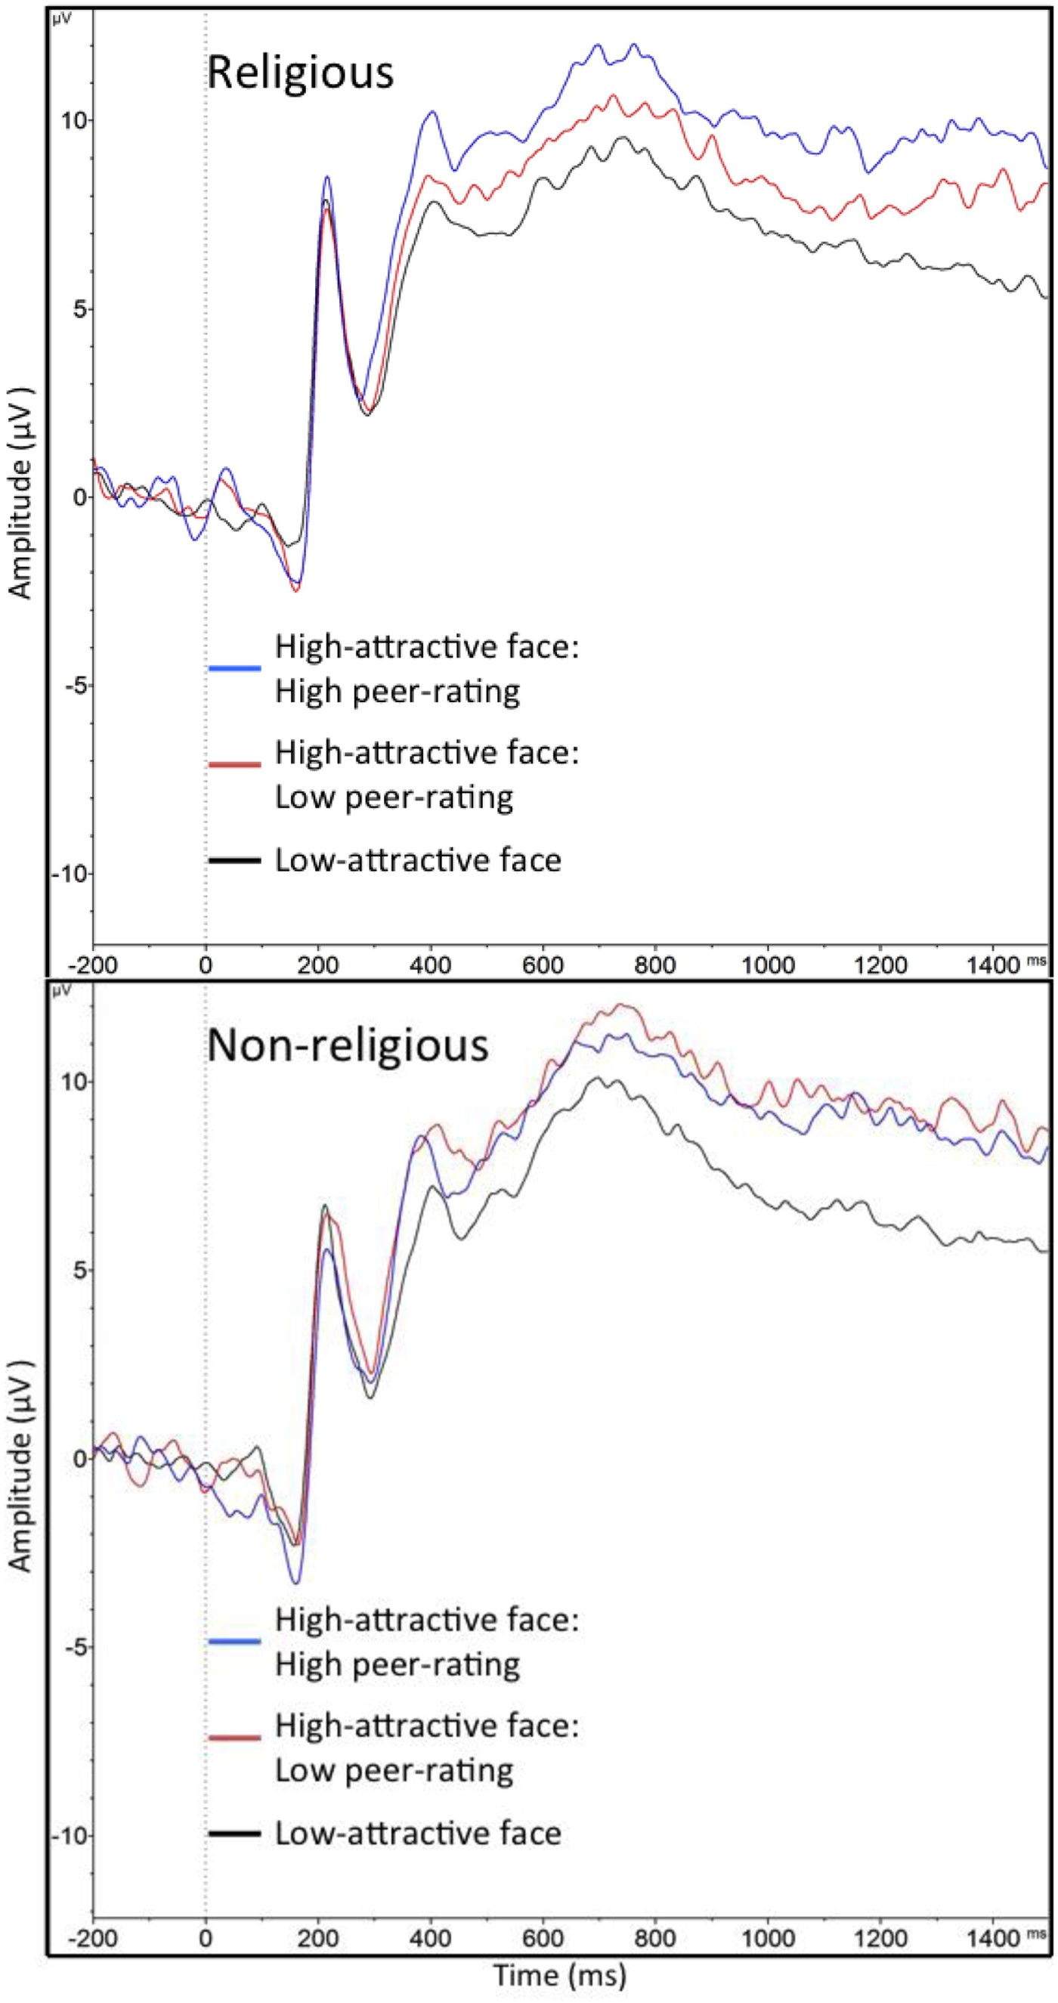
Fig. 3. LPP waveforms (at site Pz) to face presentation by trial type in the religious and non-religious group.
Notes:
Fig. 3. LPP waveforms (at site Pz) to face presentation by trial type in the religious and non-religious group.
Unless provided in the caption above, the following copyright applies to the content of this slide: © The Author(s) (2017). Published by Oxford University Press.This is an Open Access article distributed under the terms of the Creative Commons Attribution Non-Commercial License (http://creativecommons.org/licenses/by-nc/4.0/), which permits non-commercial re-use, distribution, and reproduction in any medium, provided the original work is properly cited. For commercial re-use, please contact journals.permissions@oup.com

Slide 4
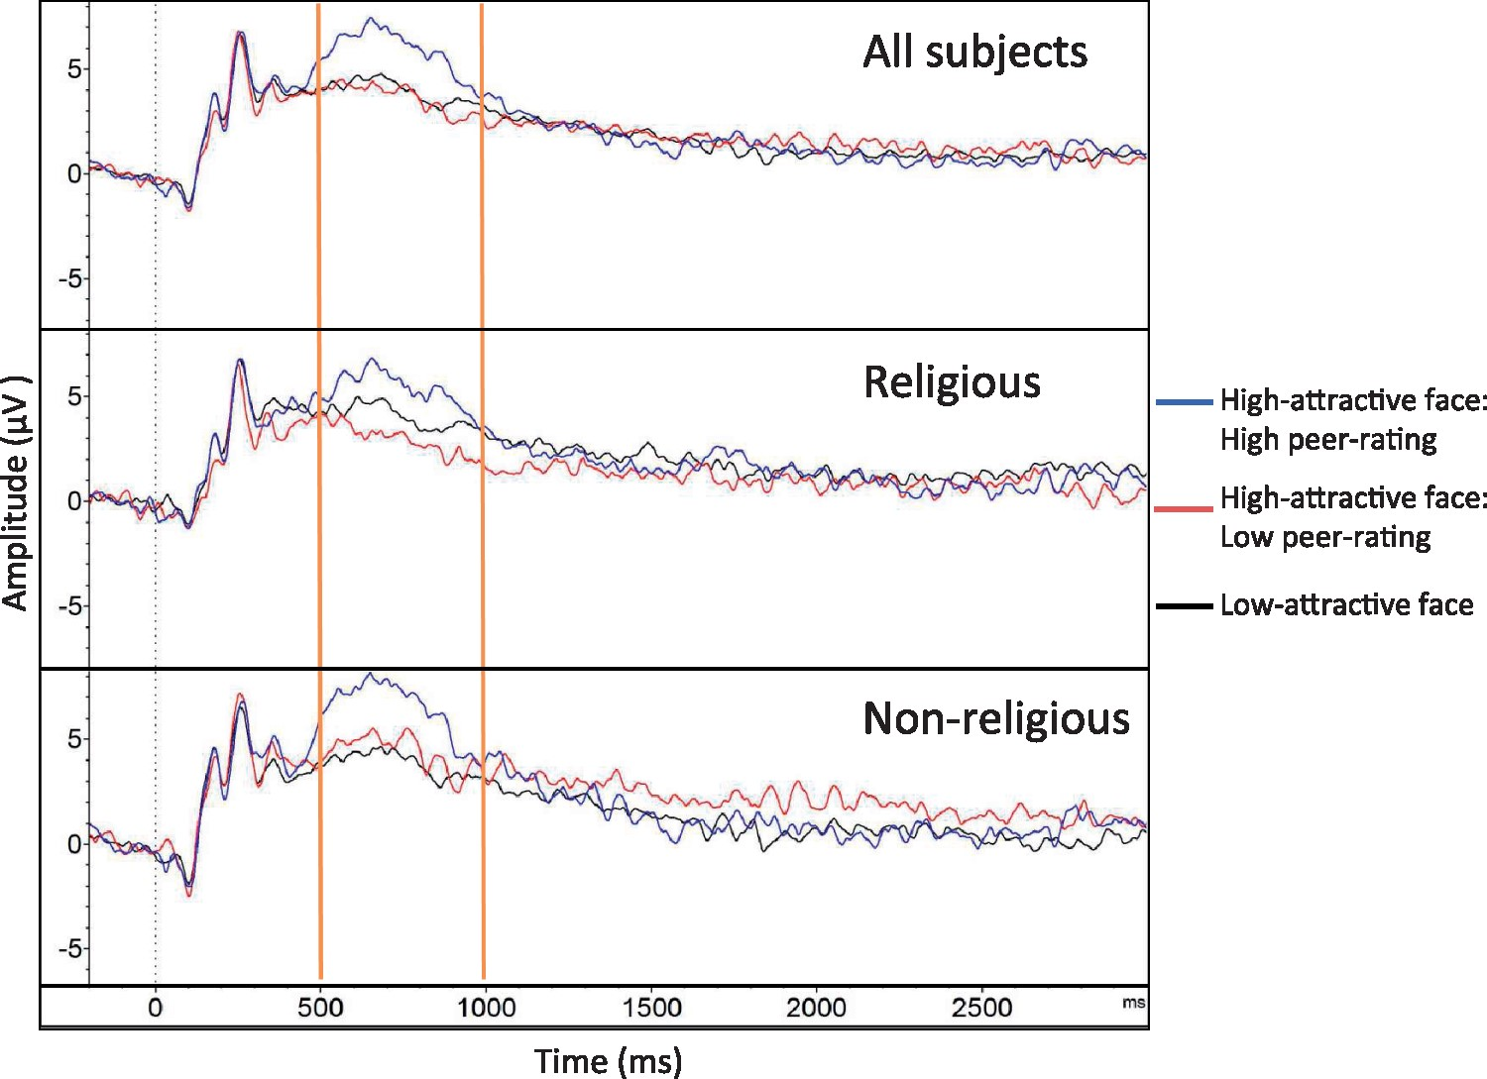
Fig. 4. LPP waveforms (at site Pz) to peer-rating presentation by trial type in the religious and non-religious ...
Notes:
Fig. 4. LPP waveforms (at site Pz) to peer-rating presentation by trial type in the religious and non-religious group. The 500–1000 ms time range used for analyses is highlighted for clarity.
Unless provided in the caption above, the following copyright applies to the content of this slide: © The Author(s) (2017). Published by Oxford University Press.This is an Open Access article distributed under the terms of the Creative Commons Attribution Non-Commercial License (http://creativecommons.org/licenses/by-nc/4.0/), which permits non-commercial re-use, distribution, and reproduction in any medium, provided the original work is properly cited. For commercial re-use, please contact journals.permissions@oup.com

