Slide 1
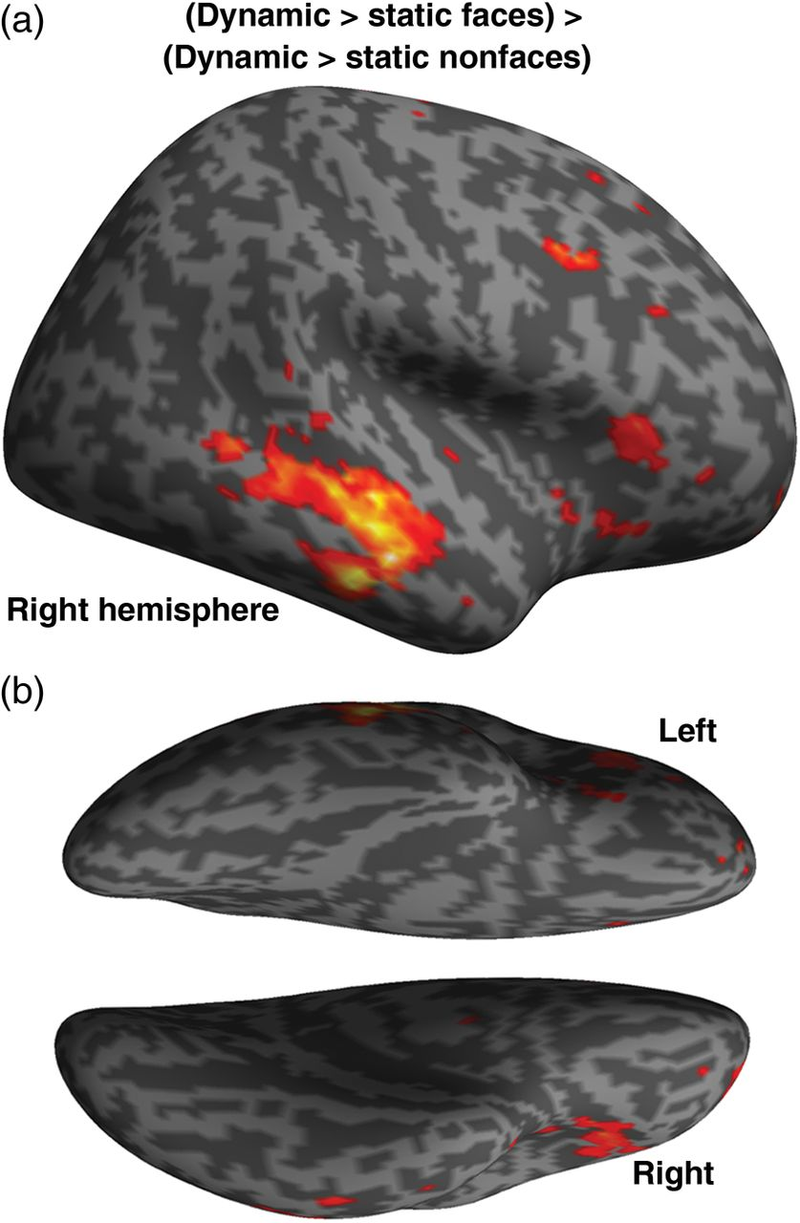
Figure 1. Group-level whole-brain analysis. (a) Results of contrast (dynamic faces > static faces) > (dynamic nonfaces ...
Notes:
Figure 1. Group-level whole-brain analysis. (a) Results of contrast (dynamic faces > static faces) > (dynamic nonfaces > static nonfaces). (b) Voxels showing significant effects at P < 0.005 (uncorrected) are projected on an inflated cortical surface of the right hemisphere in MNI space. STS, superior temporal sulcus.
Unless provided in the caption above, the following copyright applies to the content of this slide: © The Author 2014. Published by Oxford University PressThis is an Open Access article distributed under the terms of the Creative Commons Attribution License (http://creativecommons.org/licenses/by/3.0/), which permits unrestricted reuse, distribution, and reproduction in any medium, provided the original work is properly cited.

Slide 2
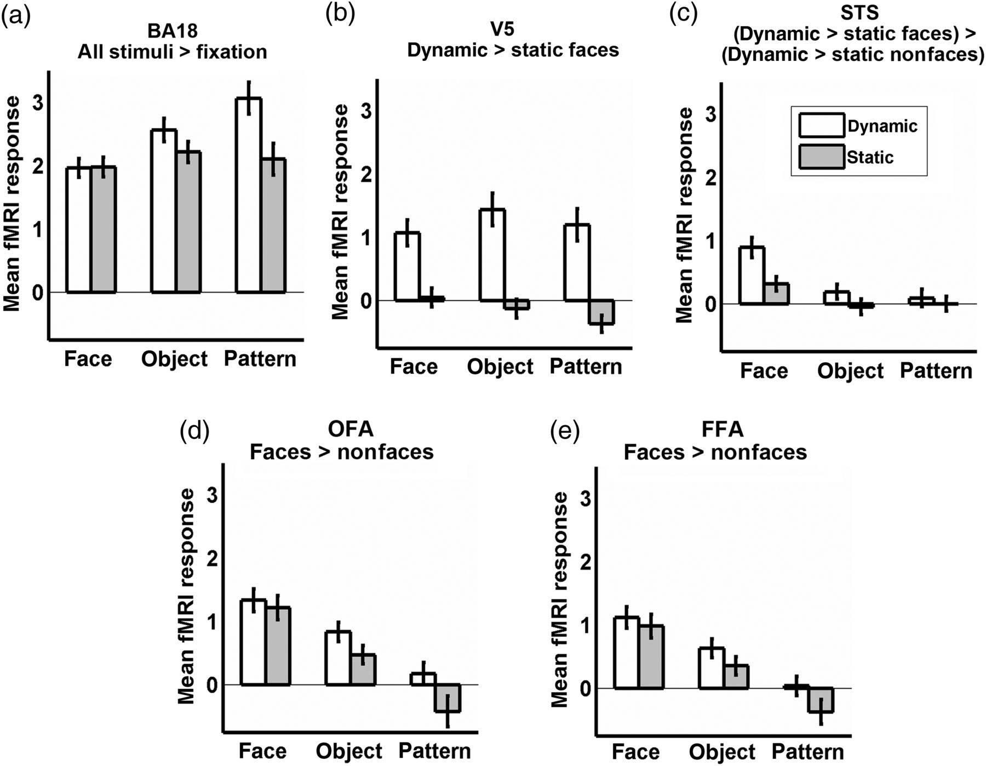
Figure 2. Group-level region-of-interest (ROI) analysis. (a) Mean responses in Brodmann area 18 (BA18) to faces, ...
Notes:
Figure 2. Group-level region-of-interest (ROI) analysis. (a) Mean responses in Brodmann area 18 (BA18) to faces, objects, and random-dot patterns; (b) mean responses in V5; (c) mean responses in the superior temporal sulcus (STS); (d) mean responses in the occipital face area (OFA); (e) mean responses in the fusiform face area (FFA). Graph titles describe contrast used to define ROI.
Unless provided in the caption above, the following copyright applies to the content of this slide: © The Author 2014. Published by Oxford University PressThis is an Open Access article distributed under the terms of the Creative Commons Attribution License (http://creativecommons.org/licenses/by/3.0/), which permits unrestricted reuse, distribution, and reproduction in any medium, provided the original work is properly cited.

Slide 3
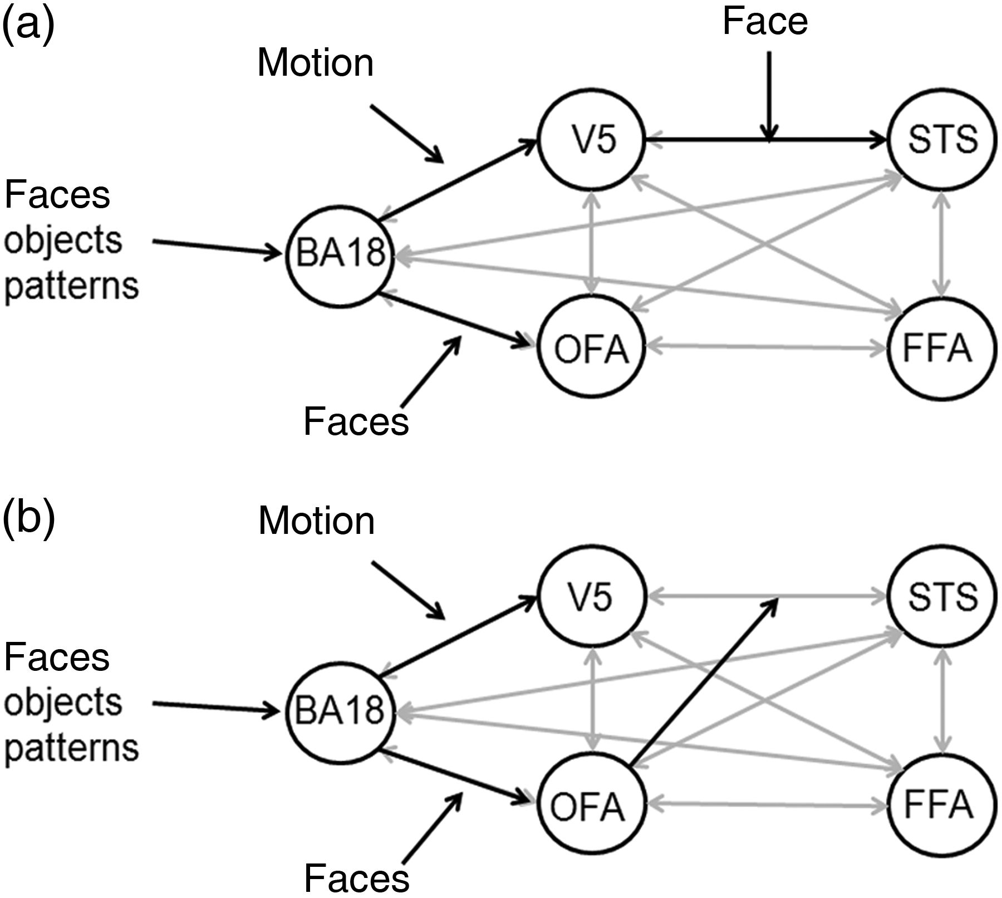
Figure 3. Optimal dynamic causal models (a) the optimal bilinear model generates motion sensitivity that is selective ...
Notes:
Figure 3. Optimal dynamic causal models (a) the optimal bilinear model generates motion sensitivity that is selective to facial form in the superior temporal sulcus (STS) when faces modulate connections from the motion-sensitive V5 to STS. Bilinear modulations indicated by black arrows, endogenous connections indicated in light gray. The optimal model had full endogenous connectivity. (b) The optimal nonlinear model shows that the face-selective occipital face area (OFA) is the most likely origin of face modulation on the connections from V5 to STS. Bilinear and nonlinear modulations indicated by black arrows, endogenous connections indicated in light gray. FFA, fusiform face area, BA18, Brodmann area 18.
Unless provided in the caption above, the following copyright applies to the content of this slide: © The Author 2014. Published by Oxford University PressThis is an Open Access article distributed under the terms of the Creative Commons Attribution License (http://creativecommons.org/licenses/by/3.0/), which permits unrestricted reuse, distribution, and reproduction in any medium, provided the original work is properly cited.

