Slide 1
Figure 1 Two sites in each of two aligned sequences drawn from different branches of a phylogeny.
Notes:
Figure 1 Two sites in each of two aligned sequences drawn from different branches of a phylogeny.
Unless provided in the caption above, the following copyright applies to the content of this slide: © 2004 Society of Systematic Biologists

Slide 2
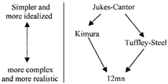
Figure 2 Models of the evolutionary process are simpler or more complex according to how many adjustable parameters ...
Notes:
Figure 2 Models of the evolutionary process are simpler or more complex according to how many adjustable parameters they contain. The arrow represents deductive implication; “M1→M2” means that if M1 is true, M2 must be true.
Unless provided in the caption above, the following copyright applies to the content of this slide: © 2004 Society of Systematic Biologists

Slide 3
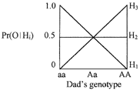
Figure 3 The likelihoods of three hypotheses about Mom's genotype, relative to the observation (O) that the offspring ...
Notes:
Figure 3 The likelihoods of three hypotheses about Mom's genotype, relative to the observation (O) that the offspring is a heterozygote. For two of them (H1 and H3), Dad's genotype is a nuisance parameter.
Unless provided in the caption above, the following copyright applies to the content of this slide: © 2004 Society of Systematic Biologists

