Slide 1
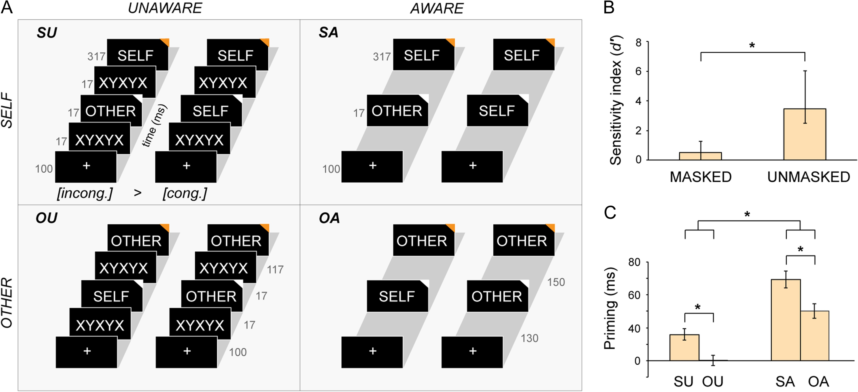
Figure 1. Experimental design and behavioral results. (A) Self- and other-related stimuli (names, surnames, dates of ...
Notes:
Figure 1. Experimental design and behavioral results. (A) Self- and other-related stimuli (names, surnames, dates of birth, and nationality codes) were presented visually, and the participants’ task was to decide (by pressing one of the two buttons) whether stimuli occurring at the end of each trial (the targets; indicated by orange triangles) were related to themselves or to another person. In half of the trials, stimuli appearing before the targets (the primes; white triangles) were immediately preceded and followed by visual masks, thus making the aware processing of these primes highly demanding. In the other half of the trials, there were no masks, which made the aware processing easy. Stimulus durations and intervals between stimuli are indicated in milliseconds, next to the time axis. (B) The results of the visibility test showed that subjects were much worse at discriminating masked primes than unmasked primes (zero indicates the chance level; bar plots indicate medians ± interquartile ranges). (C) The priming effect (RTs incongruent > congruent trials) was significantly stronger in the “self” than in the “other” condition and stronger in the “aware” than in the “unaware” condition (bars indicate means ± standard errors). cong., congruent trials; incong., incongruent trials.
Unless provided in the caption above, the following copyright applies to the content of this slide: © The Author 2017. Published by Oxford University Press.This is an Open Access article distributed under the terms of the Creative Commons Attribution Non-Commercial License (http://creativecommons.org/licenses/by-nc/4.0/), which permits non-commercial re-use, distribution, and reproduction in any medium, provided the original work is properly cited. For commercial re-use, please contact journals.permissions@oup.com

Slide 2
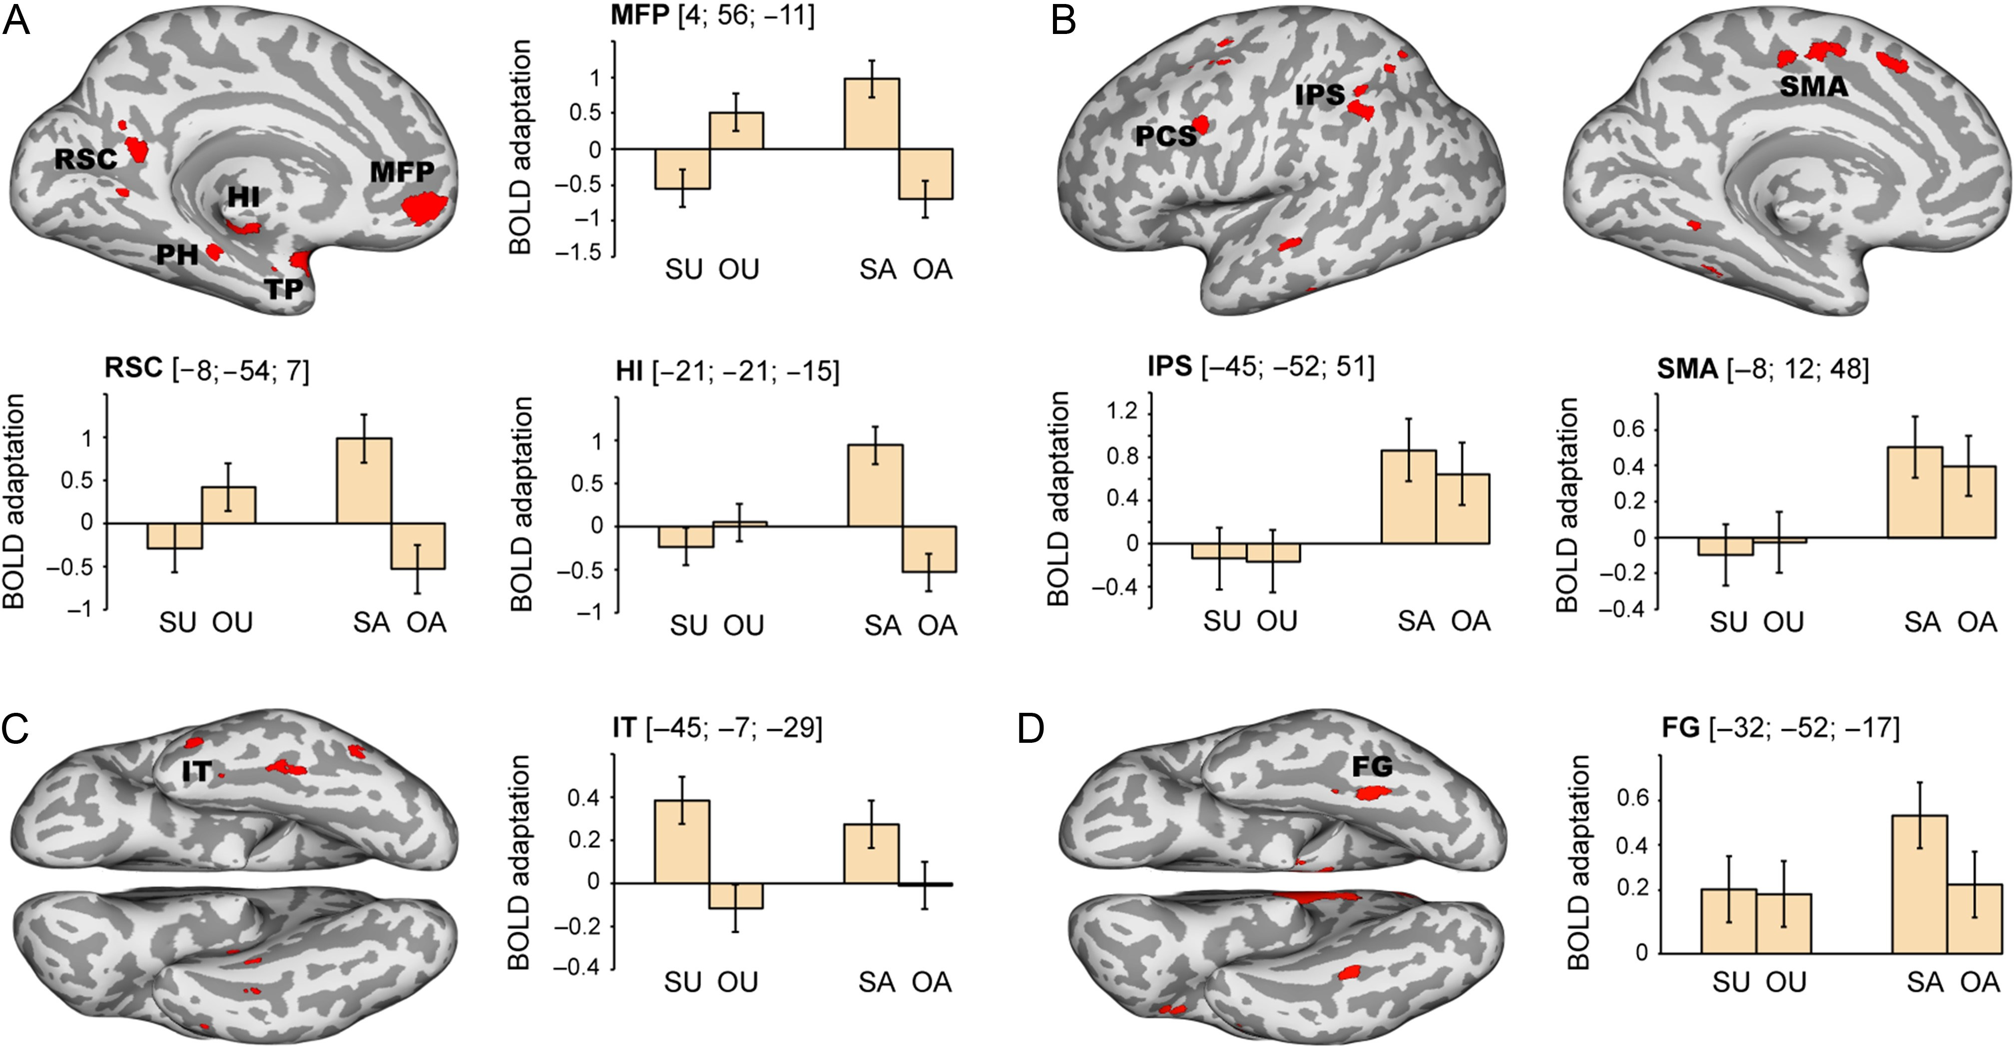
Figure 2. Results of fMRI analysis. Brain regions related to (A) conceptual self-awareness, (B) perceptual awareness, ...
Notes:
Figure 2. Results of fMRI analysis. Brain regions related to (A) conceptual self-awareness, (B) perceptual awareness, (C) unaware processing of self-related information, and (D) unaware processing of all types of stimuli. Areas showing significant BOLD-adaptation effects are highlighted in red (peaks P < 0.05 corrected; cluster maps thresholded at P congruent trials) and they are added for purely descriptive purposes; error bars denote standard errors. FG, fusiform gyrus; HI, hippocampus; IPS, intraparietal sulcus; IT, inferior temporal cortex; MFP, medial frontal pole; PCS, precentral sulcus; PH, parahippocampal gyrus; RSC, retrosplenial cortex; SMA, supplementary motor area; TP, temporal pole.
Unless provided in the caption above, the following copyright applies to the content of this slide: © The Author 2017. Published by Oxford University Press.This is an Open Access article distributed under the terms of the Creative Commons Attribution Non-Commercial License (http://creativecommons.org/licenses/by-nc/4.0/), which permits non-commercial re-use, distribution, and reproduction in any medium, provided the original work is properly cited. For commercial re-use, please contact journals.permissions@oup.com

Slide 3
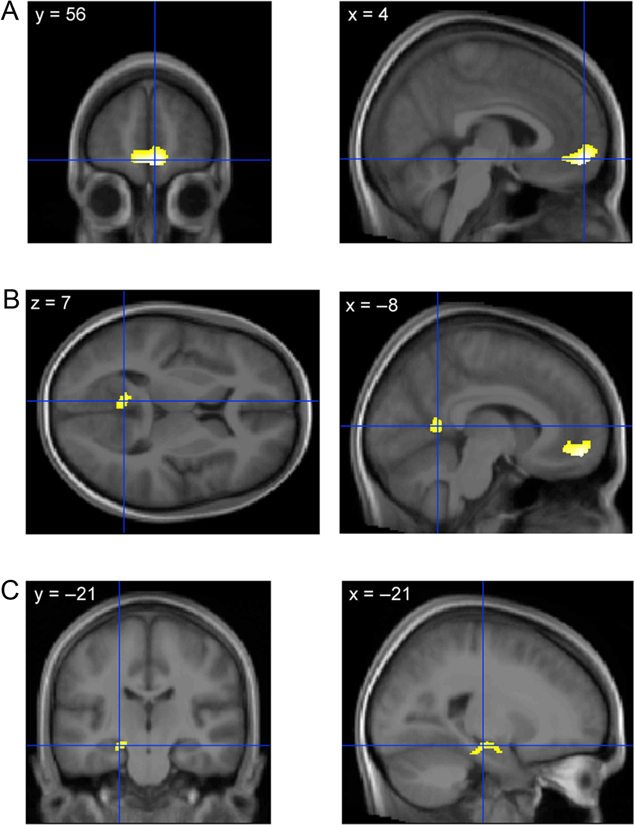
Figure 3. Anatomical localization of BOLD-adaptation responses related to conceptual self-awareness. The peak ...
Notes:
Figure 3. Anatomical localization of BOLD-adaptation responses related to conceptual self-awareness. The peak activations from the interaction contrast (also shown in Fig. 2A) are here superimposed on a mean MRI generated from the standardized anatomical MRIs of the 26 participants. As can be seen, the peaks (indicted by the crossing of the blue lines) are located in (A) the medial frontopolar prefrontal cortex, (B) the hippocampus, and (C) the retrosplenial cortex. Voxels showing a significant BOLD-adaptation effect are highlighted in yellow (peaks P < 0.05 corrected; cluster maps thresholded at P < 0.001, uncorrected for display purposes).
Unless provided in the caption above, the following copyright applies to the content of this slide: © The Author 2017. Published by Oxford University Press.This is an Open Access article distributed under the terms of the Creative Commons Attribution Non-Commercial License (http://creativecommons.org/licenses/by-nc/4.0/), which permits non-commercial re-use, distribution, and reproduction in any medium, provided the original work is properly cited. For commercial re-use, please contact journals.permissions@oup.com

Slide 4
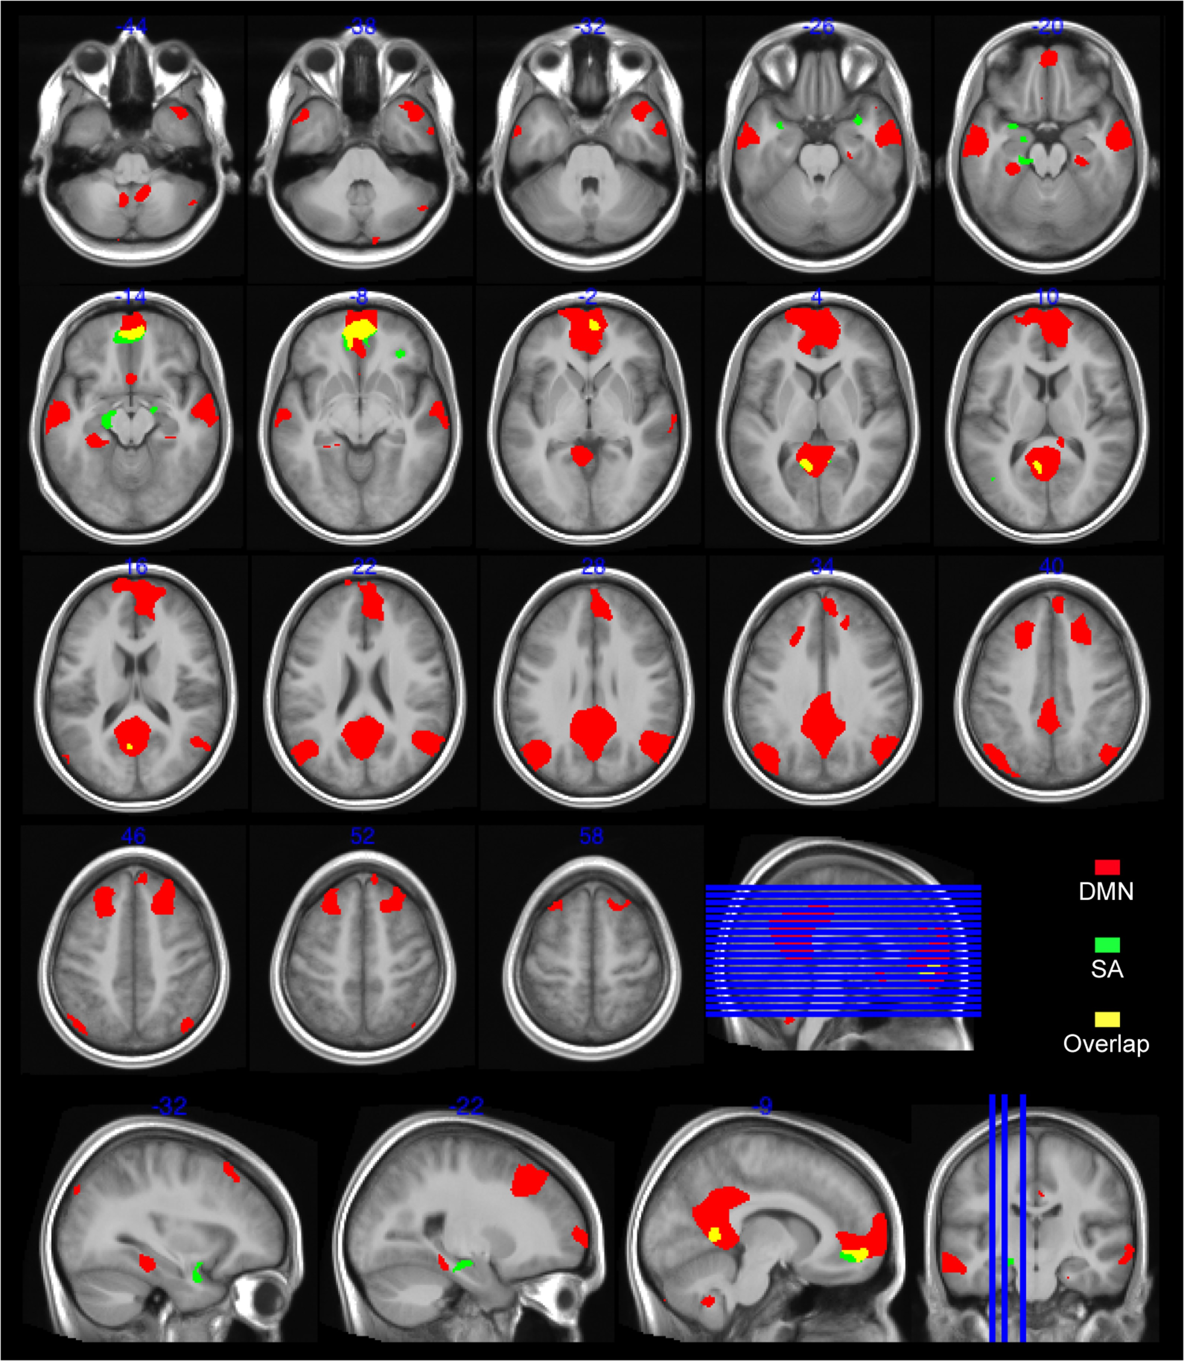
Figure 4. Overlap between the “conceptual self-awareness network” and the “DMN”. Neural responses selective for ...
Notes:
Figure 4. Overlap between the “conceptual self-awareness network” and the “DMN”. Neural responses selective for conceptual self-awareness (SA; marked in green) are based on the BOLD-adaptation analysis. A map of DMN's functional connectivity (marked in red) is based on resting-state data that were collected separately for the same group of participants. The overlap is present especially in the medial prefrontal and posterior cingulate regions (marked in yellow). The cluster map thresholds are P < 0.001 (uncorrected) and are superimposed on axial and sagittal slices of a mean MRI generated from the standardized anatomical MRIs of the 26 participants.
Unless provided in the caption above, the following copyright applies to the content of this slide: © The Author 2017. Published by Oxford University Press.This is an Open Access article distributed under the terms of the Creative Commons Attribution Non-Commercial License (http://creativecommons.org/licenses/by-nc/4.0/), which permits non-commercial re-use, distribution, and reproduction in any medium, provided the original work is properly cited. For commercial re-use, please contact journals.permissions@oup.com

