Slide 1
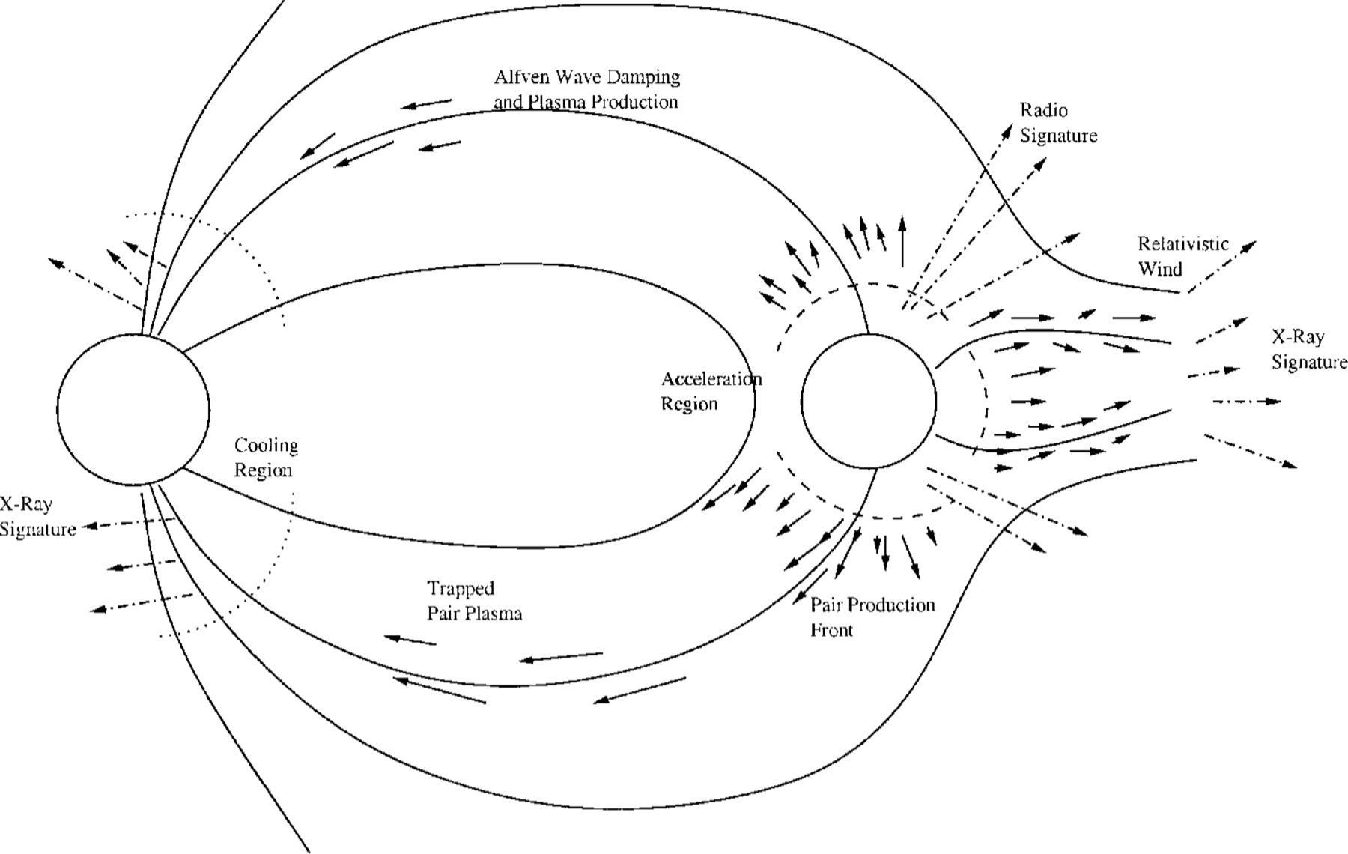
Figure 1. Schematic version of the energy extraction process. The motion of the companion through the magnetar field ...
Notes:
Figure 1. Schematic version of the energy extraction process. The motion of the companion through the magnetar field induces a plasma flow from the companion into the magnetosphere. The pressure of this flow will drive a relativistic wind in those regions where the flow moves into a regime of weaker field, while the plasma remains trapped in the case when it flows into a stronger field regime. The hot pair plasma will ablate some baryons off the surface of the neutron star, providing a baryon-loaded sheath which regulates the cooling of the trapped plasma.
Unless provided in the caption above, the following copyright applies to the content of this slide: © 2001 RAS

Slide 2
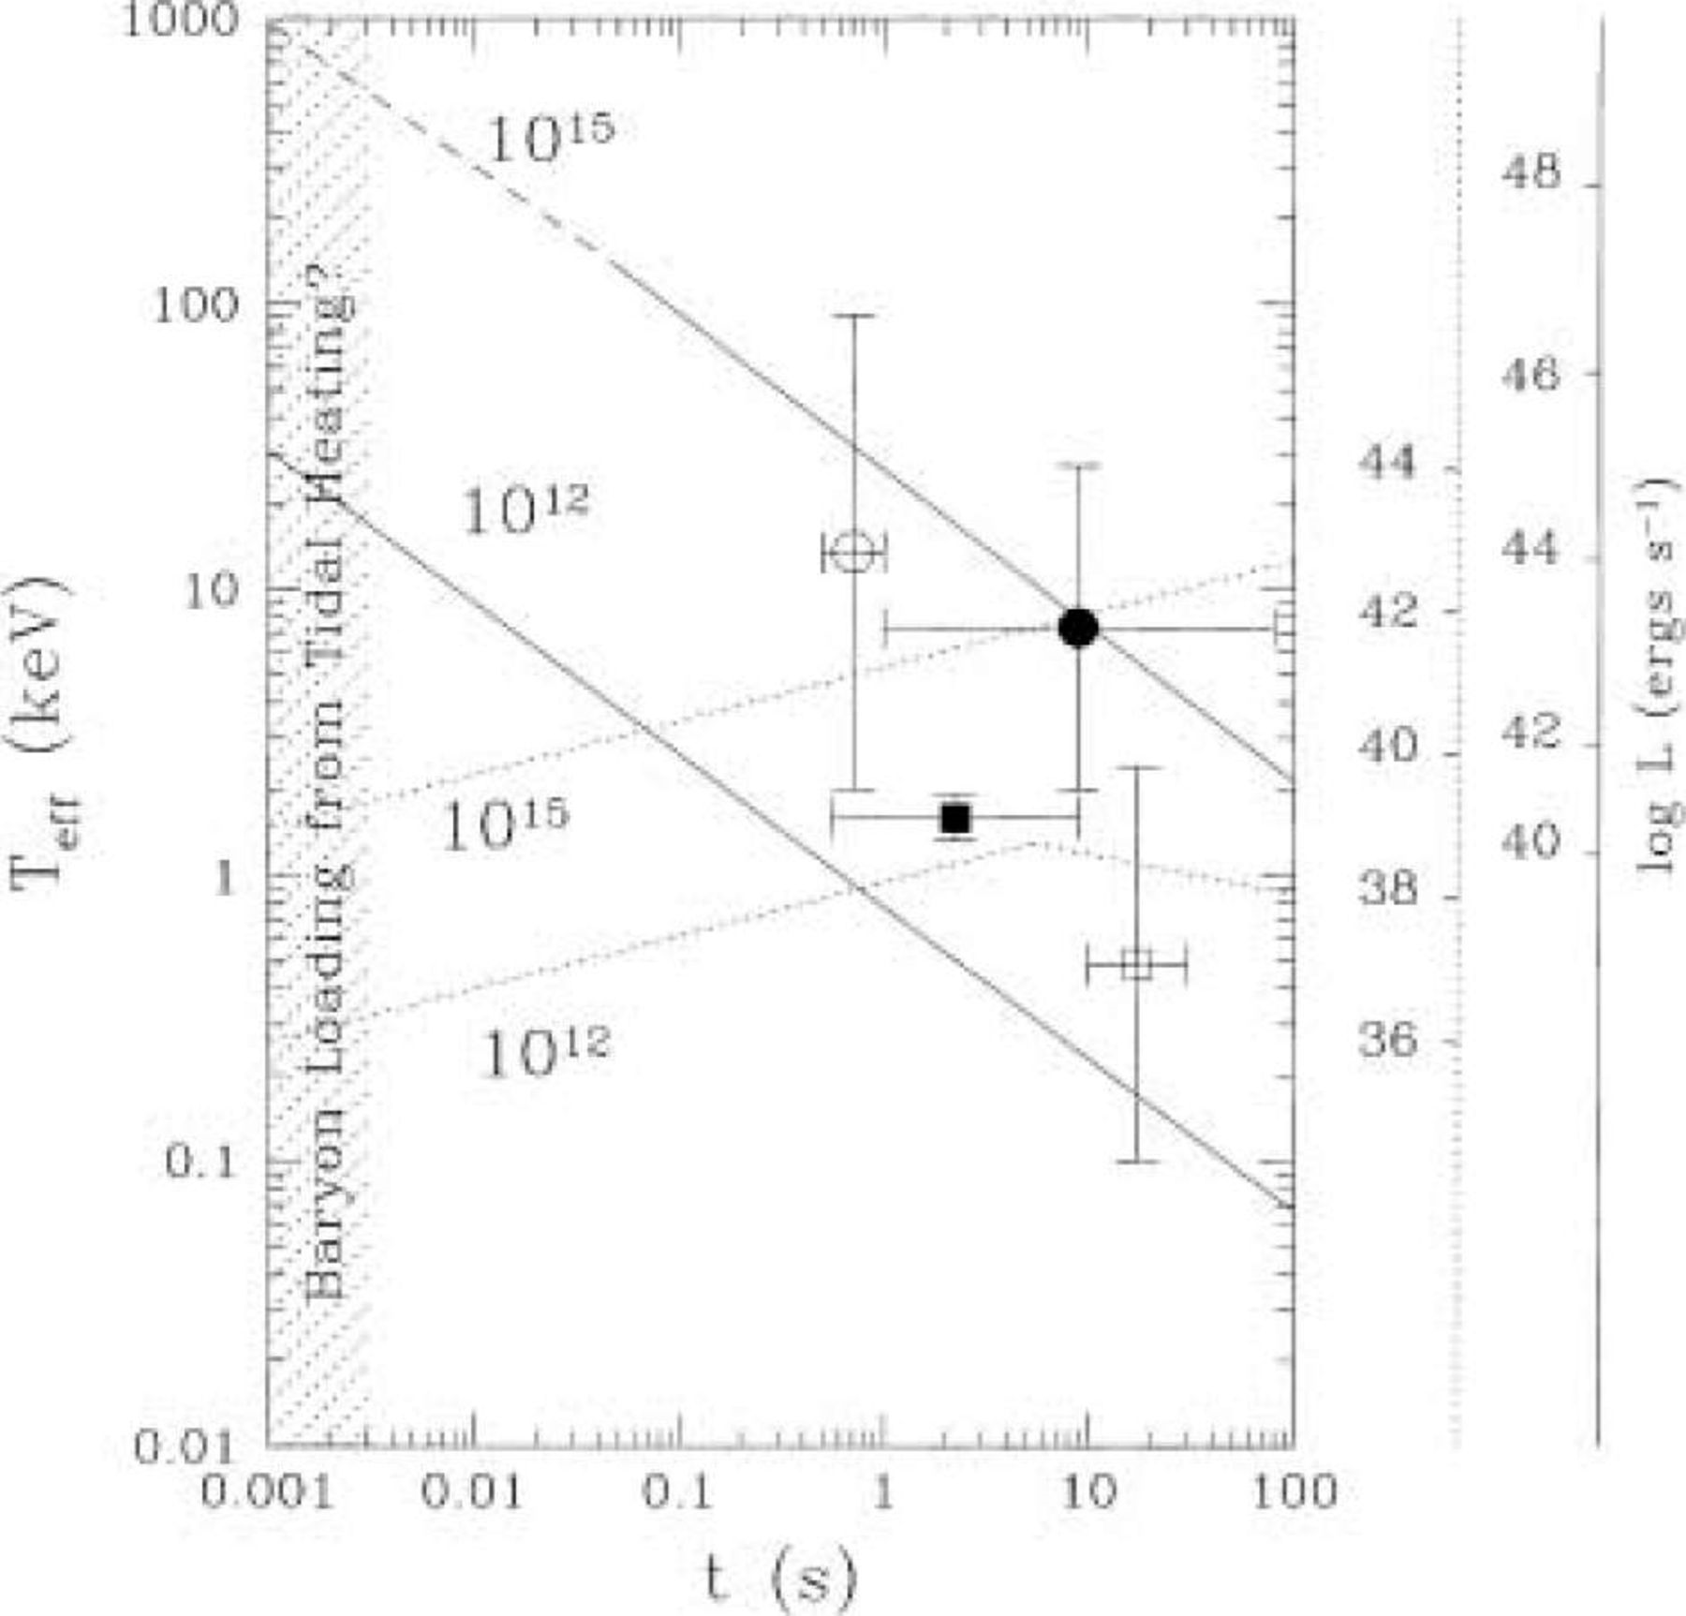
Figure 2. Here we show the expected evolution of the X-ray precursor signal for binaries containing a recycled pulsar ...
Notes:
Figure 2. Here we show the expected evolution of the X-ray precursor signal for binaries containing a recycled pulsar with either a normal field neutron star or a magnetar. The solid lines indicate the wind emission (the solid vertical line at the right indicates the luminosity) while the dotted lines indicate the cooling emission of the trapped magnetospheric plasma (also with appropriate luminosity scale). The dashed part of the 1015 G curve indicates the region where bound positronium production may alter the plasma injection mechanisms, possibly resulting in more non-thermal, high-energy emission. The points show the various transients discussed in the text (solid symbols are associated with GRB, open symbols are not). The time error bars are determined from the quoted time resolution and rise times of the signals. We see that the detected temperatures and time delays are broadly consistent with the expected theoretical values.
Unless provided in the caption above, the following copyright applies to the content of this slide: © 2001 RAS

