Slide 1
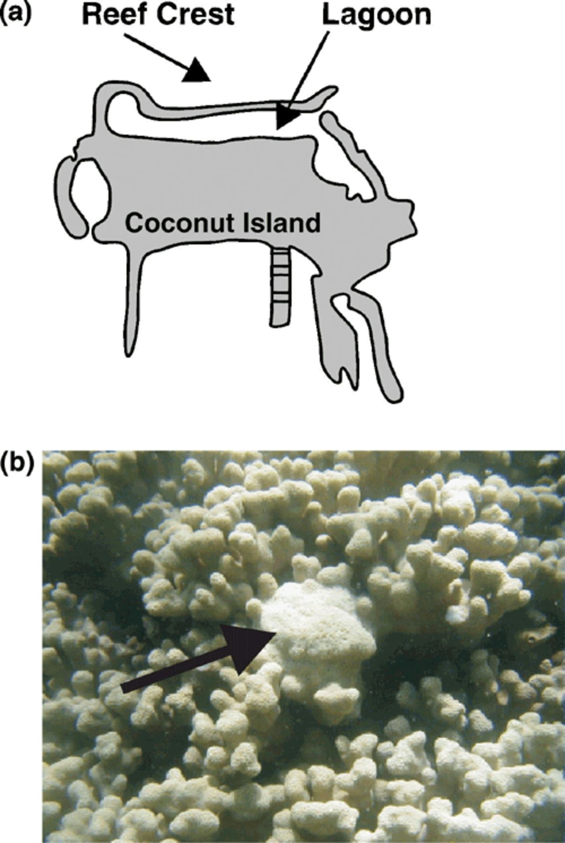
1 (a) Schematic of Coconut Island; Oahu, Hawaii. Coral samples were taken either from the lagoon or the reef ...
Notes:
1 (a) Schematic of Coconut Island; Oahu, Hawaii. Coral samples were taken either from the lagoon or the reef crest. (b) Example of a tumor on Porites compressa. The arrow indicates the tumor.
Unless provided in the caption above, the following copyright applies to the content of this slide: © 2005 Federation of European Microbiological Societies

Slide 2
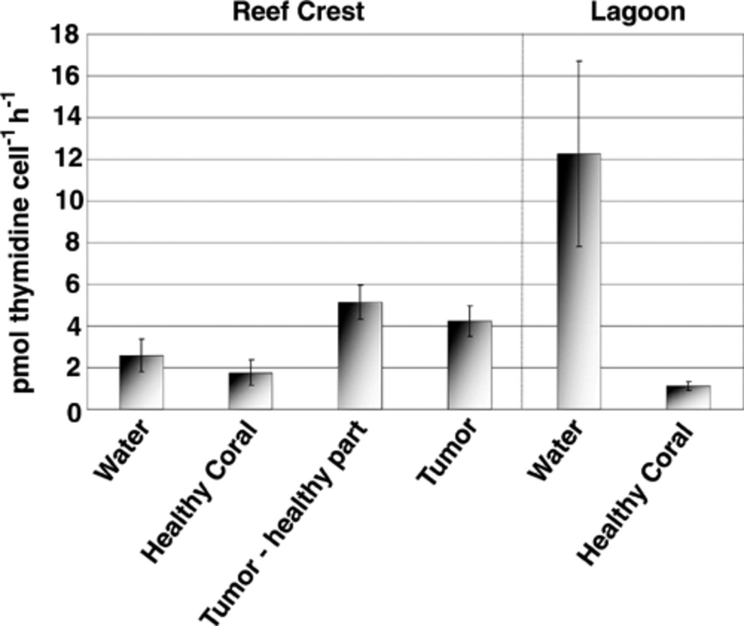
2 Cell-specific microbial growth rates from seawater, healthy P. compressa from the reef crest, tumors on P. ...
Notes:
2 Cell-specific microbial growth rates from seawater, healthy P. compressa from the reef crest, tumors on P. compressa from the reef crest, healthy areas on tumorous colonies from the reef crest, lagoon water, and healthy P. compressa in the lagoon. Data is shown as the mean ± standard error for each sample.
Unless provided in the caption above, the following copyright applies to the content of this slide: © 2005 Federation of European Microbiological Societies

