Slide 1
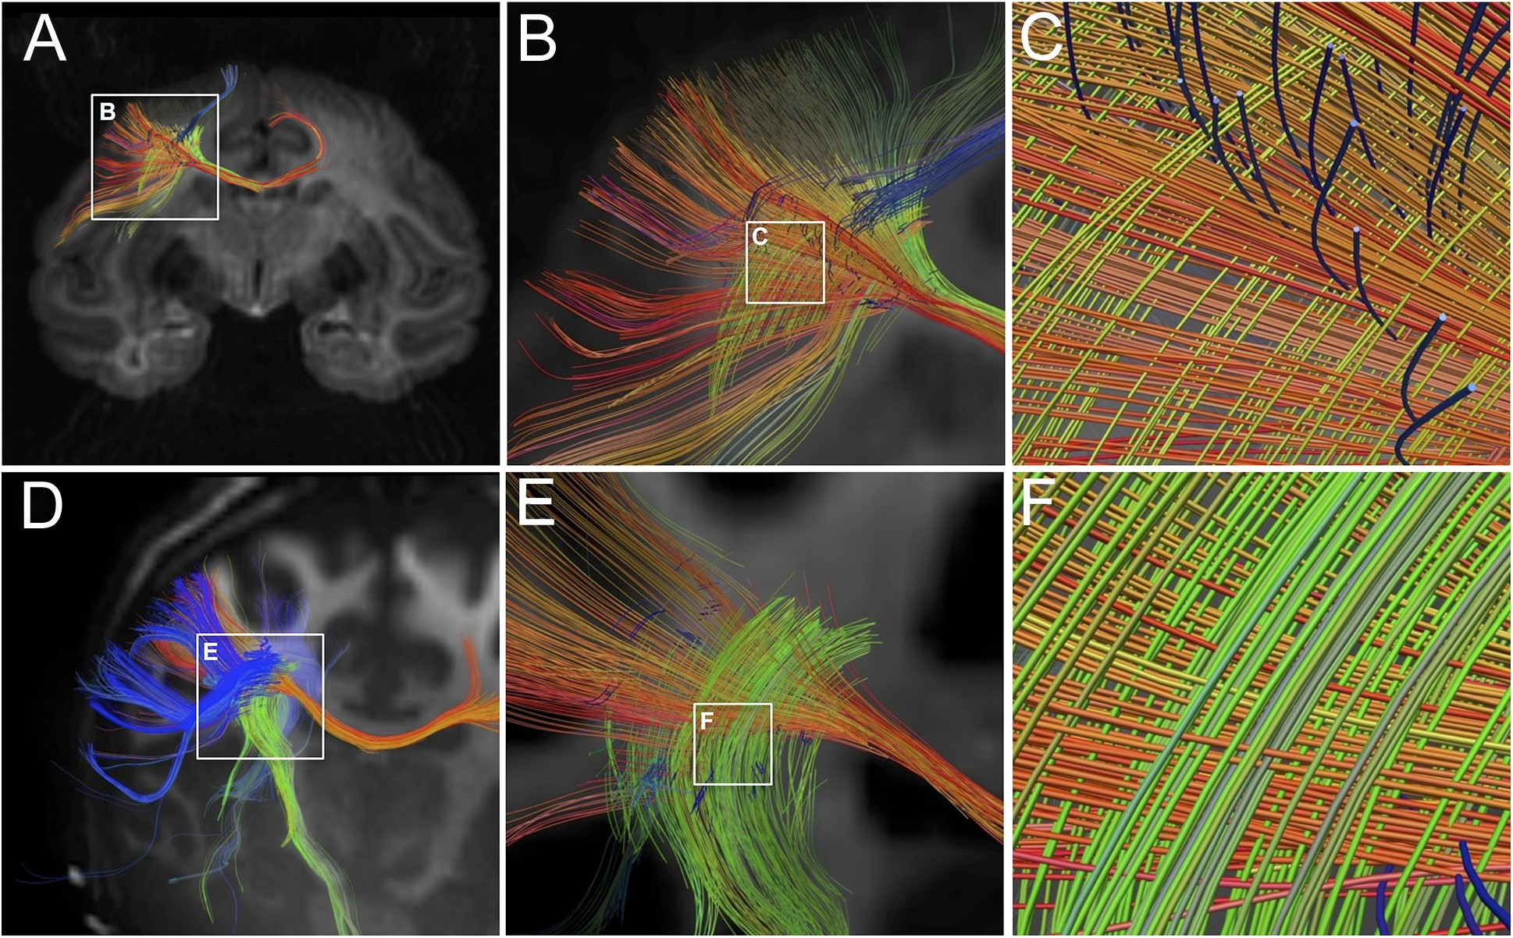
Figure 2. Fiber crossings in monkey and human forebrain with high angular resolution dMRI. The top row (Panels A–C) ...
Notes:
Figure 2. Fiber crossings in monkey and human forebrain with high angular resolution dMRI. The top row (Panels A–C) shows fiber reconstructions from ex vivo dMRI imaging of rhesus monkey brain using DSI protocol at 0.5 mm3 spatial resolution. The bottom row (Panels D–F) shows fiber reconstructions from in vivo dMRI images of human brain using QBI at 1.5 mm3 spatial resolution. Both images are approximately coronal sections that include the white matter of the centrum-semiovale beneath primary motor cortex. Panels A and D show at widefield similar geometric fiber crossings beneath primary motor cortex. Panels B,C and E,F show at higher magnification that these fibers are aligned in 3 approximately orthogonal directions forming a “grid-like” pattern. The in-plane mediolaterally and dorsoventrally oriented fibers are prominent. Some rostrocaudal fibers in the z-dimension can also be seen. Overall, this confirms at multiple scales the grid-like orientation of fibers in the subcortical white matter of both species.
Unless provided in the caption above, the following copyright applies to the content of this slide: © The Author 2017. Published by Oxford University Press. All rights reserved. For Permissions, please e-mail: journals.permissions@oup.comThis article is published and distributed under the terms of the Oxford University Press, Standard Journals Publication Model (https://academic.oup.com/journals/pages/about_us/legal/notices)

Slide 2
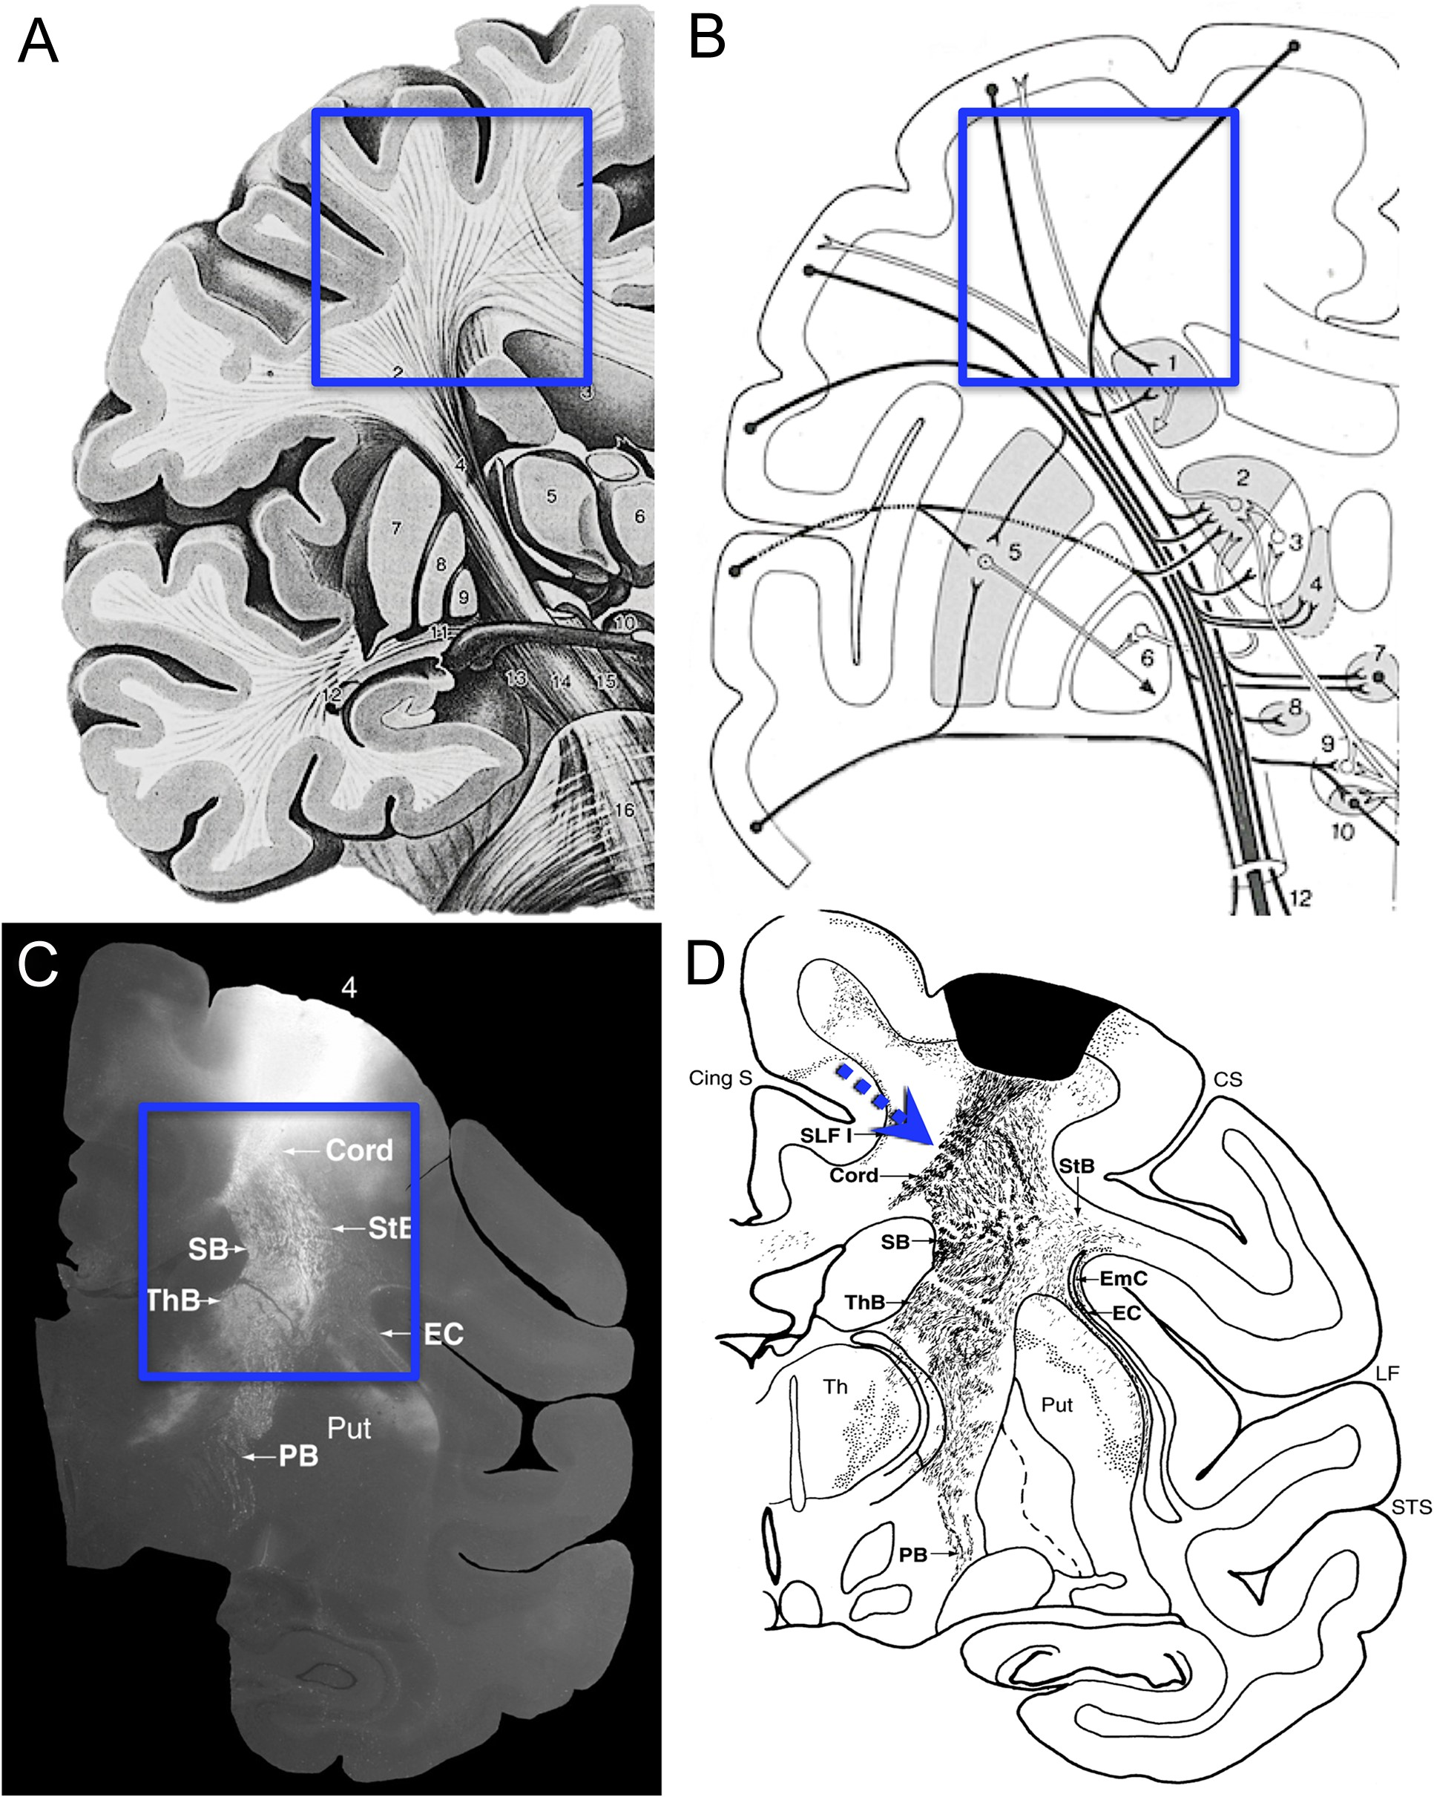
Figure 1. Fiber trajectories from published illustrations. Panel A is a typical artistic rendering of cerebral fibers ...
Notes:
Figure 1. Fiber trajectories from published illustrations. Panel A is a typical artistic rendering of cerebral fibers originating from cortex. The superimposed box identifies the subcortical white matter, where fibers are shown descending from the cortex along smoothly curved geodesic paths into the internal capsule and corpus callosum (Fig. 21.8 from Nieuwenhuys et al. 2008). In B, the box identifies the same region, where connectional pathways are again shown following smooth arcs (Fig. 128, Nieuwenhuys et al. 1981). In contrast to these typical representations, Panel C is an autoradiograph of fiber projections from primary motor cortex with the box identifying subcortical white matter, where there are rather sharp breaks in the overall trajectories (Fig. 11-8B from Schmahmann and Pandya 2006). Panel D shows a “charting” of a nearby section from the same case as in C (Fig. 11-7(81) from Schmahmann and Pandya 2006). The superimposed dashed arrows to point out likely fiber trajectories at these sharp breaks. Whether axons actually branch or make sharp turns at these breaks cannot be established because individual fibers cannot be reliably followed in autoradiographs.
Unless provided in the caption above, the following copyright applies to the content of this slide: © The Author 2017. Published by Oxford University Press. All rights reserved. For Permissions, please e-mail: journals.permissions@oup.comThis article is published and distributed under the terms of the Oxford University Press, Standard Journals Publication Model (https://academic.oup.com/journals/pages/about_us/legal/notices)

Slide 3
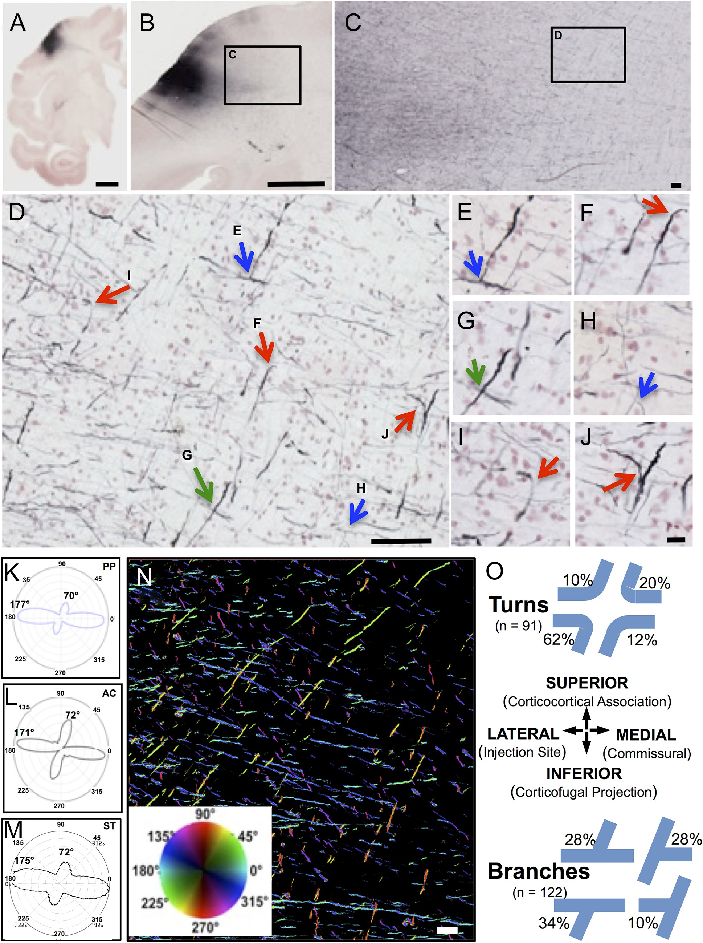
Figure 3. Trajectories and quantitative orientations of BDA-labeled corticofugal axons. Panel A is a 30 µm whole ...
Notes:
Figure 3. Trajectories and quantitative orientations of BDA-labeled corticofugal axons. Panel A is a 30 µm whole hemisphere section though the BDA injection site in the precentral gyrus of rhesus monkey BM097, processed for BDA (black) and counterstained with neutral red to show cells. Panel B is a higher magnification view of a nearby section of the same case showing BDA-labeled fibers leaving the injection site (box C). These fibers are shown at successively higher magnifications in Panels C and D as they disburse in the white matter into mediolateral and dorsoventral directions. In D, fibers are identified as crossing (green arrows), branching (blue arrows), or making sharp turns (red arrows). Panels E–J show these and surrounding fibers at higher magnification. Panels K–M illustrate the orientations of the BDA fibers of D using quantified using (K) PP analysis, (L) AC, and (M) ST. Panel N is a field from the same case with BDA-labeled fibers pseudocolored for orientation using PP (K) and the color wheel inset where the fibers in the primary orientation at 177° are coded in reddish to green hues and those near the secondary peak at 70° are coded in aqua to blue hues. These 2 major directions account for about 80% of all fibers present in the image. Panel O graphically illustrates the frequency of different orientations observed as either sharp turns (top) or as T-branches (bottom) among the BDA fibers analyzed in all 9 sections across all 3 cases (e.g., Supplementary Fig. 2). Scale bars: A = 5 mm, B = 2 mm, C = 200 µm, D = 100 µm, J = 20 µm for E–J; N = 200 µm.
Unless provided in the caption above, the following copyright applies to the content of this slide: © The Author 2017. Published by Oxford University Press. All rights reserved. For Permissions, please e-mail: journals.permissions@oup.comThis article is published and distributed under the terms of the Oxford University Press, Standard Journals Publication Model (https://academic.oup.com/journals/pages/about_us/legal/notices)

Slide 4
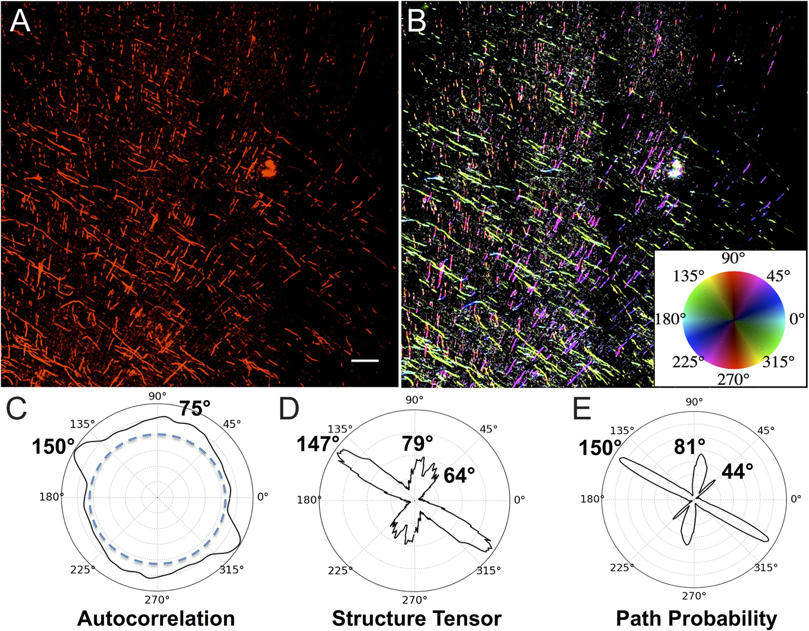
Figure 4. Trajectories and quantitative orientations of SMI-32 labeled projection axons. Panel A shows axons labeled by ...
Notes:
Figure 4. Trajectories and quantitative orientations of SMI-32 labeled projection axons. Panel A shows axons labeled by IHC processing with the neurofilament H (heavy chain) antibody SMI-32. The image is taken in a region of subcortical white matter beneath motor cortex caudal to that of Figure 3D. Panel B shows the same image as A, with orientation encoded in hue according to PP analysis (E) and as per the inset color wheel. Panels C–E are polar plots comparing orientation analysis of fibers in Panel A using AC, ST, and PP with a major orientation between 147° and 150° and minor orientation between 75° and 81°. Notably ST and PP detect a smaller third peak between 44° and 64°. Scale bar in A = 200 µm.
Unless provided in the caption above, the following copyright applies to the content of this slide: © The Author 2017. Published by Oxford University Press. All rights reserved. For Permissions, please e-mail: journals.permissions@oup.comThis article is published and distributed under the terms of the Oxford University Press, Standard Journals Publication Model (https://academic.oup.com/journals/pages/about_us/legal/notices)

Slide 5
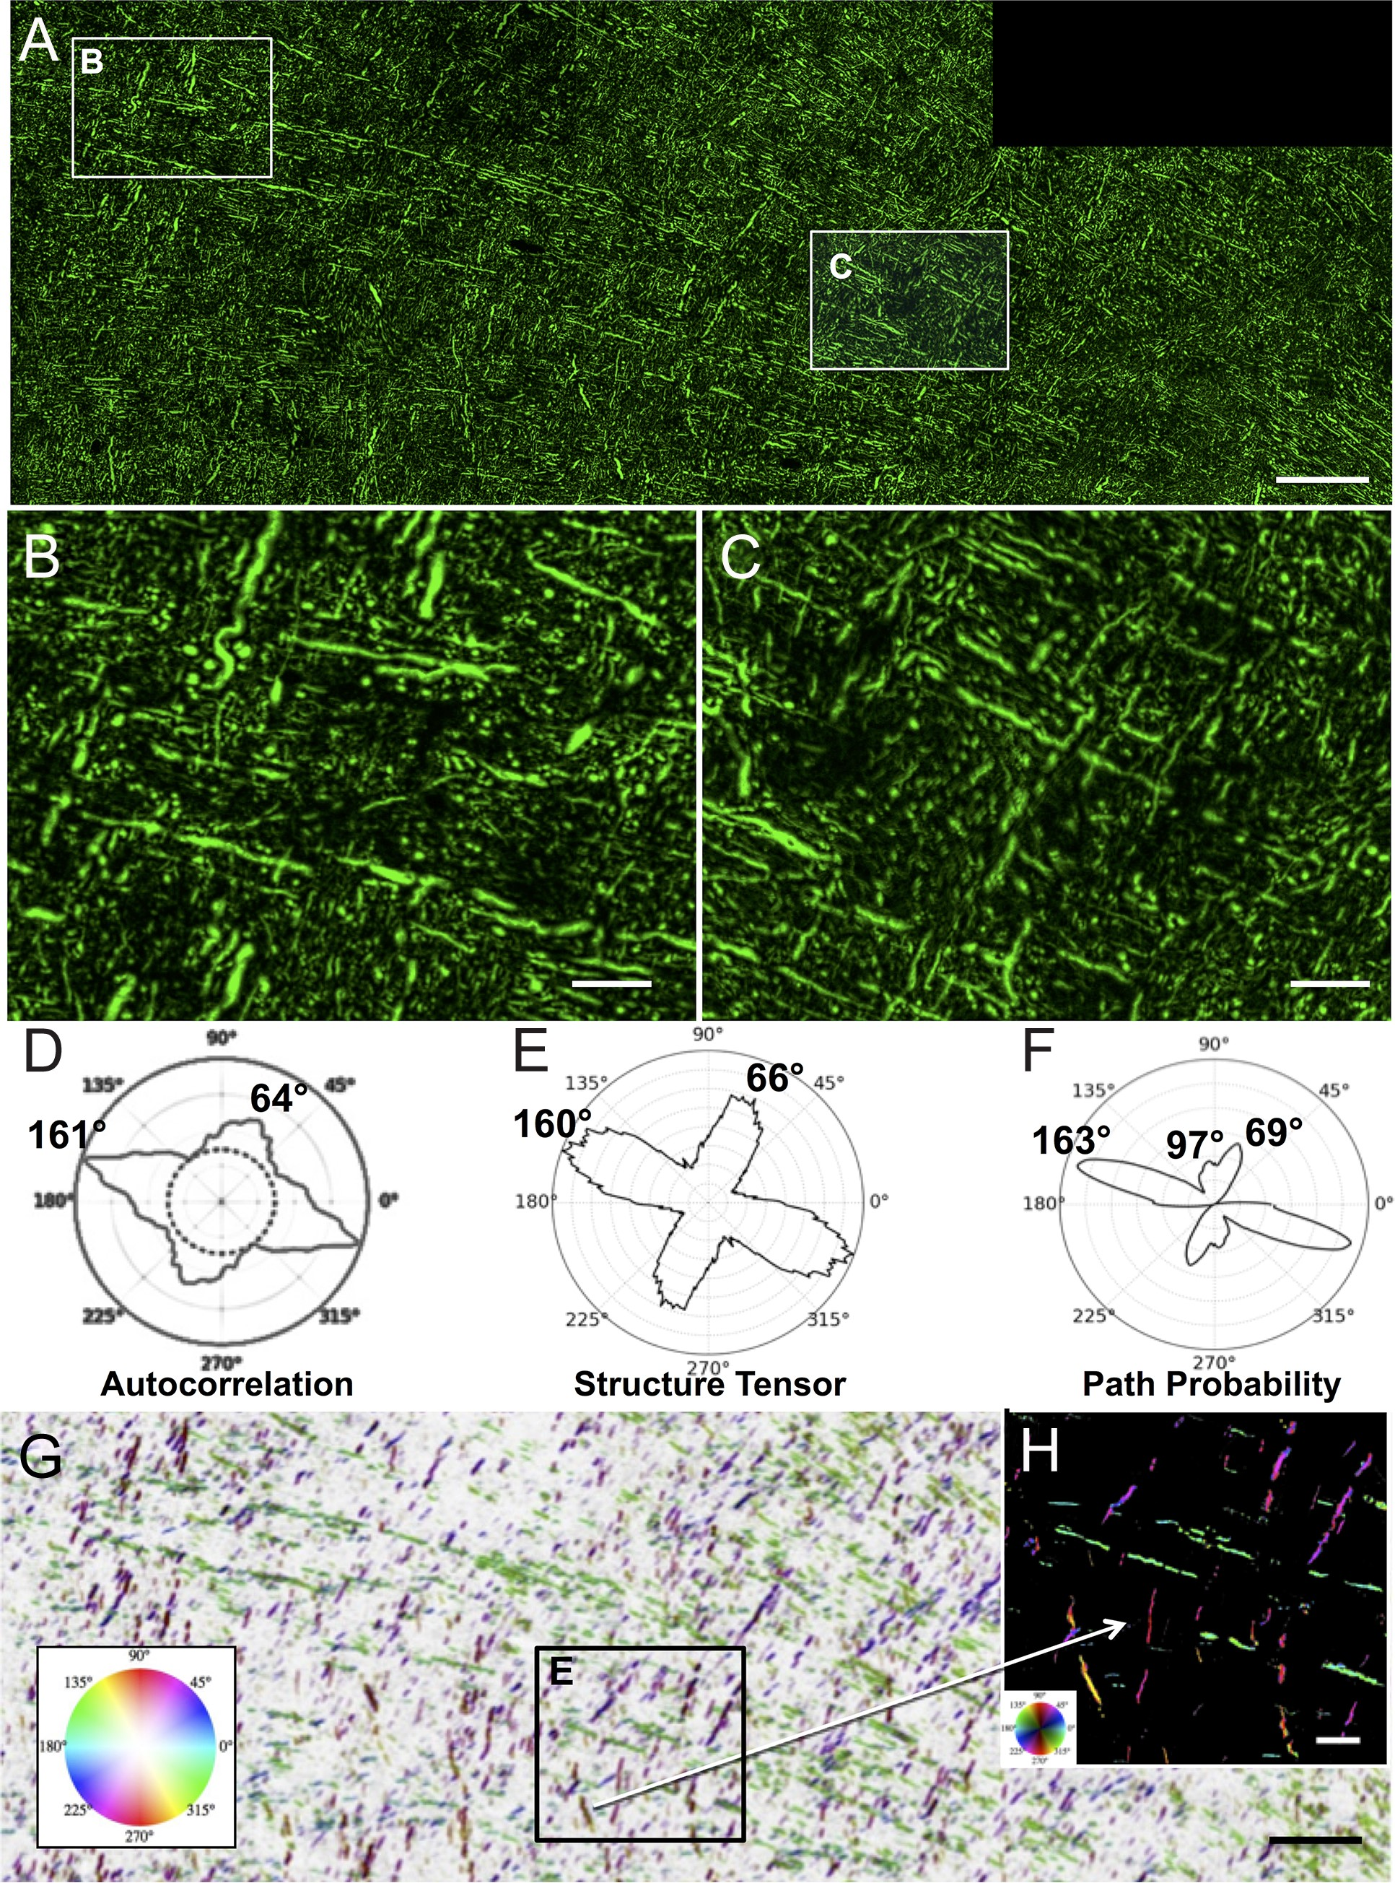
Figure 5. Trajectories and quantitative analysis of SMI-312 labeled axons. Panel A is a montage of 8 confocal images of ...
Notes:
Figure 5. Trajectories and quantitative analysis of SMI-312 labeled axons. Panel A is a montage of 8 confocal images of a 30 µm thick section processed by IHC with the pan-axonal neurofilament antibody SMI-312 to label all axons. The section was nearly adjacent to the BDA section in Figure 3 and A shows a field corresponding to Figure 3C. Panels B and C are higher magnification images, showing that the majority of fibers within the plane of section are oriented in approximately orthogonal directions but also shows the small segments and round cross sections of axons running into the z-plane. The polar plots in D–F compare the orientation quantifications obtained with AC (D), ST (E), and PP (F) and all show similar major and minor orientation peaks. Panel G is the same image as A but with background inverted and pseudocolored according to the PP orientation analysis with hue of orientation according to the inset color wheel and brightness proportional to the anisotropy of PP (Pmax/Paverage). Thus, axons oriented near 163° are in green, those near 69° are in purple. PP also detected about 20% of the fibers oriented near 97° and these are colored in reddish-orange. An enlarged view is shown in H with background not inverted. Scale bar in A, and G = 200 µm and in B, C, and E = 50 µm.
Unless provided in the caption above, the following copyright applies to the content of this slide: © The Author 2017. Published by Oxford University Press. All rights reserved. For Permissions, please e-mail: journals.permissions@oup.comThis article is published and distributed under the terms of the Oxford University Press, Standard Journals Publication Model (https://academic.oup.com/journals/pages/about_us/legal/notices)

Slide 6
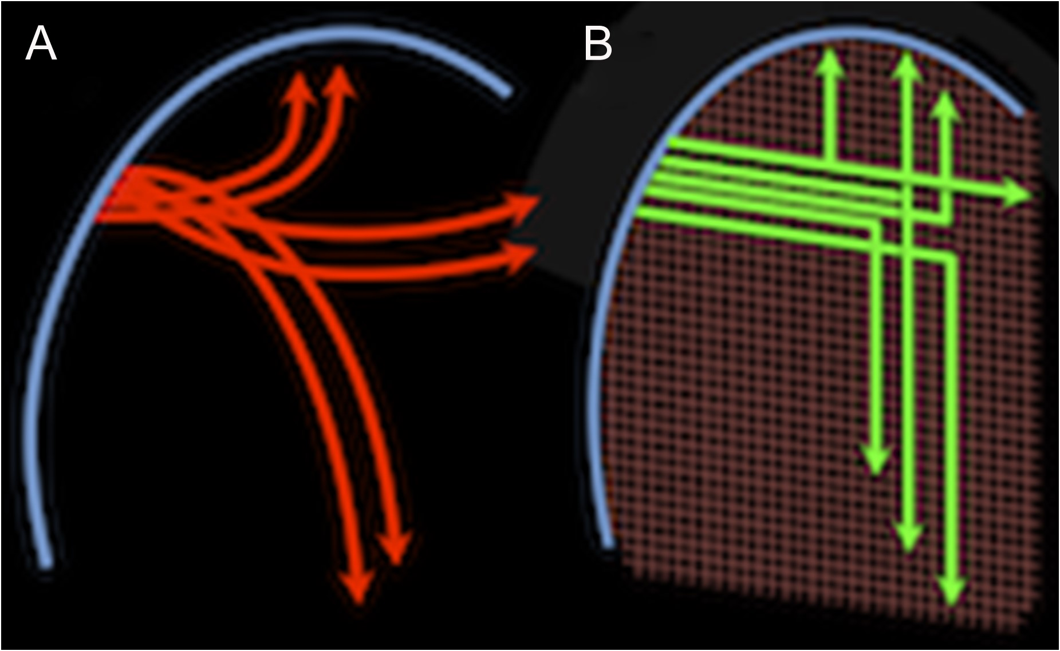
Figure 6. Alternatives views of fiber navigation. This schematic compares 2 views of the trajectories taken by ...
Notes:
Figure 6. Alternatives views of fiber navigation. This schematic compares 2 views of the trajectories taken by corticofugal axons leaving the cortical gray matter (blue arc on the left) and traveling to diverse cortical and subcortical targets. Association fibers are represented traveling vertically toward ipsilateral cortical targets, commissural fibers are represented traveling horizontally toward contralateral targets and projection fibers are represented traveling downward toward subcortical targets. In the classical model (A), these fibers (red) form groups, or bundles, that diverge smoothly from the cortex, possibly in geodesic arcs, as they interweave and disburse to different targets. In the geometric grid model (B), even as the grid deviates from perfectly orthogonal angles as it is warped by brain curvature, the different fibers (green) adhere to these coordinate axes as they make approximately right-angle sharp turns or branch as they travel to the different targets.
Unless provided in the caption above, the following copyright applies to the content of this slide: © The Author 2017. Published by Oxford University Press. All rights reserved. For Permissions, please e-mail: journals.permissions@oup.comThis article is published and distributed under the terms of the Oxford University Press, Standard Journals Publication Model (https://academic.oup.com/journals/pages/about_us/legal/notices)

