Slide 1
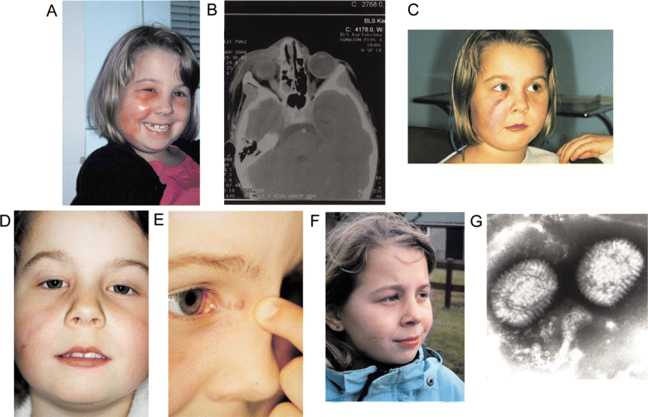
Figure 1 Serial photographs and a CT scan for a patient with facial cowpoxvirus infection. A, Lesion and facial edema ...
Notes:
Figure 1 Serial photographs and a CT scan for a patient with facial cowpoxvirus infection. A, Lesion and facial edema 2 weeks after onset of infection. B, CT obtained 2 weeks after onset. C, Abscess prior to hyperbaric oxygen treatment and surgical incision 6 weeks after onset. D, Status 4 months after hyperbaric oxygen treatment and incision. E, Close-up of long-lasting lesion in medial canthus 24 month after onset. F, Late results, 36 months after onset, showing a minimum of scarring. G, Electron microscopic image of orthopoxvirus obtained from our patient. Consent to appear in the photographs was obtained from the patient's guardian.
Unless provided in the caption above, the following copyright applies to the content of this slide: © 2006 by the Infectious Diseases Society of America

Slide 2
Table 1 Reports on spread of orthopoxvirus in western European rodents and carnivores.
Notes:
Table 1 Reports on spread of orthopoxvirus in western European rodents and carnivores.
Unless provided in the caption above, the following copyright applies to the content of this slide: © 2006 by the Infectious Diseases Society of America

Slide 3
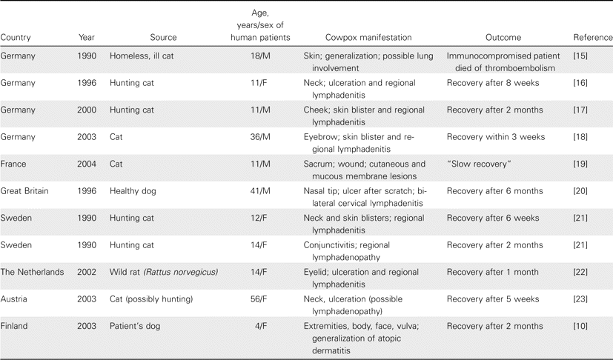
Table 2 Clinical manifestations in a selection of reported cases of cowpox.
Notes:
Table 2 Clinical manifestations in a selection of reported cases of cowpox.
Unless provided in the caption above, the following copyright applies to the content of this slide: © 2006 by the Infectious Diseases Society of America

