Slide 1
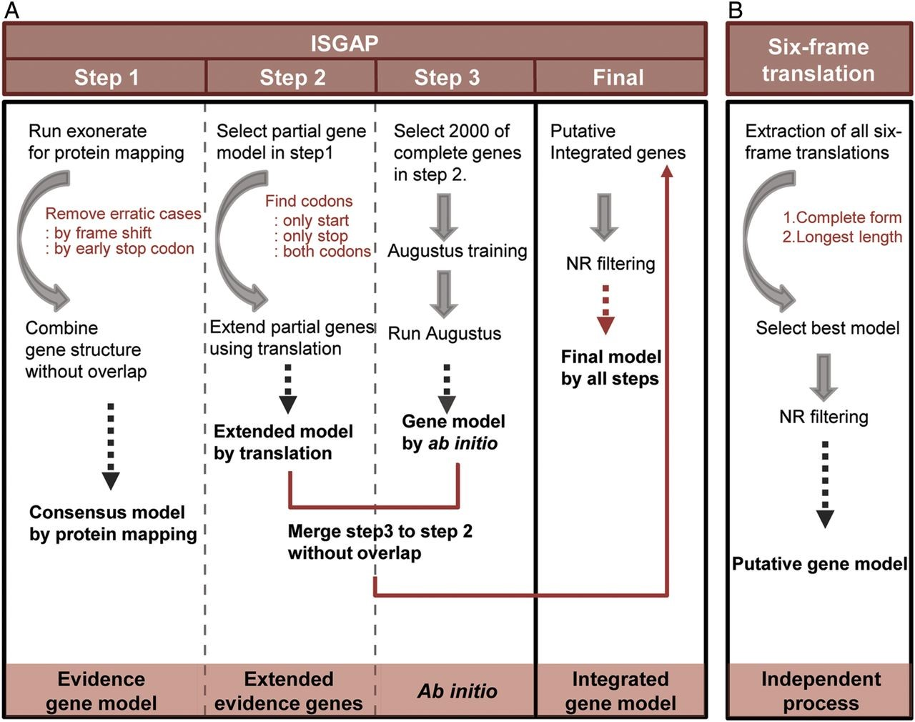
Figure 1. Integrated structural gene annotation pipeline (ISGAP). (A) ISGAP based on reference proteins and ab initio ...
Notes:
Figure 1. Integrated structural gene annotation pipeline (ISGAP). (A) ISGAP based on reference proteins and ab initio prediction. (B) The six-frame translation method as an independent process.
Unless provided in the caption above, the following copyright applies to the content of this slide: © The Author 2014. Published by Oxford University Press on behalf of Kazusa DNA Research Institute.This is an Open Access article distributed under the terms of the Creative Commons Attribution License (http://creativecommons.org/licenses/by/4.0/), which permits unrestricted reuse, distribution, and reproduction in any medium, provided the original work is properly cited.

Slide 2
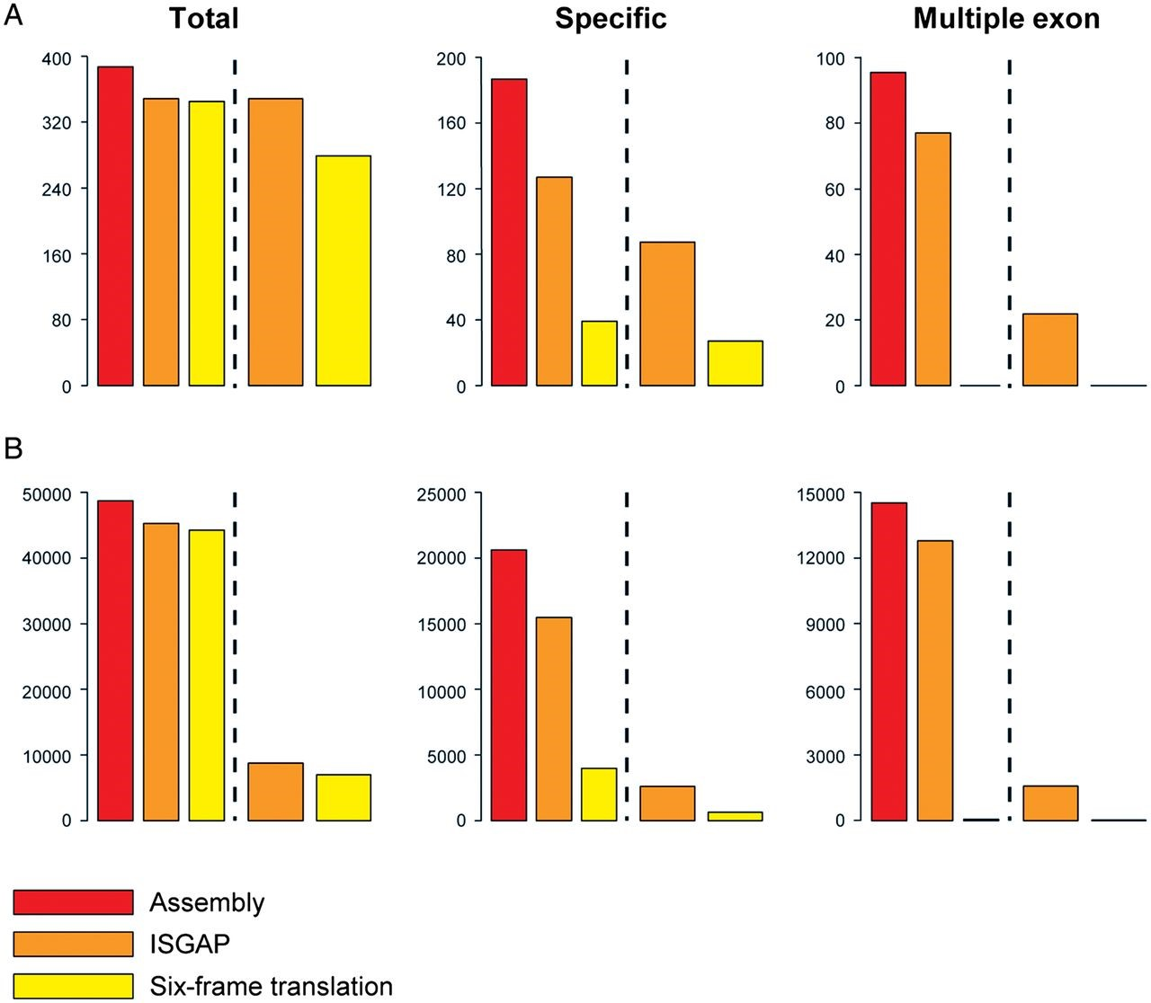
Figure 2. Comparison of the annotated onion gene sets predicted the combined library by six-frame translation and ...
Notes:
Figure 2. Comparison of the annotated onion gene sets predicted the combined library by six-frame translation and ISGAP. For the black dotted line, the left and right of the histogram represent the numbers of covered query sequences and predicted genes, respectively. (A) Validation of the predicted gene sets using 511 onion proteins. (B) Assessment of the predicted proteins against the plant proteins in the RefSeq database.
Unless provided in the caption above, the following copyright applies to the content of this slide: © The Author 2014. Published by Oxford University Press on behalf of Kazusa DNA Research Institute.This is an Open Access article distributed under the terms of the Creative Commons Attribution License (http://creativecommons.org/licenses/by/4.0/), which permits unrestricted reuse, distribution, and reproduction in any medium, provided the original work is properly cited.

Slide 3
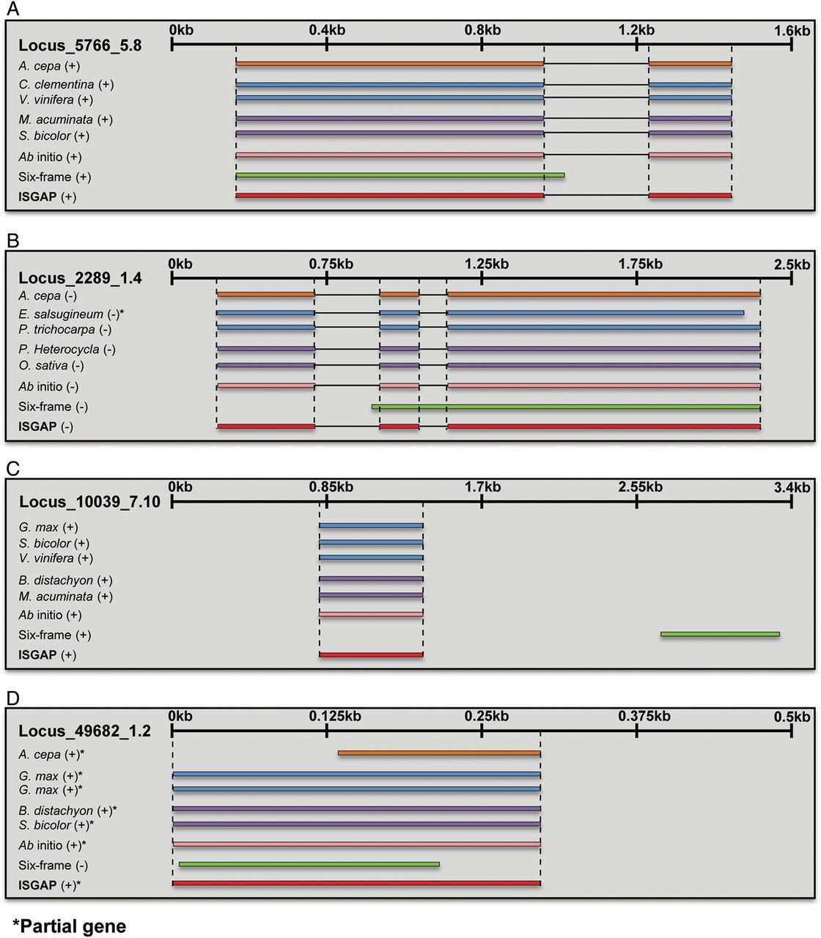
Figure 3. Representative cases of well-annotated genes predicted by ISGAP compared with the genes predicted by ...
Notes:
Figure 3. Representative cases of well-annotated genes predicted by ISGAP compared with the genes predicted by six-frame translation. The genes predicted by ISGAP and six-frame translation are shown, as well as the onion, RefSeq, reference, and ab initio gene models. The plus and minus signs in the brackets indicate the strand of mapped or predicted genes. (A and B) Cases of genes containing multiple exons; (C) gene annotation with the correct region. (D) Gene annotation with the correct strand.
Unless provided in the caption above, the following copyright applies to the content of this slide: © The Author 2014. Published by Oxford University Press on behalf of Kazusa DNA Research Institute.This is an Open Access article distributed under the terms of the Creative Commons Attribution License (http://creativecommons.org/licenses/by/4.0/), which permits unrestricted reuse, distribution, and reproduction in any medium, provided the original work is properly cited.

Slide 4
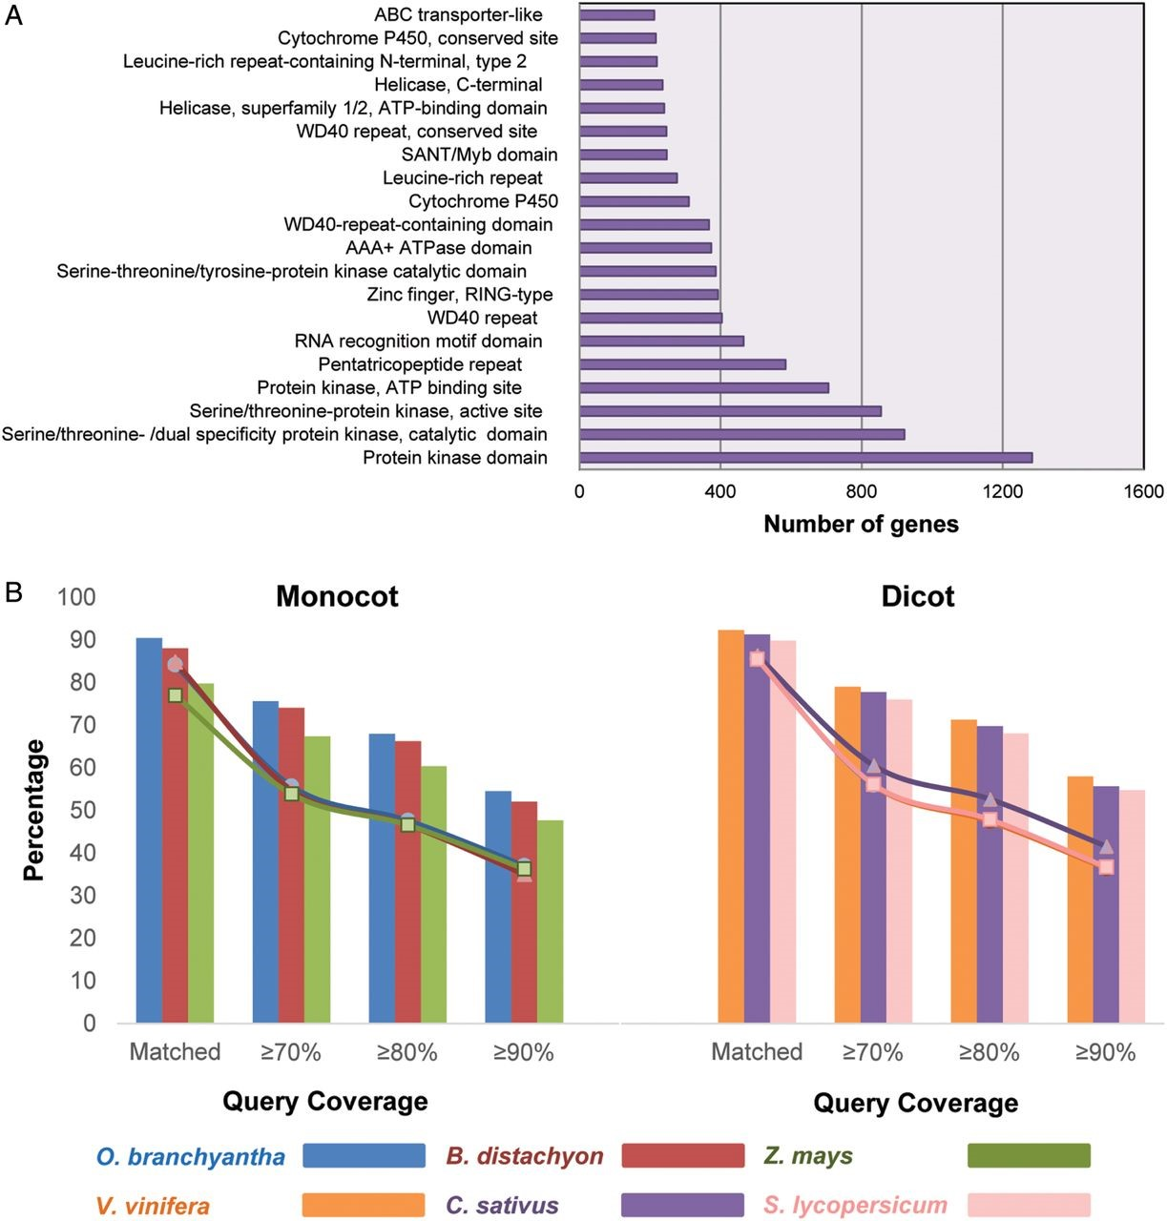
Figure 4. Distribution of biological functions and coverage graph for monocot and dicot plants. (A) Top 20 InterPro ...
Notes:
Figure 4. Distribution of biological functions and coverage graph for monocot and dicot plants. (A) Top 20 InterPro domains among the onion genes from the combined library. (B) Coverage graph of the onion genes in the assembly of the combined library on monocot and dicot plants. The line graph and histogram illustrate the proportions of onion genes and plant proteins in each species, respectively.
Unless provided in the caption above, the following copyright applies to the content of this slide: © The Author 2014. Published by Oxford University Press on behalf of Kazusa DNA Research Institute.This is an Open Access article distributed under the terms of the Creative Commons Attribution License (http://creativecommons.org/licenses/by/4.0/), which permits unrestricted reuse, distribution, and reproduction in any medium, provided the original work is properly cited.

