Slide 1
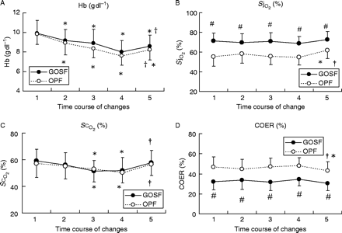
Fig 1 The time course of changes in (a) Hb concentrations, (b) jugular venous bulb oxygen saturation (\batchmode ...
Notes:
Fig 1 The time course of changes in (a) Hb concentrations, (b) jugular venous bulb oxygen saturation (\batchmode \documentclass[fleqn,10pt,legalpaper]{article} \usepackage{amssymb} \usepackage{amsfonts} \usepackage{amsmath} \pagestyle{empty} \begin{document} \(S\mathrm{j}_{\mbox{\textsc{\mathrm{o}}}_{2}}\) \end{document}), (c) cerebral oxygen saturation (\batchmode \documentclass[fleqn,10pt,legalpaper]{article} \usepackage{amssymb} \usepackage{amsfonts} \usepackage{amsmath} \pagestyle{empty} \begin{document} \(S\mbox{\textsc{\mathrm{c}}}_{\mbox{\textsc{\mathrm{o}}}_{2}}\) \end{document}), and (d) cerebral oxygen extraction ratio (COER) in the two experimental groups. Patients in Group P received propofol/fentanyl anaesthesia and those in Group S received nitrous oxide/sevoflurane/fentanyl anaesthesia. Measurements were performed at: (i) 10 min after the start of operation (control values), (ii) at 400 ml of blood loss, (iii) at 800 ml of blood loss, (iv) just before the transfusion of pre-donated autologous blood, and (v) after 400 ml transfusion. Data are expressed as mean (sd). *P<0.05 vs control values; †P<0.05 vs time (iv), #P<0.05 vs Group P.
Unless provided in the caption above, the following copyright applies to the content of this slide: © The Board of Management and Trustees of the British Journal of Anaesthesia 2004. All rights reserved. For Permissions, please e-mail: journal.permissions@oupjournals.org

Slide 2
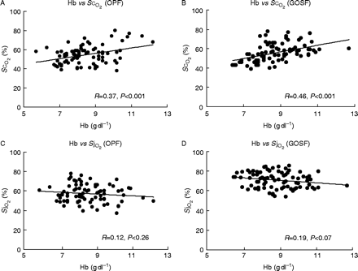
Fig 2 Relationship between Hb concentrations and cerebral oxygen saturation (\batchmode ...
Notes:
Fig 2 Relationship between Hb concentrations and cerebral oxygen saturation (\batchmode \documentclass[fleqn,10pt,legalpaper]{article} \usepackage{amssymb} \usepackage{amsfonts} \usepackage{amsmath} \pagestyle{empty} \begin{document} \(S\mbox{\textsc{\mathrm{c}}}_{\mbox{\textsc{\mathrm{o}}}_{2}}\) \end{document}) values in (a) Group P and (b) Group S. There were significant positive correlations between \batchmode \documentclass[fleqn,10pt,legalpaper]{article} \usepackage{amssymb} \usepackage{amsfonts} \usepackage{amsmath} \pagestyle{empty} \begin{document} \(S\mbox{\textsc{\mathrm{c}}}_{\mbox{\textsc{\mathrm{o}}}_{2}}\) \end{document} values and Hb concentrations (Group P, r=0.37, P<0.001; Group S, r=0.46, P<0.001). Relationship between Hb concentrations and jugular venous bulb oxygen saturation (\batchmode \documentclass[fleqn,10pt,legalpaper]{article} \usepackage{amssymb} \usepackage{amsfonts} \usepackage{amsmath} \pagestyle{empty} \begin{document} \(S\mathrm{j}_{\mbox{\textsc{\mathrm{o}}}_{2}}\) \end{document}) in (c) Group P and (d) Group S. There were no significant correlations between \batchmode \documentclass[fleqn,10pt,legalpaper]{article} \usepackage{amssymb} \usepackage{amsfonts} \usepackage{amsmath} \pagestyle{empty} \begin{document} \(S\mathrm{j}_{\mbox{\textsc{\mathrm{o}}}_{2}}\) \end{document} values and Hb concentrations (Group P, r=0.12, P=0.26; Group S, r=0.19, P=0.07).
Unless provided in the caption above, the following copyright applies to the content of this slide: © The Board of Management and Trustees of the British Journal of Anaesthesia 2004. All rights reserved. For Permissions, please e-mail: journal.permissions@oupjournals.org

