Slide 1
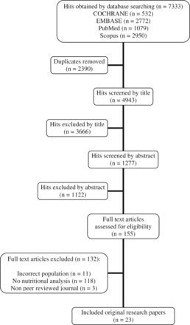
Figure 1 Flow diagram of the literature search process.
Notes:
Figure 1 Flow diagram of the literature search process.
Unless provided in the caption above, the following copyright applies to the content of this slide: © The Author(s) 2016. Published by Oxford University Press on behalf of the International Life Sciences Institute. All rights reserved. For Permissions, please e-mail: journals.permissions@oup.com.

