Slide 1
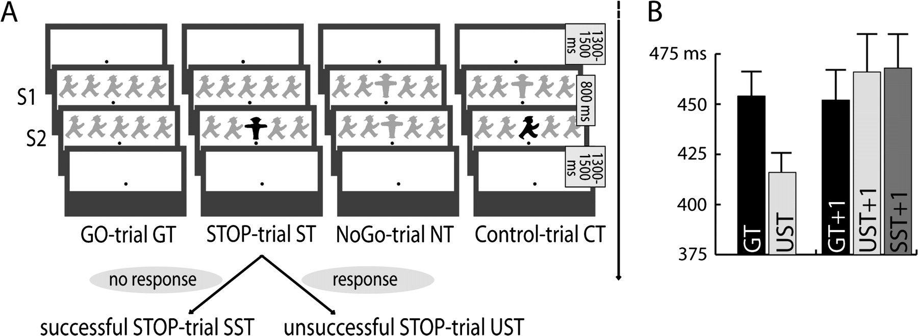
Figure 1. Schematic of the trial-types and RT-data. (A) On Go-trials an array of 5 symbols was presented for 800 ms, ...
Notes:
Figure 1. Schematic of the trial-types and RT-data. (A) On Go-trials an array of 5 symbols was presented for 800 ms, with the center one being the target. On Stop-trials the green (depicted in gray) symbol in the center (S1) was substituted by a red (depicted in black) STOP (S2) after an SOA set by a staircase-procedure. The total stimulus duration was 800 ms. Stop-trials were later classified as SST, where subjects successfully inhibited their response, and UST where they did not succeed. In NoGo-trials a display with 5 symbols was presented for 800 ms, of which the center stimulus was a green colored STOP. Control-trials started identically to NoGo-trials, but after SOAs corresponding to those of the Stop-trials the green STOP was replaced by a red stimulus (LEFT or RIGHT), mimicking the visual stimulation timeframe of a Stop-trial. (B) Reaction times were faster for UST than for Go-trials (GT). Reaction times to Go-trials also differed with respect to their trial history (GT + 1 = Go-trial following on another Go-trial; UST + 1 = Go-trial following on an unsuccessful Stop-trial; SST + 1 = Go-trial following on a successful Stop-trial; error bars depict standard error).
Unless provided in the caption above, the following copyright applies to the content of this slide: © The Author 2008. Published by Oxford University Press. All rights reserved. For permissions, please e-mail: journals.permissions@oxfordjournals.org

Slide 2
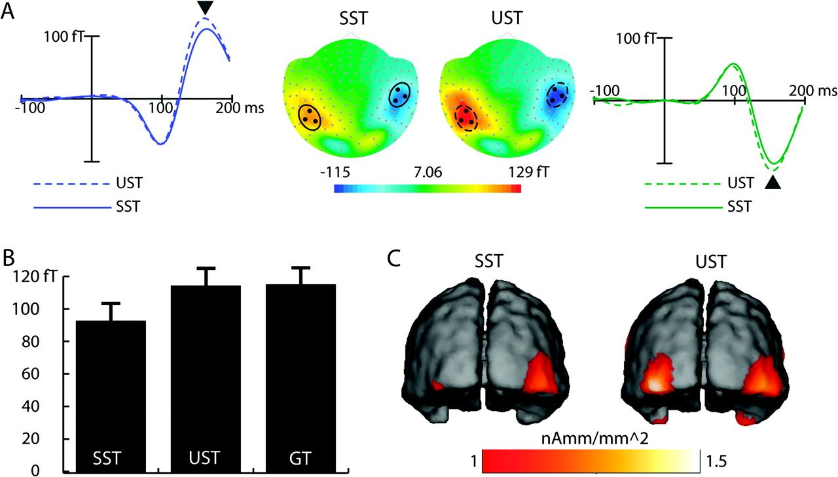
Figure 2. ERMF and SDE results to the Go-stimulus (Average over subjects; S1-time-range). (A) ERMF distributions for ...
Notes:
Figure 2. ERMF and SDE results to the Go-stimulus (Average over subjects; S1-time-range). (A) ERMF distributions for SST and UST averaged between 130 and 180 ms after the Go-stimulus are displayed in the middle (azimuth projection of the whole sensor array; upper side corresponds to frontal). Additionally the ERMF time course of 3 sensors averaged for each hemisphere (highlighted by black dots in the ERMF distribution) is depicted. Time-course results for the left hemisphere are colored blue, those for the right hemisphere green. Dashed lines depict UST, solid lines SST. The maximum amplitude is reached around 160 ms after display-onset (see arrowheads). (B) The ERMF activity at the selected sensors (average of responses over the right and the left hemisphere) was smaller for SST than for UST and GT (error bars depict standard error). (C) SDE results are displayed at 160 ms poststimulus. Maxima are observed in the inferior occipito-temporal cortex. Both ERMF response and SDE were stronger for UST than for SST.
Unless provided in the caption above, the following copyright applies to the content of this slide: © The Author 2008. Published by Oxford University Press. All rights reserved. For permissions, please e-mail: journals.permissions@oxfordjournals.org

Slide 3
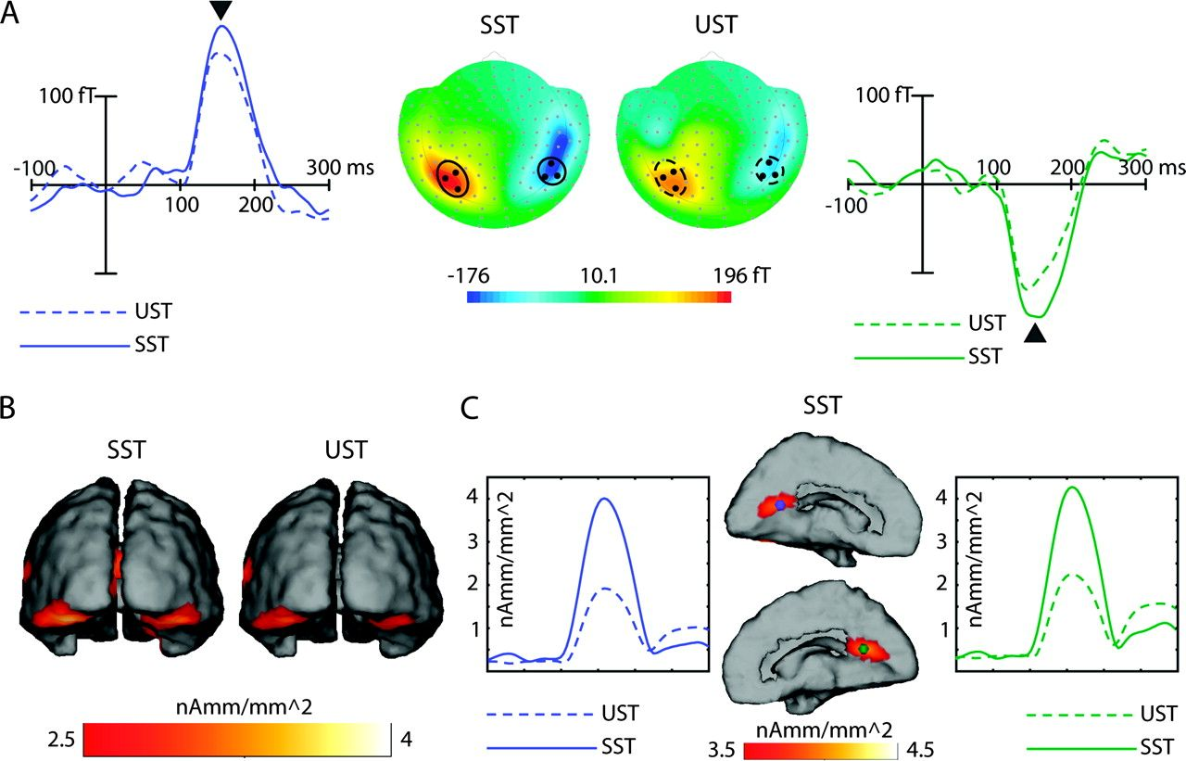
Figure 3. ERMF and SDE results related to the Stop-stimulus (average over subjects; S2-time-range). (A) ERMF ...
Notes:
Figure 3. ERMF and SDE results related to the Stop-stimulus (average over subjects; S2-time-range). (A) ERMF distributions for SST and UST averaged between 140 and 200 ms after the Stop-stimulus presentation. Additionally, the time course of 3 neighboring sensors averaged for each hemisphere is illustrated (highlighted by black dots in the ERMF distribution). Time-course results for the left hemisphere are colored blue, those for the right hemisphere green. Dashed lines depict UST, the solid lines SST. The maximum amplitude is reached around 160 ms after the onset of S2 (see arrowheads). (B) SDE results at 160 ms poststimulus. Strong activity is observed bilaterally in ventral occipito-temporal cortex. (C) Additionally strong estimates of activity are found in the PCG. Both ERMF responses and SDE in ventral occipito-temporal cortex and the PCG are stronger for SST than for UST.
Unless provided in the caption above, the following copyright applies to the content of this slide: © The Author 2008. Published by Oxford University Press. All rights reserved. For permissions, please e-mail: journals.permissions@oxfordjournals.org

Slide 4
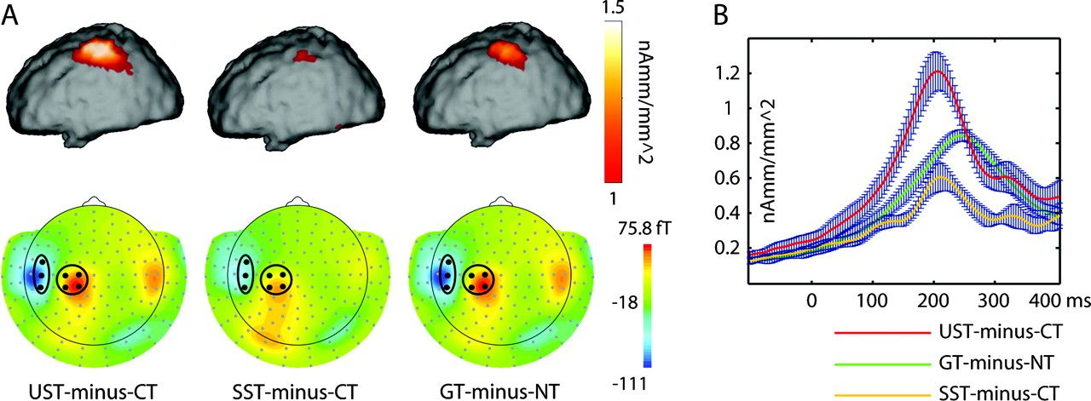
Figure 4. ERMF and SDE results from the motor cortex (average over subjects; S2-time-range). (A) The upper panel ...
Notes:
Figure 4. ERMF and SDE results from the motor cortex (average over subjects; S2-time-range). (A) The upper panel displays the SDE results averaged between 200 and 240 ms after S2. The lower part illustrates the corresponding ERMF distributions. Black dots depict the positions of the sensors that were averaged for the statistical analysis. The ERMF activity represents the average over all subjects, that was also used for the source density estimation. (B) SDE time course of the average of individual SDE normalized to the maximum SDE value for GT-minus-NT (error bars depict standard error). Consistent with the ERMF and with the average SDE results, the strongest activation of the motor-cortex was found for UST-minus-CT followed by GT-minus-NT and SST-minus-CT. Additionally estimates of activity in the motor-cortex were found earlier for UST-minus-CT and the activation maximum occurred earlier.
Unless provided in the caption above, the following copyright applies to the content of this slide: © The Author 2008. Published by Oxford University Press. All rights reserved. For permissions, please e-mail: journals.permissions@oxfordjournals.org

Slide 5
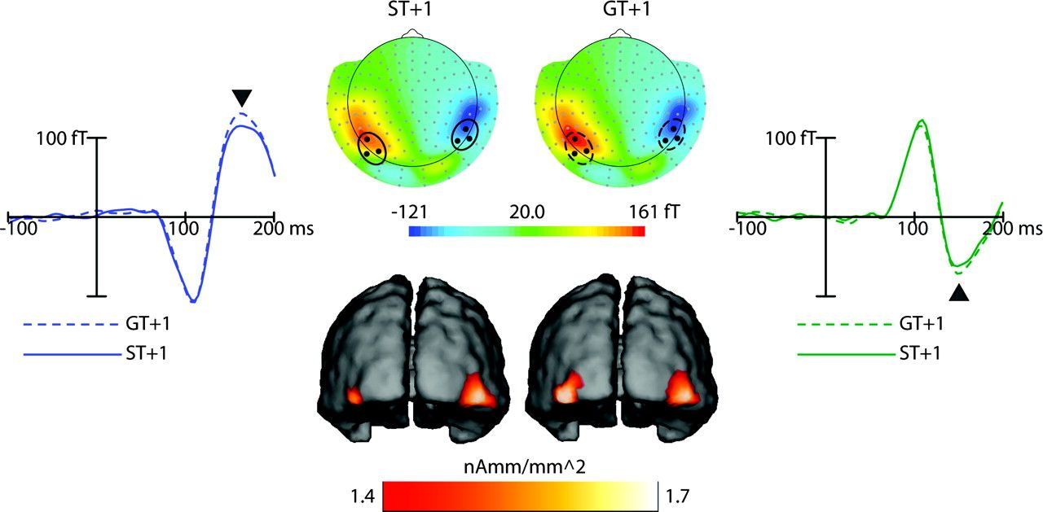
Figure 5. ERMF and SDE results to Go-stimuli (average over subjects; S1-time-range) with different trial history. ERMF ...
Notes:
Figure 5. ERMF and SDE results to Go-stimuli (average over subjects; S1-time-range) with different trial history. ERMF distributions for Go-trials averaged between 140 and 170 ms after the Go-stimulus are displayed in the upper panel separately for Go-trials that either followed a Stop-trial (ST + 1) or another Go-trial (GT + 1). Additionally, the ERMF time course of 3 sensors averaged for each hemisphere (highlighted by black dots in the ERMF distribution) is displayed. Time-course results for the left hemisphere are shown in blue, those for the right hemisphere in green. Dashed lines depict GT + 1, solid lines ST + 1. The maximum amplitude is reached around 160 ms after display-onset (see arrowheads). Black dots in the field distribution mark the locations of the averaged sensors. The lower panel depicts the SDE results at 160 ms poststimulus. Maxima are observed in the inferior occipito-temporal cortex. Both ERMF response and SDE were stronger for GT + 1 than for ST + 1.
Unless provided in the caption above, the following copyright applies to the content of this slide: © The Author 2008. Published by Oxford University Press. All rights reserved. For permissions, please e-mail: journals.permissions@oxfordjournals.org

