Slide 1
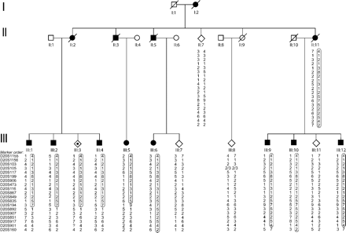
Fig. 1 Pedigree of the SCA23 family. Haplotype analysis is shown for 19 chromosome 20 markers. To maintain ...
Notes:
Fig. 1 Pedigree of the SCA23 family. Haplotype analysis is shown for 19 chromosome 20 markers. To maintain confidentiality, some individuals are depicted with the symbol sex unknown. The disease haplotype is boxed. Open figures = unaffected; closed figures = affected; dotted figures = asymptomatic carrier; square = male; circle = female; diamond = unknown sex;/= deceased.
Unless provided in the caption above, the following copyright applies to the content of this slide: Brain Vol. 127 No. 11 © Guarantors of Brain 2004; all rights reserved

Slide 2
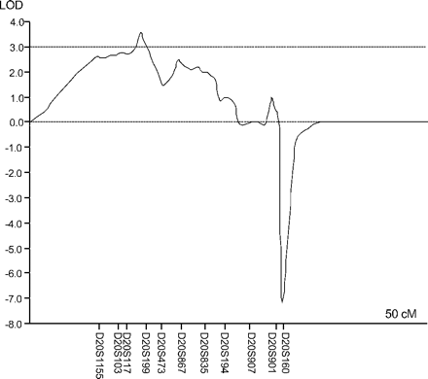
Fig. 3 Multi-point analysis with eleven chromosome 20 markers.
Notes:
Fig. 3 Multi-point analysis with eleven chromosome 20 markers.
Unless provided in the caption above, the following copyright applies to the content of this slide: Brain Vol. 127 No. 11 © Guarantors of Brain 2004; all rights reserved

Slide 3
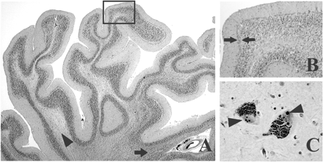
Fig. 2 Neuropathological findings. The cerebellar folia, especially of the rostral vermis (A,B), show severe atrophy ...
Notes:
Fig. 2 Neuropathological findings. The cerebellar folia, especially of the rostral vermis (A,B), show severe atrophy with (sub)total loss of myelin in some parts (lighter staining, loosely textured area of white matter, indicated by arrowhead in A) and relative preservation of myelin in other parts of the white matter (darker staining for myelin in more compact area, indicated by arrow in A). Panel (B) represents a higher magnification of the area indicated by the rectangle in (A); it illustrates severe Purkinje cell loss, accompanied by Bergmann gliosis in the affected cerebellar cortex (arrows). Occasional neurons in the substantia nigra contain up to four round, intranuclear inclusions in (arrowheads in C, maximum diameter = 5 mm). These are strongly ubiquitin positive, but negative in the 1C2 and ataxin-3 staining and were therefore interpreted as Marinesco bodies. No pathological neuronal intranuclear inclusions were encountered in the CNS of this patient. (A,B) Luxol fast blue and haematoxylin and eosin staining. (C) Ubiquitin staining. Original magnification ×12.5 (A), ×100 (B) and ×400 (C).
Unless provided in the caption above, the following copyright applies to the content of this slide: Brain Vol. 127 No. 11 © Guarantors of Brain 2004; all rights reserved

