Slide 1
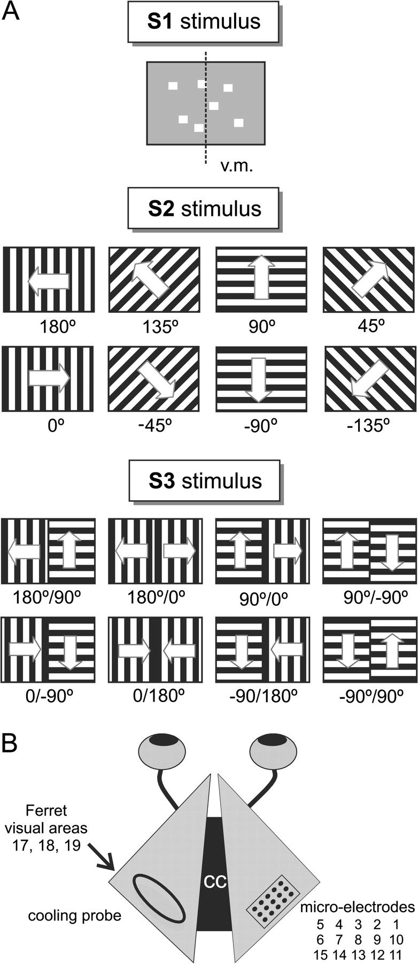
Figure 1. Experimental setup. (A) Visual stimuli used. S1 was a bright 2.5° square flashed for 50 ms at 10 × 10 random ...
Notes:
Figure 1. Experimental setup. (A) Visual stimuli used. S1 was a bright 2.5° square flashed for 50 ms at 10 × 10 random positions covering 25° in the central portion of the visual field. S2 were 30 × 40° whole-field gratings of 4 different orientations moving into the 2 orthogonal directions, centered on the midline of the visual field. S3 were gratings with either different orientations or different directions of motions in the 2 visual hemifields. The midline of the visual field (v.m.) is shown only for S1. (B) An array of 15 microelectrodes was lowered into occipital cortex of the right hemisphere of the ferret. A 3-mm × 6-mm metal cooling loop was positioned on the corresponding position of the contralateral hemisphere. Electrodes 1 and 9 were permanently disabled. The electrodes cover a 1640 × 820-μm rectangle and are spaced in 410-μm intervals.
Unless provided in the caption above, the following copyright applies to the content of this slide: © The Author 2007. Published by Oxford University Press. All rights reserved. For permissions, please e-mail: journals.permissions@oxfordjournals.org

Slide 2
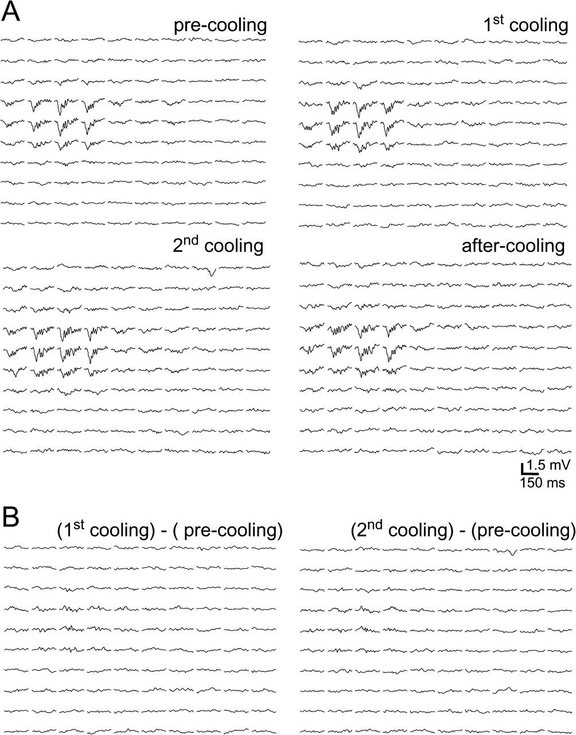
Figure 2. (A) Responses to stimulus S1 before, during and after 2 successive cooling sessions. At each position S1 ...
Notes:
Figure 2. (A) Responses to stimulus S1 before, during and after 2 successive cooling sessions. At each position S1 generated LFPs of different amplitude, which together delineated a PRF (see also Supplementary Fig. 1). Neither the location of the PRFs nor the amplitude or shape of the LFPs was changed by cooling the contralateral hemisphere. (B) Subtractions of the responses obtained before cooling, from those obtained during the first and second cooling sessions. As expected, they are flat. In the same experiment and microelectrode location cooling elicited the D type response shown in Figure 4, during stimulation with the S2 grating.
Unless provided in the caption above, the following copyright applies to the content of this slide: © The Author 2007. Published by Oxford University Press. All rights reserved. For permissions, please e-mail: journals.permissions@oxfordjournals.org

Slide 3
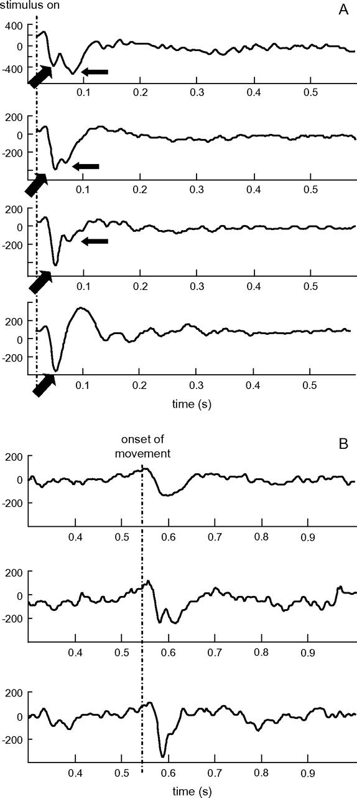
Figure 3. Types of LFPs obtained with the S2 or S3 stimuli. Stimuli invariably generated an LFP response when appearing ...
Notes:
Figure 3. Types of LFPs obtained with the S2 or S3 stimuli. Stimuli invariably generated an LFP response when appearing in the visual field (response to static stimulus (A) and less constantly a longer latency, lower amplitude response initiated by stimulus motion (response to dynamic stimulus (B). The static response usually had 2 peaks at different latencies (arrows) but the second peak could vary in amplitude and was occasionally absent. The response to the dynamic stimulus was usually 1 peak (as in the uppermost example) but occasionally 2 peaks were also seen.
Unless provided in the caption above, the following copyright applies to the content of this slide: © The Author 2007. Published by Oxford University Press. All rights reserved. For permissions, please e-mail: journals.permissions@oxfordjournals.org

Slide 4
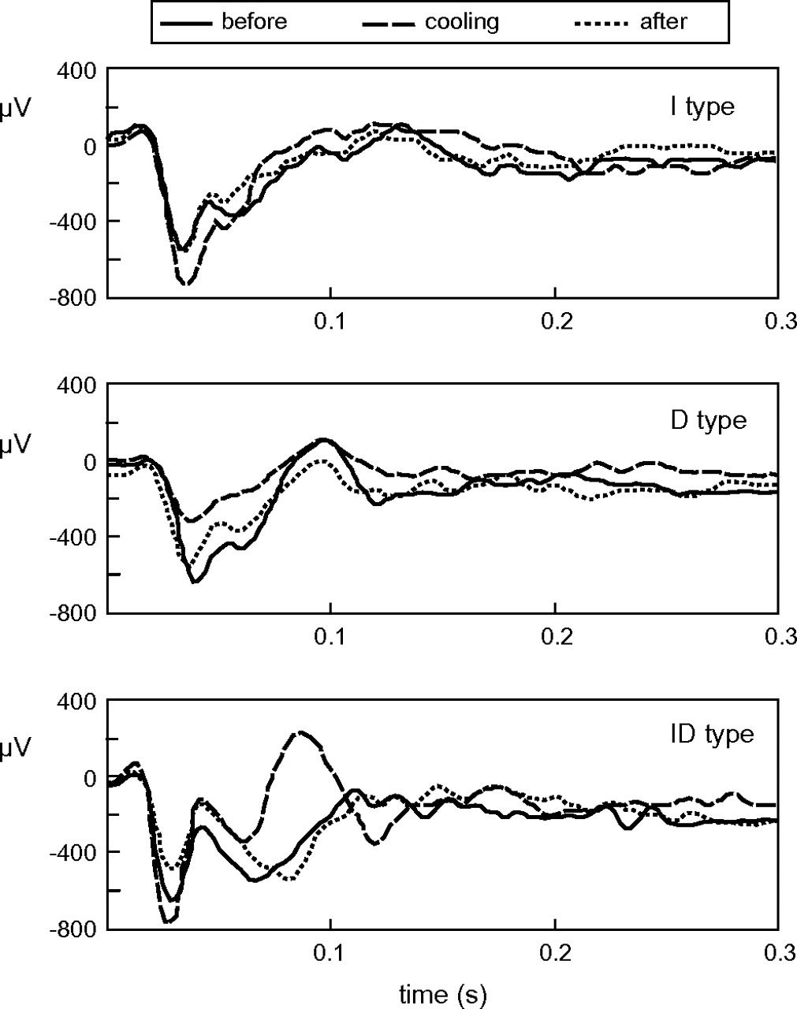
Figure 4. Cooling the contralateral hemisphere modifies the responses to the stimuli (examples from S2 stimuli). ...
Notes:
Figure 4. Cooling the contralateral hemisphere modifies the responses to the stimuli (examples from S2 stimuli). Cooling either increased (I type effect) or decreased (D type effect) the amplitude of the response although sometimes the effects were more complex and depended on latency after stimulus onset. For example, in the recording from experiment 041105 (electrode CH 4; bottom panel) statistical analysis shows a moderate increase of the static response, first peak at 24–40 ms and a more robust decrease of the second peak at 60–80 ms (ID effect).
Unless provided in the caption above, the following copyright applies to the content of this slide: © The Author 2007. Published by Oxford University Press. All rights reserved. For permissions, please e-mail: journals.permissions@oxfordjournals.org

Slide 5
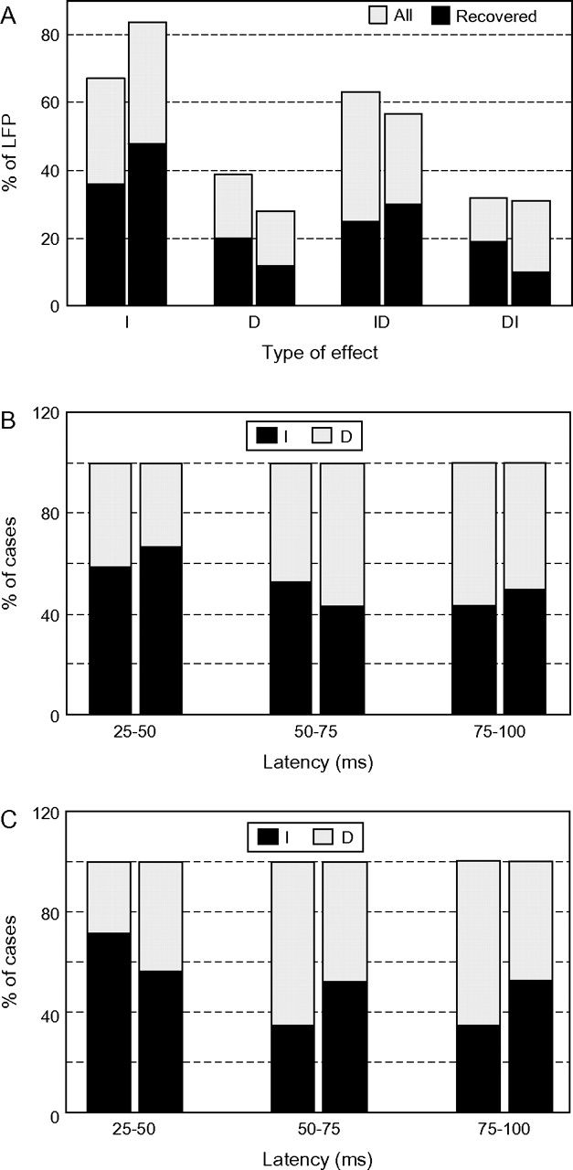
Figure 5. (A) Frequency of cooling effects on the responses to the static phase of S2 (left bars in each pair) and S3 ...
Notes:
Figure 5. (A) Frequency of cooling effects on the responses to the static phase of S2 (left bars in each pair) and S3 (right bars) stimuli. I: increase in response amplitude, D: decrease in response amplitude, ID: sequence of increase–decrease, and DI: sequence of decrease–increase. Notice that I and ID predominate both with S2 and with S3 and that the distribution of effects is similar for the LFPs which recovered after cooling and for those which did not. (B,C) Latency of the I and D effects for the static phase of S2 (left bars) and S3 (right bars) stimuli; responses recovered after cooling (B) and all responses (C). The 2 panels consistently show a higher frequency of increase in the early phase of the responses and a progressively more frequent decrease at longer latencies.
Unless provided in the caption above, the following copyright applies to the content of this slide: © The Author 2007. Published by Oxford University Press. All rights reserved. For permissions, please e-mail: journals.permissions@oxfordjournals.org

Slide 6
Figure 6. (A) Mean amplitude and the standard error of the dynamic phase of the response to S2 and S3 stimuli. (B) ...
Notes:
Figure 6. (A) Mean amplitude and the standard error of the dynamic phase of the response to S2 and S3 stimuli. (B) Frequency and (C) magnitude of cooling effects on the dynamic phase of the responses to S2 and S3. Notice that the response to the dynamic phase of the stimuli consisted of a negative wave, of larger amplitude for S3 than for S2. Instead, the amplitude of the responses to the static phase of the S2 and S3 stimuli (not shown; see text) was not different. Cooling more often increased (I) the amplitude of the response to S2 and decreased (D) that to S3. Also, the increase was larger than the decrease for the S2 stimuli. For the S3 stimuli the opposite was true; furthermore, the increase was not statistically significant when only the responses which fully recovered after cooling were considered. Only the cases which recovered after cooling are shown (Table 1).
Unless provided in the caption above, the following copyright applies to the content of this slide: © The Author 2007. Published by Oxford University Press. All rights reserved. For permissions, please e-mail: journals.permissions@oxfordjournals.org

Slide 7
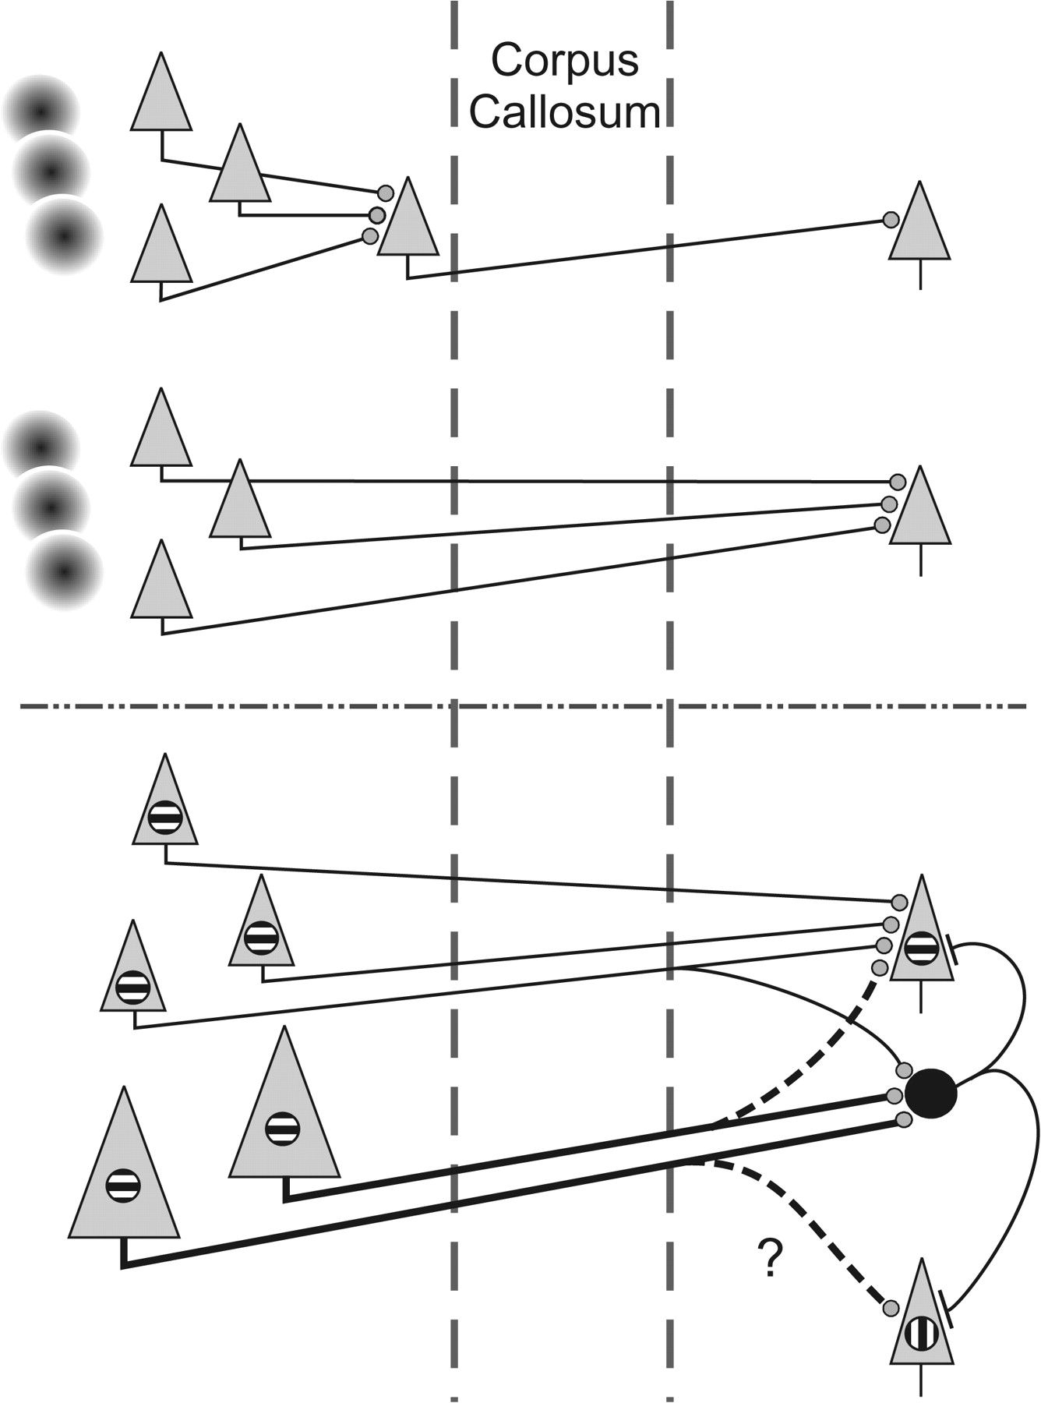
Figure 7. A model meant to capture the main aspects of the present results. Upper panel: because small squares do not ...
Notes:
Figure 7. A model meant to capture the main aspects of the present results. Upper panel: because small squares do not affect contralateral targets, whereas gratings do, it appears that the output from neurons responsive to the small squares needs summation, to affect the contralateral targets. The cartoon suggests that the summation can occur either at the output stage of the sending hemisphere or at the target neurons in the receiving hemisphere. Lower panel: the interhemispheric input appears to be mainly excitatory (round synaptic axonal terminals), however, it elicits an early inhibitory response, via local interneurons. This early inhibition is more widespread than the excitation and might be driven mainly via thicker axons, with higher conduction velocity, whereas the later excitation is driven mainly by thinner, lower conduction velocity axons. The lower panel captures the following additional aspects of the results: inhibition is both between iso-oriented and cross-oriented neurons. Excitation is mainly between iso-oriented neurons. There may be an early, but weak iso-oriented and cross-oriented (question mark) excitation (interrupted lines). For further discussion see text.
Unless provided in the caption above, the following copyright applies to the content of this slide: © The Author 2007. Published by Oxford University Press. All rights reserved. For permissions, please e-mail: journals.permissions@oxfordjournals.org

