Slide 1
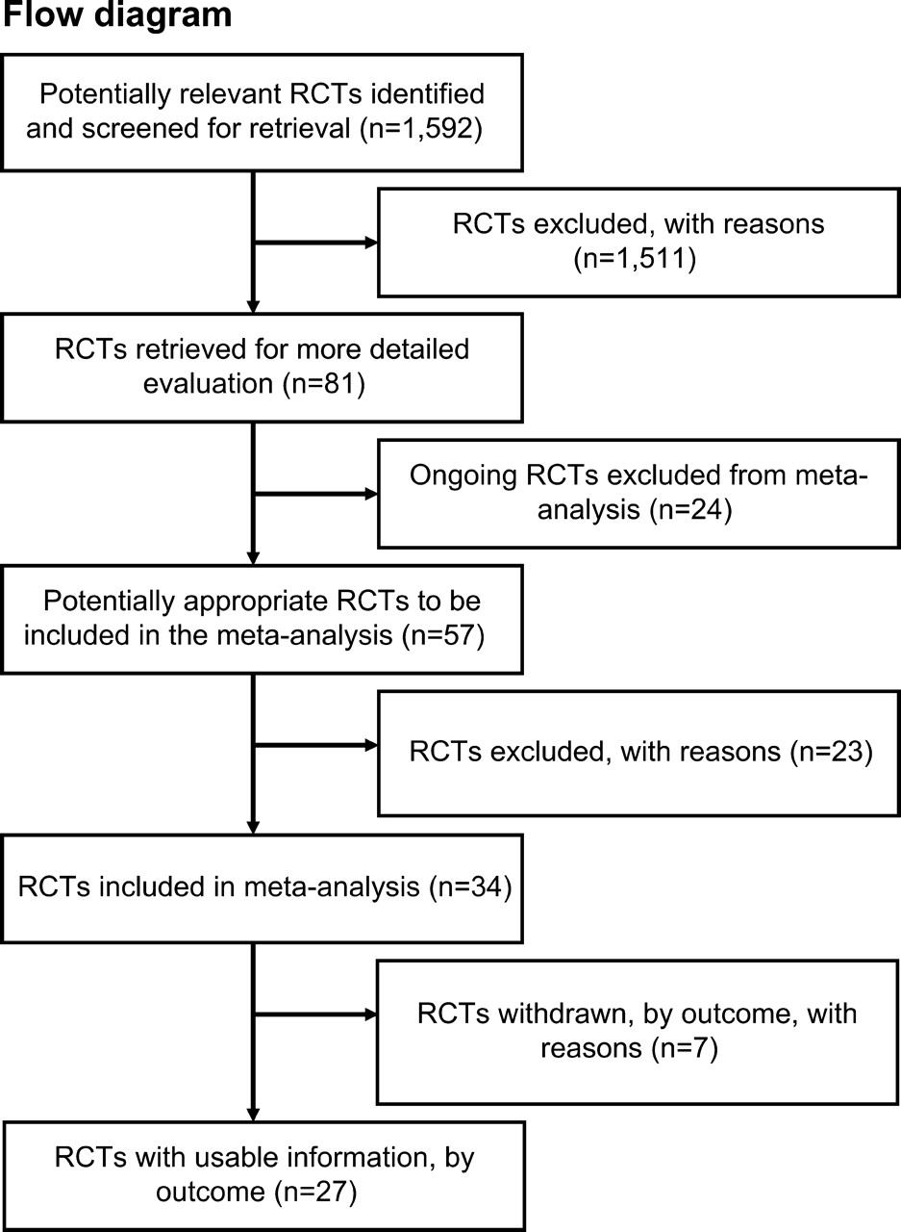
Fig. 1. Identifying and evaluating randomized controlled trials (RCTs).
Notes:
Fig. 1. Identifying and evaluating randomized controlled trials (RCTs).
Unless provided in the caption above, the following copyright applies to the content of this slide: Journal of the National Cancer Institute, Vol. 97, No. 7, © Oxford University Press 2005, all rights reserved.

Slide 2
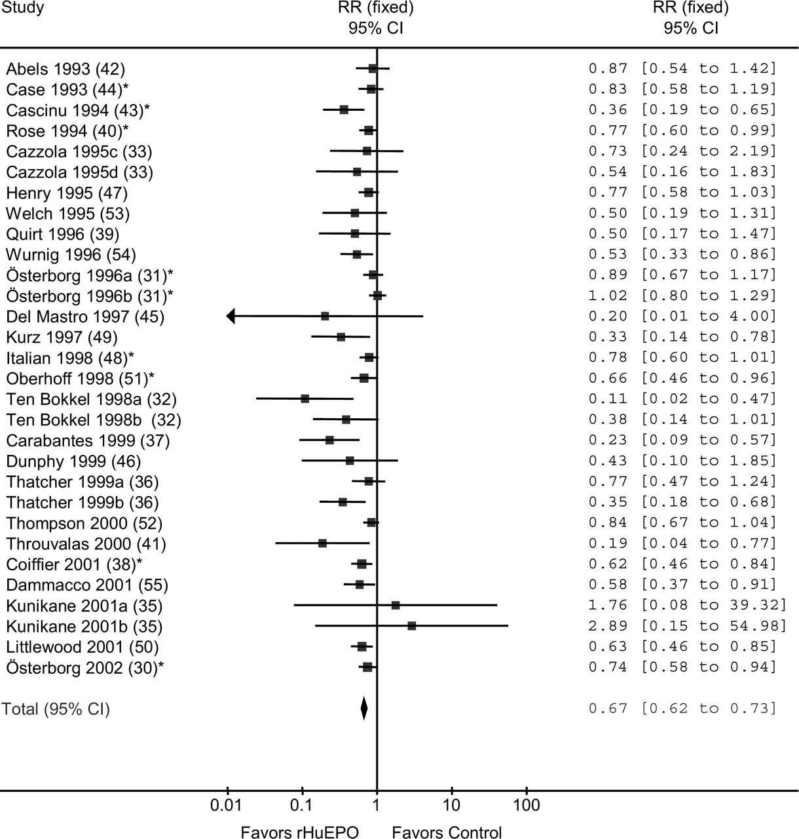
Fig. 2. Meta-analysis of the relative risk to receive red blood cell transfusions for cancer patients receiving ...
Notes:
Fig. 2. Meta-analysis of the relative risk to receive red blood cell transfusions for cancer patients receiving erythropoietin or standard care. Risk estimates for the single studies ( solid squares ). The size of the squares is proportional to the sample size and the number of events. Horizontal lines denote 95% confidence intervals. Wide confidence intervals were truncated with an arrow . The confidence intervals for the pooled relative risks are shown ( diamonds ). Negative values indicate a relative risk reduction for red blood cell transfusions favoring the erythropoietin group. *Additional unreported data from personal communication. Cazzola 1995c: patients in treatment arm received 5000 IU daily; Cazzola 1995d: patients in treatment arm received 10 000 IU daily; Österborg 1996a: patients in treatment arm received 10 000 IU daily; Österborg 1996b: patients in treatment arm received 2000 IU daily, if Hb did not increase after 8 weeks, dose was increased to 5000 IU and 10 000 IU daily after 12 weeks; Ten Bokkel 1998a: patients in treatment arm received 3 × 150 IU/kg three times a week; Ten Bokkel 1998b: patients in treatment arm received 3 × 300 IU/kg three times a week; Thatcher 1999a: patients in treatment arm received 3 × 150 IU/kg three times a week; Thatcher 1999b: patients in treatment arm received 3 × 300 IU/kg three times a week; Kunikane 2001a: patients in treatment arm received 3 × 100 IU/kg three times a week; Kunikane 2001b: patients in treatment arm received 3 × 200 IU/kg three times a week. Test for overall effect: z = 9.73, P <.001 (two-sided), test for heterogeneity chi-square = 57.8, degrees of freedom = 29, P <.001 (one-sided).
Unless provided in the caption above, the following copyright applies to the content of this slide: Journal of the National Cancer Institute, Vol. 97, No. 7, © Oxford University Press 2005, all rights reserved.

Slide 3
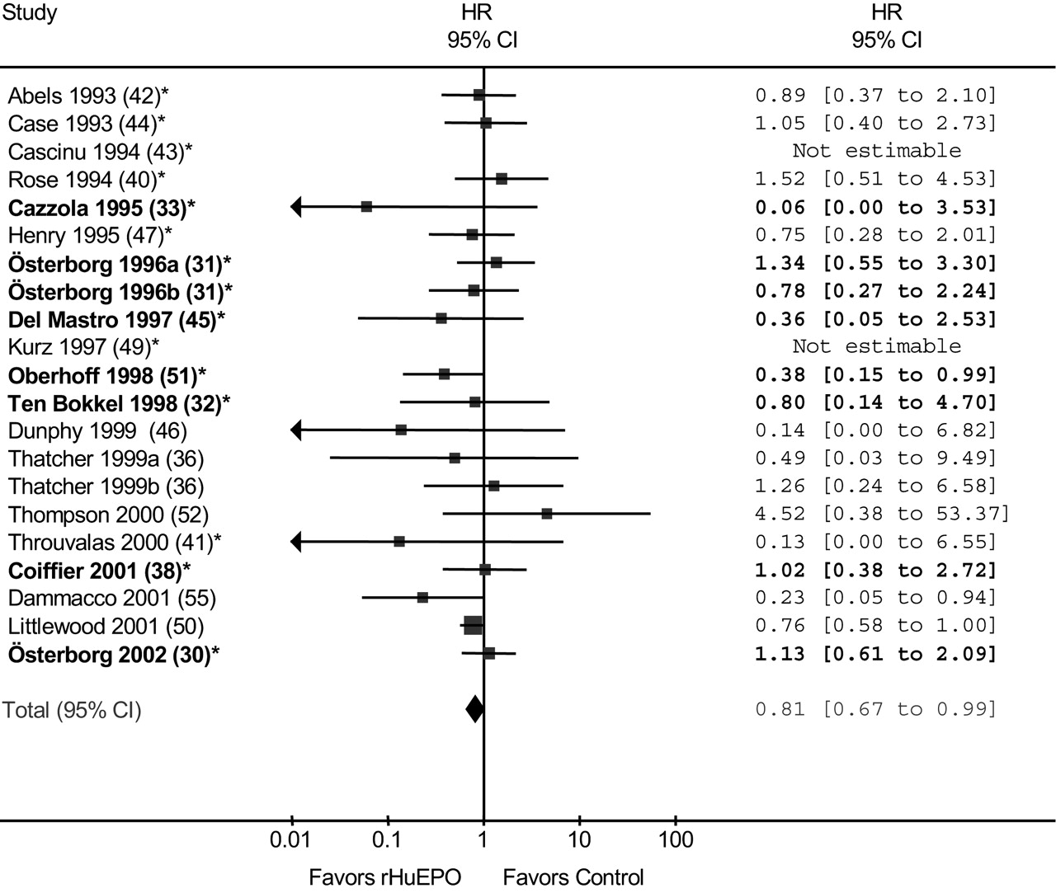
Fig. 3. Meta-analysis of the hazard ratio for overall survival for cancer patients receiving erythropoietin or ...
Notes:
Fig. 3. Meta-analysis of the hazard ratio for overall survival for cancer patients receiving erythropoietin or standard care. Risk estimates for the single studies ( solid squares ). The size of the squares is proportional to the sample size and the number of events. Horizontal lines denote 95% confidence intervals. Wide confidence intervals were truncated with an arrow . The confidence intervals for the pooled hazard ratio are shown ( diamonds ). Negative values indicate a hazard ratio reduction favoring the erythropoietin group. Studies in which individual patient data were available are in bold. *Additional unreported data from personal communication. Österborg 1996a: patients in treatment arm received 10 000 IU daily; Österborg 1996b: patients in treatment arm received 2000 IU daily, if Hb did not increase after 8 weeks, dose was increased to 5000 IU and 10 000 IU daily after 12 weeks; Thatcher 1999a: patients in treatment arm received 3 × 150 IU/kg three times a week; Thatcher 1999b: patients in treatment arm received 3 × 300 IU/kg three times a week. Test for overall effect: z = 2.1, P = .04 (two-sided); test for heterogeneity chi-square = 15.88, degrees of freedom = 18, P = .60 (one-sided).
Unless provided in the caption above, the following copyright applies to the content of this slide: Journal of the National Cancer Institute, Vol. 97, No. 7, © Oxford University Press 2005, all rights reserved.

