Slide 1
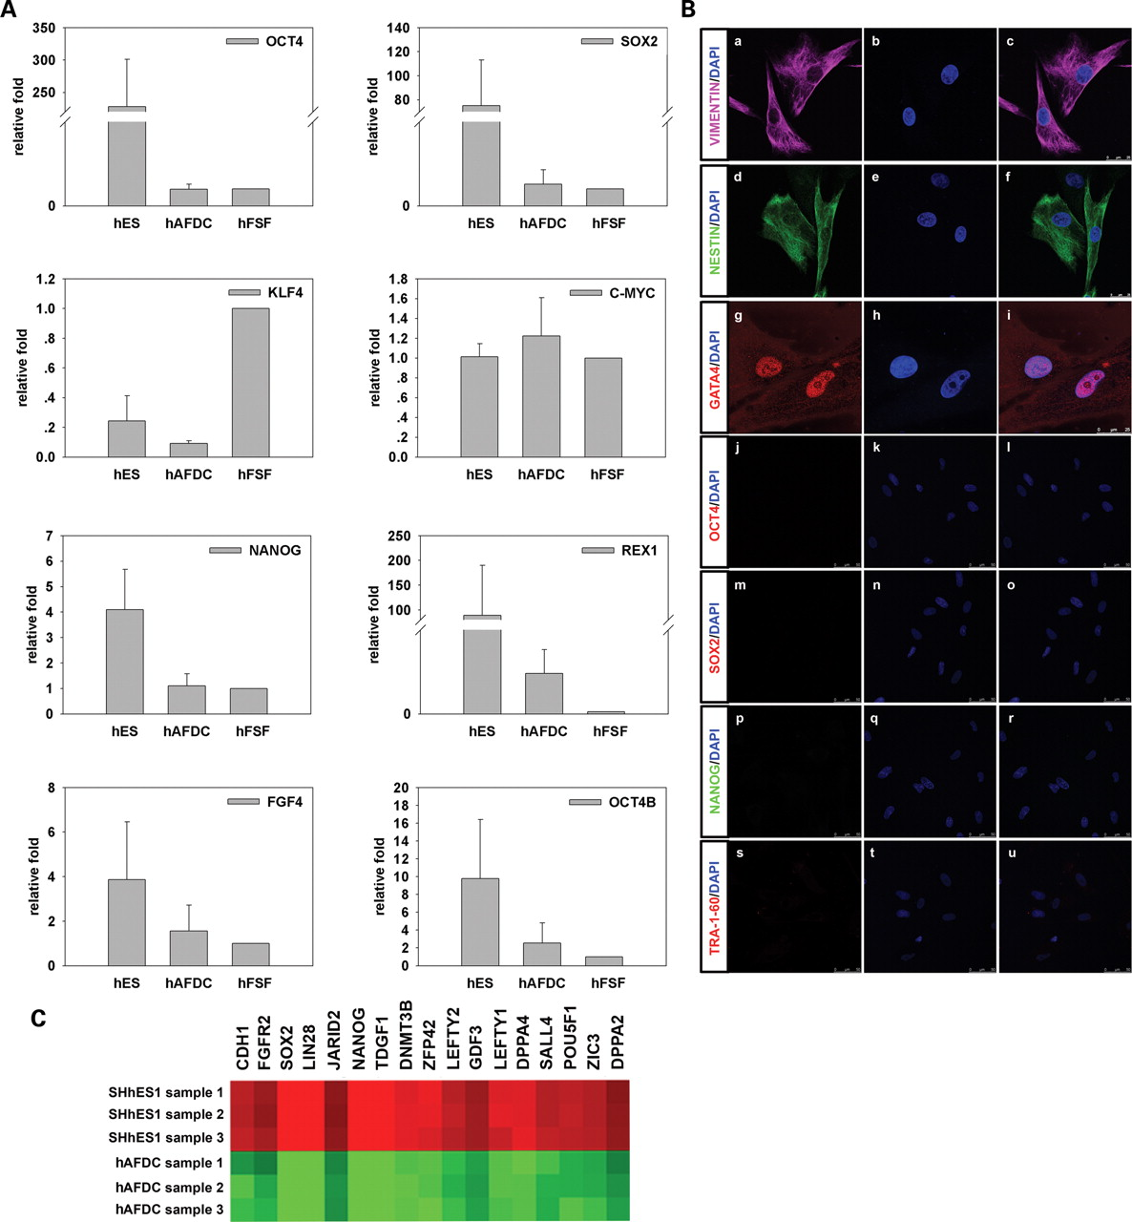
Figure 1. Characterization of hAFDCs. (A) qPCR was performed on human ES cells (hES), hFSF and hAFDCs using primers ...
Notes:
Figure 1. Characterization of hAFDCs. (A) qPCR was performed on human ES cells (hES), hFSF and hAFDCs using primers against OCT4A, OCT4B, NANOG, SOX2, KLF4, C-MYC, FGF4 and REX1. Values are shown as means ± SD of results from three independent experiments. (B) Immunostaining was performed on hAFDCs using antibodies against VIMENTIN, NESTIN, GATA4, OCT4, SOX2, NANOG and TRA-1-60. The scale bars are 25 µm in (a)–(i) and 50 μm in (j)–(u). (C) Clustering analysis of pluripotency marker genes detected by the microarray assay in hAFDCs and human ES cells. Green panels denote low expression levels, whereas red panels denote high expression levels.
Unless provided in the caption above, the following copyright applies to the content of this slide: © The Author 2009. Published by Oxford University Press. All rights reserved. For Permissions, please email: journals.permissions@oxfordjournals.org

Slide 2
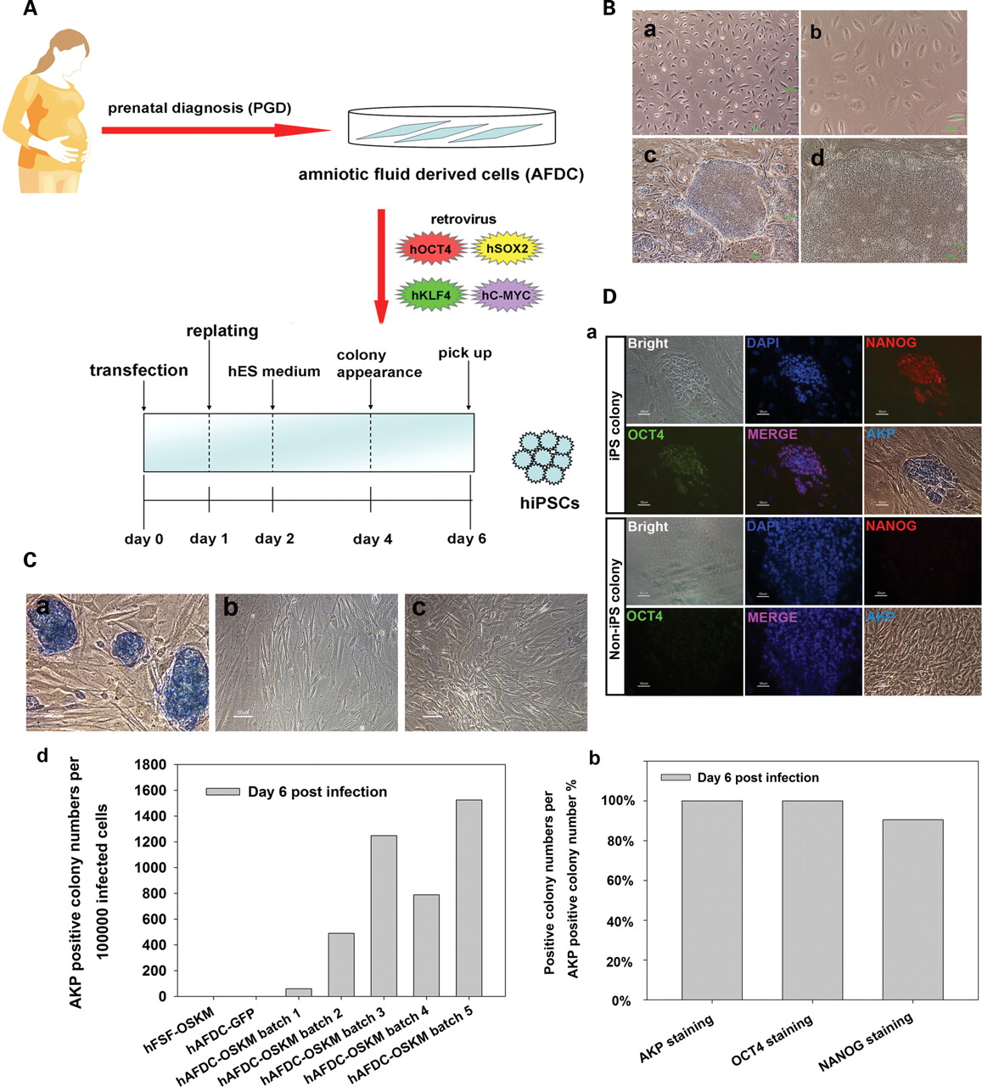
Figure 2. Derivation of iPS cells from hAFDCs. (A) The flow diagram of hAFDC-iPS cell generation based on retroviral ...
Notes:
Figure 2. Derivation of iPS cells from hAFDCs. (A) The flow diagram of hAFDC-iPS cell generation based on retroviral transduction of four factors. (B) Morphology of hAFDCs at low (a) and high (b) magnifications. Typical undifferentiated colonies at low (c) and high (d) magnifications in culture dishes at day 6 post-viral infection are shown. The scale bars are 1000 µm in (a) and (c) and 100 µm in (b) and (d). (C) At day 6 post-infection, the number of colonies having human ES cell-like cells as well as being AKP positive was counted and calculated in hAFDC-OSKM (a), hAFDC-GFP (b) and hFSF-OSKM (c) groups. The efficiency of iPS cell induction from hAFDCs by retroviral transduction of the four factors was compared with that from hFSF cells or that hAFDCs transduced by GFP virus alone. Five independent experiments were performed using different batches of viruses and starting cells. The quantitative data are shown in (d). The ‘OSKM’ denotes the mixture of the four retroviruses. The scale bars are 50 µm. (D) At day 6 post-infection, hAFDC-iPS cells were immunostained by antibodies against OCT4 and NANOG, and then restained using the AKP kit. Representative iPS cell colonies and non-iPS colonies were analyzed for OCT4, NANOG and AKP expression and shown in (a). For AKP positive colonies, the percentage of OCT4 or NANOG positive colonies was calculated and is shown in (b).
Unless provided in the caption above, the following copyright applies to the content of this slide: © The Author 2009. Published by Oxford University Press. All rights reserved. For Permissions, please email: journals.permissions@oxfordjournals.org

Slide 3
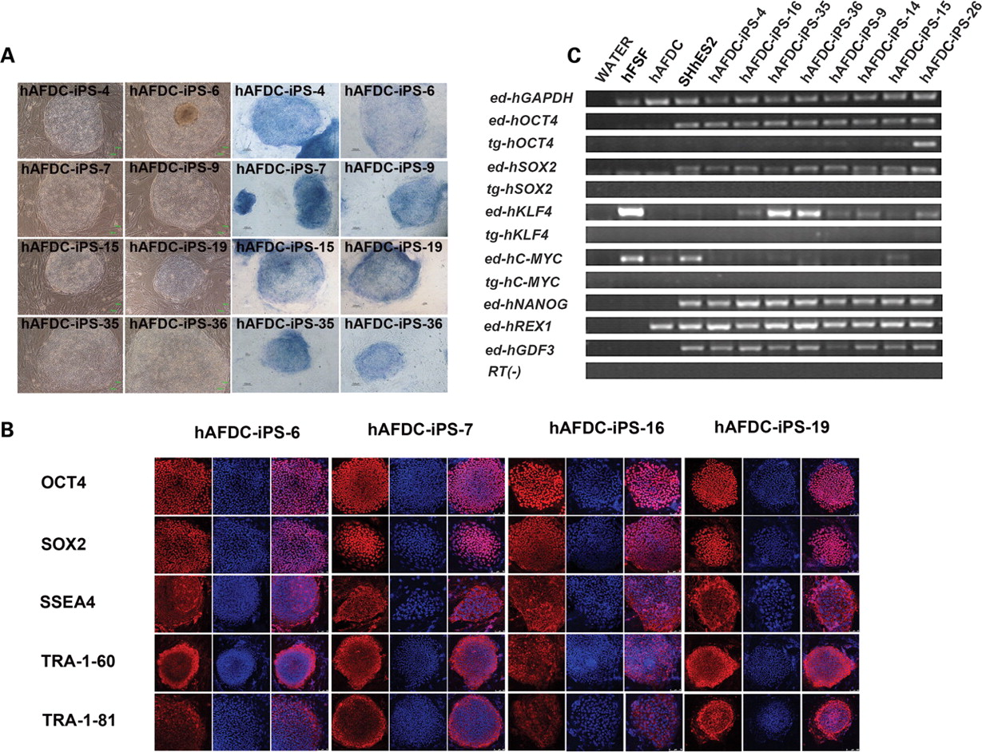
Figure 3. Characterization of hAFDC-iPS cells. (A) hAFDC-iPS cell lines 4, 6, 7, 9, 16, 19, 35 and 36 maintained ...
Notes:
Figure 3. Characterization of hAFDC-iPS cells. (A) hAFDC-iPS cell lines 4, 6, 7, 9, 16, 19, 35 and 36 maintained typical undifferentiated human ES morphology and high levels of AKP expression during long-term culture in vitro. (B) Immunostaining was performed on hAFDC-iPS cell lines 6, 7, 16 and 19 using antibodies against OCT4, SOX2, SSEA4, TRA-1-60 and TRA-1-81. All scale bars are 100 µm. (C) RT–PCR assays were performed using primers against endogenous and transgenic pluripotency markers. Representative data of two independent experiments are shown.
Unless provided in the caption above, the following copyright applies to the content of this slide: © The Author 2009. Published by Oxford University Press. All rights reserved. For Permissions, please email: journals.permissions@oxfordjournals.org

Slide 4
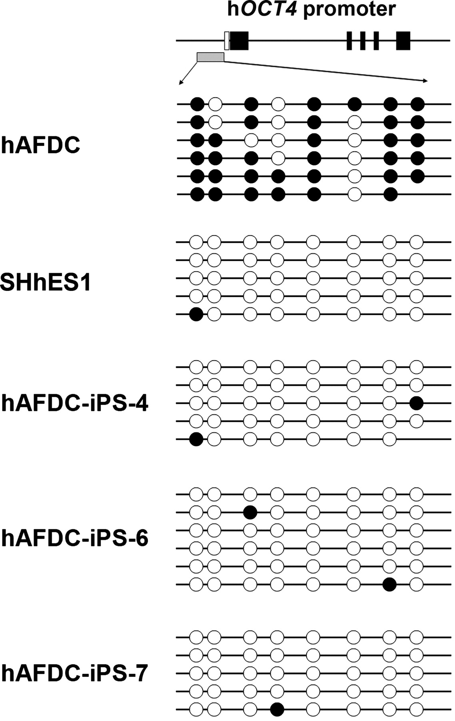
Figure 4. Demethylated states of the endogenous OCT4 promoter after reprogramming. Bisulfite sequencing analysis was ...
Notes:
Figure 4. Demethylated states of the endogenous OCT4 promoter after reprogramming. Bisulfite sequencing analysis was performed for the endogenous OCT4 promoter in cells of human ES cells (SHhES1), hAFDCs and cells of hAFDC-iPS cell lines 4, 6 and 7. Each horizontal row of circles represents an individual sequencing result. Hollow circles denote unmethylated CpG islands, whereas black circles denote methylated CpG islands.
Unless provided in the caption above, the following copyright applies to the content of this slide: © The Author 2009. Published by Oxford University Press. All rights reserved. For Permissions, please email: journals.permissions@oxfordjournals.org

Slide 5
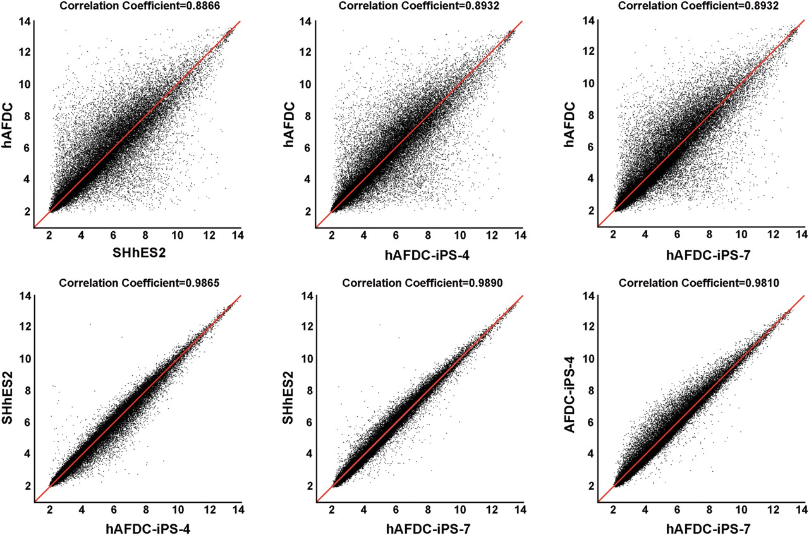
Figure 5. Microarray analysis of hAFDC-iPS cells. The global gene expression profiles were compared between hAFDC-iPS ...
Notes:
Figure 5. Microarray analysis of hAFDC-iPS cells. The global gene expression profiles were compared between hAFDC-iPS cells and human ES cells (SHhES2), as well as between hAFDC-iPS cells and hAFDCs using an Affymetrix microarray. The correlation coefficient is calculated between the groups.
Unless provided in the caption above, the following copyright applies to the content of this slide: © The Author 2009. Published by Oxford University Press. All rights reserved. For Permissions, please email: journals.permissions@oxfordjournals.org

Slide 6
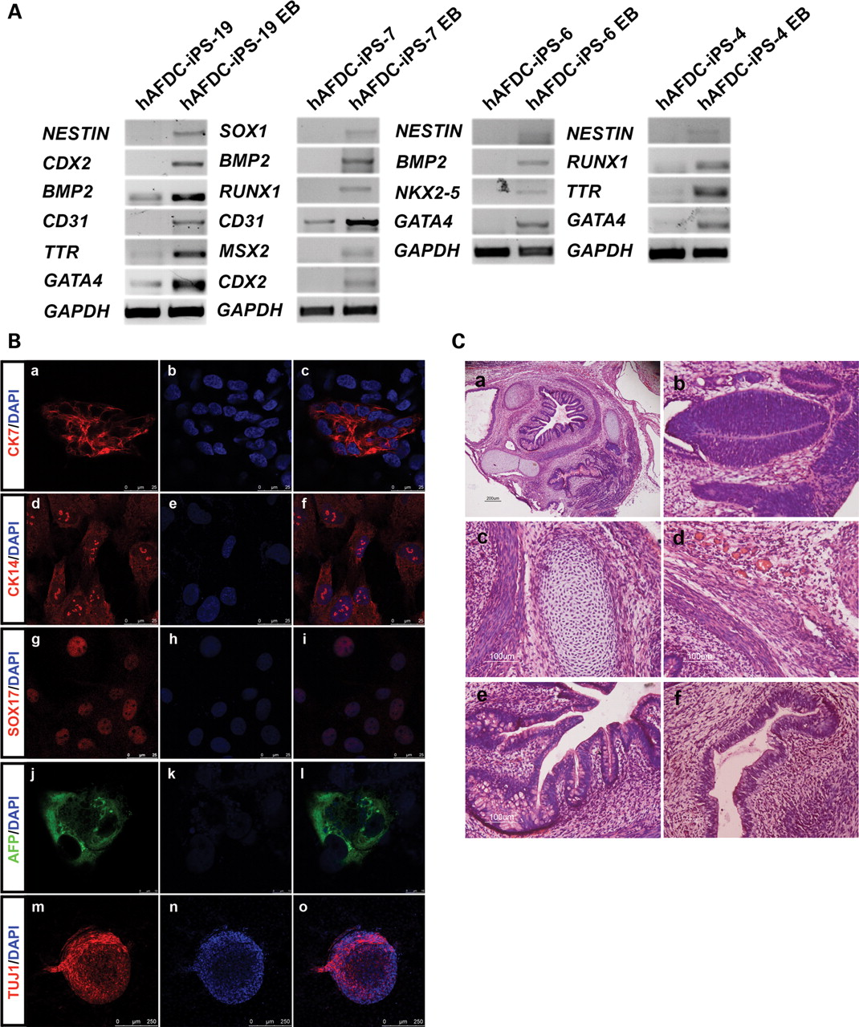
Figure 6. In vitro and in vivo differentiation abilities of hAFDC-iPS cells. (A) RT–PCR analysis of expression levels ...
Notes:
Figure 6. In vitro and in vivo differentiation abilities of hAFDC-iPS cells. (A) RT–PCR analysis of expression levels of various germ layer markers was performed for EB samples of hAFDC-iPS cell lines 4, 6, 7, 19. Representative results of two independent experiments are shown. (B) Expression of germ layer markers in differentiated iPS cells was examined using immunostaining. The scale bars are 25 µm in (a)–(i), 10 µm in (j)–(l) and 250 µm in (m)–(o). (C) Teratomas were harvested 6–8 weeks after intramuscular injection of undifferentiated cells from hAFDC-iPS cell line 36 into SCID-NOD mice. Using histochemical staining, low magnification of a teratoma was shown in (a). Various tissues, such as neural epithelia (b); cartilages (c); smooth muscle and blood vessels (d); intestinal glandular tissues (e) and lung epithelia (f) were found. The scale bars are 500 µm in (a) and 50 µm in (b–f).
Unless provided in the caption above, the following copyright applies to the content of this slide: © The Author 2009. Published by Oxford University Press. All rights reserved. For Permissions, please email: journals.permissions@oxfordjournals.org

