Slide 1
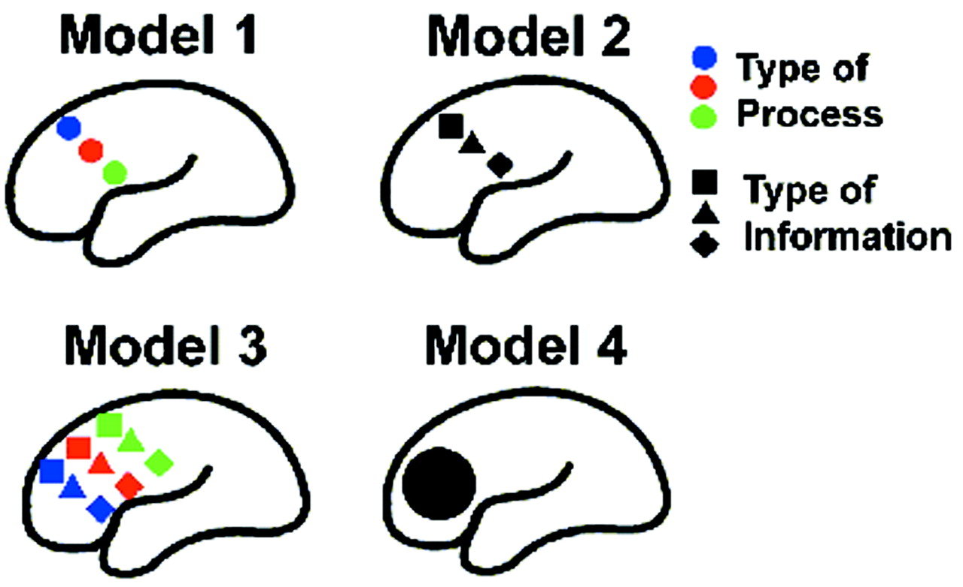
Figure 1. Four possible models of the functional organization of prefrontal cortex (see text).
Notes:
Figure 1. Four possible models of the functional organization of prefrontal cortex (see text).
Unless provided in the caption above, the following copyright applies to the content of this slide: © Oxford University Press

Slide 2
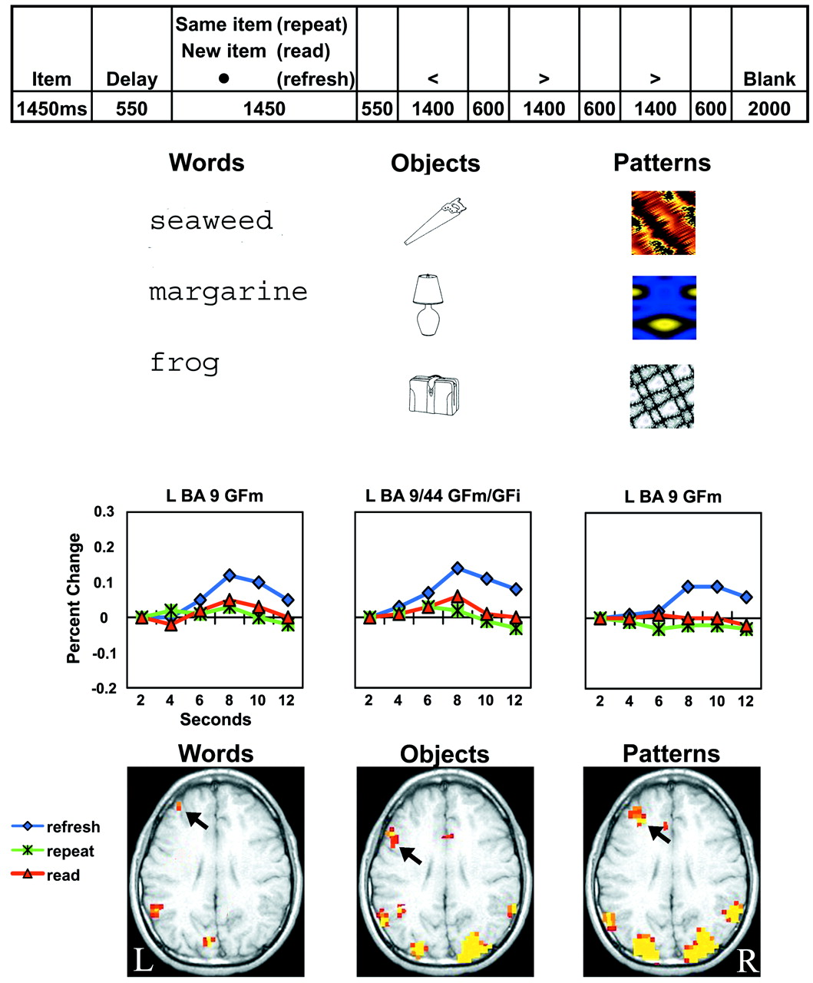
Figure 2. Frontal activations associated with refreshing. Axial slice z = 28. Trial event-sequence and timing for ...
Notes:
Figure 2. Frontal activations associated with refreshing. Axial slice z = 28. Trial event-sequence and timing for experiment 1 and example stimuli, together with left PFC regions of activation and their corresponding time-courses for three types of information: words, objects and patterns. Refresh regions shown were identified by the condition by time interaction. For the time-courses, the x-axis represents time within a trial (2, 4, 6, 8, 10, or 12 s, corresponding to volumes 1–6), the y-axis represents mean percentage change from time 1; blue diamonds, refresh; green asterisks, repeat; red triangles, read. The position of the peak reflects the lag in the hemodynamic response, typically 4–6 s.
Unless provided in the caption above, the following copyright applies to the content of this slide: © Oxford University Press

Slide 3
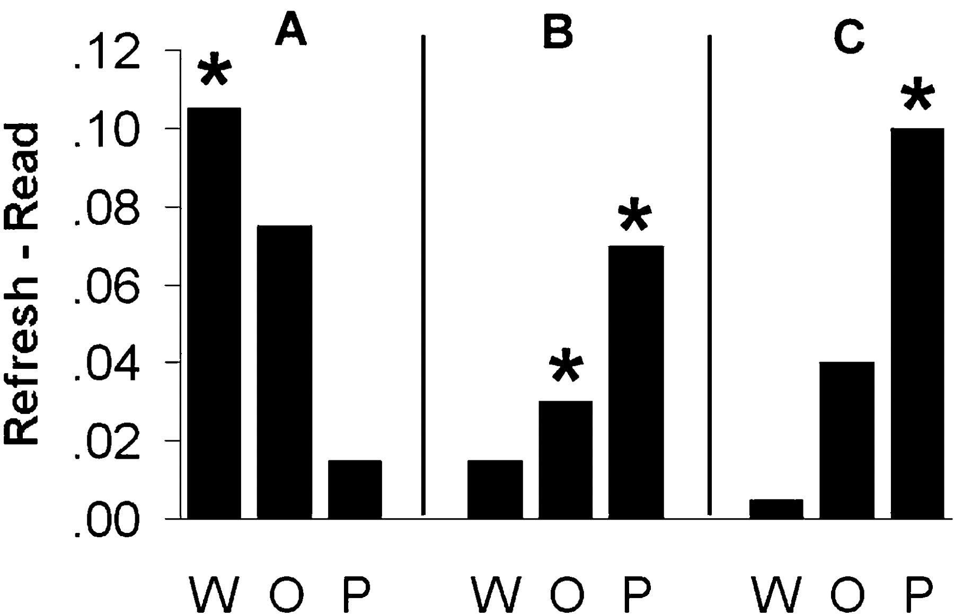
Figure 3. Areas of PFC showing a materials by condition interaction. The y-axis represents the difference between ...
Notes:
Figure 3. Areas of PFC showing a materials by condition interaction. The y-axis represents the difference between refresh and read in percentage change (times 4 and 5 relative to time 1); W, words; O, objects; P, patterns. (A) A region of left GFm, BA 9/8 (x = −52, y = 12, z = 40) showing refresh > read for words (P 0.10). (B) A region of left GFs/GFm, BA 10, 9 (x = −18, y = 54, z = 20) showing refresh > read for both objects (P < 0.06) and patterns (P 0.10). (C) A region of right GFi, BA 47 (x = 46, y = 20, z = −4) showing refresh > read (P 0.10).
Unless provided in the caption above, the following copyright applies to the content of this slide: © Oxford University Press

Slide 4
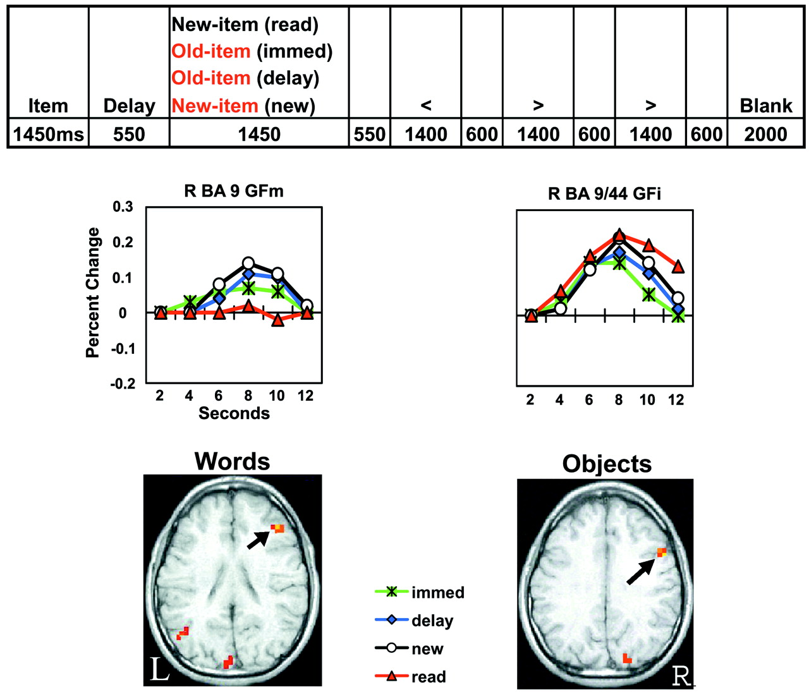
Figure 4. Frontal activations associated with noting old–new. Axial slice z = 26 (words) and z = 32 (objects). Trial ...
Notes:
Figure 4. Frontal activations associated with noting old–new. Axial slice z = 26 (words) and z = 32 (objects). Trial event-sequence and timing for experiment 2, together with right PFC regions of activation and their corresponding time-courses for two types of information: words and objects. Regions associated with noting whether an item was old or new were identified by the condition by time interaction. For the time-courses, the x-axis represents time within a trial (2, 4, 6, 8, 10, or 12 s, corresponding to volumes 1–6), the y-axis represents mean percentage change from time 1; green asterisks, old (immediate); blue diamonds, old (delay); white circles, new; red triangles, read. The position of the peak reflects the lag in the hemodynamic response, typically 4–6 s.
Unless provided in the caption above, the following copyright applies to the content of this slide: © Oxford University Press

Slide 5
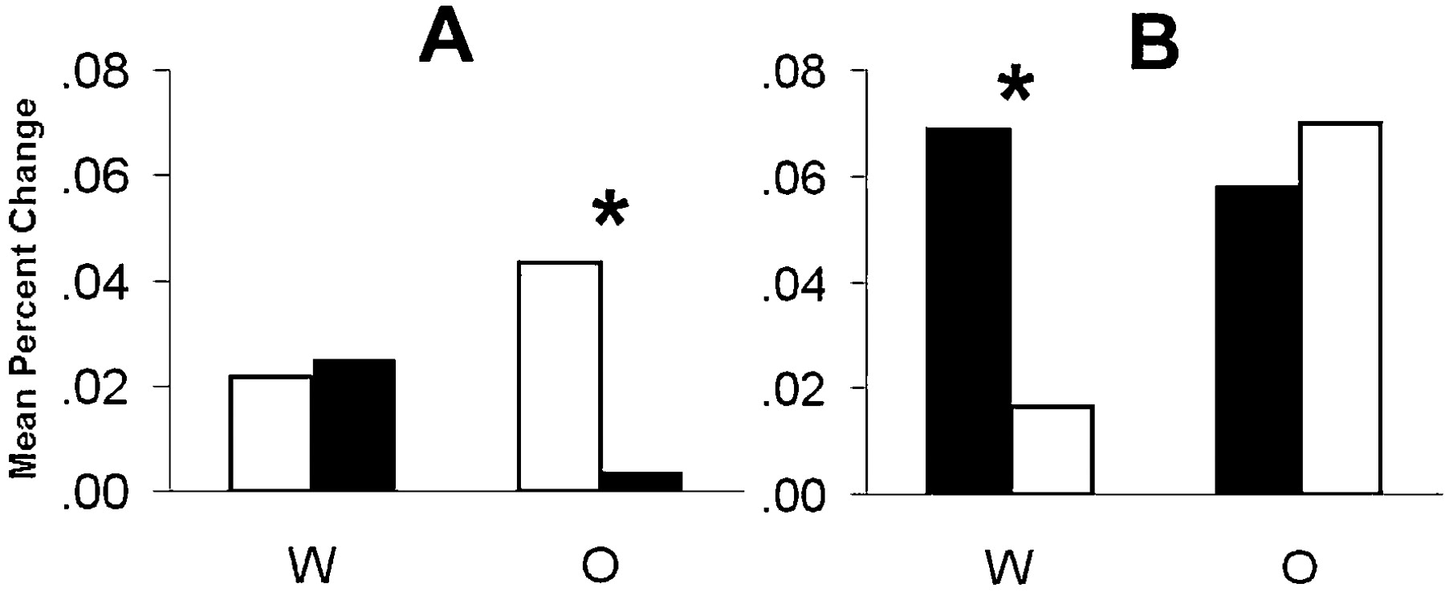
Figure 5. Areas of PFC showing a materials by condition interaction. (A) A region at the juncture of right GFm, GFi and ...
Notes:
Figure 5. Areas of PFC showing a materials by condition interaction. (A) A region at the juncture of right GFm, GFi and GPrC, BA 9 (x = 37, y = 9, z = 28) in which, for objects only, the signal during processing of novel items [read, new (white)] was greater than during processing of old items [immediate, delay (black)] (P < 0.025). (B) A region of left GFi, BA 47/45/insula (x = −32, y = 22, z = 2) in which, for words only, the signal during noting old/new [immediate, delay, new (black)] was greater than in read (white) (P < 0.04). The y-axis represents the percentage signal change (times 4, 5, 6 relative to time 1) averaged across conditions as specified above. W, words; O, objects.
Unless provided in the caption above, the following copyright applies to the content of this slide: © Oxford University Press

Slide 6
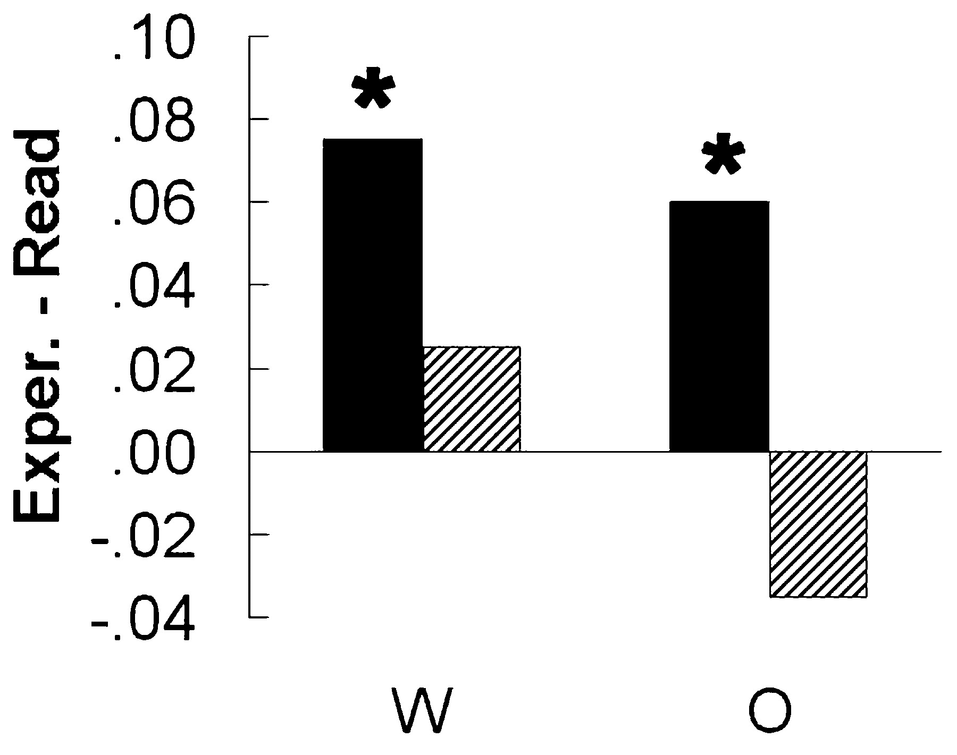
Figure 6. A region of left GFm, BA 46 (x = −46, y = 30, z = 20) showing a condition by experiment interaction (P < ...
Notes:
Figure 6. A region of left GFm, BA 46 (x = −46, y = 30, z = 20) showing a condition by experiment interaction (P < 0.01). In experiment 1 (refreshing, black bars), for both words (P < 0.01) and objects (P read. In experiment 2 (noting, hatched bars), differences between immediate and read were not significant for either words or objects. The y-axis represents the difference in percentage change signal between each experimental condition (refresh or immediate) and its own read control condition. W, words; O, objects.
Unless provided in the caption above, the following copyright applies to the content of this slide: © Oxford University Press

