Slide 1
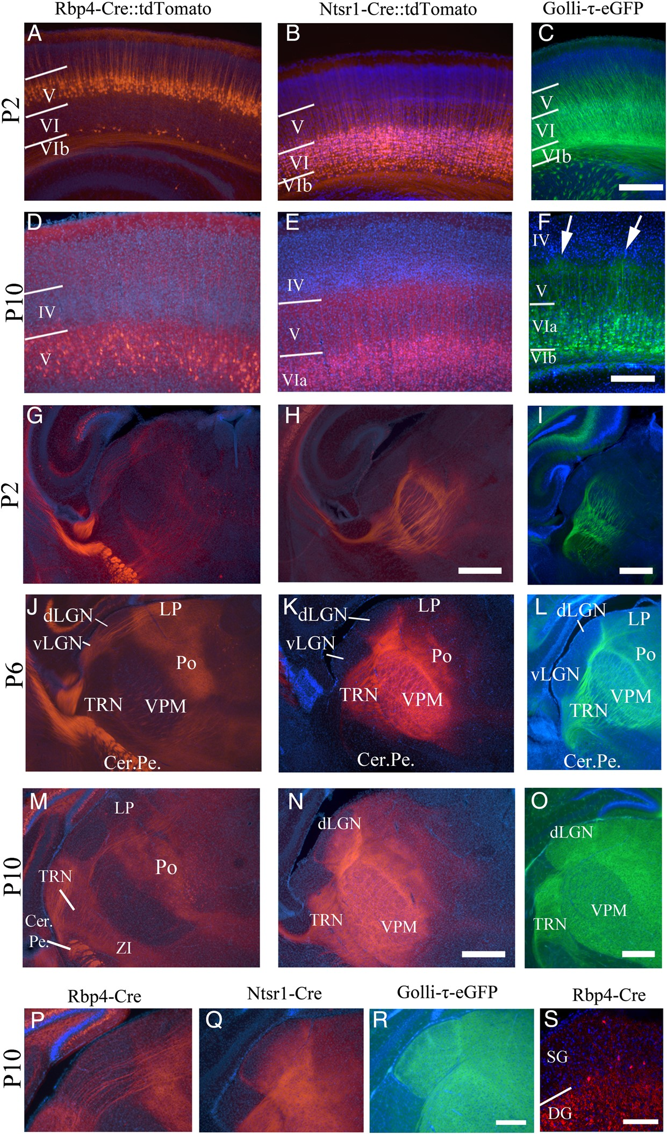
Figure 1. Fluorescent marker expression in the Rbp4-Cre::tdTomato, Ntsr1-Cre::tdTomato, and Golli-τ-eGFP mice. (A) Cre ...
Notes:
Figure 1. Fluorescent marker expression in the Rbp4-Cre::tdTomato, Ntsr1-Cre::tdTomato, and Golli-τ-eGFP mice. (A) Cre induced tdTomato expression in layer V pyramidal neurons of the Rbp4-Cre line at P2. (B) Cre-induced tdTomato expression is confined to layer VIa of the Ntsr1-Cre mouse at P2. (C) In the Golli-τ-eGFP mouse at P2, eGFP expression is in layer VI including sublayers VIa and VIb. (D) Rbp4-Cre::tdTomato layer V pyramidal neurons at P10. (E) Ntsr1-Cre::tdTomato layer VI neurons at P10. (F) Golli-τ-eGFP expressing VIa and VIb neurons at P10. Periphery-related barrel patterning is visible (white arrows) (G). Rbp4-Cre::tdTomato layer V corticothalamic fibers have entered the thalamus and project through the VPM and dLGN and project to the LP and Po at P2. They are also densely packed in the cerebral peduncle (H). Ntsr1-Cre::tdTomato layer VIa fibers are strongly visible in the TRN, VPM and reach Po at P2. (I) Golli-τ-eGFP fibers have reached the TRN and VPM at P2. (J) At P6, layer V tdTomato fibers have reached the medial, higher-order, thalamic nuclei while coursing through the first-order dLGN and VPM without barbarizations. Fibers remain absent from TRN. (K) At P6, the layer VIa tdTomato fibers are densely innervating the first-order VPM and are projecting into the dLGN, they have also started entering the most medial higher-order thalamic nuclei. (L) The layer VIa and VIb eGFP fibers are strongly visible in VPM and have reached more medial higher-order nuclei and have formed a line around the dLGN, but have not yet entered it at P6. (M) At P10, the layer V fibers innervate the LP and Po, but still do not branch in dLGN or VPM. Innervation of TRN and ZI has increased in density. (N) Ntsr1-Cre::tdTomato layer VI corticothalamic fibers arborize in the TRN, the dLGN, the VPM, the LP, and the Po. (O) Golli-τ-eGFP layer VI and VIb fibers arborize in the TRN, the dLGN, the VPM, the LP, and the Po. (P) Layer V tdTomato fibers run through the dLGN, but do not arborize in it. (N) Layer VI tdTomato fibers enter the dLGN from the ventral/medial edge and by P10 have not yet filled it. (Q) Layer VI and VIb fibers enter the dLGN and have filled it by P10. (S) Rbp4-Cre::tdTomato-positive layer V fibers innervate the superficial gray (SG) layer of the SC. Layer boundaries determined by DAPI. Images are representative of the n ≥ 3 brains per age and strain that were analyzed in detail. LP, lateral posterior thalamic nucleus; Po, posterior thalamic nucleus; dLGN, dorsal lateral geniculate nucleus; VPM, ventral posterior (medial) nucleus; TRN, thalamic reticular nucleus; Cer. Pe., cerebral peduncle; SG, superficial gray layer of SC; DG; deep gray layer of SC. Scale bars = A–C 125 µm, D and E 500 µm, F 500 µm, G–I 250 µm, J 50 µm.
Unless provided in the caption above, the following copyright applies to the content of this slide: © The Author 2016. Published by Oxford University PressThis is an Open Access article distributed under the terms of the Creative Commons Attribution License (http://creativecommons.org/licenses/by/4.0/), which permits unrestricted reuse, distribution, and reproduction in any medium, provided the original work is properly cited.

Slide 2
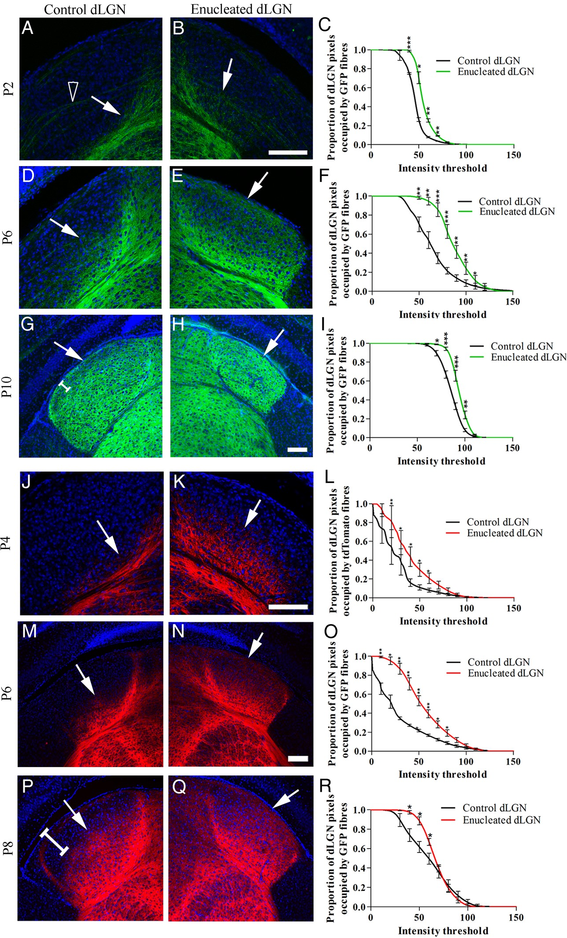
Figure 2. Fluorescently labeled layer VI and VIa corticothalamic fibers enter the dLGN prematurely after the removal of ...
Notes:
Figure 2. Fluorescently labeled layer VI and VIa corticothalamic fibers enter the dLGN prematurely after the removal of retinal input at birth by monocular enucleation. (A) Golli-τ-eGFP-positive VI and VIb fibers reach the ventral edge of the control dLGN by P2 (white arrow). Some eGFP-labeled fibers can be seen crossing the dLGN from the few layer V cells labeled (hollow arrow head). (B) By P2, Golli-τ-eGFP-positive VIa and VIb fibers begin to enter the enucleated dLGN (white arrow). (C) Proportionally more pixels are occupied by bright eGFP fibers in the enucleated dLGN compared with control dLGN, n = 3. (D) By P6, eGFP-positive fibers have entered the ventral half of the control dLGN (white arrow). (E) The eGFP fibers have reached the dorsal/lateral edge of the enucleated dLGN and extend throughout the nucleus (white arrow). (F) Proportionally more pixels are occupied by bright eGFP fibers in the enucleated dLGN compared with control dLGN, n = 6. (G,H) By P10, eGFP fibers have reached the dorsal/lateral edge of both the control and enucleated dLGN (white arrows); however, a less dense band remains in the control dLGN (white bracket). (I) Proportionally more pixels are occupied by bright eGFP fibers in the enucleated dLGN compared with control dLGN though the difference is less substantial, n = 5. (J) At P4, layer VI Ntsr1-Cre::tdTomato fibers have reached the ventral edge of the control dLGN, but do not yet enter (white arrow). (K) Layer VI Ntsr1-Cre::tdTomato fibers have entered the ventral half of the enucleated dLGN (white arrow). (L) Proportionally more pixels are occupied by bright tdTomato fibers in the enucleated dLGN compared with control, n = 3. (M) By P6, Ntsr1-Cre::tdTomato-positive layer VIa fibers have entered the ventral half of the control dLGN (white arrow). (N) Layer VIa tdTomato-labeled fibers have reached the dorsal/lateral edge of the enucleated dLGN (white arrow). (O) Proportionally more pixels are occupied by bright tdTomato fibers in the enucleated dLGN compared with control dLGN, the difference is greatest at this age, n = 4. (P) By P8, tdTomato fibers do not yet reach the dorsal/lateral edge of the control dLGN (white arrow and white bracket). (Q) The fibers are more densely arborized throughout the enucleated dLGN, but are not yet evenly distributed. (R) There are proportionally more pixels occupied by bright tdTomato-positive fibers in the control dLGN compared with the enucleated dLGN at P8, n = 4. Values on graphs are mean and standard error. Scale bars = 50 µm A–E, G–H, I–J, M–Q.
Unless provided in the caption above, the following copyright applies to the content of this slide: © The Author 2016. Published by Oxford University PressThis is an Open Access article distributed under the terms of the Creative Commons Attribution License (http://creativecommons.org/licenses/by/4.0/), which permits unrestricted reuse, distribution, and reproduction in any medium, provided the original work is properly cited.

Slide 3
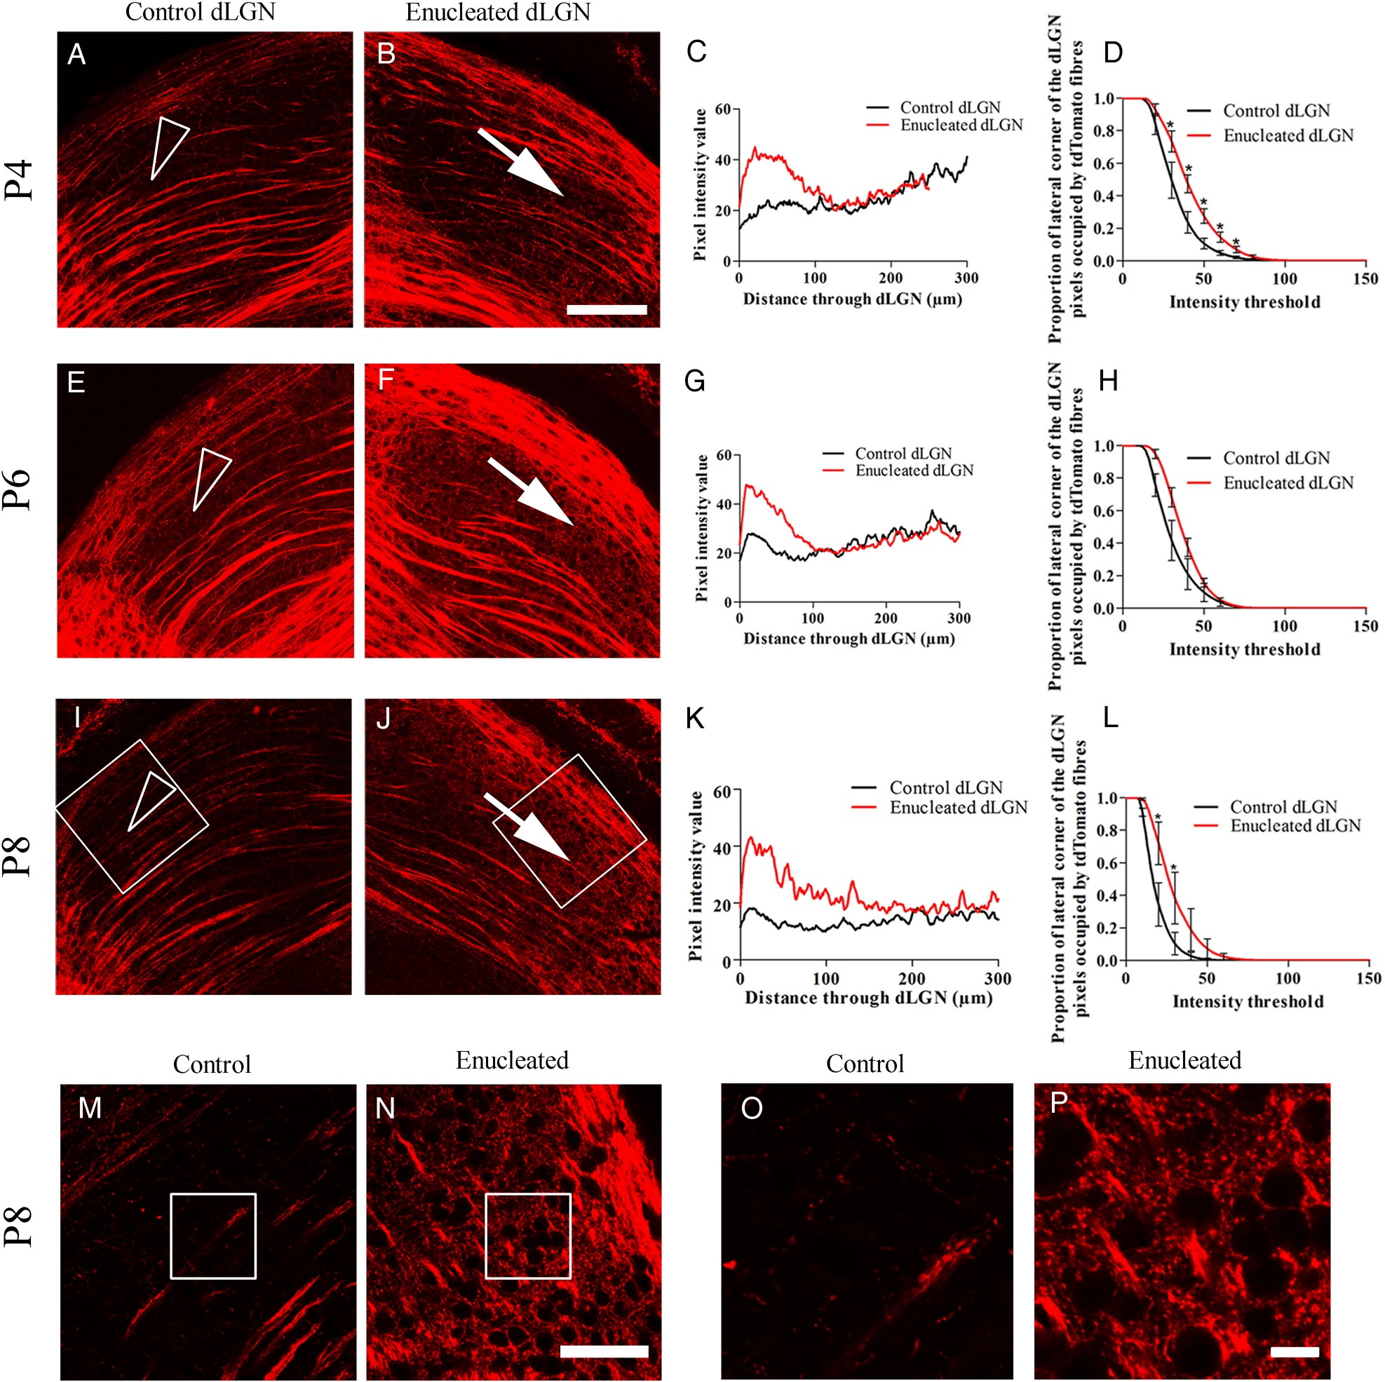
Figure 5. Rbp4-Cre::tdTomato layer V fibers rewire to innervate the dLGN after monocular enucleation at birth. (A) At ...
Notes:
Figure 5. Rbp4-Cre::tdTomato layer V fibers rewire to innervate the dLGN after monocular enucleation at birth. (A) At P4, layer V Rbp4-Cre::tdTomato fibers cross the control dLGN without arborizing (arrow head). (B) In the dLGN-lacking retinal input the layer V fibers continue to cross dLGN. However, fibers appear denser near the dorsal edge and also appear to arborize in the lateral corner (white arrow). (C) The brightness of pixels along a line from the dorsal/lateral edge of the dLGN shows brighter pixels in the dorsal region of the dLGN-lacking retinal input compared with control. (D) Proportionally more pixels are occupied by brighter tdTomato fibers in the lateral corner of the dLGN-lacking retinal input compared with the control dLGN, n = 3. (E–H) At P6, layer V tdTomato fibers are denser in a dorsal band of the dLGN without retinal input and arborize in the lateral corner of the dLGN-lacking retinal input (white arrow) unlike the control dLGN which they grow through (arrow head), n = 4. (I–L) At P8, in the control dLGN, the fibers are sparse and grow through without arborizing (arrow head). In the dLGN-lacking retinal input, the layer V fibers are dense near the dorsal edge and arborize in the lateral corner (white arrow), n = 3. (M and N) High power images of the area demarcated by the white box in I and J, demonstrating sparse labeling in the control dLGN (M) compared with dense tdTomato fibers in the dLGN-lacking retinal input (N). (O and P) Enlarged image of area outlined in M and N, respectively, to show clear small fibers surrounding cells in the enucleated dLGN, which are not present in the control dLGN. Values on graphs are mean ± standard error. Scale bar = 50 µm A–J, 100 µm M and N, 10 µm O and P.
Unless provided in the caption above, the following copyright applies to the content of this slide: © The Author 2016. Published by Oxford University PressThis is an Open Access article distributed under the terms of the Creative Commons Attribution License (http://creativecommons.org/licenses/by/4.0/), which permits unrestricted reuse, distribution, and reproduction in any medium, provided the original work is properly cited.

Slide 4
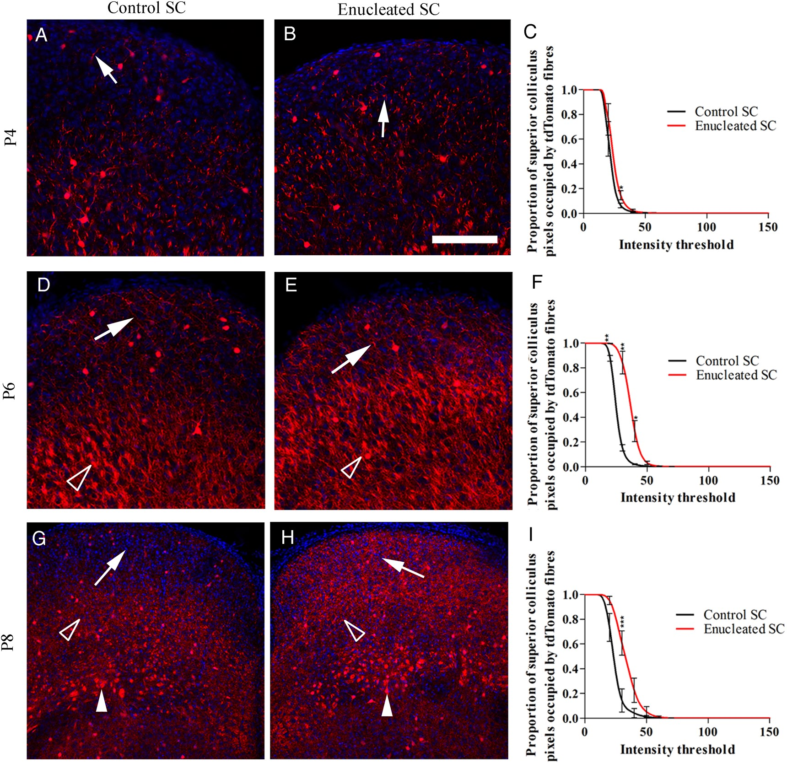
Figure 4. Premature entry of Rbp4-Cre::tdTomato-positive layer V fibers to the superficial gray layer of the SC ...
Notes:
Figure 4. Premature entry of Rbp4-Cre::tdTomato-positive layer V fibers to the superficial gray layer of the SC following monocular enucleation at birth. (A) At P4, few layer V fibers are present in the superficial gray layer of the control SC (white arrow). (B) In the enucleated superficial gray layer, slightly more fibers are visible (white arrow). (C) At P4, there is no significant difference between the proportion of pixels occupied by tdTomato fibers in the superficial gray layer in the control or enucleated SC, n = 3. (D) At P6, fibers are visible in the control superficial gray layer (white arrow). Thick bundles of fibers are visible in the deeper layers (hollow arrow head). (E) Fibers are denser in the enucleated superficial gray layer. Thick bundles of fibers are visible in the deeper layers (hollow arrow head). (F) Proportionally more pixels are occupied by tdTomato fibers in the enucleated superficial gray compared with control, n = 4. (G) At P8, tdTomato-positive fibers are present in the control superficial gray layer (white arrow). At this age, the fibers appear to arborize in the optic nerve layer (hollow arrow head), but remain in bundles in the intermediate white layer (filled arrow head). (H) The layer V fibers densely fill the superficial gray layer of the enucleated SC (white arrow heads). Fibers are visible arborizing in the optic nerve layer (hollow arrow head) and running through the intermediate white layer in thicker bundles (filled arrow head). (I) Proportionally more pixels are occupied by tdTomato fibers in the enucleated superficial gray compared with control, n = 3. Values on graphs are mean and standard error. Scale bar = 50 µm.
Unless provided in the caption above, the following copyright applies to the content of this slide: © The Author 2016. Published by Oxford University PressThis is an Open Access article distributed under the terms of the Creative Commons Attribution License (http://creativecommons.org/licenses/by/4.0/), which permits unrestricted reuse, distribution, and reproduction in any medium, provided the original work is properly cited.

Slide 5
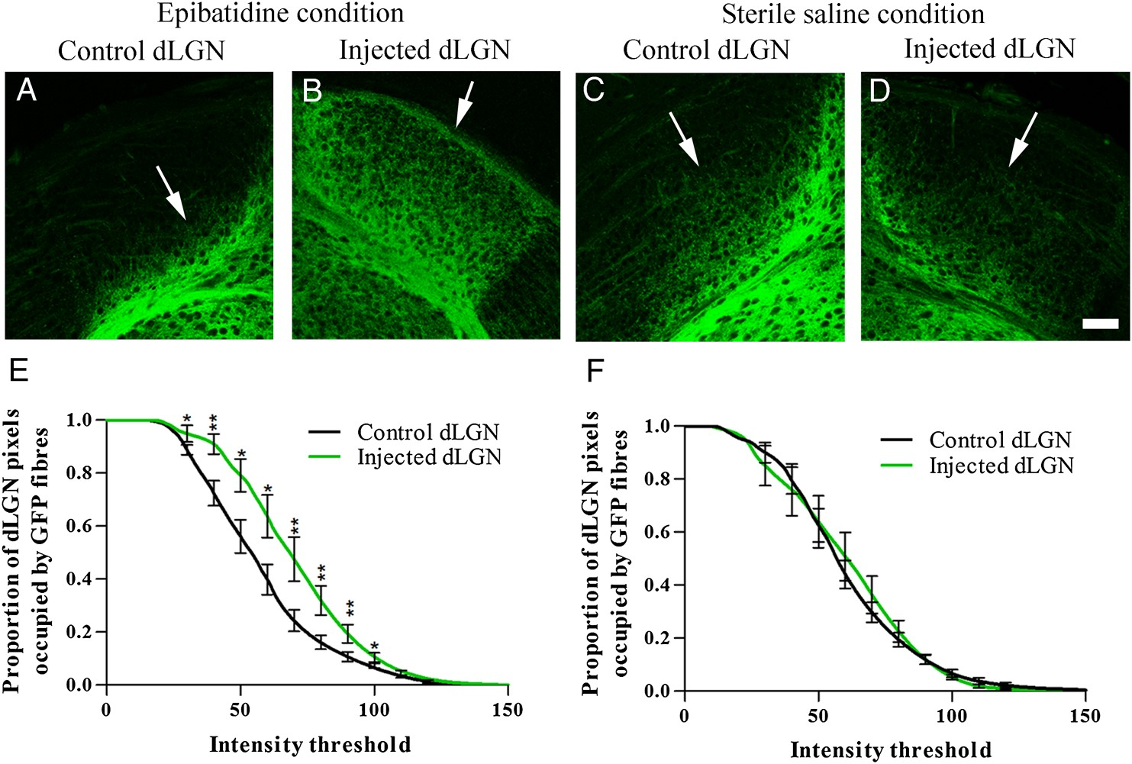
Figure 3. Layer VIa and VIb Golli-τ-eGFP fiber ingrowth to the dLGN following daily injections of epibatidine or ...
Notes:
Figure 3. Layer VIa and VIb Golli-τ-eGFP fiber ingrowth to the dLGN following daily injections of epibatidine or sterile saline into one eye from birth until P6. (A) At P6, eGFP fibers have only entered the ventral edge of dLGN in the control (non-injected) side of epibatidine-treated animals. (B) eGFP VIa and VIb fibers have filled the epibatidine-treated dLGN at P6; n = 7. (C and D) Using sterile saline as a sham control, there is no difference between ingrowth in the control and saline-treated dLGN, with eGFP+ fibers only innervating the ventral half of dLGN; n = 8. (E) There are proportionally more pixels occupied by bright eGFP fibers in the epibatidine-treated dLGN to control dLGN. (F) There is no difference between control dLGN and sterile saline-treated dLGN. Values on graphs are mean and standard error. Scale bar = 25 µm.
Unless provided in the caption above, the following copyright applies to the content of this slide: © The Author 2016. Published by Oxford University PressThis is an Open Access article distributed under the terms of the Creative Commons Attribution License (http://creativecommons.org/licenses/by/4.0/), which permits unrestricted reuse, distribution, and reproduction in any medium, provided the original work is properly cited.

Slide 6
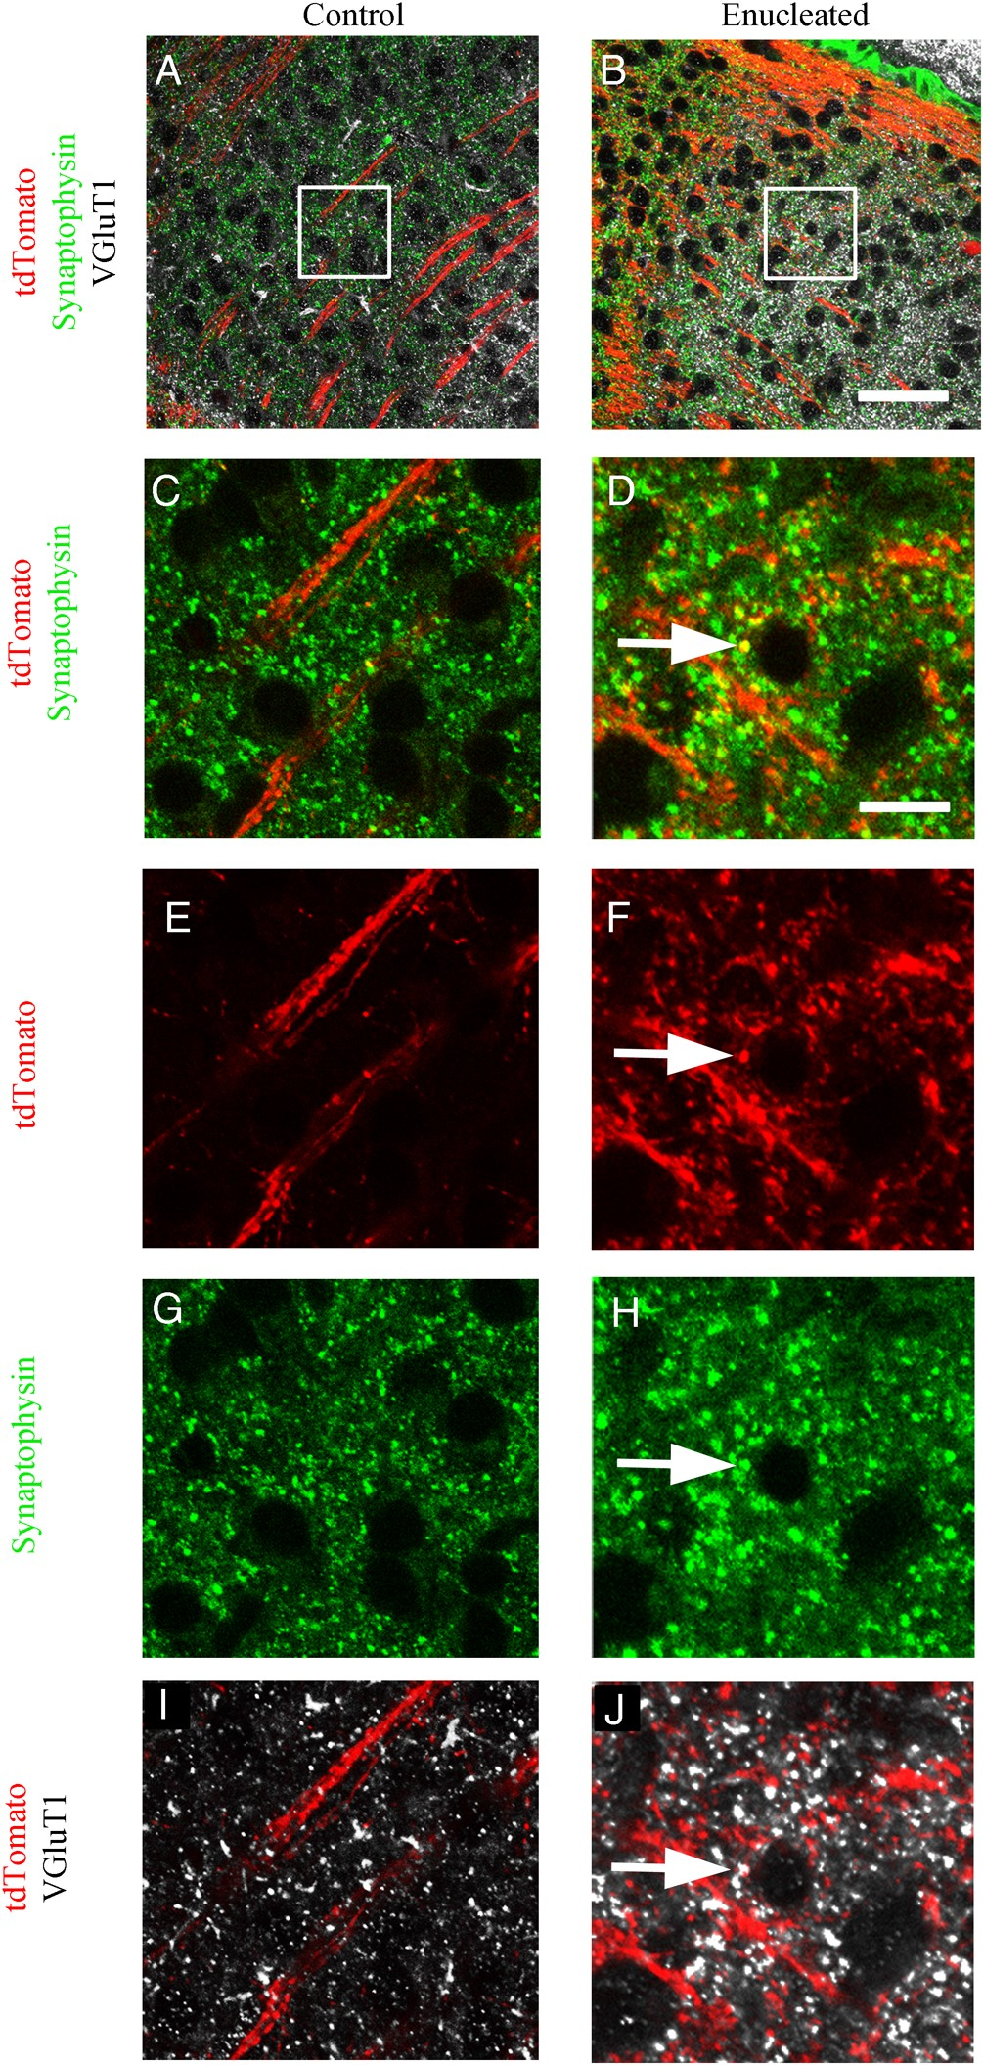
Figure 6. VGluT1 and synaptophysin immunohistochemistry on Rbp4-Cre::tdTomato demonstrate colocalization of tdTomato ...
Notes:
Figure 6. VGluT1 and synaptophysin immunohistochemistry on Rbp4-Cre::tdTomato demonstrate colocalization of tdTomato with cortical synapses. (A and B) VGluT1 labels cortical synapses in white, and synaptophysin in green labels all synapses. Both are visible in the control and enucleated dLGN, but VGluT1 labeling is denser and extends more dorsally into dLGN (C). In the control dLGN, layer V tdTomato fibers course through the dLGN but do not produce structures that overlap with synaptophysin labeled synapses. (D) In the enucleated dLGN, the red fibers include structures that are labeled with synaptophysin, suggesting the fibers terminate in synapses. (E) In the control dLGN, there are very few red structures corresponding to the tdTomato-positive layer V fibers coursing through the dLGN and there are no tdTomato synapses colabeled with synaptophysin (G) or VGluT1 (I). (F) In the enucleated dLGN, many fine red fibers arise from the red fibers traversing dLGN, and small round swellings are visible which are triple-labeled with tdTomato, synaptophysin (H), and VGluT1 (J). VGluT1 labels cortical synapses, which suggests that the tdTomato swellings are cortical synapses from layer V fibers. n = 3. Scale bar A and B = 50 µm, C–J = 5 µm.
Unless provided in the caption above, the following copyright applies to the content of this slide: © The Author 2016. Published by Oxford University PressThis is an Open Access article distributed under the terms of the Creative Commons Attribution License (http://creativecommons.org/licenses/by/4.0/), which permits unrestricted reuse, distribution, and reproduction in any medium, provided the original work is properly cited.

