Slide 1
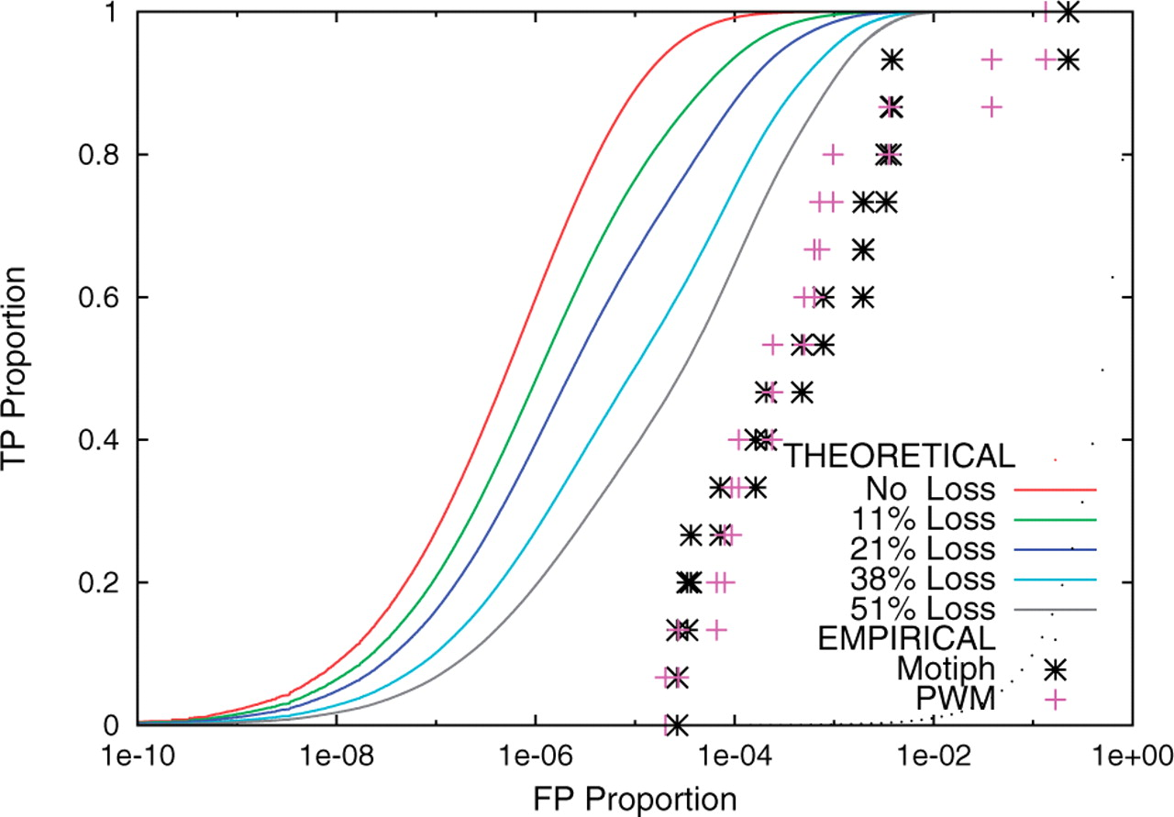
Fig. 1. Theoretical and empirical ROC curves for the ABF1 motif. The empirical ROC curves are shown as points, and ...
Notes:
Fig. 1. Theoretical and empirical ROC curves for the ABF1 motif. The empirical ROC curves are shown as points, and are the results of the cross-validation experiment using the gold standard binding site set for ABF1. The theoretical curves are shown for different choices of the loss rate parameter, λ, and the corresponding percentage chance of a loss in any lineage is indicated.
Unless provided in the caption above, the following copyright applies to the content of this slide: © 2009 The Author(s)This is an Open Access article distributed under the terms of the Creative Commons Attribution Non-Commercial License (http://creativecommons.org/licenses/by-nc/2.0/uk/) which permits unrestricted non-commercial use, distribution, and reproduction in any medium, provided the original work is properly cited.

Slide 2
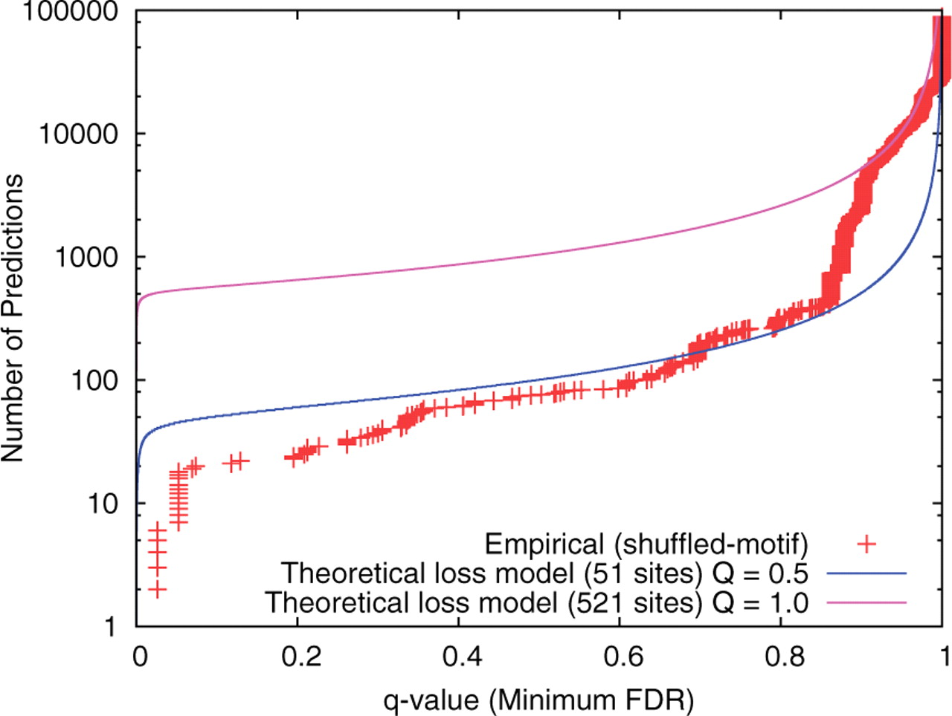
Fig. 2. Theoretical and empirical statistical power curves for the ABF1 motif. The empirical curve (points) is ...
Notes:
Fig. 2. Theoretical and empirical statistical power curves for the ABF1 motif. The empirical curve (points) is computed using the shuffled-motif approach with the Monkey PMM scanning algorithm. The two theoretical curves are generated using the theoretical model with 51% chance of loss on any lineage and with the given estimates of the numbers of real sites (shown in parentheses).
Unless provided in the caption above, the following copyright applies to the content of this slide: © 2009 The Author(s)This is an Open Access article distributed under the terms of the Creative Commons Attribution Non-Commercial License (http://creativecommons.org/licenses/by-nc/2.0/uk/) which permits unrestricted non-commercial use, distribution, and reproduction in any medium, provided the original work is properly cited.

